Slide 1
Budgeting and Financial Planning
Why should people make a plan for how to get and spend money? What strategies can be used to do this most effectively?

Slide 2
Types of Accounts
There are many different ways of holding your money.
1. You can keep all of your money as cash in your piggy bank at home.
- Why do you think this is risky?
2. You can keep your money in a checking account at a bank. At any time you can write a check, use your debit card, or withdraw cash.
- Interest: A percentage increase on the total amount of an account or debt. You can be paid interest by the bank for holding your money there.
- Why would a bank choose not to offer interest on checking accounts?

Slide 3
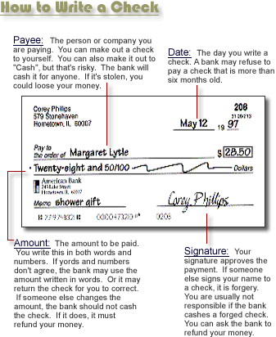

Slide 4
Types of Accounts
3. Savings Accounts: It is very easy to deposit money into a savings account, but most do not allow checks or debit cards.
- Some banks charge extra each time a customer withdraws money from their savings account.
- Why would banks offer higher interest rates on savings accounts than on checking accounts?
4. Certificates of Deposit (CDs): Like a savings account, accept that consumers agree not to withdraw any money for a set period of time, often 6 months or one year.
- Why would banks offer higher interest rates on CDs than on savings accounts?

Slide 5
Types of Accounts
5. Individual Retirement Accounts (IRAs): Accounts that allow you to deposit money now that is being saved for retirement.
- The money is usually invested in the stock market in the hope that it will grow faster than at normal interest rates.
- Many IRAs allow depositors to save their income without being taxed for its growth over time.
Which of these accounts is best for money you need to spend now? Why?
Which is best for money you want to save for later? Why?

Slide 6
Budgets
Budget: A plan for how a person, family, or organization will raise and spend money.
Why do you think it is important for families to create a budget?
Fixed Costs: Charges/costs that will be the same every month, no matter how often something is used.
Rent/Mortgage payments: The money you owe for housing will be the same every month whether you spend one night or every night there.
Car payments: Same as rent.
What are some other fixed costs?

Slide 7
Budgets
Variable Costs: Charges/costs that will change depending on how much of something is used.
- Food: eating more or buying more expensive foods will cost more.
- Travel: Driving more will require more gas, meaning more money.
- Entertainment: Choosing to go out to eat, to movies, buy video games, etc. Everything costs money. The more stuff you want to buy, the more money you will need.

Slide 8
Creating a Family Budget
List all of your fixed costs for each month.
Estimate your variable costs based on previous experience. (This can be difficult at first, but you will learn more as you become a more experienced consumer).
Set an amount you want to save each month and put it into your savings account as soon as you get paid.
List large purchases you may want to make this year (vacations, home improvements, etc.) and determine additional money to save to achieve these goals.

Slide 9
Debt
Your debt is the money you owe to creditors. People build debt by taking loans for homes, cars, education, starting a new business, etc.
People also build debt when making purchases with credit cards. Buying on credit is like taking a small loan.
Every loan will include interest. Banks and credit card companies charge interest on loans in order to make money.
Different kinds of loans have higher interest rates, especially credit cards. The higher the interest rate, the more money you end up paying back.

Slide 10
Debt
Building debt is not always bad.
Most people will need to take a loan of some kind during their lives.
Banks are more willing to offer loans, or low interest rates, to people with a good credit history/credit score.
You can build a good history/score by paying back your debts on time or early.
- Credit cards only help your score if you pay back the money quickly.
- You can also build credit by having bills and utilities in your name and paying them on time every time.

Slide 11
Building Wealth
There are many strategies you can use to make the money you make work for you.
1. Put money in savings accounts and CDs: The money will grow at a slow rate of interest, but it is guaranteed to grow.
2. Buy US Government Bonds and Treasury Bills: Similar to a CD, when you buy a US govt. bond, you can sell it back to the government years later at a much higher price.

Slide 12
Building Wealth
3. Buy a home: In most economic situations, house prices rise over time. When you buy a house, you should be able to sell it several years later for more money.
4. Invest in the Stock Market: When you buy shares of stock you are buying pieces of ownership in a corporation.
- You can make money from stocks in two ways: 1) Dividends: You get a piece of the company’s profits for owning some of the company. 2) Capital Gains: Selling your shares of stock at a higher price than when you bought it.
Which wealth building strategies are safe? Which are risky? Why do people use the risky strategies?

