Slide 1
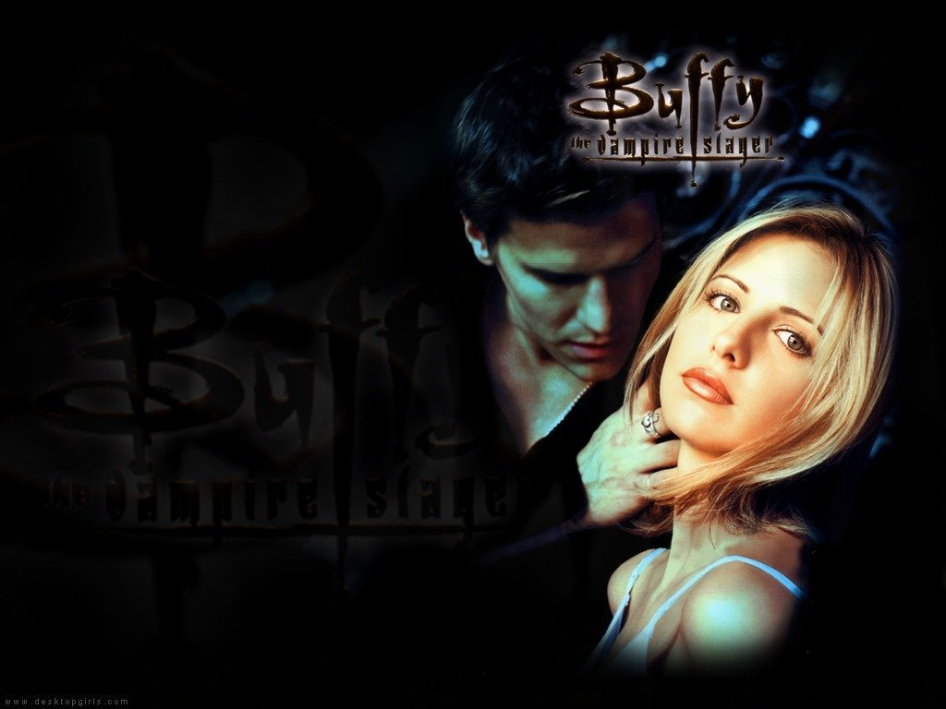
“It’s wonderful to get lost in a story, isn’t it? Adventure and heroics and discovery – don’t they just take you away? Come with me now, if you will, gentle viewers. Join me on a new voyage of the mind. A little tale I like to call…
Buffy, Slayer of the Vampyrs.”

Slide 2
Introduction
Buffy is the Vampire Slayer. There is just one per generation. She is the chosen one.
She is a superhero who fights off all kinds of monsters. She lives on a “hellmouth” in Sunnydale California, which is a hotspot of demonic activity.
She also works with witches who use magic for good instead of evil, werewolves who suppress their urges to eat people, and vampires who have regained their souls.
There is a love story (or two), but the main focus of the show is on Buffy’s growth and friendships.

Slide 3
It began with a movie that told the story of how she was “called” and originally became the Slayer. It was a commercial and critical failure. Even creator/writer Joss Whedon hated how it turned out.
Later, he resurrected it for TV. It ran for 7 seasons, produced a successful spin-off (Angel), and continues even now in comic book format.
In addition to becoming a cult classic, Buffy was also critically-acclaimed. Some colleges even taught courses that included “Buffy studies”.
Whedon is now a Comic-Con hero: he also co-wrote Toy Story, created Firefly and S.H.I.E.L.D., wrote/directed the first two Avengers movies, etc.
The series also launched successful careers for most of the actors involved, some of whom you will even recognize

Slide 4
Project Outline
Introduction
Themes and supporting Terms:
Metaphor: symbolic communication, social change, socialization
Ethics and Morality: beliefs and values, internalization and sanctions, conflict
Feminism: gender roles, social structure, social movements
Sociological Perspectives
Works Cited

Slide 5
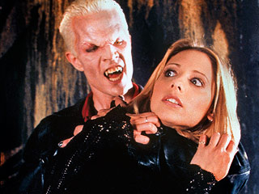
Metaphor
“You think this isn’t real just because of all the vampires, and demons, and ex-vengeance demons, and the sister that used to be a big ball of universe-destroying energy?”
Metaphors are symbols that represent reality, help us communicate about issues that are too multi-dimensional for literal language

Slide 6
“Demons after money. Whatever happened to the still beating heart of a virgin? No one has any standards anymore.”
Monsters represent society’s fears
They change with social change
Frankenstein = scientific and industrial revolutions, Cinderella and Snow White = stratification
BtVS = rejection, abandonment, powerlessness, invisibility, etc.
“They want an apocalypse? Well, we’ll give ‘em one…From now on, we won’t just face our worst fears, we will seek them out…There is only one thing on this earth more powerful than evil. And that’s us.”
Superheroes as agents of reform fighting corruption and abuse of power
First boom during New Deal and WW2 era
Resurgence since 9/11

Slide 7
“Getting killed made me feel really alive for the first time. I was through living by society’s rules. Decided to make a few of my own.”
Metamorphosis/death/immortality represents change and transformation
Aging, loss, redemption
BtVS = growing up, socialization
Sunnydale High is located on a “Hellmouth” with very high demonic activity
Adolescence is Hell?

Slide 8
“You’re a sheep…I do what I wanna do, and I wear what I wanna wear. And you know what? I’ll date whoever the hell I wanna date. No matter how lame he is.”
Identity and self-concept (who am I? where do I belong? how do others see me?)
“This isn’t some fairy tale. When I kiss you, you don’t wake up from a deep sleep and live happily ever after. No. When you kiss me I want to die.”
Love (functional v. dysfunctional relationships, finding out they aren’t who you thought they were)
“Graduation doesn’t just mean your circumstances change, it means you do.”
The End of the World (starting over after a break up, family tragedy, or move)

Slide 9
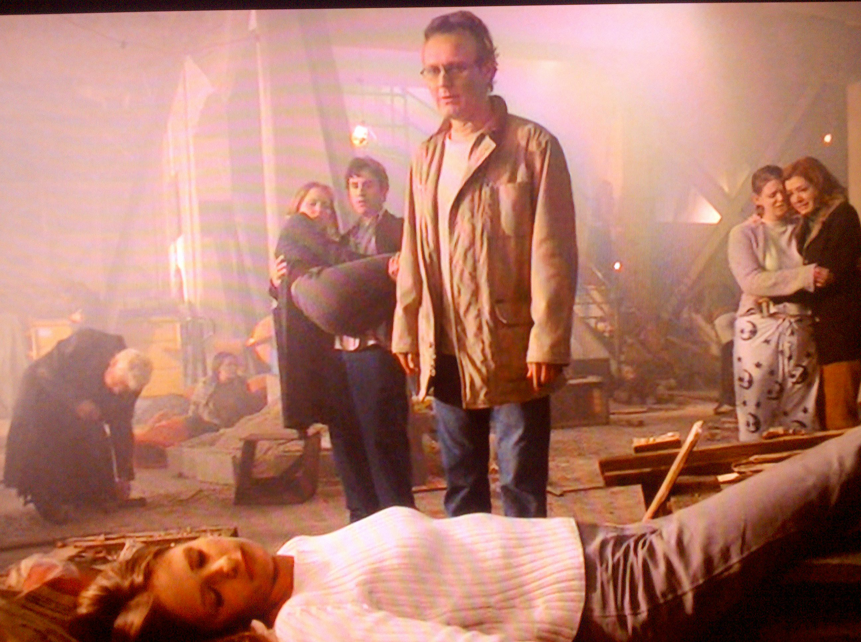
Ethics and Morality
“The good guys are always stalwart and true, the bad guys are easily distinguished by their pointy horns or black hats, and we always defeat them and save the day. No one ever dies and everybody lives happily ever after.”
Beliefs and values: What is good/evil? Is there an in-between? How do we know what it looks like?
“I would love to be upstairs watching TV or gossiping about boys or, god, even studying! But I have to save the world. Again.”
Individualism v. communalism – Should I sacrifice something I want or love for the greater good?

Slide 10
“I told one lie. I had one drink. Yes, and you were very nearly devoured by a giant demon snake.”
Internalization and sanctions – When do I need guidance and when should I trust my own judgment?
“A lot of things that seem strong and good and powerful, they can be painful. Like, say…immortality? Exactly. I’m dying to get rid of that.”
What will the consequences be of using “magic” (substances, cheating, etc.) to solve a problem?
“I can beat up the demons, until the cows come home. And then I can beat up the cows. But I’m not sure I like what it’s doing to me.”
Conflict: Is violence the answer? Could some form of cooperation or accommodation work better?

Slide 11
Feminism
“I’m sorry. What’s your name? Buffy. No, really.”
Irony: turning the cliché of the helpless blonde girl victim on its head
Gender role formation, status of women
“That’s what I want to do – fight evil, help people… I think it’s worth doing. And I don’t think you do it because you have to. It’s a good fight, Buffy, and I want in.”
Celebration of female power: having it, using it, sharing it

Slide 12
“So, no problem. All we need is combo Buffy, her with Slayer strength, Giles’s multilingual know-how, and Willow’s witchy power.”
Social Structure: relational power, interdependence
“In every generation, one Slayer is born, because a bunch a men who died thousands of years ago made up that rule… I say we change the rule. I say my power…should be our power…From now on, every girl in the world who might be a Slayer, will be a Slayer. Every girl who could have the power, will have the power…Make your choice. Are you ready to be strong?”
Social movements: Activating latent power of women as a group

Slide 13
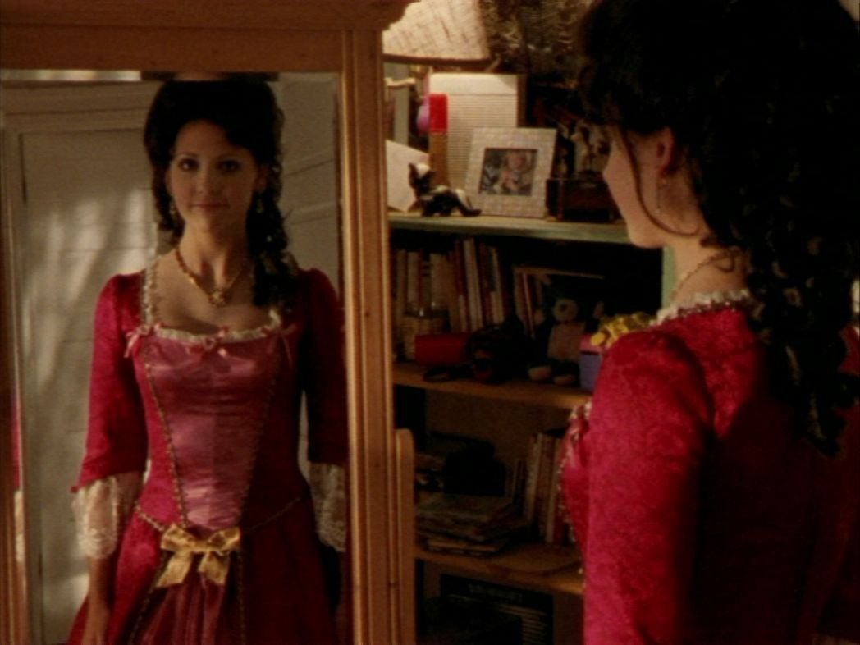
Sociological Perspectives
Interactionist
Focus on agents and stages of socialization: Buffy’s transition to adulthood, Willow’s sexuality
Communicating through metaphor: fighting “demons”
Group relationships and interactions: Scoobies, Slayer-Vampire relationships
Functionalist
Manifest and latent functions of education: library as center of operations, Giles needed as Watcher
Division of labor and hierarchy: Buffy as leader, Willow’s increasing power, Xander as supporting figure with no powers
Fighting evil gives them purpose, creates social cohesion out of chaos: Apocalypse averted, activating new Slayers worldwide
Conflict
Gender role inequality: woman as the superhero is rare, “ironic”
Conflicts arise in adolescence because of competition over scarce resources: popularity and status at school, who controls the streets at night, competing Slayers
Buffy’s team is often fighting against the status quo, have to take on the vested interests: the Principal, the Mayor, the First Evil

Slide 14
Please Note
There are many ways for you to approach your final project. It will be based on the topic you choose and your own preference.
For example, there aren’t a lot of short BtVS clips on YouTube. But I have a whole book of Buffy quotes, so I used lots of quotes in my presentation. If I were a student, I would have included fewer quotes and added some video clips. But since I am the teacher, I can make you watch a full episode tomorrow!
Episode: “Halloween”
See the end for more examples of different kinds of projects…

Slide 15
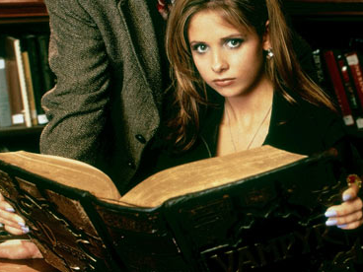
Works Cited
Mosley, Nancy. "Honors Sociology." Ms. Mosley's Classroom. Leesville Road High School, 1015. Web. 22 Oct. 2015.
Thomas, W. LaVerne, and Rinehart Holt. Holt Sociology [Gr. 9-12] the Study of Human Relationships. Austin, Tex.: Holt, Rinehart and Winston, 2003. Print.
South, James B. Buffy the Vampire Slayer and Philosophy. 1st ed. Carus Publishing Company, 2003. Print.
Brezenoff, Steven, and Micol Ostow. The Quotable Slayer. 1st ed. Pocket, 2003. Print.
Don’t forget to cite pictures in a text box below the image!

Slide 16
Your project will need to be a digital product that you can upload to Edmodo. This could be a PowerPoint, Prezi, Website, Blog, or Video.
If you are wondering how you could do a video, here’s an example:
Why You Should Watch Buffy the Vampire Slayer
Why You Should Watch Angel
You can also supplement your digital presentation with another artifact, like my poster of Buffy quotes that I made (along with this powerpoint) when I was younger and had much more free time on my hands

Slide 17
Other Examples
Your project does not have to be based on pop culture like this one. It can be based on pretty much anything you are passionate about.
Over time, I have modified this PowerPoint as necessary to be a better example of what should be in your project. However, the open-ended and creative nature of the project make it difficult. Think outside the box, but make sure you follow the Rubric and Outline I gave you. If you aren’t sure, just ask!
If I had time to do another one now, here’s some ideas I have considered…

Slide 18
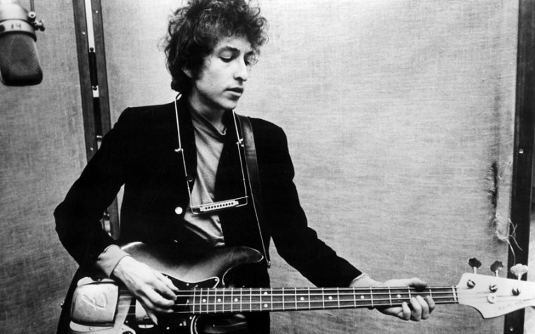
Bob Dylan
His music: subculture/counterculture, themes in lyrics about social stratification and change, reflection of his personal angst and stages of life
His life: socio-cultural context and influences over time, Jewish-Christian-? religious conversion, strange relationship with media
The very unofficial Mosley family Dylan fan club: dyad relationship between husband and wife, small group interactions with his brother and friends, cultural diffusion involved in finding cover versions of songs for people who don’t like his voice
My Kids
Socialization: use of sanctions, role-taking process, new stage of adult socialization
Social structure and interaction: connections between my nuclear and extended family, how accommodation has taken place in primary relationships over how to raise kids, theory of dramaturgy shows how I perform role of mother differently than role of teacher or wife
Social institutions: my decision to send kids to daycare and keep teaching, egalitarian authority and childcare structure of our household, how the economy affects our ability to prepare for their college and inheritance

Slide 19
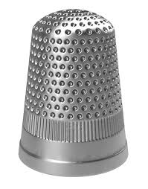
THIMBLES by my “smart-aleck” husband who was asked to help me think of a topic too superficial to work for this project
Feminism
Dainty, yet protect you from harm
Social Change
Throw away society, no one makes clothes
Superstition
If you are given three thimbles, you will never be married. "THIMBLE" A Dictionary of Superstitions. Ed. Iona Opie and Moira Tatem. Oxford University Press, 1996. Oxford Reference Online. Oxford University Press. Westminster College (PA). 2 August 2012 <http://www.oxfordreference.com/views/ENTRY.html?subview=Main&entry=t72.e1436>

