Slide 1
What is Business?

Slide 2
Type of Firms | Describe | Advantages | Disadvantages
Sole proprietorships | Single owner | + Individual has full control + Owner can act quickly on a decision + No corporate taxes | Difficult to raise capital, attract workers Individual has unlimited liability
Partnerships | Two or more owners sign an article of partnership | + Can raise more capital than a proprietorship + Partners combine talents and skills + No corporate taxes | - Complex legal agreement - Partners have unlimited liability
Corporations | Created by charter, run by a Board of Directors, sells stocks, treated by government as an individual who pays taxes and can be sued | + Can raise much more capital through stocks + Can grow to control a large percentage of the market + Owners have limited liability | - Expensive and complex - Government regulation and taxation is significant

Slide 3
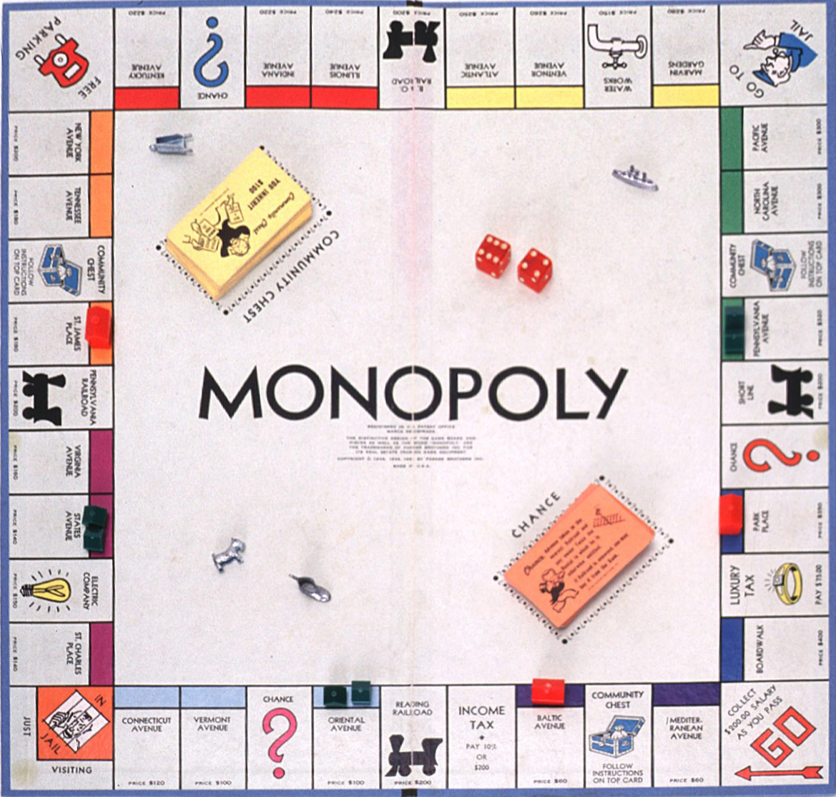
How do you win the game of ?

Slide 4
Competition
Why is competition central to a market economy?
How does competition work?
What kinds of competition exist in our mixed economy?
What did Karl Marx think about competition in a capitalistic society?

Slide 5
Market Structures
Definition: The amount of competition that exists in an industry
What determines the market structure?
Number of buyers and sellers in the industry
Type of product (identical or unique)
Degree to which individual firms in the industry control price
Amount of info available to producers and consumers
Ease of entry and exit from the industry
Role of government
Market Structures Video

Slide 6
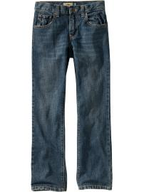
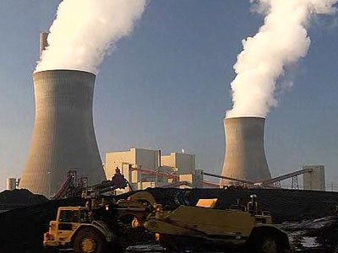
Examples?
Perfect Competition
Monopolistic Competition
Oligopoly
Monopoly

Slide 7
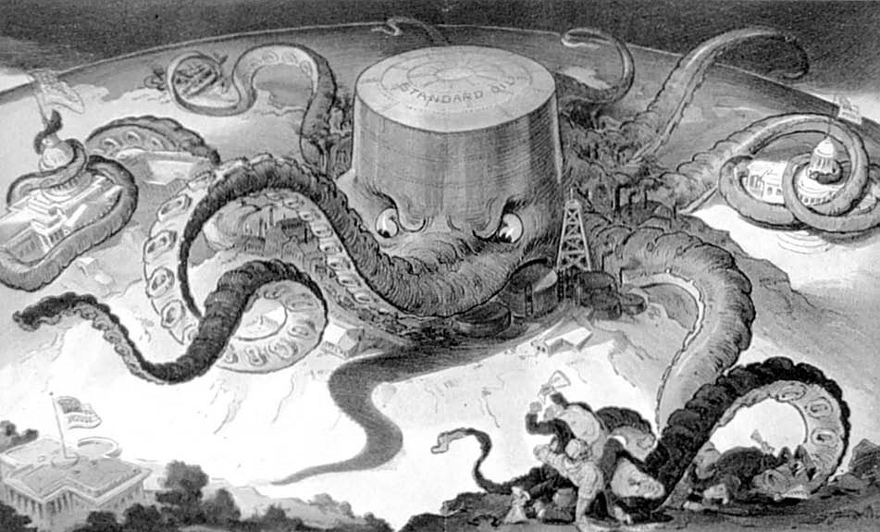

Slide 8
Monopolies
There is just one dominant firm in the industry
The product it produces is unique (no substitutes)
Because the firm has no competition, it has considerable control over the price of the product
Has little need to share information with or advertize to consumers
It is extremely difficult for a new firm to enter the industry because it controls raw materials needed
The government regulates them strictly

Slide 9
Are all monopolies bad?
Natural monopolies
When a single firm can produce a good or service more efficiently than a number of competing firms could
These often become government monopolies
Examples?
Technological monopolies
When a firm develops a new technology and they apply for a patent or copyright
Examples?

Slide 10
Antitrust Legislation
The U.S. gov’t first began to regulate monopolies in 1890 with the Sherman Antitrust Act
There were too many loopholes, but it set a trend of increasing gov’t regulation to protect competition
By 1914, the Clayton Antitrust Act had clearly defined illegal forms of:
mergers
price discrimination
requiring buyers to not deal with a competitor
interlocking boards of directors between competitors

Slide 11
Other Regulations
Private property rights (Amend. ?)
Consumer protections: labeling, checking scales, warranties, etc. (FDA, FCC)
Responding to negative externalities (side-effects): pollution (EPA), noise violations, traffic issues, etc.
Workplace (OSHA)
Triangle Shirtwaist Fire Video

Slide 12
What would these different people think about these regulations?
Adam Smith
Karl Marx
Democrats
Republicans
You

Slide 13
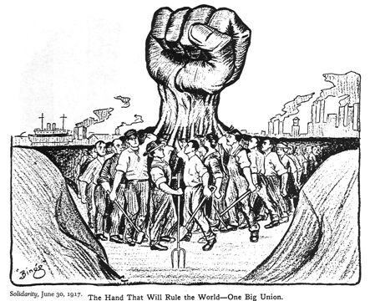
What is a labor union?
A group that negotiates with employers to improve pay and working conditions for its members
Most common for semi-skilled or unskilled workers
Why?
Wikipedia Entry

Slide 14
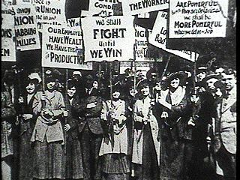
A Rough Start
Were very unsuccessful because they had no legal protection under the laissez-faire system
They also hurt their own chances by staying segregated by race and gender
Gained some strength during the Depression, but died down during the World Wars and the “Red Scare”
Why?

Slide 15
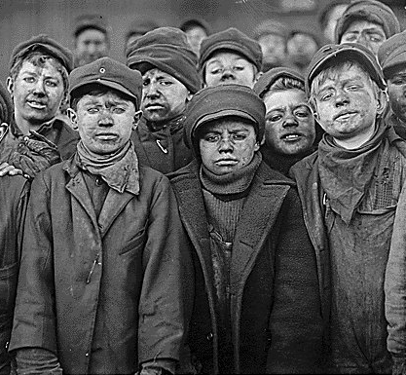
Gaining Strength
Investigative journalism and tragedies like the Triangle Shirtwaist Fire increased public support
New Deal Era saw the first legal protections for unions and workers
Biggest issues: Child labor, safety, wages, and hours

Slide 16
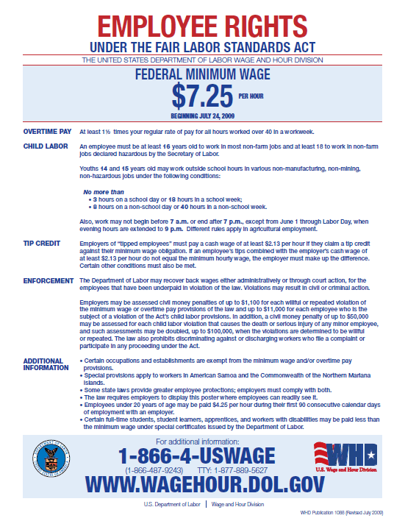
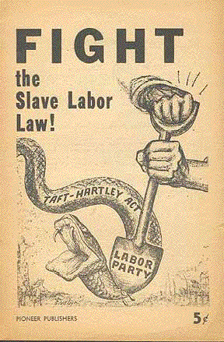
Major Legislation
National Labor Relations Board: Oversees union elections to ensure fairness and honesty
Fair Labor Standards Act: Set minimum mages and maximum hours, created child labor laws
Taft-Hartley Act: Made closed-shops illegal, allows states to pass right-to-work laws

Slide 17
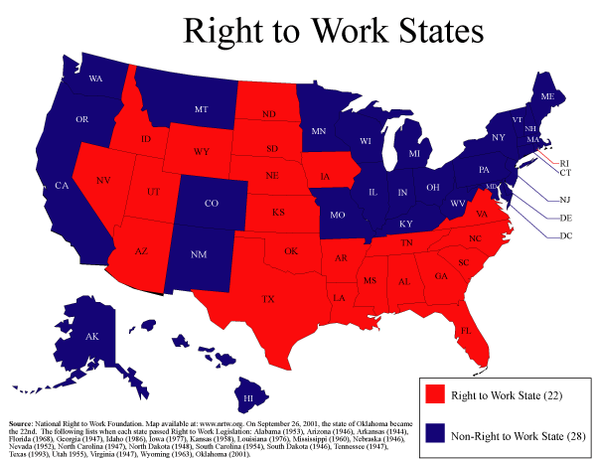
“Right-to-Work”?
A state can prohibit agreements that require employers to only hire union members
What conclusion can you draw from this map about the labor movement in the United States?

Slide 18
Collective Bargaining
Negotiations on workers’ contracts between union representatives and employers to determine wages, benefits, work conditions, and rules.
Often use mediation or arbitration to reach a compromise

Slide 19
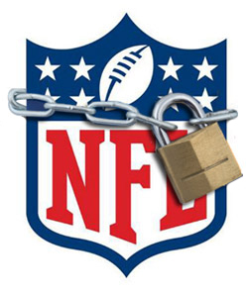
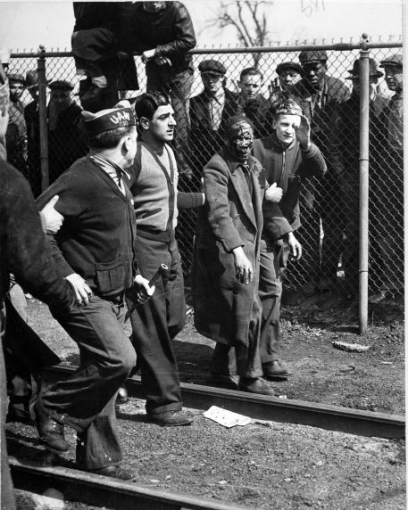
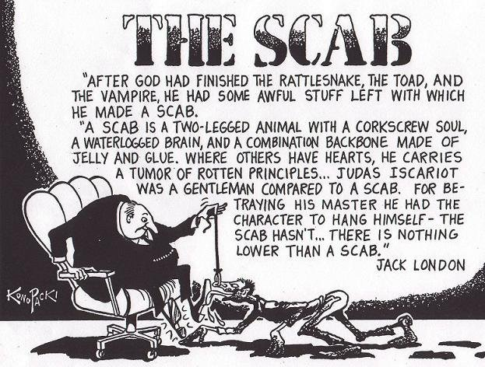
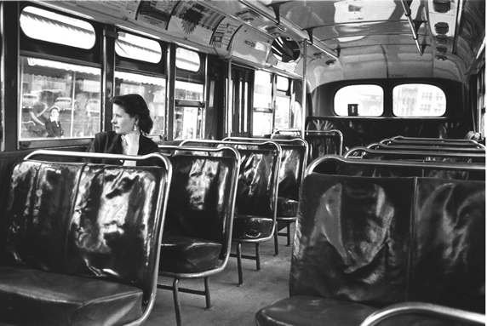
And if that doesn’t work...
Labor
Management
Go on strike
Use a picket line to get attention and prevent strikebreakers from entering
Lead a boycott
Get a court to issue an injunction to stop the lockout
Hire strikebreakers
Get a court to issue an injunction to stop the strike
Lockout workers

Slide 20
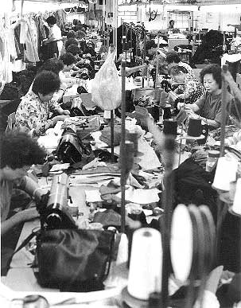
Current Challenges
Globalization
Why?
Recession
Why?
What could workers do instead?
Corporations?
Nightline Video
PBS Video

