Slide 1
Cake & Crumb Bakery
Mackenna Moore, Eliana Gunter,Sami Miller and Yasmine Siwan

Slide 2
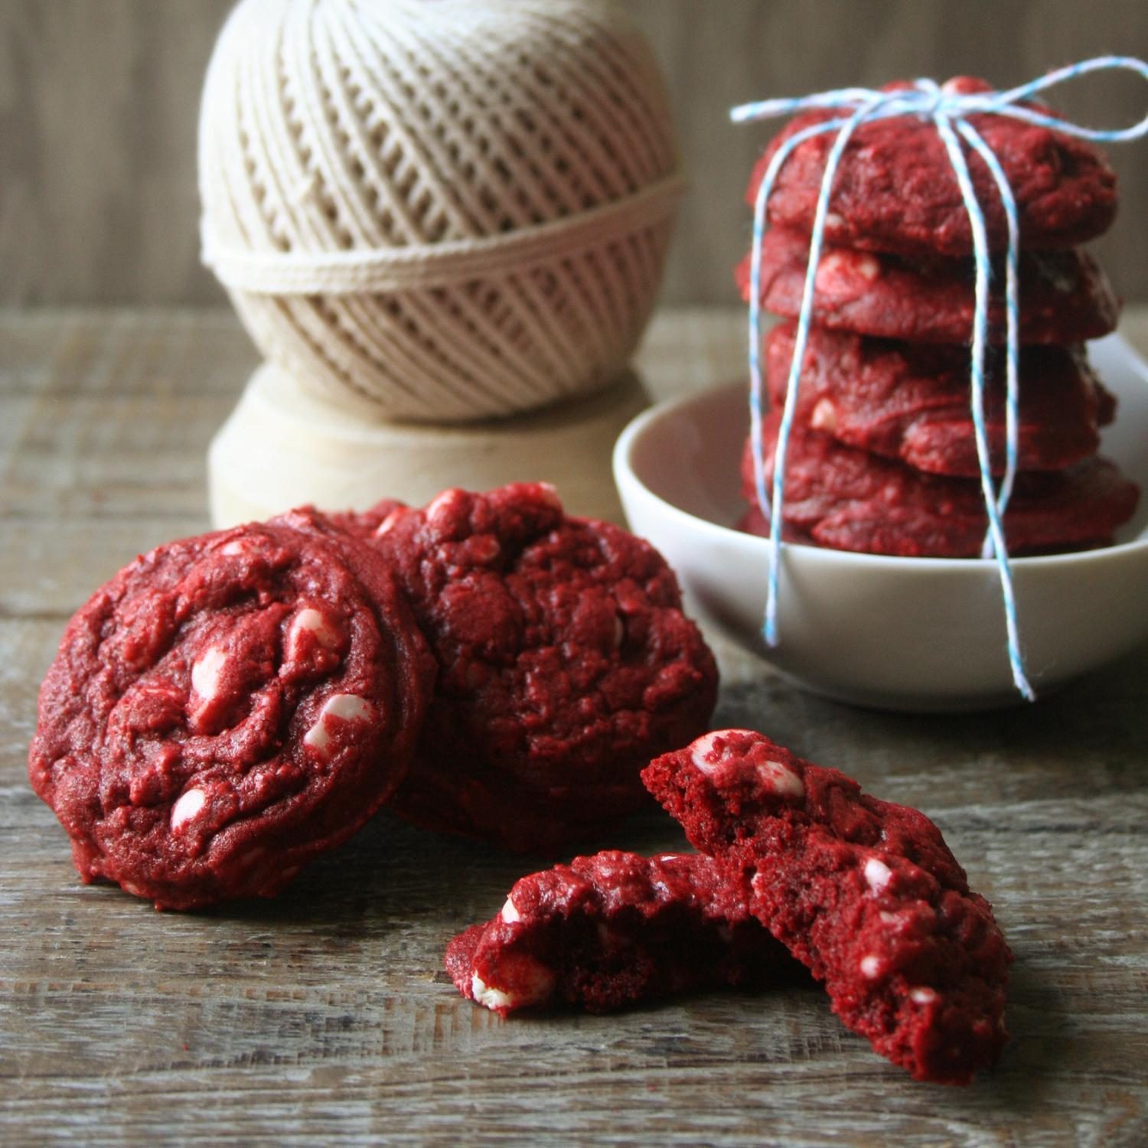
Our Purpose
We will provide quality baked goods such as cookies, cakes, and brownies to the the general public.
Here is an image of our quality Red velvet cookies:

Slide 3
Marketing
Once people taste our baked goods they will want to keep coming back for more.
Our target market is general consumers.
On average bakery items costs approximately $2 to produce, we would sell these items for $4.
Our customers can purchase most of our goods individually or as a bakers dozen.

Slide 4
Resources
Skills and time are the resources we already have.
Technology such as an oven, and tools such as mixing bowls and spoons are the resources we will need.

Slide 5
Location Cost
Leasing a bakery location will involve paying rent. A small commercial space will cost about $300 dollars a month.

Slide 6
Equipment Cost
Our Bakery will need sinks, at least one oven, mixers and refrigeration. A used stainless steel commercial sink would usually cost $400. A used oven will likely cost around $1,000 and a used reach-in cooler will cost approximately $1,000.

Slide 7
Utility Setup
In order to prepare our space for the equipment we will need to make improvements such as electrical work and plumbing. Plumbing setup will cost about $10,000 and a ventilation system will cost us $5,000.

Slide 8
Why You Should Invest
We initially require a $20,000 loan to help meet our start up costs. Once we reach this target we expect to make around $5,000 a month if we remain a single shop.

