Slide 1
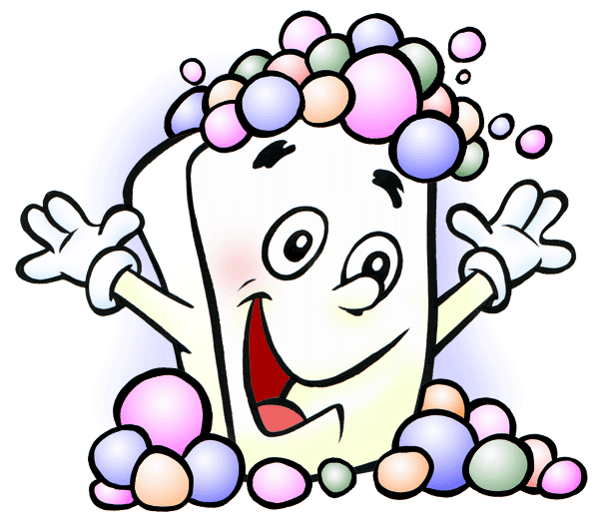
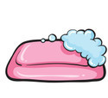
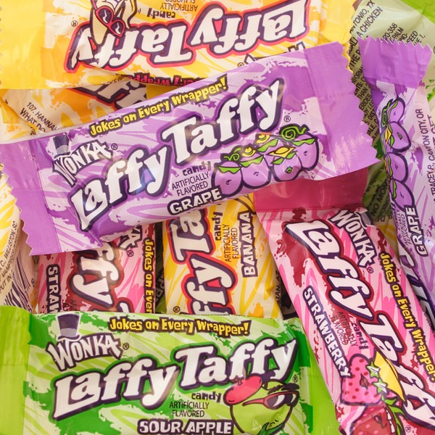
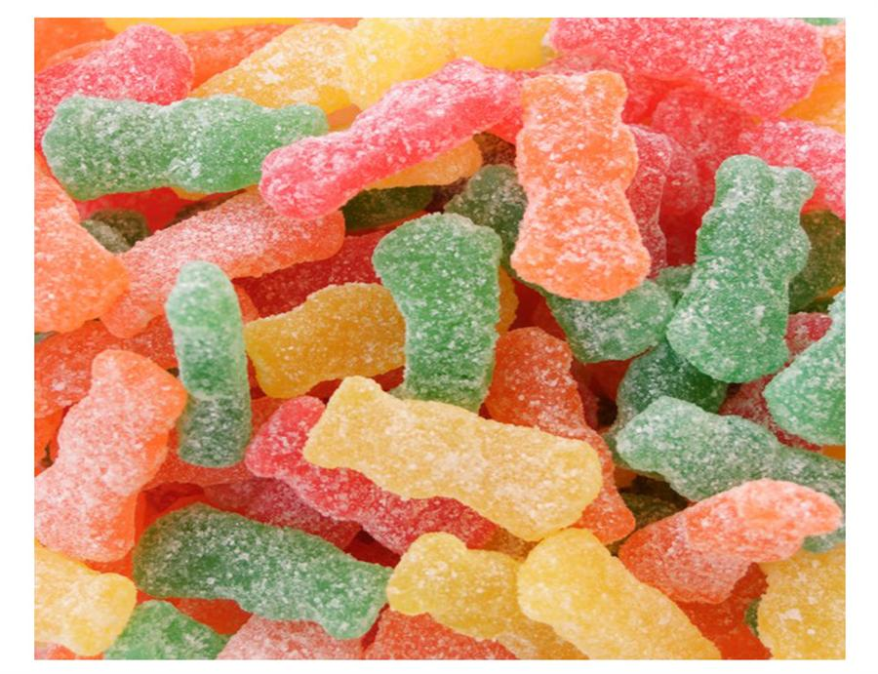
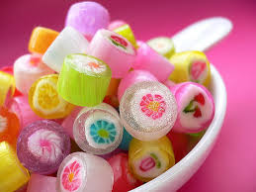
Candy Soap
By: Marisa Fields, Jennifer Davis, Jack Swingle, Zac Macia

Slide 2
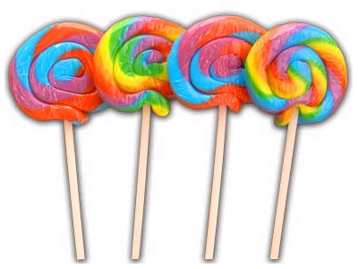
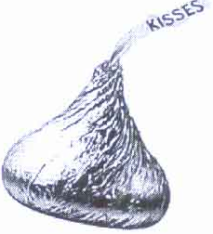
About the company
Candy soap will be soap that looks and smells like candy
Candy soap will be appealing to kids of any age
Candy soap will come in five different scents; Hershey’s Kisses™, Sour Patch Kids™, Laffy Taffy™, and Haribo Golden Gummy Bears™, Lollipop.
It would be created in a factory and sold in grocery stores, malls, and drug stores.

Slide 3
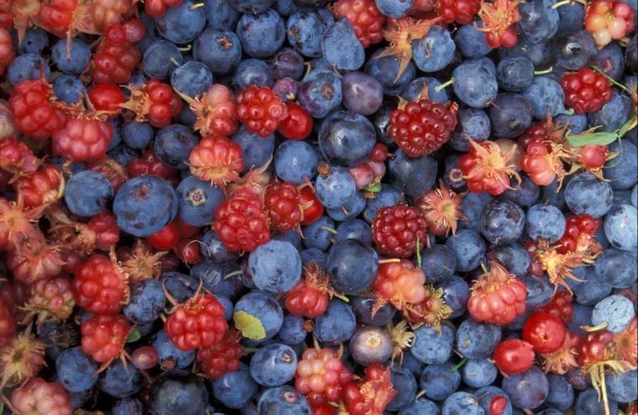
Ingredients
This soap will contain:
Oil
Fats
Ivory
Cranberries, blueberries, and apricots to create the color
Shay butter

Slide 4
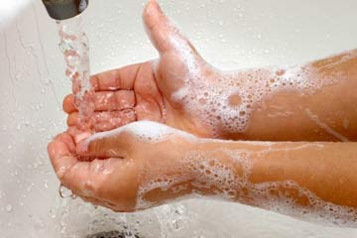
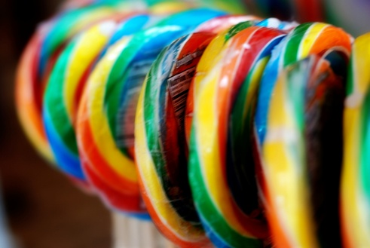
Where/How they will be made
The soaps will be wrapped in a plastic bag
Once we find a space we will hire 15-20 workers to help make the soaps
We will call local stores that sell soap or have the same demographics as us and propose our product and ask if we can sell through them
The inventory in the factory will be shelves, machines, and a conveyer belt for the soap to be made on
Our rent will be about $1500 per month for the factory and utilities.

Slide 5
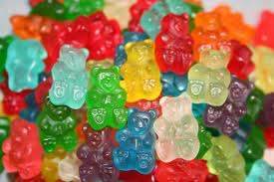
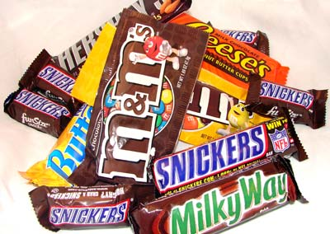
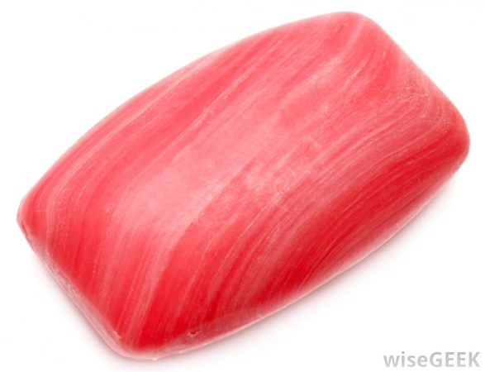
Sales
The soaps will be sold for $4.50 a piece.
We will be selling a box of them for $20, there are five soaps in one box.

Slide 6
Why you should buy our product
Our product is for anyone no matter what age
It is great for Birthday presents, Easter baskets, Mothers Day gifts, Christmas, and many more special occasions
They have a great smell and are so unique, not only will they make you smell great but they have a smooth texture and will make your hands so soft.
Just remember candy soaps are not for eating

