Slide 1
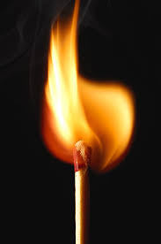
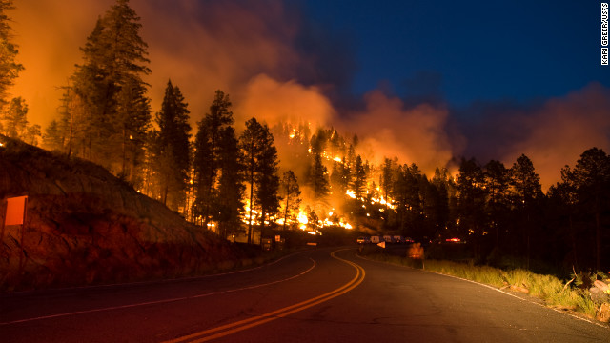
History Skill Builder
Cause and Effect

Slide 2
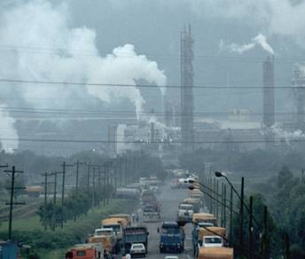
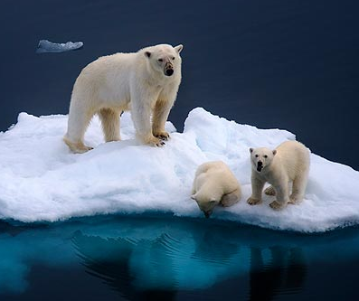
Cause and Effect
The study of history is important for understanding the results of human action or inaction
Historical significance is determined by the overall effect of an event, person/group, or new idea/invention on society
When problems arise, we need to be able to figure out what could be done to prevent or minimize similar problems in the future
Citizens need to be able to evaluate proposals made by the government based on the potential outcomes

Slide 3
Definitions
CAUSE
EFFECT
Action or event that produces a result.
Reason or motive for action.
To bring something about.
A consequence of an action or event.
The power of influence.
To accomplish or fulfill.

Slide 4
Chronology
For something to cause an effect, it must occur first in time.
World War II did not cause Americans to get involved in the Philippines. The U.S. had already taken possession of the Philippines after the Spanish-American War in 1898.
But just because something happens first, or is related, it is not necessarily the cause.
Filipinos led a revolt against the U.S. from 1899-1902, but that did not result in the Japanese attack on Pearl Harbor in 1941. U.S. control of the Philippines definitely contributes to Japanese strategy in WWII, but Japan did not bomb Pearl Harbor because of American treatment of Filipinos.

Slide 5
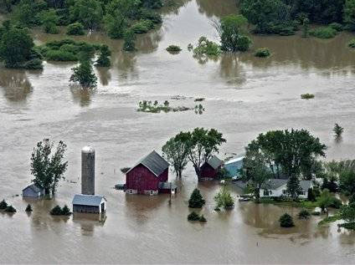
Complexity
There can be multiple causes of an effect.
World War II was not solely caused by Hitler. He was just one of several dictators seeking to build an empire to rival other European powers. There were many problems with the Treaty of Versailles that ended World War I, and the Great Depression had also made matters worse.
There can be several effects resulting from a single cause.
The aftermath of WWII resulted in a second Red Scare, a nuclear arms race, the creation of the United Nations, etc.

Slide 6
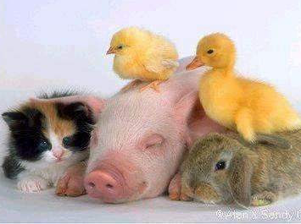
Classifications
Political: government policies, changes in parties, constitutional debates
Economic: ups/downs, regulations, trade
Social: beliefs and values, inequality, cultural influences
Combinations:
Economic regulation results in change to parties, and vice versa
Change in values results in government reform
Problems with inequality results in constitutional debate and new regulations

Slide 7
Critical Thinking
Long-term vs. Immediate
Causes: Imperialism vs. Pearl Harbor
Effects: Hiroshima vs. nuclear arms race
Positives/negatives?
Suburbia: larger middle class vs. conformity
Creation of Israel: homeland for European Jews vs. conflict with Palestinians
Degree
Causes: fear of communism and nativism vs. fear for national security, nativism, and racism
Effects: McCarthyism vs. Japanese internment

Slide 8
Key Words
Don’t just look for forms of the words “cause” and “effect.” Here is a list of examples of key words that can be used, but there are others.
Adverbs & Prepositions
Thus, so, therefore, since, consequently
Action verbs
Launched, sparked, helped, responded
Phrases
Due to, brought about, on account of, owing to, led to, as a result
Chronology
After, when, later, then
Motivation
Because, reason, in order to, for the purpose of, driven by
Multiple Causes/Effects
Several, many, various, contributing factors

Slide 9
Annotate and Think
In the early 1930s, a flood of books argued that the United States had been dragged into World War I by greedy bankers and arms dealers. Public outrage led to the creation of the Nye Committee in Congress, which investigated the activities of those who profited from the war. Antiwar feeling was fueled by fear of these “merchants of death”.
Americans’ growing isolationism eventually had an impact on President Roosevelt’s foreign policy. He officially recognized and began negotiating with the Soviet Union and continued the Good Neighbor Policy of nonintervention in Latin America. In 1935, Congress passed a series of Neutrality Acts which outlawed arms sales or loans to any nation engaged in a war or civil war.
Despite Congressional efforts to legislate neutrality, Roosevelt found it impossible to remain neutral. When Japan launched a new attack on China, he used a loophole in the Acts to send aid to China. He asked nations to “quarantine” aggressor nations in order to stop the spread of war. He faced heavy criticism from newspapers, so he backed off and the U.S. clung to neutrality. However, he had begun to shift the debate at home.

Slide 10
Annotate and Think
In the early 1930s, a flood of books argued that the United States had been dragged into World War I by greedy bankers and arms dealers. Public outrage led to the creation of the Nye Committee in Congress, which investigated the activities of those who profited from the war. Antiwar feeling was fueled by fear of these “merchants of death”.
Americans’ growing isolationism eventually had an impact on President Roosevelt’s foreign policy. He officially recognized and began negotiating with the Soviet Union and continued the Good Neighbor Policy of nonintervention in Latin America. In 1935, Congress passed a series of Neutrality Acts which outlawed arms sales or loans to any nation engaged in any kind of war to avoid entanglements.
Despite Congressional efforts to legislate neutrality, Roosevelt found it impossible to remain neutral. When Japan launched a new attack on China in 1937, he used a loophole in the Acts to send aid to China. He asked nations to “quarantine” aggressor nations in order to stop the spread of war. He faced heavy criticism from newspapers, so he backed off and the U.S. clung to neutrality. However, he had begun to shift the debate at home.

Slide 11
Annotate and Think
So was this cause what they did or what people feared they had done? Both?
In the early 1930s, a flood of books argued that the United States had been dragged into World War I by greedy bankers and arms dealers. Public outrage led to the creation of the Nye Committee in Congress, which investigated the activities of those who profited from the war. Antiwar feeling was fueled by fear of these “merchants of death”.
Americans’ growing isolationism eventually had an impact on President Roosevelt’s foreign policy. He officially recognized and began negotiating with the Soviet Union and continued the Good Neighbor Policy of nonintervention in Latin America. In 1935, Congress passed a series of Neutrality Acts which outlawed arms sales or loans to any nation engaged in any kind of war to avoid entanglements.
Despite Congressional efforts to legislate neutrality, Roosevelt found it impossible to remain neutral. When Japan launched a new attack on China in 1937, he used a loophole in the Acts to send aid to China. He asked nations to “quarantine” aggressor nations in order to stop the spread of war. He faced heavy criticism from newspapers, so he backed off and the U.S. clung to neutrality. However, he had begun to shift the debate at home.

Slide 12
Annotate and Think
So was this cause what they did or what people feared they had done? Both?
In the early 1930s, a flood of books argued that the United States had been dragged into World War I by greedy bankers and arms dealers. Public outrage led to the creation of the Nye Committee in Congress, which investigated the activities of those who profited from the war. Antiwar feeling was fueled by fear of these “merchants of death”.
Americans’ growing isolationism eventually had an impact on President Roosevelt’s foreign policy. He officially recognized and began negotiating with the Soviet Union and continued the Good Neighbor Policy of nonintervention in Latin America. In 1935, Congress passed a series of Neutrality Acts which outlawed arms sales or loans to any nation engaged in any kind of war to avoid entanglements.
Despite Congressional efforts to legislate neutrality, Roosevelt found it impossible to remain neutral. When Japan launched a new attack on China in 1937, he used a loophole in the Acts to send aid to China. He asked nations to “quarantine” aggressor nations in order to stop the spread of war. He faced heavy criticism from newspapers, so he backed off and the U.S. clung to neutrality. However, he had begun to shift the debate at home.
Multiple immediate effects: both political and economic

Slide 13
Annotate and Think
So was this cause what they did or what people feared they had done? Both?
In the early 1930s, a flood of books argued that the United States had been dragged into World War I by greedy bankers and arms dealers. Public outrage led to the creation of the Nye Committee in Congress, which investigated the activities of those who profited from the war. Antiwar feeling was fueled by fear of these “merchants of death”.
Americans’ growing isolationism eventually had an impact on President Roosevelt’s foreign policy. He officially recognized and began negotiating with the Soviet Union and continued the Good Neighbor Policy of nonintervention in Latin America. In 1935, Congress passed a series of Neutrality Acts which outlawed arms sales or loans to any nation engaged in any kind of war to avoid entanglements.
Despite Congressional efforts to legislate neutrality, Roosevelt found it impossible to remain neutral. When Japan launched a new attack on China in 1937, he used a loophole in the Acts to send aid to China. He asked nations to “quarantine” aggressor nations in order to stop the spread of war. He faced heavy criticism from newspapers, so he backed off and the U.S. clung to neutrality. However, he had begun to shift the debate at home.
Multiple immediate effects: both political and economic
What are the Pros/Cons of a president going against Congress? Being affected by the media?

Slide 14
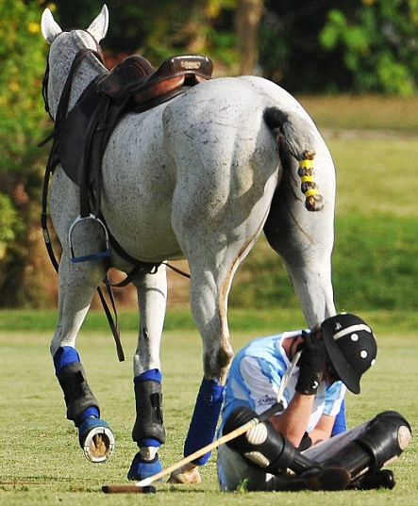
Practice, Practice, Practice
As with any skill, you may not get it the first time (or second…)
Review these directions and examples at the beginning of each unit and before quizzes and tests!
The written portion of the next test will be based on this skill.

