Slide 1
From D-Day to Doomsday
UNIT 4 : 1930-1960
Part A - Foreign

Slide 2
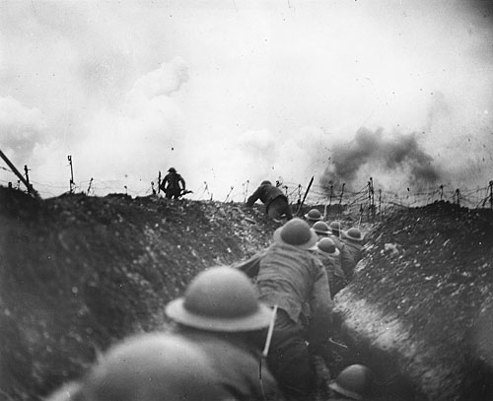
World War I Unresolved
Treaty of Versailles
increases German nationalism
Hitler violates treaty to re-militarize
League of Nations has no way to enforce treaty and former Allies want to avoid war
Imperialism
Allies still have colonies, trade dominance
Mandates added in Middle East after the war
Germany, Italy, Japan want to build empires

Slide 3
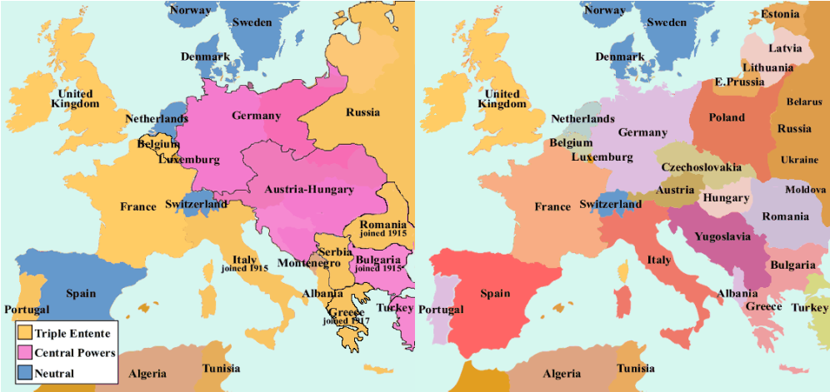

Slide 4
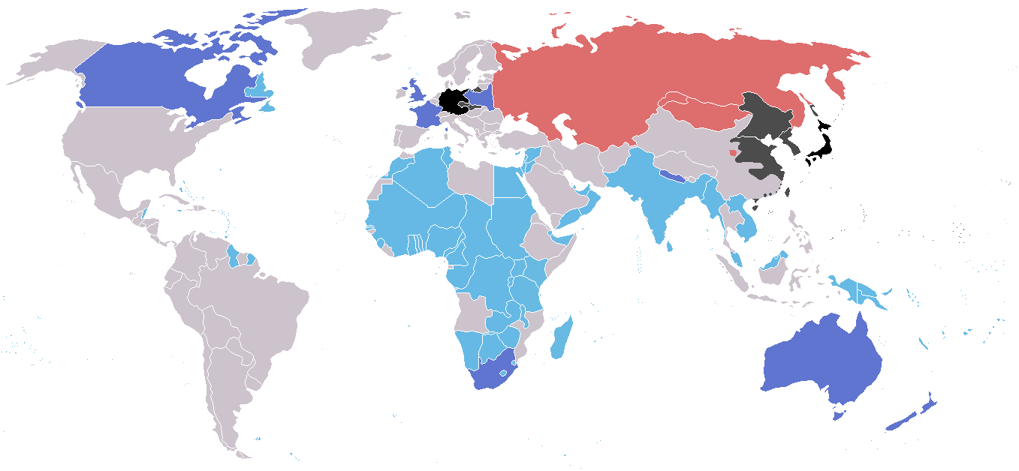
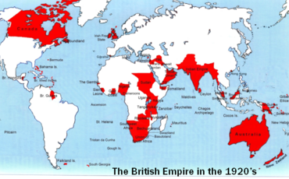
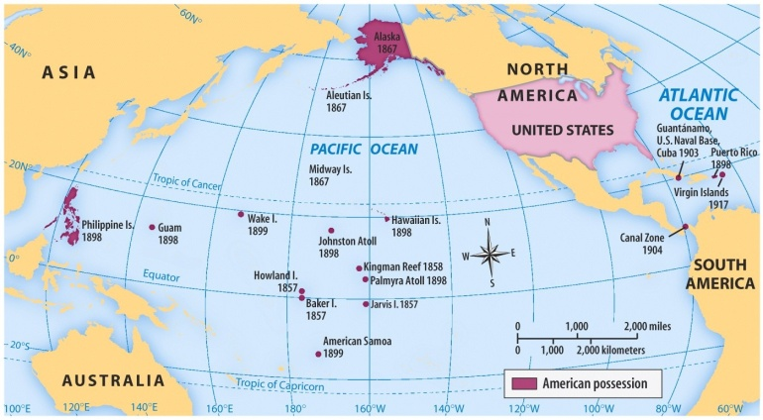
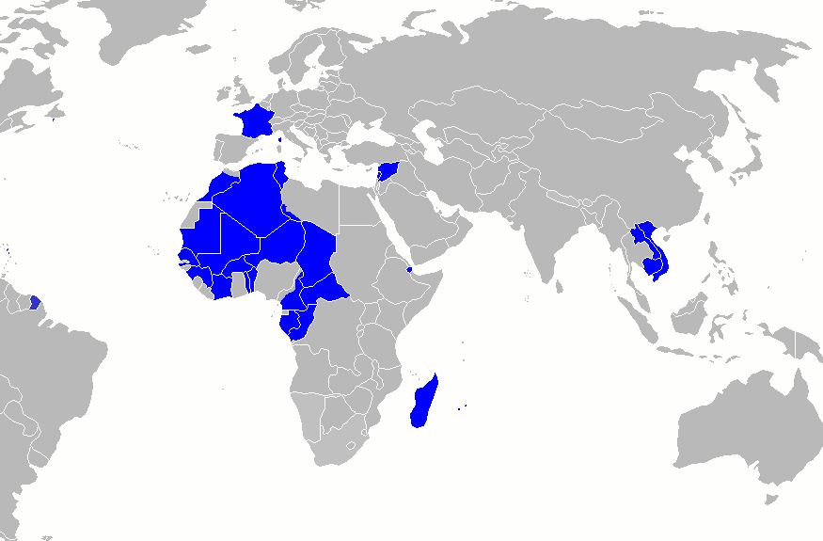

Slide 5
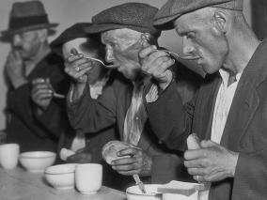
Great Depression
War debts and reparations made European recovery after WWI slow, affected global trade
Depression hit Europe hard, people begin to question capitalism and democracy
With the promise of a return to prosperity, dictators rise to power
Communism, Fascism, Nazism, Militarism
Mobilization for military expansion fueled recovery, added to their popularity

Slide 6
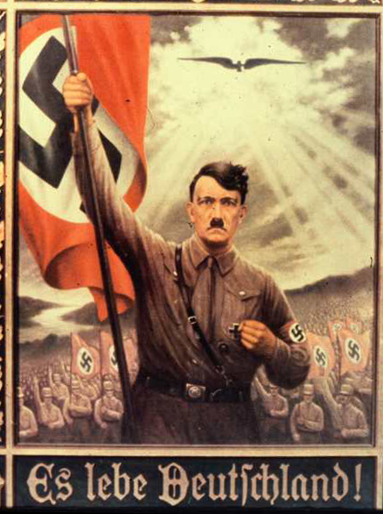
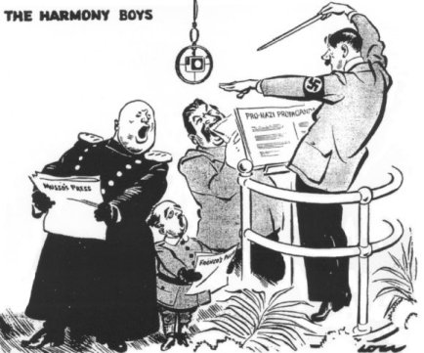

Slide 7
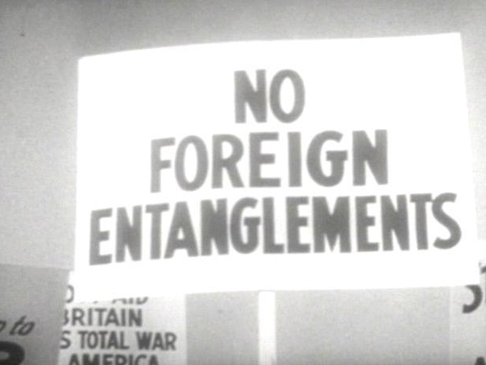
U.S. Neutrality
Isolationism: Americans want to avoid getting caught up in another European war
Neutrality Acts
Trade with Allies during WWI led to
Attacks by German U-boats
War debts never repaid
So, no weapons or supplies will be sold to countries at war or in civil war

Slide 8
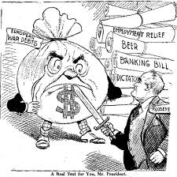
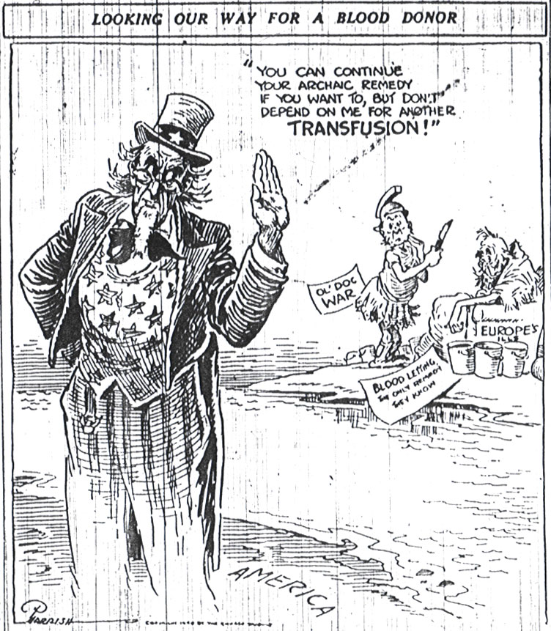

Slide 9
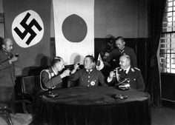
Axis Powers Formed
Militarist leaders in Japan want an Asian empire, seize Manchuria in 1931
Italy invades Ethiopia in 1935 to begin building Mussolini’s New Roman Empire
Germany builds up military, sends troops into “demilitarized” Rhineland bordering France
Rome-Berlin-Tokyo Axis formed in 1936 to fight Soviet communism and clear way for their individual expansion

Slide 10
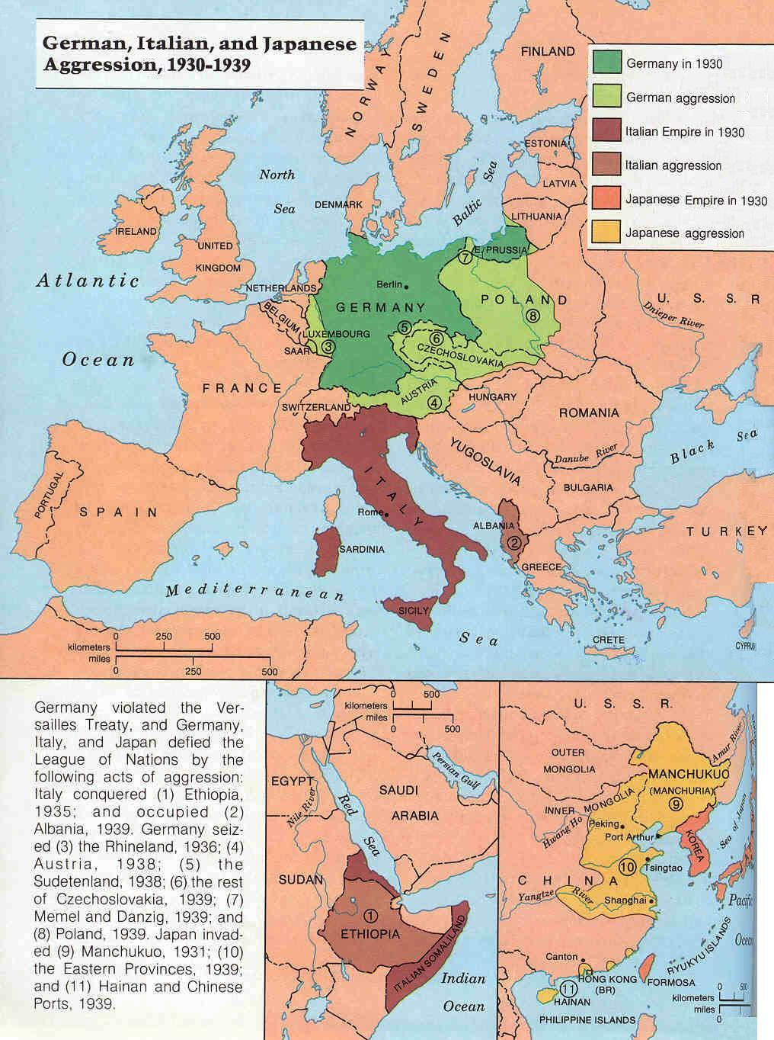
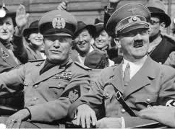
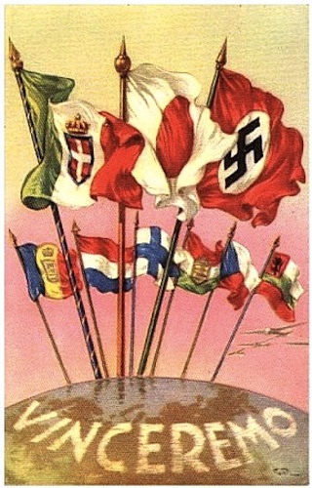
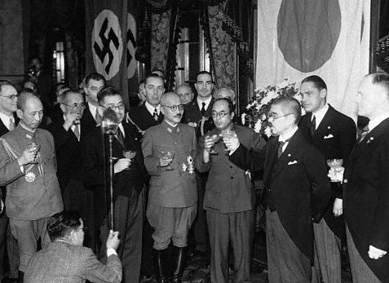

Slide 11
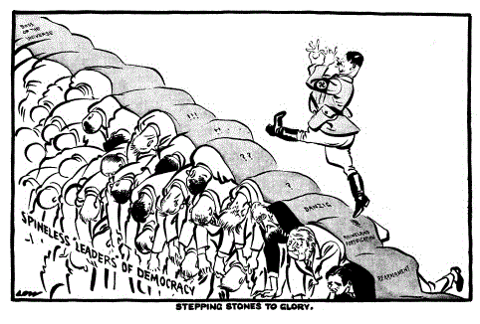
Appeasement
Anschluss
With help of Austrian Nazis, Hitler forces union of Germany and Austria
Munich Conference
Hitler demands part of Czechoslovakia, Britain and France “appease” for promise of no further expansion
Non-Aggression Pact
Hitler and Stalin want to avoid another two-front war, plan to divide up Poland and Eastern Europe

Slide 12
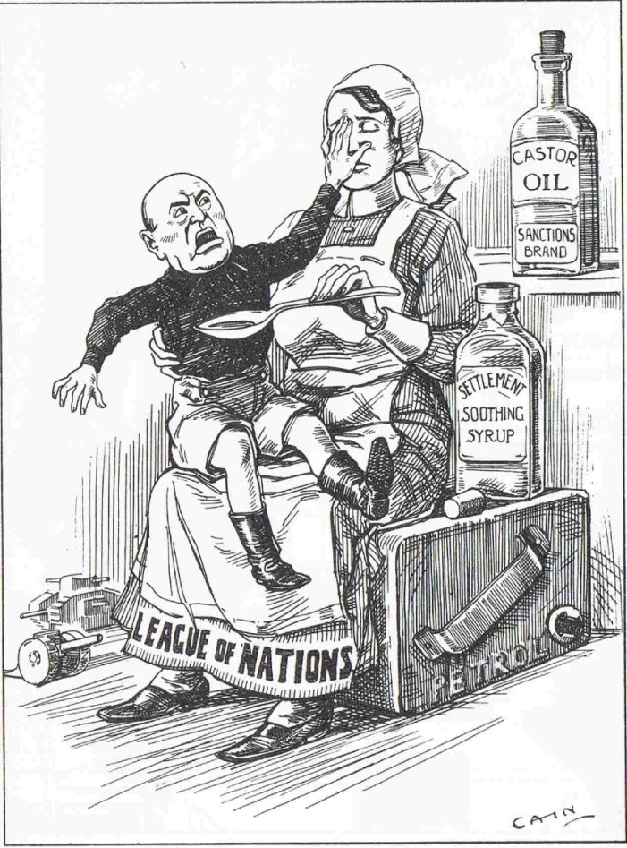
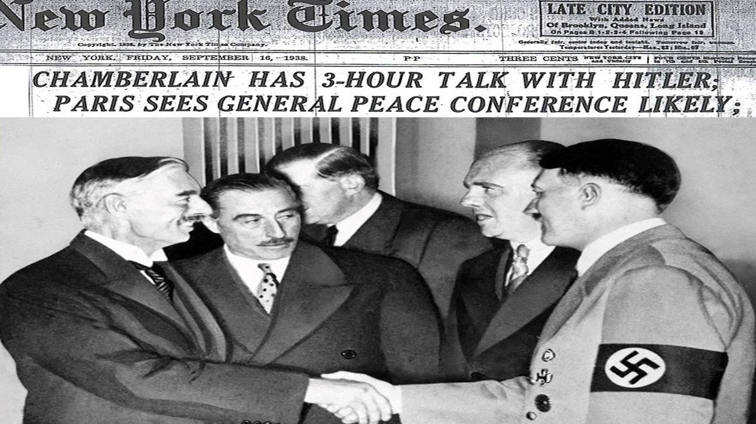
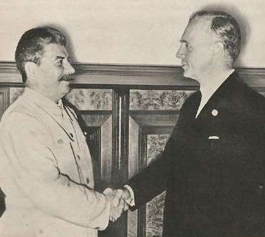

Slide 13
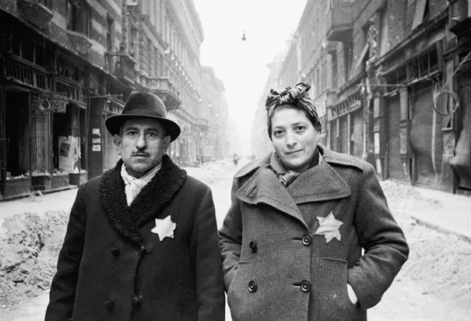
The Holocaust
Since Hitler took power, the persecution of Jews in Germany escalated greatly
Nuremburg Laws
Kristallnacht
Nazis tried to push Jews out, but refugees faced resistance from other countries
Quota system
St. Louis
Those remaining were relocated to Ghettos, and eventually concentration camps

Slide 14
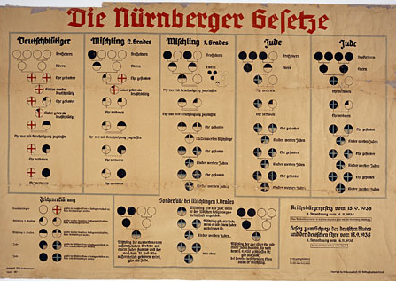
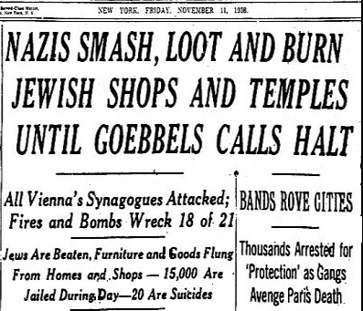
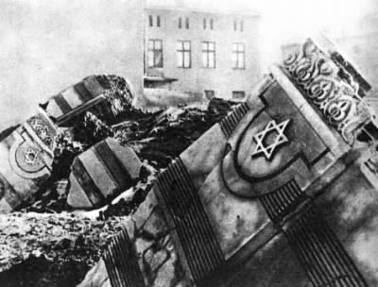
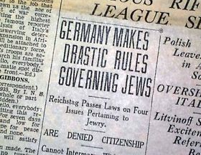

Slide 15
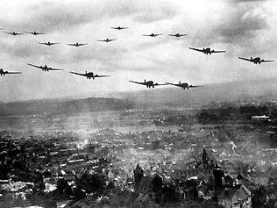
The War Begins
Germany invades the rest of Czechoslovakia and Poland in 1939
Violates Munich Pact, end of appeasement
Britain and France honor agreement with Poland and declare war on Germany
Hitler overwhelms Poland with “blitzkreig”
Japan occupies eastern China
Will look to other parts of SE Asia for resources to defeat China

Slide 16
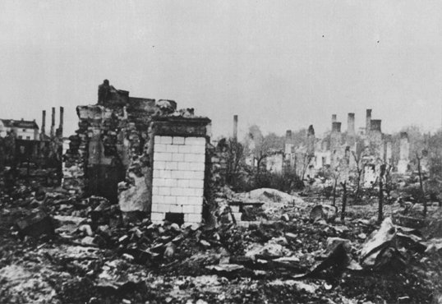
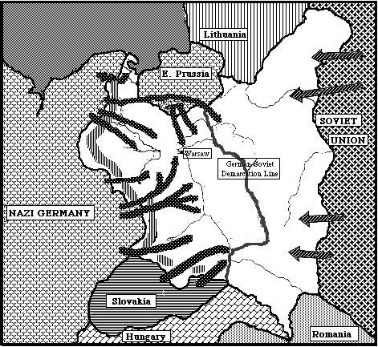
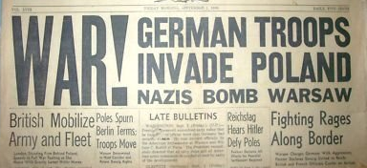

Slide 17
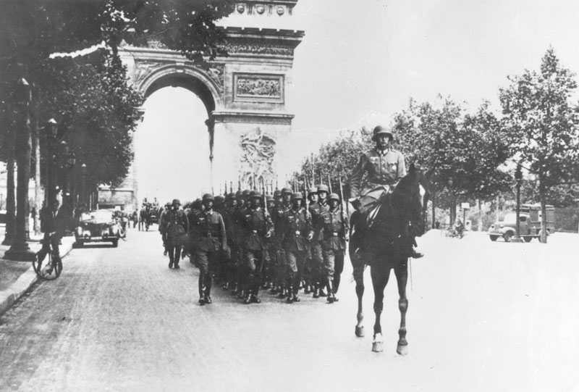
Allies Under Attack
German blitzkreig broke down Maginot Line, Paris falls and French government flees to Britain
Takes control of northern Europe, helps Italy invades southern Europe and North Africa
Battle of Britain
London survives blitz
Hitler looks to the East for further expansion
Japan invades French Indochina
U.S. begins embargo: ban on selling war materials (including oil) to Japan

Slide 18
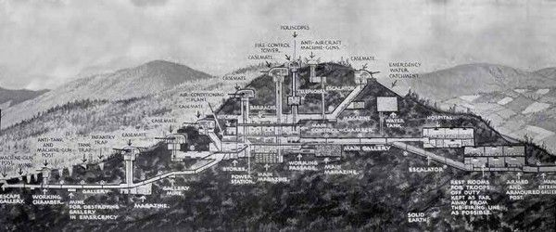
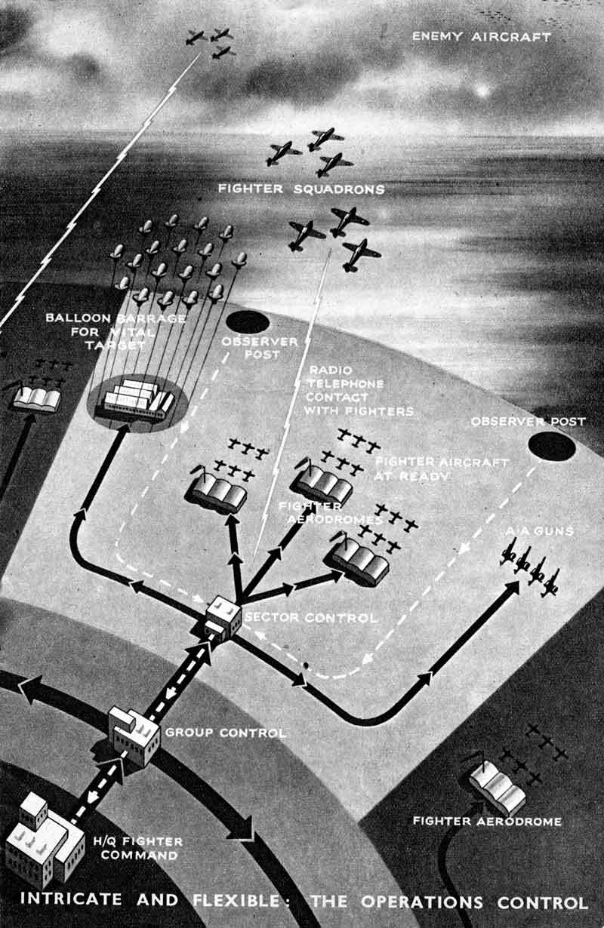
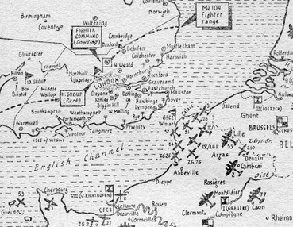

Slide 19
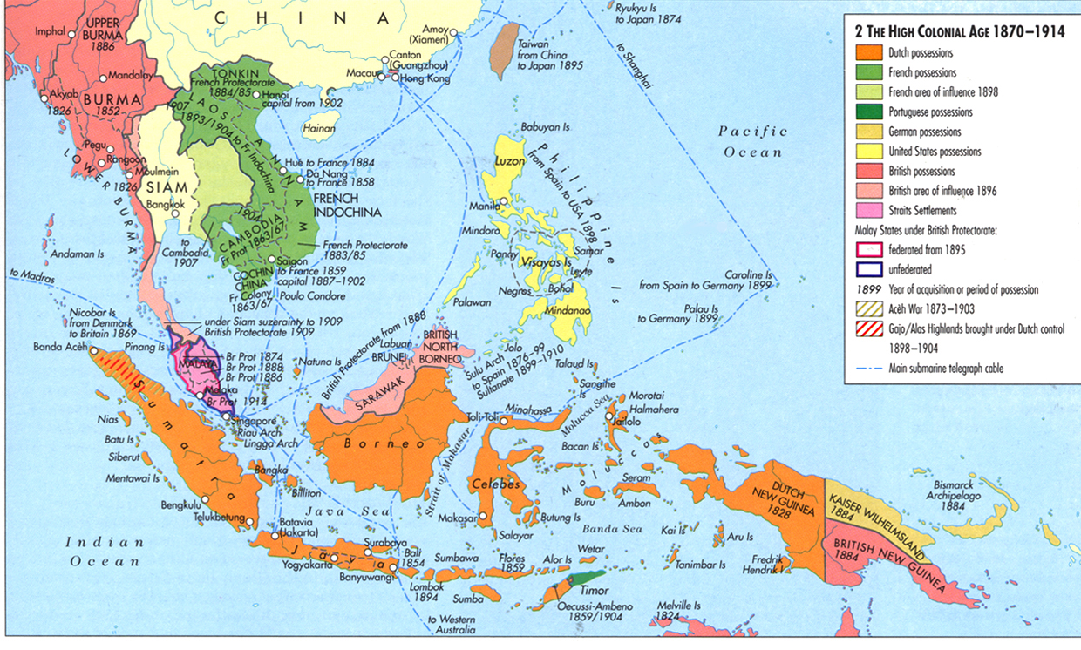

Slide 20
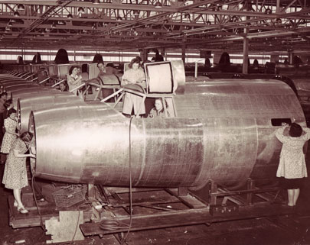
Arsenal of Democracy
FDR had already used a loophole in Neutrality Acts to continue sending arms, supplies to China
Due to increasing need from the Allies, the U.S. made significant moves away from neutrality
Cash-and-Carry provision
Lend-Lease Act
Began the only peacetime draft in U.S. history
When Hitler breaks the Non-Aggression Pact by invading the Soviet Union in 1941, the U.S. sends aid to Stalin

Slide 21
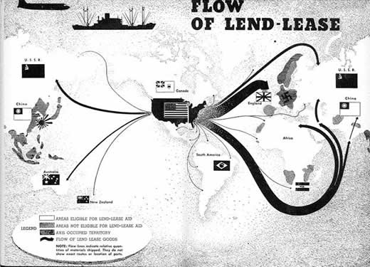
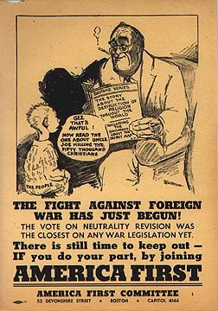
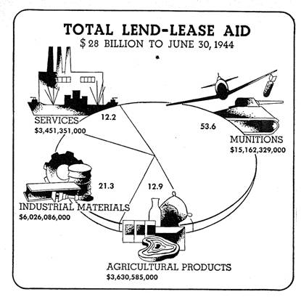
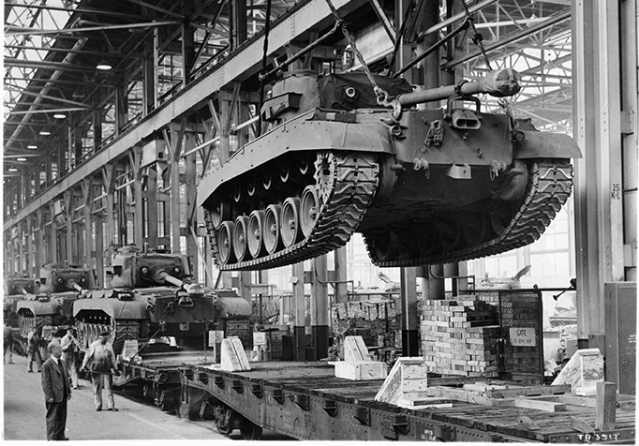

Slide 22
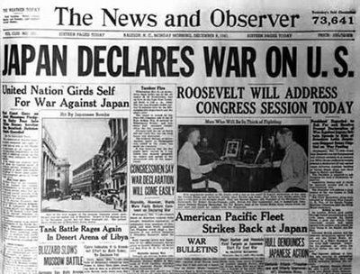
U.S. Declares War
Pearl Harbor
Japan’s Tojo wanted the Philippines and other colonial possessions
Plans for bombing the naval base in Hawaii made during peace talks called due to the embargo
War declared December 1941
Home Front
Mobilization
Japanese internment

Slide 23
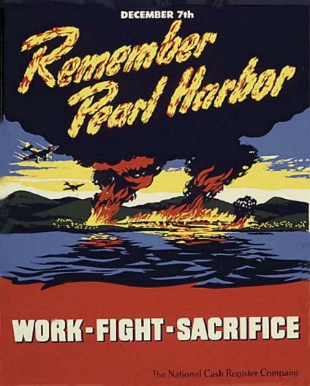
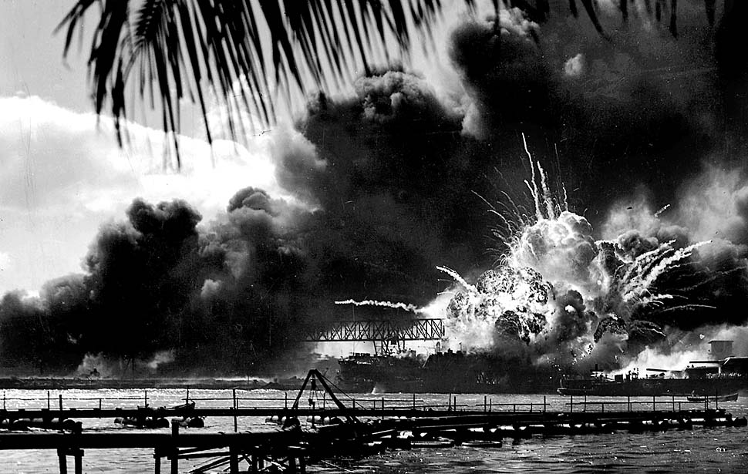
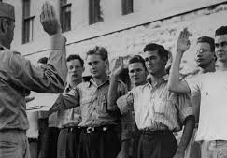
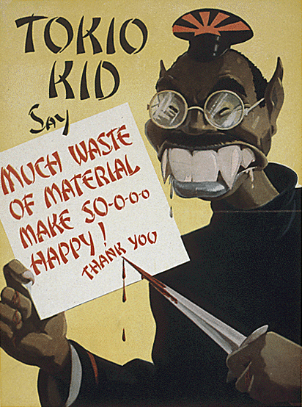
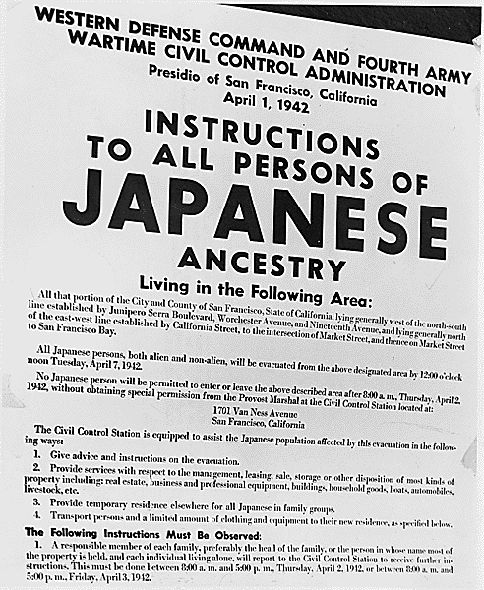

Slide 24
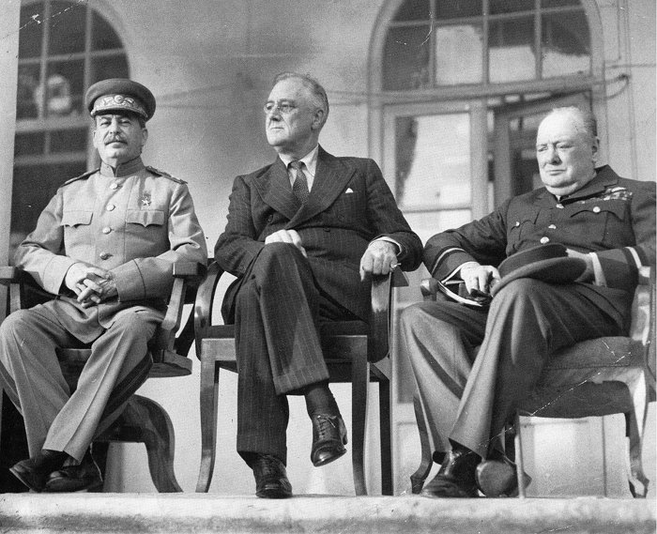
The Big Three Meet
FDR had previously met with Churchill and signed the Atlantic Charter
Outlined a permanent system of security that would become the basis of the United Nations
They meet with Stalin in 1942
Agreed to focus on stopping Hitler first
Reports of death camps are investigated, consider options but decide not to bomb them
Japan takes control of the Pacific, the U.S. is forced out of the Philippines

Slide 25
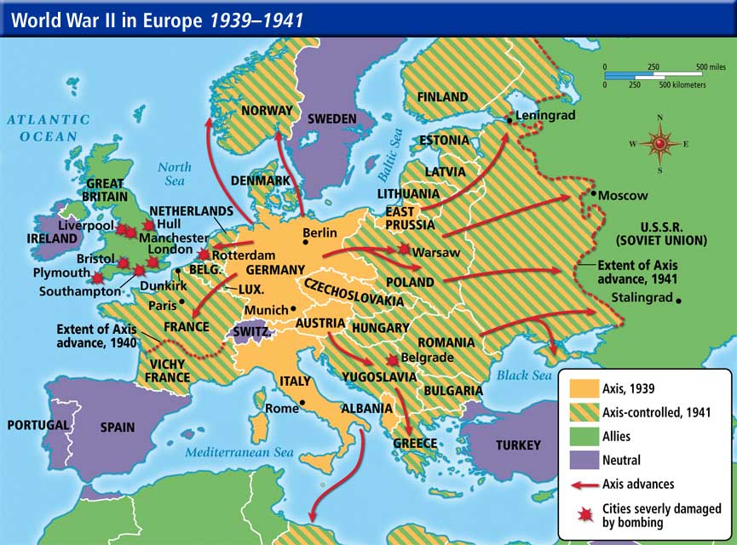
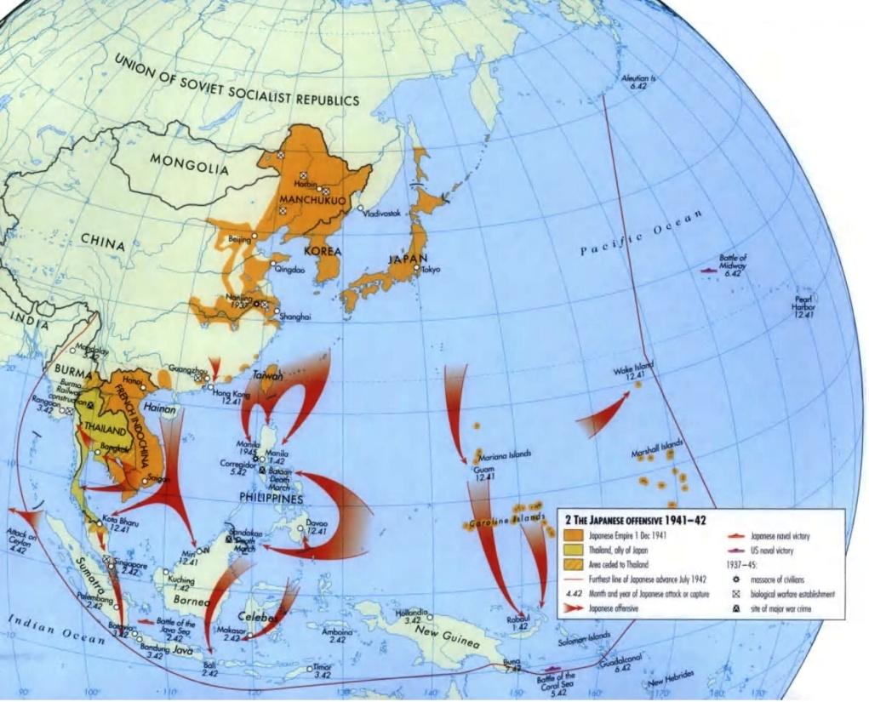

Slide 26
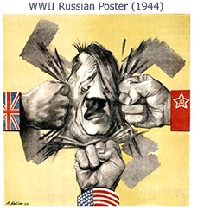
Allies Turn the Tide
The Pacific Front
After the Battle of Midway, Japan stays on the defensive the rest of the war
North Africa and Italy
Mussolini overthrown, Hitler sends aid but Allies take control
Soviet Union and Eastern Europe
Hitler’s army suffers devastating losses in the Battle of Stalingrad, Soviets push toward Germany
France and Western Europe
After the D-Day invasion of Normandy, France is liberated

Slide 28
Victory in Europe
After the Battle of the Bulge fails in the West, the German army could only retreat
Soviet forces liberated death camps in Eastern Europe, took control of Berlin
Mussolini is executed, Hitler commits suicide as Nazis are captured and arrested
General Eisenhower accepts unconditional surrender on May 8, 1945 (V-E Day)
FDR died just weeks before, Truman now president

Slide 30
Truman’s Decision
Island hopping strategy successful in pushing towards Japanese mainland
Japanese military became increasingly desperate and dug in
Kamikazes, Iwo Jima and Okinawa
Truman learned of the Manhattan Project
Debate with military advisors and scientists over the need to use the bomb to end the war and the morality of using it

Slide 32
Victory in Japan
After the first atomic bomb is dropped on Hiroshima, the Japanese military still refuse to surrender
After the second is dropped on Nagasaki, Emperor Hirohito forces them to surrender
Surrendered to General MacArthur on Sept. 2, 1945 (V-J Day)

Slide 34
Casualties Estimated
50-75 million dead worldwide
20.5 million civilians
Most in China and the Soviet Union
6 million Jews
Almost 200,000 victims of A-bomb
Soviet Union suffers greatest losses (again), almost 22 million

