Slide 1
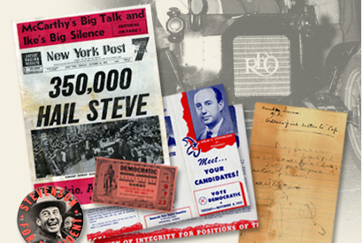
History Skill Builder
Document Analysis

Slide 2
Document Analysis
Historians rely on texts to construct their accounts of the past, citizens should learn to analyze texts to form their opinions about issues
In an age of digital information overload, it is essential that you learn to distinguish between different types of sources and know how to draw conclusions from them

Slide 3
Document Types
A primary source was created during the time period and gives an inside perspective. It can be an original document, artifact, or creative work.
Examples: law, essay, speech, letter, song lyrics, painting, news article, political cartoon, etc.
A secondary source interprets and analyzes primary sources. It is one or more steps removed from the event.
Examples: textbooks, encyclopedia articles, research
Is the purpose informational, functional, persuasive, artistic?
Are primary sources always biased? Secondary?

Slide 4
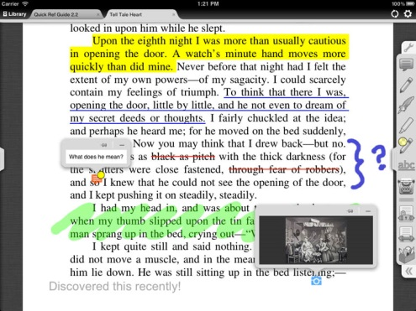
Annotation
Think, interact, and connect with the text!
Before you read/view: look at titles, pictures and captions, date published, etc.
Read though once quickly, then do a second close reading
Mark it up: Underline, highlight, write notes in the margins, use post-its if necessary
After you finish annotations: Re-read what you wrote to look for patterns, write critical thinking questions, draw conclusions

Slide 5
Analysis Tools
Tools provided by gov’t sites
Library of Congress
National Archives
Tools adapted from AP/College Board
SOAPSTONE
APPARTS

Slide 6
Common mistakes
Assuming you got it the first time. Re-read!
Marking everything. Focus on the purpose of the assignment!
Not keeping yourself in the time period. Maintain perspective!
Expecting the answers to the questions are going to be spelled out for you. Look for clues, read between the lines!
Forgetting this is history, not English, class. Make connections to what we have learned!

Slide 7
Annotate
Section 1. All persons born or naturalized in the United States, and subject to the jurisdiction thereof, are citizens of the United States and of the State wherein they reside. No State shall make or enforce any law which shall abridge the privileges or immunities of citizens of the United States; nor shall any State deprive any person of life, liberty, or property, without due process of law; nor deny to any person within its jurisdiction the equal protection of the laws.
- Amendment XIV (1868)

Slide 8
Annotate
Former slaves. What about Native Americans?
Immigrants who become citizens.
This makes me think about the conflict going on in Ferguson…
Section 1. All persons born or naturalized in the United States, and subject to the jurisdiction thereof, are citizens of the United States and of the State wherein they reside. No State shall make or enforce any law which shall abridge the privileges or immunities of citizens of the United States; nor shall any State deprive any person of life, liberty, or property, without due process of law; nor deny to any person within its jurisdiction the equal protection of the laws.
- Amendment XIV (1868)
Civil Rights
Natural Rights
Fair treatment by police, court system
Right after Civil War, during Reconstruction
CITIZENS MUST BE TREATED EQUALLY!

Slide 9
Analyze
Source information: Amendment to Constitution 1868, Congress was dominated by northern state and Republicans after the Civil War. For state governments to comply.
Historical context: Because the Southern states were trying to preserve white power as much as possible after the war, the federal gov’t needed to intervene. The Civil Rights movement had little success until the 1960s, so there will be problems with interpretation/enforcement…
Argument being made by the author: All citizens (including former slaves) must be treated equally by state gov’ts and legal systems.
Quotes from the text that support the argument:
“No State shall..” – federal supremacy over state gov’t
“Life, liberty, and property, without due process of law” – all citizens should have natural rights protected and Bill of Rights protections (ex. lynching)
“equal protection of the laws” – state/local gov’ts cannot treat citizens differently because of their skin color (ex. Jim Crow laws)

Slide 10
Practice, Practice, Practice
As with any skill, you may not get it the first time (or second…)
Review these directions and examples anytime I ask you to annotate or analyze an historical document!
The written portion of the next test will be based on this skill.

