Slide 1
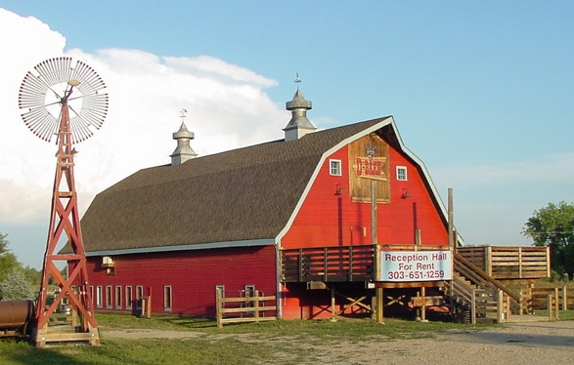
Foland Farms

Slide 2
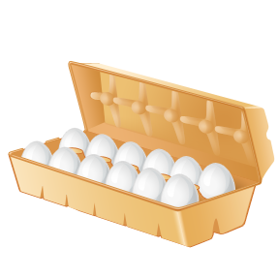
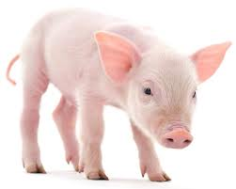
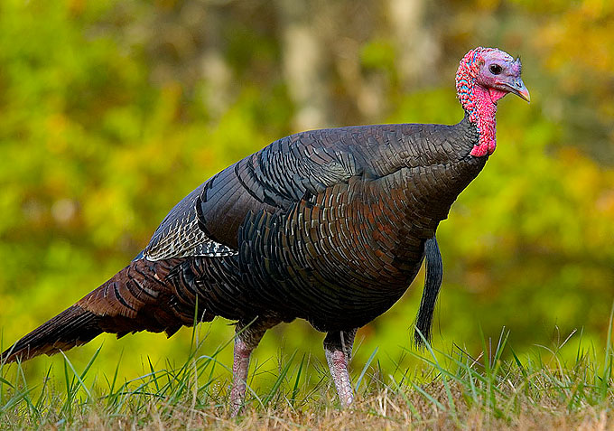
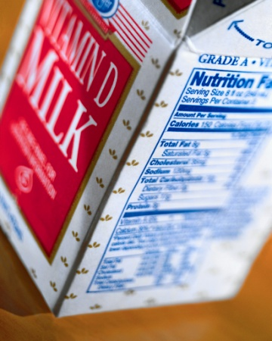
The goods We give you everything you need
Pigs
Cows
Chickens
Goats
Sheep
Turkey (Seasonal)
Hay

Slide 3
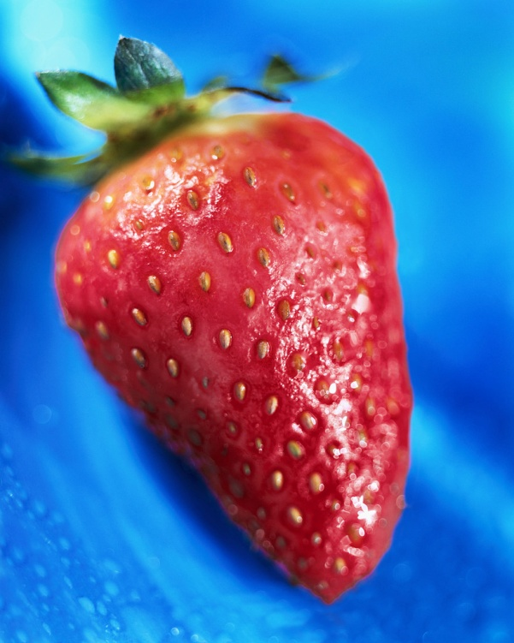
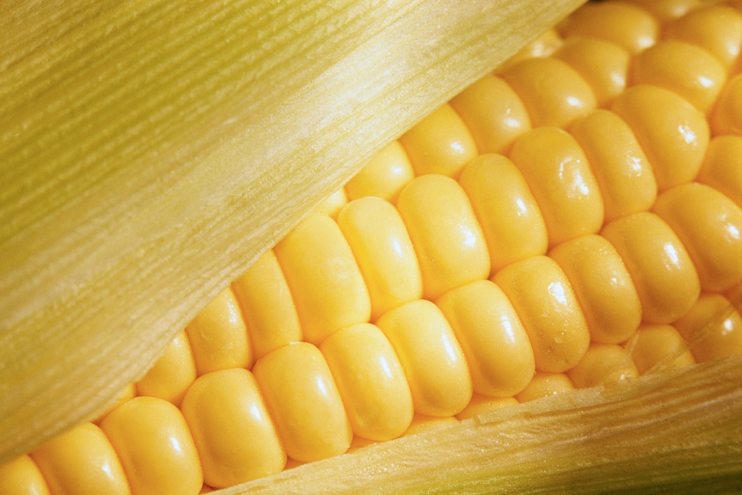
More of the goods
Corn
Potatoes
Carrots
Cucumber
Strawberries
Blueberries
Watermelon
Tomatoes

Slide 4
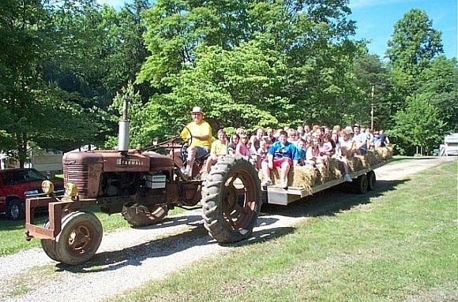
The services
Hay rides
Corn Maze (Seasonal)
Petting Zoo
Farm Tours
Online ordering/Delivery

Slide 5
Why you need the goods
Food is a necessity and a non-durable good (gone once eaten)
Target Market: people who eat or sell food (stores, consumers, etc.)
Individuals could buy/order in small quantities
Businesses could buy/order in bulk
Prices are reasonable, but will still make profit

Slide 6
Current Resources– water, time, skills
Needed Resources – Land, gas, used equipment, animals, seeds, animal feed, fertilizer, building materials (barn & slaughter house), fencing, crates/boxes, signs, delivery trucks
There is little risk because the goods provided are a necessity
The potential return would be revenue for the farm and a place for everybody to enjoy

