Slide 1
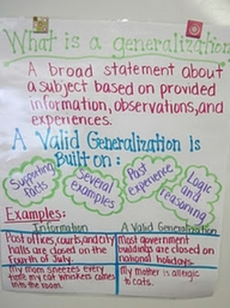
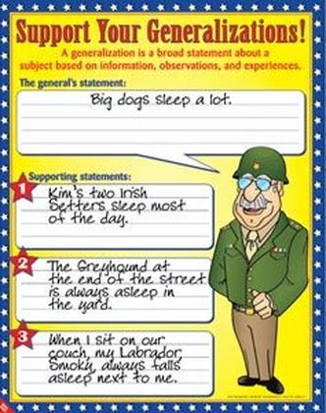
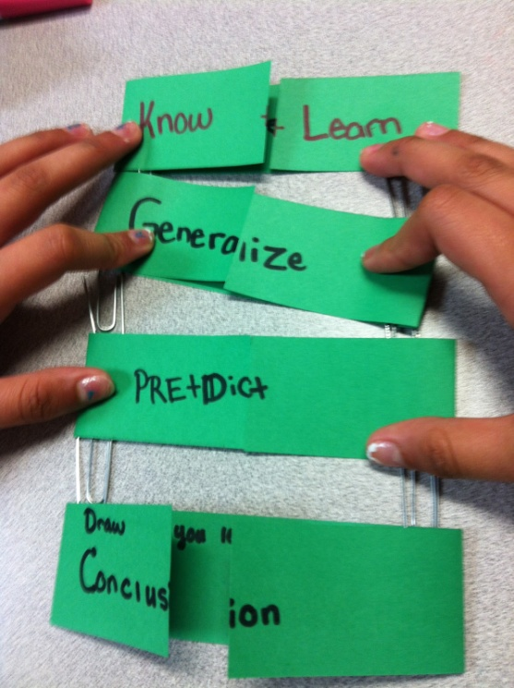
History Skill Builder
Generalizations and Evidence

Slide 2
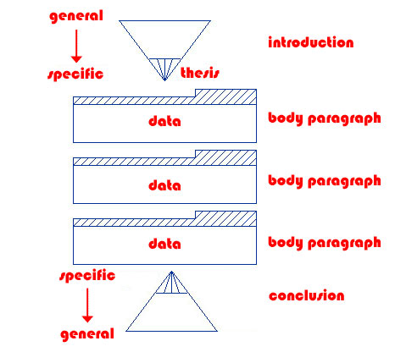
Generalization and Evidence
Reading and Writing Skills
To help you draw conclusions based on careful consideration of the facts
To give you practice supporting opinions and arguments with specific details
To strengthen your inductive and deductive reasoning skills
Similar to:
Thesis/Proof
Main Idea/Supporting details

Slide 3
A generalization should be broad, and evidence should be specific.
During the Roaring 20s, there was a clash of traditional and modern values.
Fundamentalists opposed teaching the new scientific theory of evolution in the public schools.

Slide 4
A generalization is complex, evidence is black and white.
The stock market is a place where corporations sell shares of their companies to investors to raise capital.
Investing in the stock market involves taking financial risks.

Slide 5
A generalization must be supported by multiple pieces of evidence.
With the passage of the 19th Amendment, women achieved equality with men.
Women made gains, but still remained unequal to men.
Flappers showed increasing freedom, but still subjected to the double standard
Could vote, but not get elected
Worked more, but in low paying and “pink collar” jobs

Slide 6
Evidence must correspond logically to the generalization.
The Harlem Renaissance showed increasing black pride.
Langston Hughes wrote about what it was like to be a minority in America.
Bessie Smith was a famous jazz singer.
The growth of the automobile industry changed the landscape of the U.S.
The Model T was the first car that middle class Americans could afford.
Automobiles increased urban sprawl because people could live in the suburbs and commute to the cities.

Slide 7
The generalization and evidence must be historically accurate.
After the Progressive Era, labor unions grew large and powerful.
Labor union membership suffered during WWI and the Red Scare.
There was a connection between the labor movement and socialism.
Most union members were socialist.

Slide 8
Where’s the Generalization?
The years from 1920 to 1929 were prosperous and Americans enjoyed a high standard of living. Businesses expanded due to increased technology and demand. In addition to advertising, industry lured consumers to purchase a mountain of goods by offering them easy credit. Banks offered an installment plan at a low interest rate. They were marketed with slogans like “a dollar down and a dollar forever,” and “enjoy while you pay.” Some economists and business owners worried that installment buying might be getting out of hand and that it was really a sign of fundamental weaknesses behind a superficial economic prosperity.

Slide 9
Where’s the Generalization?
The years from 1920 to 1929 were prosperous and Americans enjoyed a high standard of living. Businesses expanded due to increased technology and demand. In addition to advertising, industry lured consumers to purchase a mountain of goods by offering them easy credit. Banks offered an installment plan at a low interest rate. They were marketed with slogans like “a dollar down and a dollar forever,” and “enjoy while you pay.” Some economists and business owners worried that installment buying might be getting out of hand and that it was really a sign of fundamental weaknesses behind a superficial economic prosperity.

Slide 10
Where’s the Generalization?
The years from 1920 to 1929 were prosperous and Americans enjoyed a high standard of living. Businesses expanded due to increased technology and demand. In addition to advertising, industry lured consumers to purchase a mountain of goods by offering them easy credit. Banks offered an installment plan at a low interest rate. They were marketed with slogans like “a dollar down and a dollar forever,” and “enjoy while you pay.” Some economists and business owners worried that installment buying might be getting out of hand and that it was really a sign of fundamental weaknesses behind a superficial economic prosperity.

Slide 11
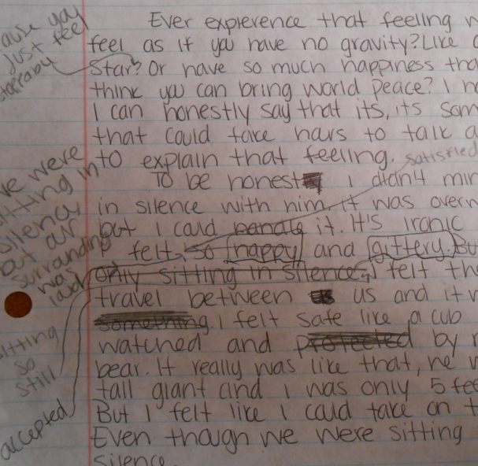
Practice, Practice, Practice
As with any skill, you may not get it the first time (or second…)
We’ll be practicing throughout the unit, so review these directions and examples anytime I ask you to make a generalization and support it with evidence!
The written portion of the Unit 3 test will be based on this skill.

