Slide 1
inSANE
P
E
N
C
E
R
L
L
I
A
T
E
M
I
L
Y

Slide 2
The Glow-in-the-Dark Hammock

Slide 3
The product seems like a normal hammock but it is so much more! Not only does its unique cocoon-style comfort and protect you while you sleep or hang out, but it also keeps bugs out! And…. IT GLOWS IN THE DARK!

Slide 4
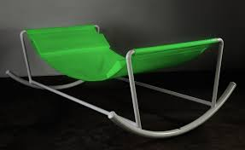
The Glow-in-the-Dark Hammock
is a luxury that can enhance your life!

Slide 5
This product is great for people of all ages.
The Glow-in-the-Dark Hammock is adjustable and can be used indoors and outdoors!
It will be sold for $80 but it only takes $20 to make.

Slide 6
Resources we already have:
Location/Warehouse
Time
Skills
Technology
Resources we need:
Glow-in-the-Dark windbreaker material
Zippers
Rope
Hooks
Net
Stand

Slide 7
There is little risk; we may not sell enough, but it is portable and functions indoors and outdoors. This enables everyone to be able to use it so the product’s production should GO inSANE!

Slide 8
By investing in the Glow-in-the-Dark Hammock, you will benefit greatly because the product will be a big hit and you will be able to share in our wealth!

