Slide 1
International Trade
One way for the government to promote competition is ensure easy interstate and international trade.
When there are more available products and more businesses, consumers are usually better off.
Trade also encourages specialization
Certain countries are very good at producing certain products and terrible with others
The US can’t produce bananas. Most developing countries can’t produce airplanes and cars.

Slide 2
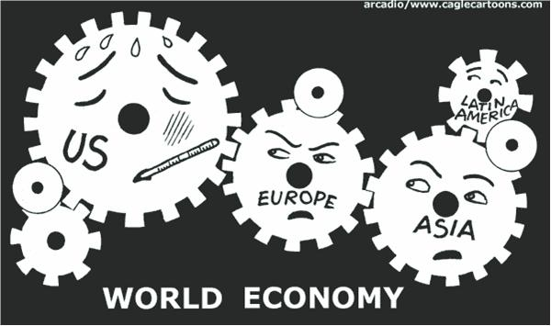
International Trade
Economic Interdependence: No person or nation is truly self-sufficient. We must rely on each other (people and nations) to produce all of the things we want and need.
Effects of Interdependence:
Environmental and Political problems in one country can cause economic problems in many other countries.
Governments must enact policies that allow their citizens access to products made in other countries.

Slide 3
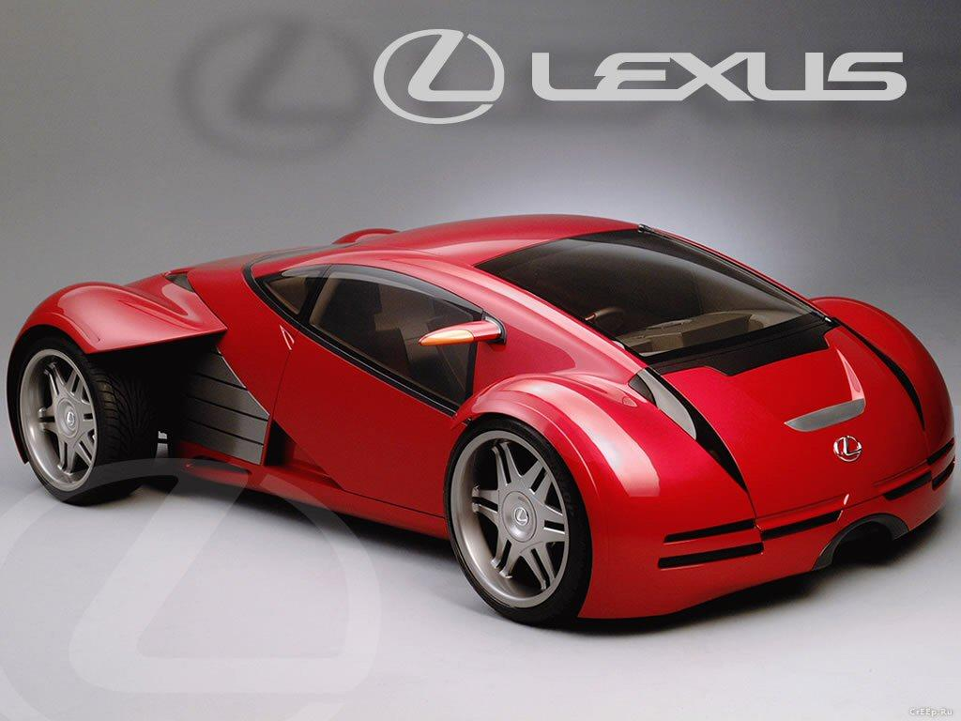
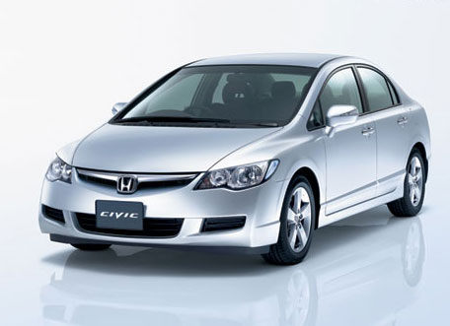
Protectionist Trade Policies
Many nations limit imports to protect domestic producers of the same product.
Tariffs: Taxes on imports - Make prices for the imported goods more expensive
Quotas: Limits on the number of specific goods that can be imported.

Slide 4
Free Trade Policies
Free Trade Agreements: Nations can legally agree that they will not limit or prevent trade between the two nations.
NAFTA, EU
Free Trade Issues:
Companies can more easily move their factories to another country = outsourcing
Domestic businesses may be hindered by increased trade with foreign companies
“Fair Trade” with Developing nations?

Slide 5
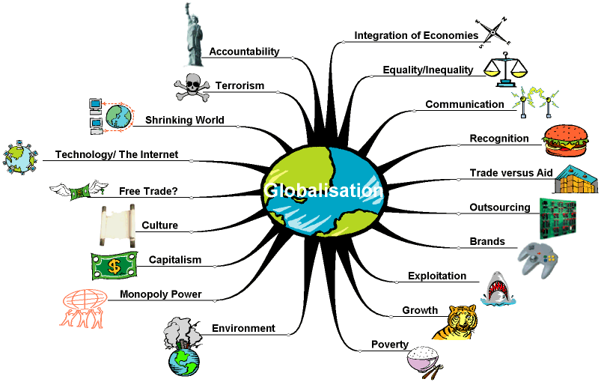
Globalization Debate
What are the pros and cons of globalization?

