Slide 1
Legal Protections Jingle
By: Conner New, Blaire Bowling, Andrew May

Slide 2
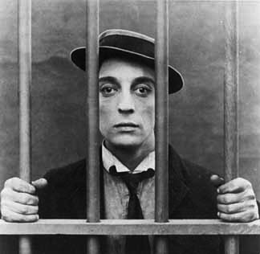
Legal Protections, Legal Protections
We depend on to keep law fair
They help us with the question of:
“Who gets the better share?”
Legal Protections, legal protections
Ensure we are not rash
In the decision-making that goes into
The punishment of the bad

Slide 3
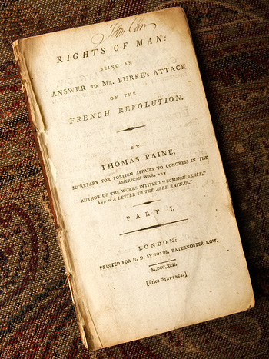
Protecting our natural rights
Is the goal of all our laws
Keeping our citizens safe
Even if you’re bourgeois
There are three crucial rights
Our life, liberty and property
These all play a serious goal in the game of popular sovereignty

Slide 4
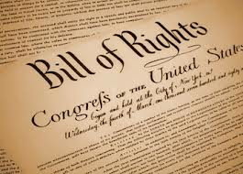
Oh! Fifth amendment, fifth amendment
plays an important role
In due process, it starts the march,
Toward Miranda rights’ goal
Hey!
Jurisprudence, Jurisprudence
The accused is ensured their rights
A jury of peers, guilt beyond doubt
Keeps fairness in our sights

Slide 5
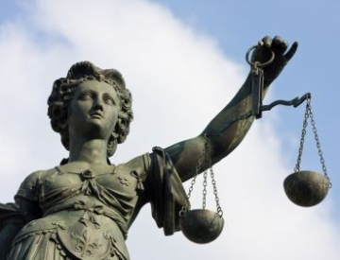
Legal Protections, Legal Protections
We depend on to keep law fair
They help us with the question of:
“Who gets the better share?”
Legal Protections, legal protections
Ensure we are not rash
In the decision-making that goes into
The punishment of the bad

Slide 6
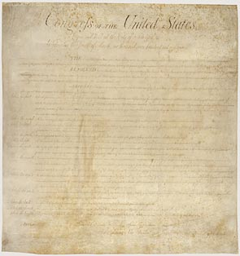
Amendments 4 through 8
Protect the person accused
Guard public privacy
Make sure we’re not abused
Amendment number 14
Had a very good intention
It hoped to do the right thing and get rid of segregation

Slide 7
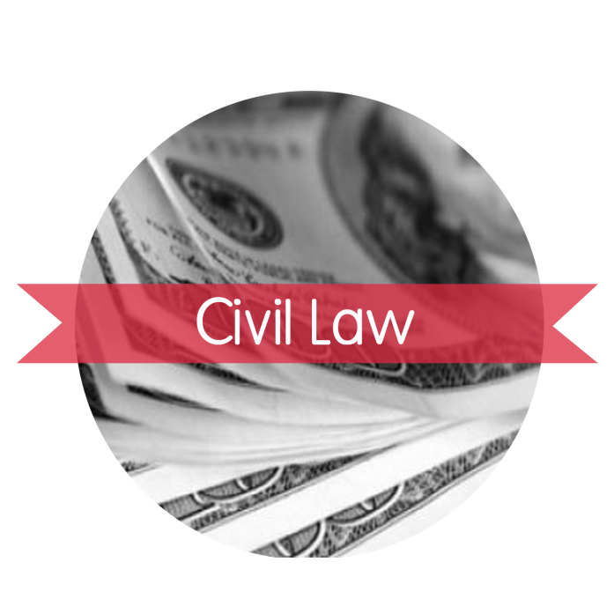
Oh! Criminal law, criminal law
It deals with punishment
Of people who break the laws
That ensure we all receive fair treatment
Civil law, civil law
Resolves civilian disputes
Split into two typs
There’s family and tort to finish through

Slide 8
Legal Protections, Legal Protections
We depend on to keep law fair
They help us with the question of:
“Who gets the better share?”
Legal Protections, legal protections
Ensure we are not rash
In the decision-making that goes into
The punishment of the bad

Slide 9
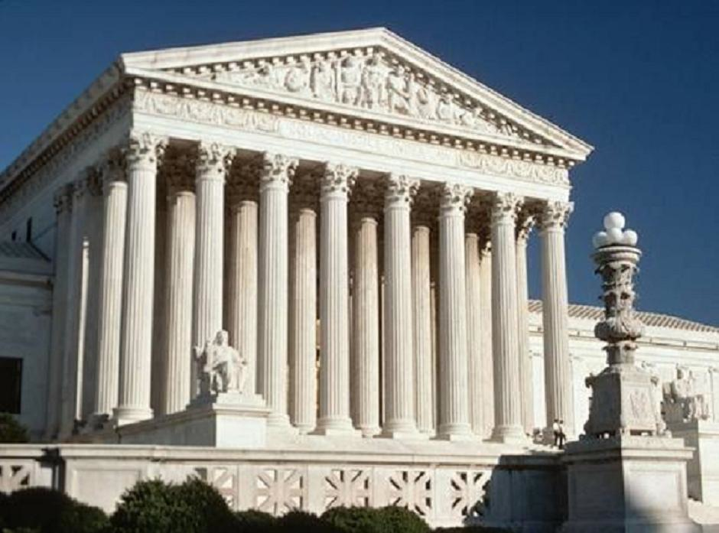
Brown V. Education
New Jersey V. TLO
Two interesting court cases
You should really get to know
Brown was for segregation
Of all of our schools
New Jersey was for privacy of students just like you and me

Slide 10
Oh!
Legal Protections, Legal Protections
We depend on to keep law fair
They help us with the question of:
“Who gets the better share?”
Legal Protections, legal protections
Ensure we are not rash
In the decision-making that goes into
The punishment of the bad

Slide 11
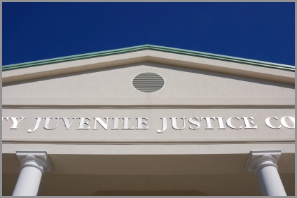
Juvenile law, Juvenile law
no jury is allowed
Proceedings are kept in secret
To keep gossips from being loud

