Slide 1
Mo-Town
Sporting
Goods

Slide 2
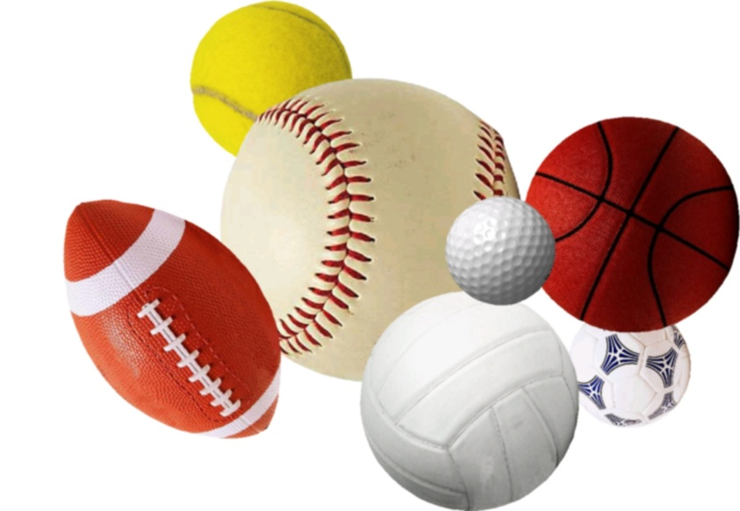
What are we selling?
We are selling services, durable, and non-durable goods, so we are able to provide everything.
Therefore, we are able to produce a lot of revenue.

Slide 3
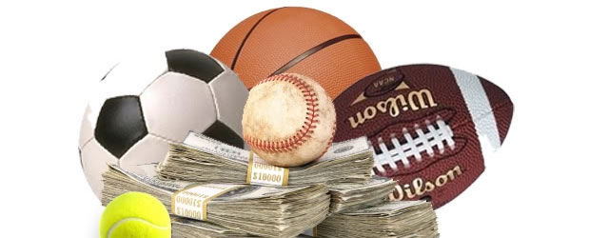
Facts
60% of Americans play a sport.
Our main market is younger people, because most of them play sports.
On average, every household spends $400 on sporting goods annually.

Slide 4
Return on Investment
Because so many people play sports and spend money on it, there is a good chance for a high return on investment.

Slide 5
Risk
Although the cost of operating the business is high, there is room for profit.
Also, our business provides a want, but people will still buy our products for their entertainment.
Americans look up to athletes, and buy sponsored sporting goods in large quantities.

