Slide 1
“NOT Discovery ED Training”
Developing Literacy Strategies
for your Discipline/Content Area

Slide 2

What is Literacy?
It is not necessarily teaching student
how to read, it is teaching a student
how to understand what is being read
It is teaching students techniques to understand the concepts behind the words
It is also teaching students how to think like an economist, historian, designer, scientist, etc.
  What does that mean for your discipline/content area? What causes your students to struggle?

Slide 3
What has worked…
What hasn’t worked…
Starting each unit with vocabulary
Changing focus from textbook reading to primary sources
Practicing with all levels of students
Engaging students in a variety of multi-media activities: pictures, music, video, articles
Direct instruction on skill-development, then practice
Teaching them to annotate and analyze documents
Including document-based questions in tests, making projects the written portion
Doing too many words at one time
Using documents that are too long or complicated
Not doing enough to differentiate for Academic students
Creating projects that were too dependent on the technology being available and working
Not pacing it carefully enough to ensure enough time for content review before tests
Using generic analysis tools or not giving them questions too
Making multiple choice questions too difficult on tests

Slide 4
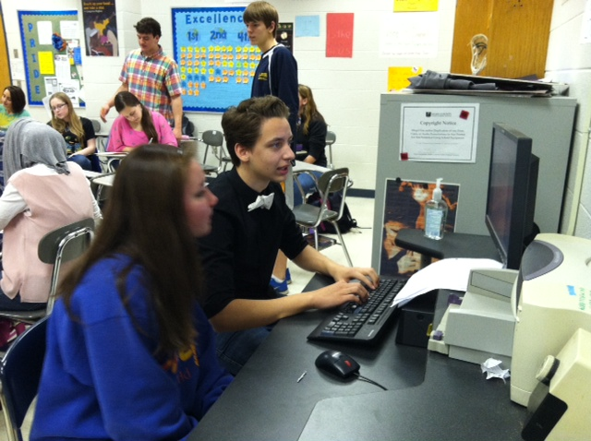
Examples
mosleysocialstudies.
weebly.com/
  Civics and Economics: Mosleytown Election and Marketplace
  Honors Sociology: Institutions Online Lessons
  American History II: Skillbuilders and Projects

Slide 5



Close Reading
Consider multiple types of text sources for your discipline/content area
  Articles
  Political cartoons
  Graphs/charts
  Speeches
  Laws, policies
  Videos
  Songs
  Photos
  Paintings

Slide 6
Text Dependent Questions
Should guide and scaffold students
through a close reading of the text
It is okay to start with simple
comprehension questions, but should
quickly move to higher order thinking
They should not ask students to simply “cut and paste” from the text
They should require the students to present evidence from the text in their answer (vs. opinion or prior knowledge)

Slide 7
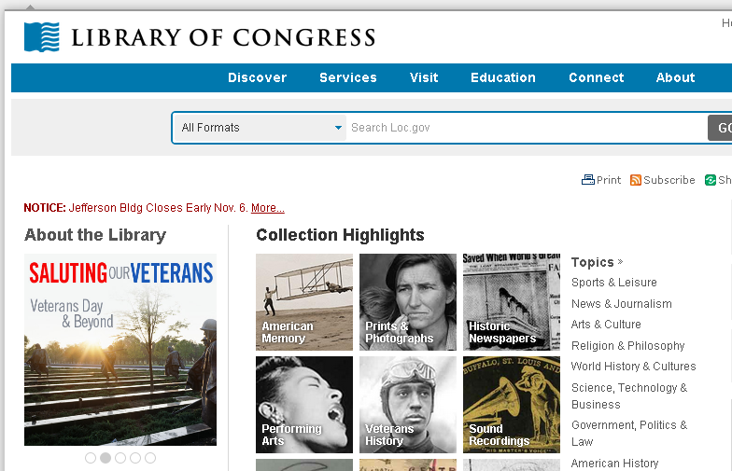


Examples
Discovery Ed username is WCPSS + 6-digit ID
(password may be 6-digit ID or discovery)
I put helpful documents from these in Shared folder
  A Closer Look at Close Reading
  Close Reading with Multimodal Text
  Writing Text Dependent Questions
Other sources
  Library of Congress
  National Archives
  AP College Board

Slide 8

Practice – Whole Group
Excerpt from Brown I opinion
Which of the questions listed at the end are Text Dependent?
What other scaffolding could you provide to help students with a close reading of the text?
Examples from DiscEd Training

Slide 9
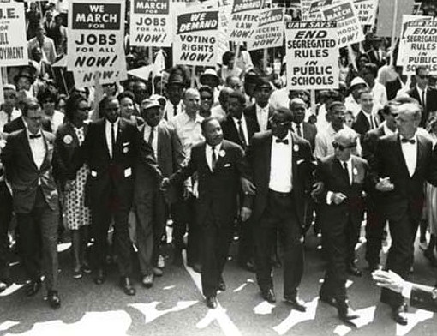
Practice – Small Group
March on Washington photos
MLK speech excerpt and video
Practice writing
questions using
Guide(s)
Share and
evaluate using
Checklist

