Slide 1
The American Economy
What are the major factors and theories that determine how people and businesses make economic decisions in the USA?

Slide 2
The Circular Flow of Economic Activity
Market: a location or other situation that allows buyers and sellers to exchange a product
Factor Markets: where productive resources (labor, natural resources, capital) are bought and sold
Product Markets: where businesses offer finished products for sale
Government Involvement: all three levels of government produce goods and services to be sold/distributed to consumers and also consume goods and services produced by businesses
The Circular Flow Model shows how money and goods “flow” through the economy. They travel in a big circle. Money goes one direction, while goods and services go the opposite direction.

Slide 3
CIRCULAR FLOW MODEL
RESOURCE/
FACTOR
MARKET
BUSINESSES
HOUSEHOLDS
PRODUCT
MARKET

Slide 4
CIRCULAR FLOW MODEL
RESOURCE/
FACTOR
MARKET
RESOURCES
INPUTS
BUSINESSES
HOUSEHOLDS
PRODUCT
MARKET

Slide 5
CIRCULAR FLOW MODEL
$ COSTS
$ INCOMES
RESOURCE/
FACTOR
MARKET
RESOURCES
INPUTS
BUSINESSES
HOUSEHOLDS
GOODS &
SERVICES
GOODS &
SERVICES
PRODUCT
MARKET

Slide 6
CIRCULAR FLOW MODEL
$ COSTS
$ INCOMES
RESOURCE/
FACTOR
MARKET
RESOURCES
INPUTS
BUSINESSES
HOUSEHOLDS
GOODS &
SERVICES
GOODS &
SERVICES
PRODUCT
MARKET

Slide 7
CIRCULAR FLOW MODEL
$ COSTS
$ INCOMES
RESOURCE/
FACTOR
MARKET
RESOURCES
INPUTS
BUSINESSES
HOUSEHOLDS
GOODS &
SERVICES
GOODS &
SERVICES
PRODUCT
MARKET
$ REVENUE
$ CONSUMPTION

Slide 8
PUBLIC SECTOR: GOVERNMENT’S ROLE
$ COSTS
$ INCOMES
RESOURCE/
FACTOR
MARKET
RESOURCES
INPUTS
BUSINESSES
GOVERNMENT
HOUSEHOLDS
GOODS &
SERVICES
GOODS &
SERVICES
PRODUCT
MARKET
$ REVENUE
$ CONSUMPTION

Slide 9
PUBLIC SECTOR: GOVERNMENT’S ROLE
$ COSTS
$ INCOMES
RESOURCE/
FACTOR
MARKET
RESOURCES
INPUTS
BUSINESSES
GOVERNMENT
HOUSEHOLDS
GOODS &
SERVICES
GOODS &
SERVICES
PRODUCT
MARKET
$ REVENUE
$ CONSUMPTION

Slide 10
PUBLIC SECTOR: GOVERNMENT’S ROLE
$ COSTS
$ INCOMES
RESOURCE/
FACTOR
MARKET
RESOURCES
INPUTS
BUSINESSES
GOVERNMENT
HOUSEHOLDS
GOODS &
SERVICES
GOODS &
SERVICES
PRODUCT
MARKET
$ REVENUE
$ CONSUMPTION

Slide 11
PUBLIC SECTOR: GOVERNMENT’S ROLE
$ COSTS
$ INCOMES
RESOURCE/
FACTOR
MARKET
RESOURCES
INPUTS
BUSINESSES
GOVERNMENT
HOUSEHOLDS
GOODS &
SERVICES
GOODS &
SERVICES
PRODUCT
MARKET
$ REVENUE
$ CONSUMPTION

Slide 12
Productivity and Economic Growth
Productivity: the amount of output produced by a given number of inputs in a period of time. Increases if more units are produced with the same amount of input, or if the same number of units are produced with less input. Being more productive is the same as being more efficient.
Ways to Improve Productivity:
1. Specialization: people and businesses focus on one thing they do well
2. Division of Labor: specialize within a certain job. Think assembly lines!
3. Invest in Human Capital: invest in training and motivation to increase productivity of workers
Economic Interdependence: we rely on others and others rely on us to fulfill wants and needs. Events in other countries, regions, or businesses can have a major effect on everyone.

Slide 13
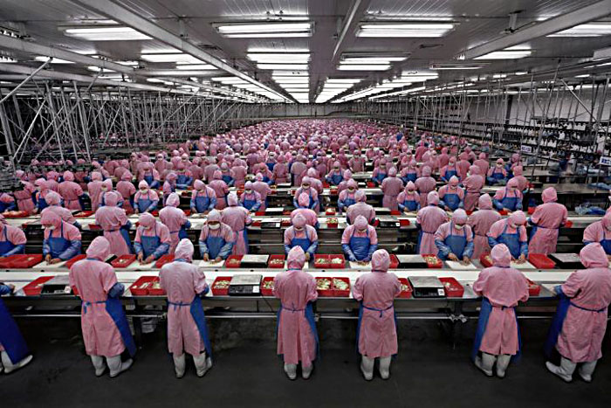
The Three Fundamental Questions of Economics
Societies as a whole and individual producers must answer three important questions:
1. What to produce? (Remember the Production Possibilities Model)
2. How to produce? → must balance environmental damage with the cost of safely dealing with waste, deciding how to treat workers, etc.
3. For Whom to Produce? → who will get your goods or services after they have been produced? In the US, we use the price system: assign prices to goods based on their production cost and perceived value.

Slide 14
Economic Systems
There are several different ways in which nations can choose how to answer the fundamental questions.
Traditional: Decisions are made based on customs and community leaders (chiefs, elders) or a person’s family background may determine their profession.
Capitalism: an economic system in which private individuals own and decide how to use the Factors of Production. (aka Market Economy) Individuals have complete freedom to decide how the fundamental questions are answered.

Slide 15
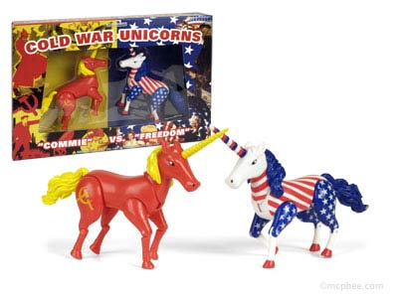
Economics Systems
Socialism: an economic system in which the government owns and decides how to use the Factors of Production. aka Command Economy
Communism: an economic system where no one really owns the Factors of Production. The community owns them, and decisions are made through people working together to decide what is best for the most people. “The Common Good”
Mixed: Any economic system in which both individuals and the government play a role in decision-making.

Slide 16
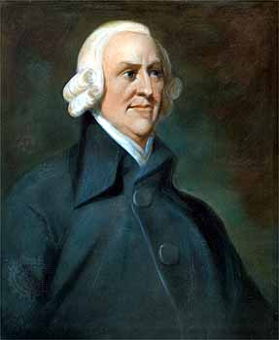
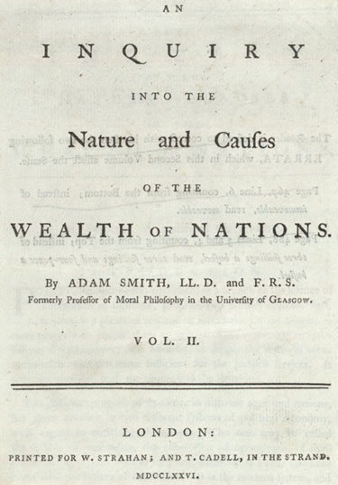
Adam Smith and Capitalism
The major ideas of modern capitalism were explained by an English economist named Adam Smith in 1776 in his book “On the Wealth of Nations”.
Smith explained that the most successful economies are the ones where the government gets out of the way = “Laisezz faire”
He also said that individuals should only focus on their own interests. If this occurs, the market will be guided by the “invisible hand” to the benefit of all.
Interaction of Supply and Demand

Slide 17
Aspects of Capitalism
Consumer Sovereignty: The consumer is king; they are the ones who determine what will be produced because they determine what they want to buy.
Economic Freedom: Individuals and businesses have the freedom to decide what to produce or buy, and what job to have. This freedom means that we must deal with whatever consequences come from our decisions.
Private Property Rights: People and businesses have almost complete control of how to use their own property. This gives us an incentive to work because we have control of what we gain by working.
Competition: Struggle between buyers and sellers to get best products at lowest prices. Competition is good for consumers because it results in higher quality products and lower prices.
Profit Motive: individuals have the right to risk their property and money in order to make a profit. If they do well, they get to keep what they make. If they do poorly, they will lose their money.
Voluntary Exchange: both buyers and sellers agree to any transaction that is made; no one is forced to buy or sell anything by the government. Both parties engage in the transaction because they will be better off after making it.

