Slide 1
Welcome to Open House!
Ms. Mosley / American History II

Slide 2
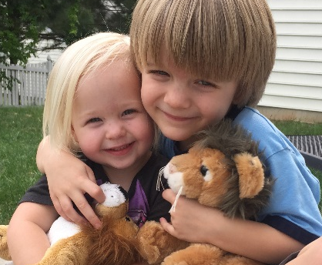
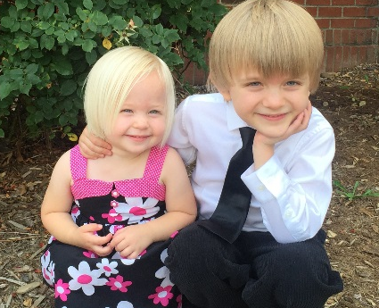
Course and Instructor
American II
Required for graduation
Exam is 20% of final grade (may be NCFE or teacher made, stay tuned…)
Honors involves more independent reading and more rigorous writing assignments
Nancy Snipes Mosley
B.A. in Sociology and Journalism
& Mass Comm from UNC-Chapel Hill
Worked at NC Governor’s School
M.A.Ed. from Wake Forest University
Joined LRHS in 2004
National Board Certified
Model UN Advisor

Slide 3


A “Typical” Class Period
Mix of:
Direct instruction, notes, video, etc.
with whole class discussion
Independent reading and writing
Partner or group activity

Slide 4
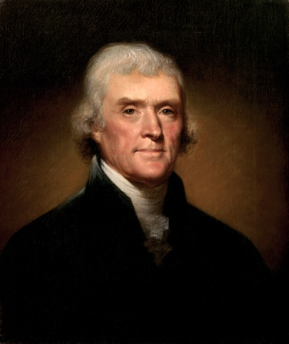
Course Benefits
Deepen understanding of historical legacies and trends in America
Connect the past, present, and future in American and global affairs
Improve reading, writing, research, and presentation skills
Develop decision-making and problem-solving abilities
Prepare to participate in the American political process
"Whenever the people are well-informed, they can be trusted with their own government."
- Thomas Jefferson

Slide 5

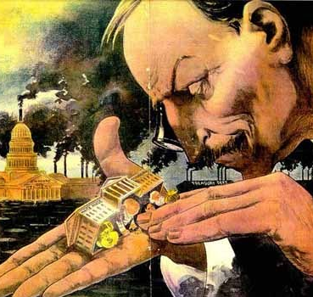
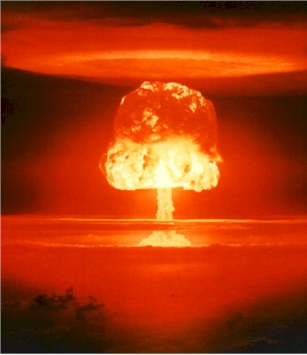

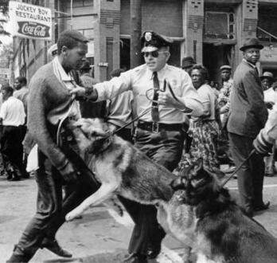
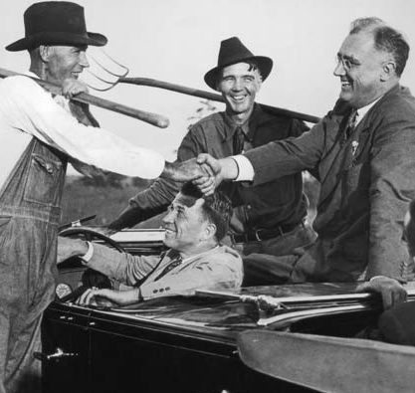
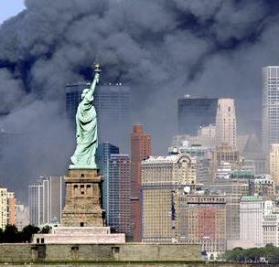
Curriculum
Great West
& Gilded Age
(1870-1920)
Imperialism
& Isolationism (1890-1930)
Speakeasies
& Hoovervilles (1920-1940)
From D-day
to Doomsday
(1940-1960)
Crisis of
Authority
(1960-1980)
New Hopes,
New Fears
(1980-Present)

Slide 6

How You Can Help
Have high but reasonable expectations
Encourage asking for help
Help teach study skills
Stay informed and keep me informed

Slide 7

Course Materials
Binder or folder
Loose-leaf notebook paper
No. 2 pencils
Strongly recommended:
Use of an agenda or planner
Highlighers
4x6 index cards
Donations appreciated!

Slide 8

Stay In Touch…
Website: mosleysocialstudies.weebly.com
Email: nmosley@wcpss.net
Power School: See LRHS website for info
Student will use Remind and Google Classroom for assignments – email me if you would like Parent access

