Slide 1
Welcome to Open House!
Ms. Mosley / Civics and Economics

Slide 2
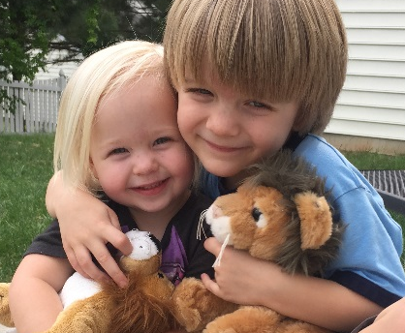
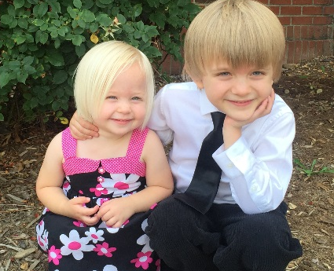
Course and Instructor
Civics & Econ
Required for graduation
Exam is teacher-made worth 20% of final grade (may be NCFE or teacher-made, stay tuned…)
Honors involves more independent reading and more rigorous writing assignments
Nancy Snipes Mosley
B.A. in Sociology and Journalism
& Mass Comm from UNC-Chapel Hill
Worked at NC Governor’s School
M.A.Ed. from Wake Forest University
Joined LRHS in 2004
National Board Certified
Model UN Advisor

Slide 3


A “Typical” Class Period
Mix of:
Direct instruction, notes, video, etc.
with whole class discussion
Independent reading and writing
Partner or group activity

Slide 4
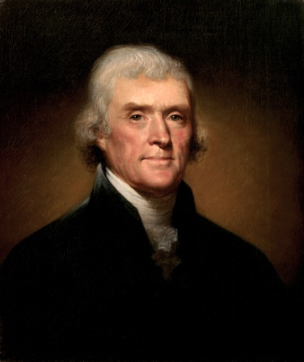
Course Benefits
Deepen understanding of political and economic concepts
Improve reading comprehension and Social Studies vocabulary
Refine research and presentation skills
Develop decision-making and
problem-solving abilities
Prepare to participate in the
American political process
"Whenever the people are well-informed, they can be trusted with their own government."
- Thomas Jefferson

Slide 5


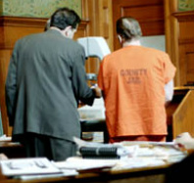
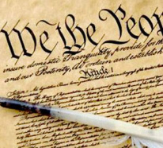





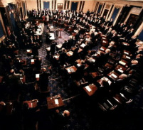

Curriculum
American Government
Legal Process
U.S. Constitution
Personal Finance
Levels and Branches of Government
Economic Fundamentals
Government in the Economy
Active Citizenship
Making Laws
International

Slide 6

How You Can Help
Have high but reasonable expectations
Encourage asking for help
Help teach study skills
Stay informed and keep me informed

Slide 7

Course Materials
Binder or folder
Loose-leaf notebook paper
No. 2 pencils
Strongly recommended:
Use of an agenda or planner
Highlighers
4x6 index cards
Donations appreciated!

Slide 8

Stay In Touch…
Website: mosleysocialstudies.weebly.com
Email: nmosley@wcpss.net
Power School: See LRHS website for info
Student will use Remind and Google Classroom for assignments – email me if you would like Parent access

