Slide 1
Welcome to Open House!
Ms. Mosley / Honors Sociology

Slide 2
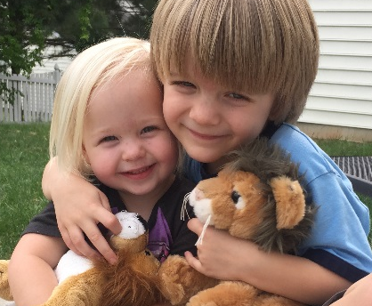
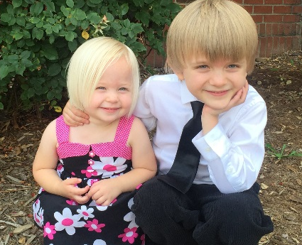
Course and Instructor
Hon. Sociology
Social Studies Elective
Exam is teacher-made, worth 20%
of final grade
Seniors who qualify may be exempt based on Grade and Attendance
Nancy Snipes Mosley
B.A. in Sociology and Journalism
& Mass Comm from UNC-Chapel Hill
Worked at NC Governor’s School
M.A.Ed. from Wake Forest University
Joined LRHS in 2004
National Board Certified
Model UN Advisor

Slide 3


A “Typical” Class Period
Mix of:
Direct instruction, notes, video, etc.
with whole class discussion
Independent reading and writing
Partner or group activity

Slide 4
Course Benefits
"Studying sociology should be a liberating experience: sociology enlarges our sympathies and imagination, opens
up new perspectives
on the sources of
our own behaviour,
and deepens a sense
of cultural settings different from our own."
- Anthony Giddens
Learn to see connections between personal and societal issues
Apply scientific methods to the study of societies and social behavior
Understand how culture is learned and transmitted
Expand perspective and explore different ways of interpreting social trends
Develop critical thinking and decision-making skills

Slide 5

Curriculum
Perspectives
Methods
Culture
Socialization
Social structure
Interaction
Stratification
Change
Institutions
Deviance

Slide 6

How You Can Help
Have high but reasonable expectations
Encourage asking for help
Help teach study skills
Stay informed and keep me informed

Slide 7

Course Materials
Binder or folder
Loose-leaf notebook paper
No. 2 pencils
Strongly recommended:
Use of an agenda or planner
Highlighers
4x6 index cards
Donations appreciated!

Slide 8

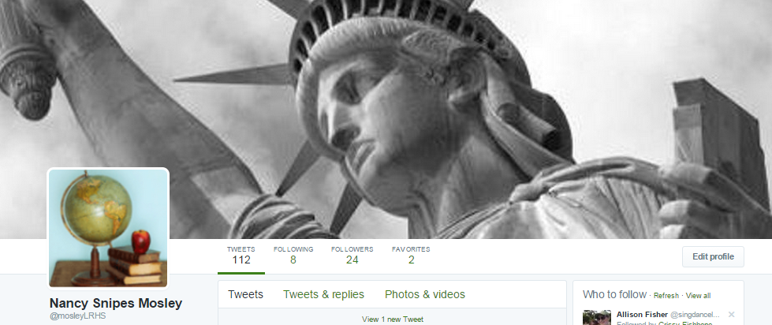
Stay In Touch…
Website: mosleysocialstudies.weebly.com
Email: nmosley@wcpss.net
Power School: See LRHS website for info
Twitter: Follow we @mosleyLRHS or bookmark https://twitter.com/mosleylrhs

