Slide 2
the Loop
Our service is a teen club/hangout space. This space will provide teens with an area where they can get together at a low cost. The club will provide food, entertainment, and a good time for the teens. There will also be rooms for private reservations for things like birthdays or youth group celebrations! The hours of the club would be from 2pm-8pm on weekdays so that students can focus on schoolwork while still having time to hangout, and from 12pm-11pm on weekends.
Goods & Services:

Slide 3
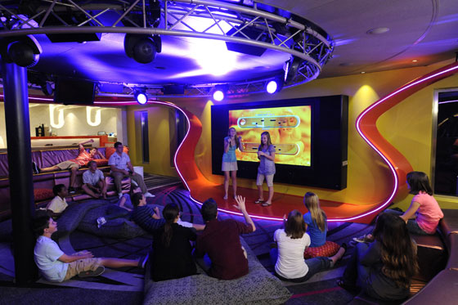

Slide 4
the Loop
A Profitable Idea
This idea/service is a want
It will be most appealing to teens because they want to be able to hang out in a fun and safe environment and still at a low cost. This club will provide a place for teens to be themselves in a bully-free zone. The club would provide food which, most foods, will be included in the entry fee.
Consumers can pay an entry fee at the door or get a membership. The entry fee will be $5 and a membership fee will be $15 per month which should create a good amount of revenue for the club.
At first it will take a lot of money and time to get the business up and running, but as more people come, it will begin to become popular and that is when we will get most of our profit from.

Slide 5
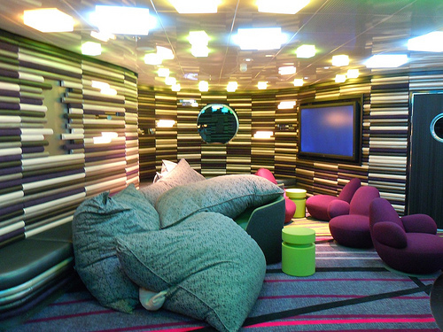

Slide 6
the Loop
Resources: What We Have Now
Natural Resources: Water, Land
Labor: Trained Staff
Capital: Kitchen Appliances and supplies
Entrepreneurship: Business Owners

Slide 7
the Loop
Additional Resources
Furniture: Couches, Tables, Chairs, Lights
Food: Vegetables, Pizzas, Vending Machine Food, Drinks, Frozen Food
Miscellaneous: TVs, Wiis, PlayStations, I-pads, Laptops, DJ Station (with speakers, lights and DJ board), Props for different themed nights, Paint, Art Work, Music
Labor: Cooks, Security, Custodians

Slide 8
the Loop
Menu
Appetizers: Fries, Nachos, Pizza (Cheese, Pepperoni, Veggie), Onion Rings, Salads, Chicken Wings, Wraps/ Sandwiches (Veggie Wraps, Chicken Wraps, Chicken Sandwich, etc.)
Main Meals: Burgers (Cheeseburgers, Veggie Burgers)
Desserts: Assorted Candy, Ice Cream, Fruits
Drinks: Soda (Soda Machine), Water (Gatorate, Vitamin Water, Bottled Water)

Slide 9
the Loop
Special events
Movie Night
Themed Parties
Karaoke Night
Study Buddy Night (weekdays)
Game Night
Charity Events (ex. Bring in 4 canned foods for food drive and get in for free; raise a certain amount of money and name would be put in for a drawing)
Girls Night (girls only: nails, chick flicks, ect.)
Guys Night (boys only: video games, sports, ect.)
TV Sports Game Nights (whenever a big sports event is on TV, watch it here on the big movie screen)

Slide 10
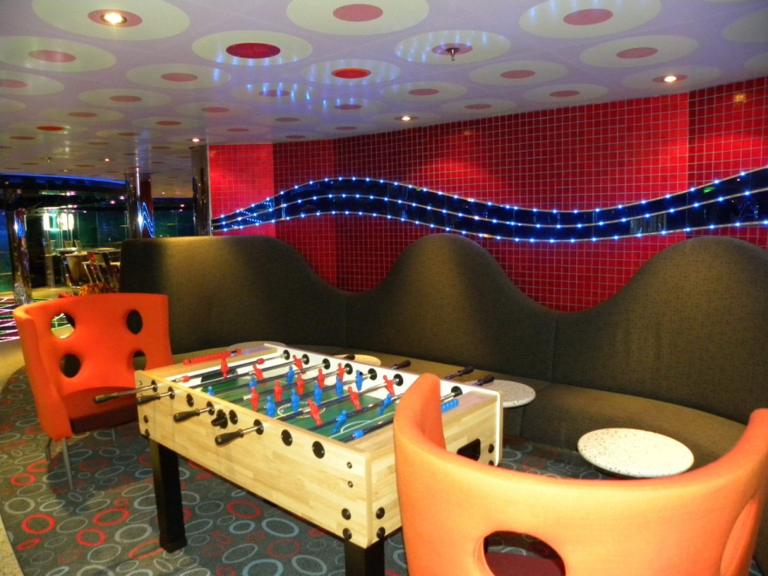

Slide 11
the Loop
Why Invest in us?
the Loop will be a safe environment where teens can be themselves and have a good time. the Loop would provide food to the teens and always have entertainment. The hours of the club will be reasonable because we do not want to take away from the teens school work and other activities.
What are the risks?: Teens will not come
Return on Investment: The club will become a popular hang out space so memberships will increase and that will produce our profit.

Slide 12
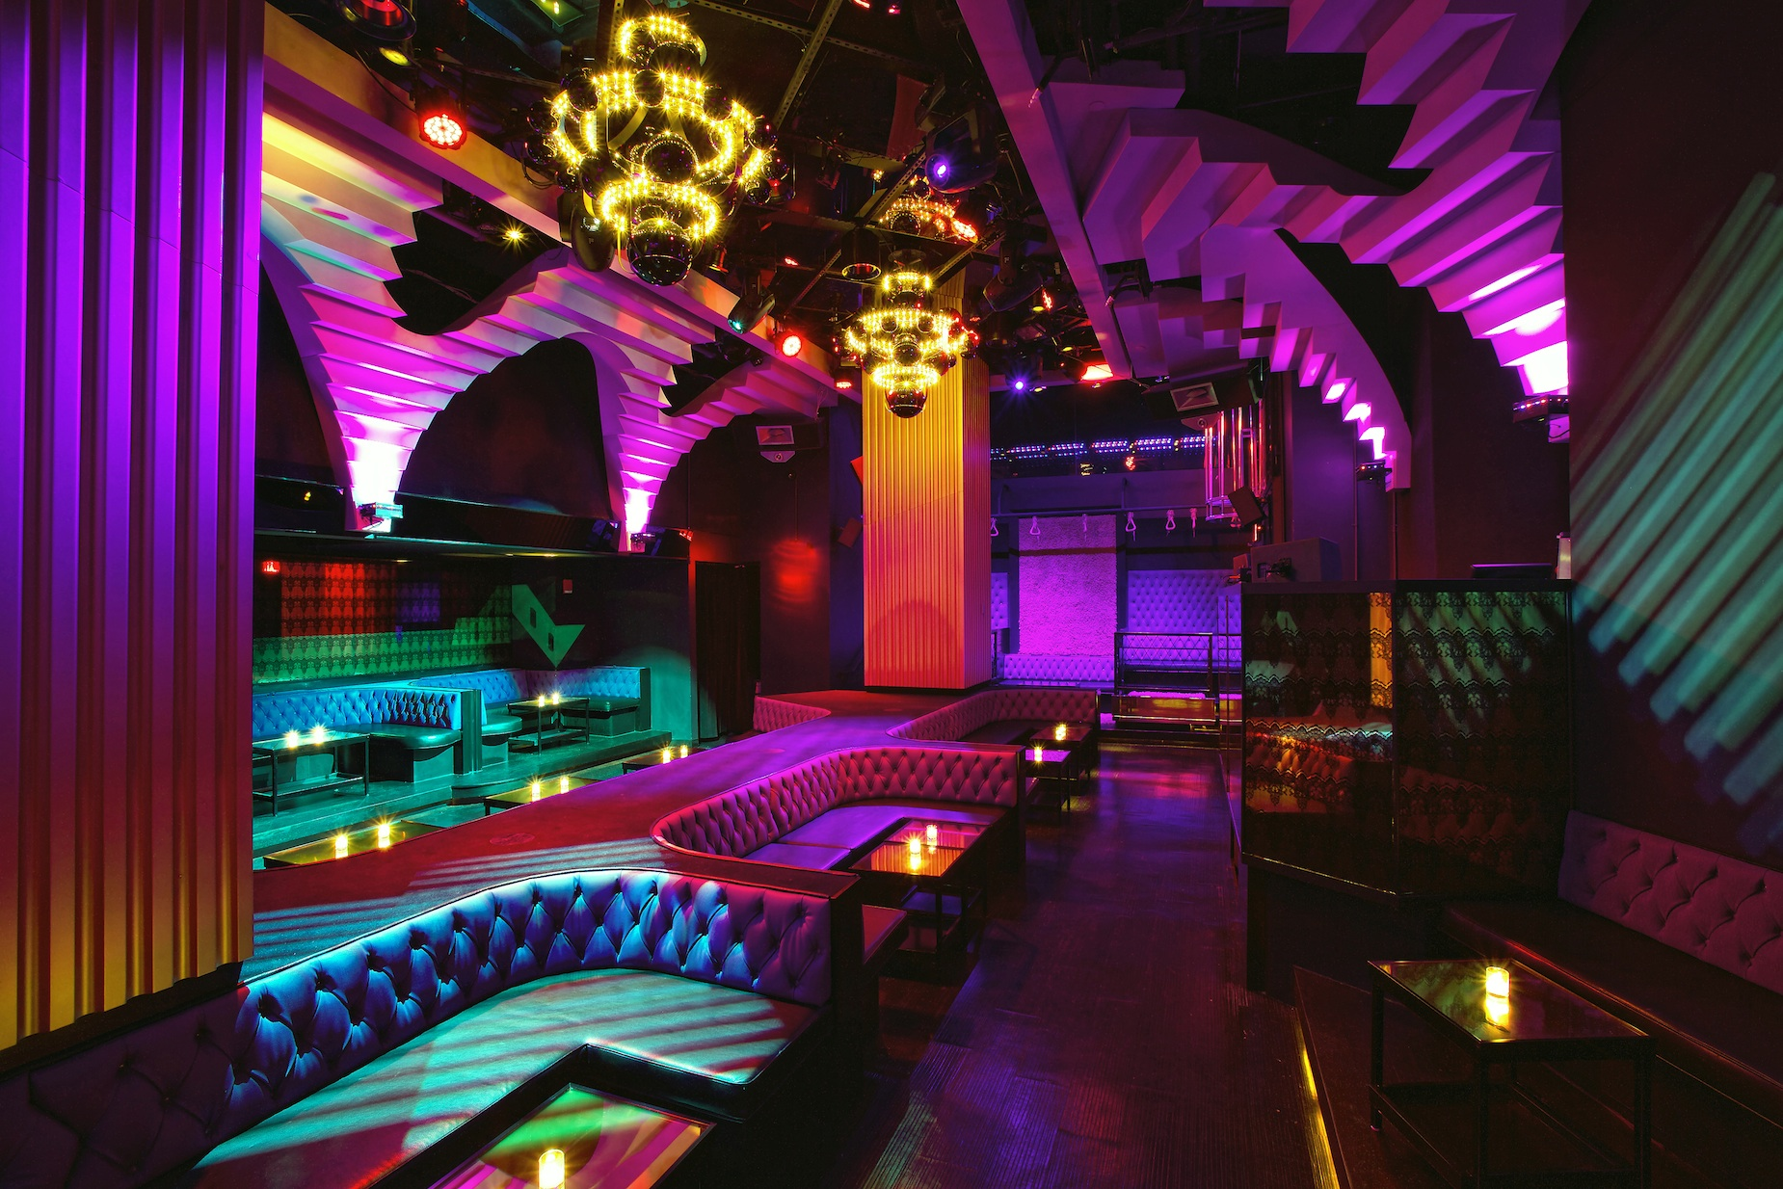
The Future the Loop

