Slide 1
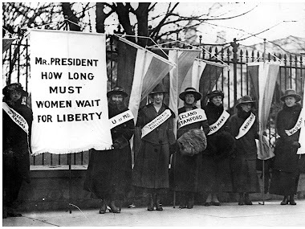
The Progressive Era
Unit 1: The Gilded Age (1870-1920)

Slide 2
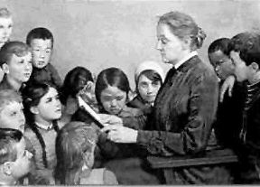
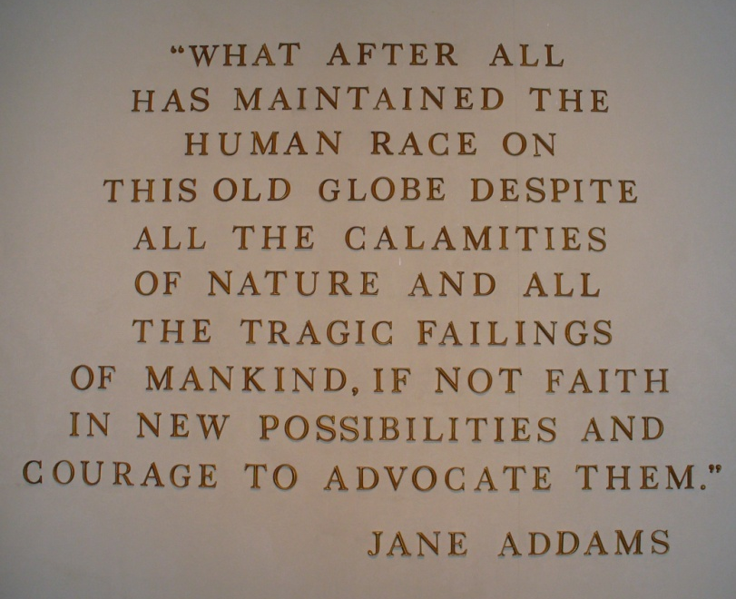
Grassroots Movement
Protecting social welfare to combat the harsh realities of industrial and urban life
Promoting morality as a key to improving the lives of the poor
Reforming the workplace to protect workers and regulating businesses to protect consumers
Cleaning up corrupt state and local governments, giving citizens more voice in government

Slide 3
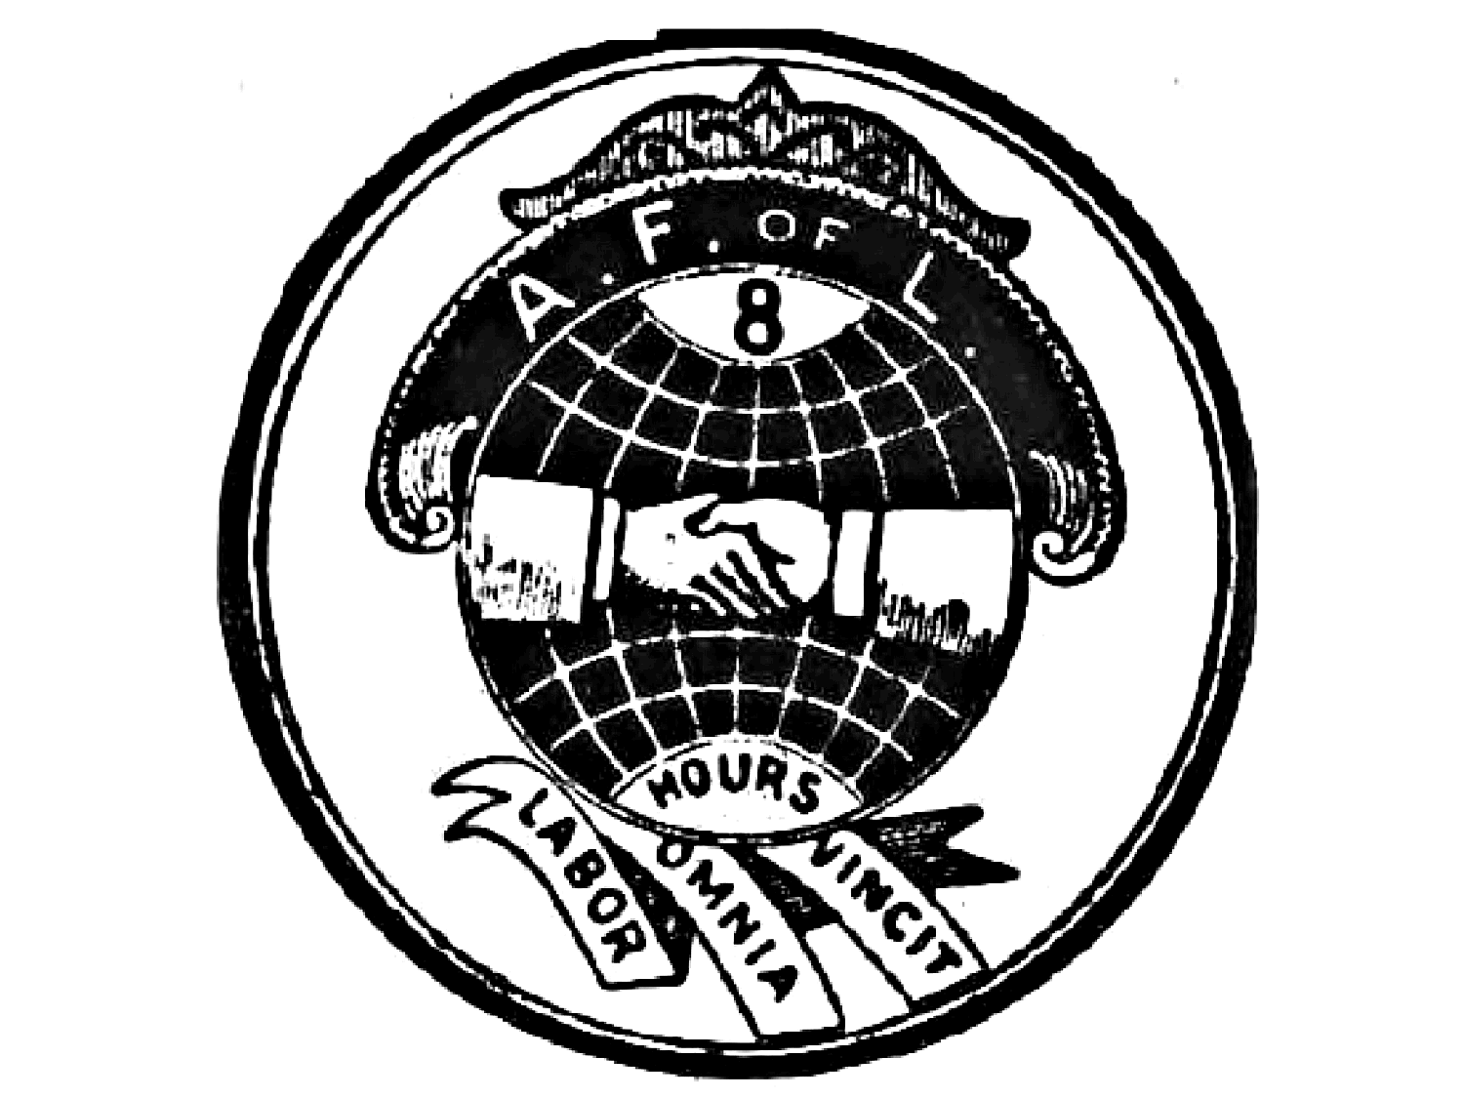
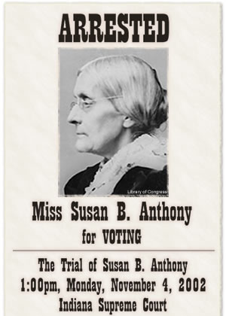
Leaders and Groups
Social Gospel and settlement house leaders like Jane Addams
Prohibition groups like the Women’s Christian Temperance Union
Labor Unions like the American Federation of Labor and the Industrial Workers of the World
Muckrakers like Upton Sinclair (The Jungle) and Jacob Riis (How the Other Half Lives)
Reform mayors and governors like Robert M. La Follette
Suffragettes like Susan B. Anthony

Slide 4
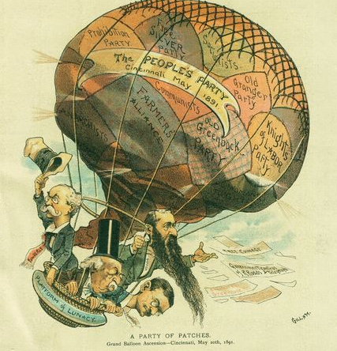
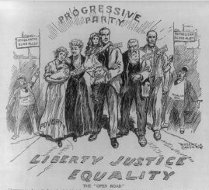
Progressivism v. Populism
Though the Populist movement died out with the loss of William J. Bryan to McKinley, many reform ideas were adopted by the Democratic Party
The progressive movement was supported by both lower and middle classes, had better organization and leadership
Reforms are resisted by conservative Republicans, but otherwise adopted by Moderate Republicans and Democrats

Slide 5
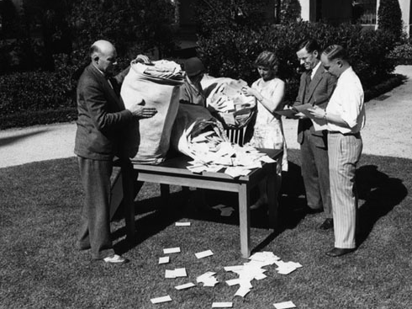
Reforms Achieved
Citizens gained the ability to propose and approve state or local laws. Through petition, an initiative can be placed on a ballot. The vote to approve the initiative is called a referendum.
Recall elections gave citizens the ability to petition to force an official to run for re-election before the end of their term
The 17th Amendment gave citizens direct election of senators. Before this, the selection of U.S. senators belonged to each state legislature.

Slide 6
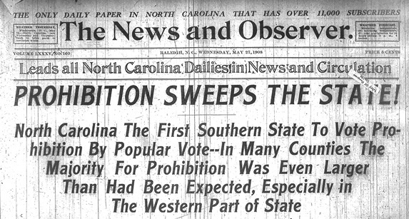
Most states passed legislation to ban child labor and limit working hours for women to 10 hr/day
Lead by the Woman’s Christian Temperance Union, supporters of prohibition succeeded in getting the 18th Amendment passed to ban alcohol
Support for women’s suffrage was bolstered by participation on the home front in WWI, 19th Amendment passed when the war was over

Slide 7
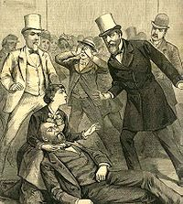
“Progressive” Presidents
Some Gilded Age Presidents began to support a limited number of reforms
Rutherford B. Hayes, James A. Garfield, and Chester A. Arthur supported civil service to replace the patronage system
Grover Cleveland tried to lower tariffs, but his efforts were blocked by Congress

Slide 8
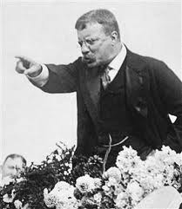
Teddy Roosevelt
Teddy Roosevelt used the presidency as a “bully pulpit” to influence the media and legislators to give the people a Square Deal.
TR used the Sherman Antitrust Act to break up monopolies, mediated the 1902 coal strike, helped increase regulation of railroads, got the Meat Inspection and Pure Food and Drug Acts passed, and advocated for conservation of land and natural resources.

Slide 9
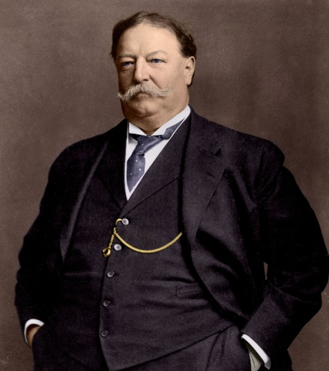
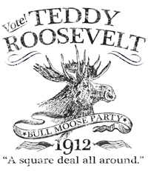
TR and Taft
His successor, William H. Taft, was even more aggressive with trustbusting than TR. He busted 90 trusts in four years.
When Taft failed with tariff and conservation reform, TR decided to run for a third term in the next election.
The Republican Party chose to keep Taft as the nominee, so TR broke off and formed the “Bull Moose” Progressive Party.

Slide 10
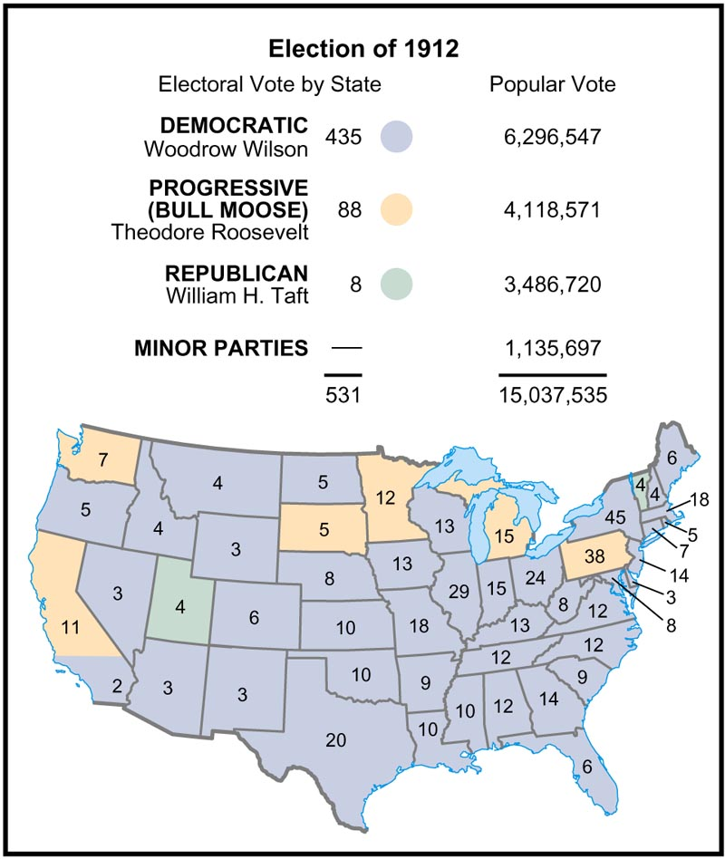
Election of 1912
The candidates all represented some degree of progressivism.
The most progressive was labor leader Eugene V. Debs (Socialist), with TR (Bull Moose) and Woodrow Wilson (Democratic) agreeing on goals but differing on strategies.
With the Republican Party vote split between Taft and TR, Wilson won easily.

Slide 11
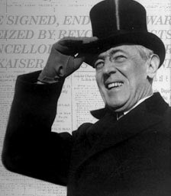
Woodrow Wilson
Wilson’s New Freedom attacked the “triple wall of privilege”: trusts, tariffs, and high finance.
The Clayton Antitrust Act closed loopholes in the Sherman Act, the FTC was created to act as a watchdog on corporations, tariffs were lowered for the first time since the Civil War, the 16th Amendment instituted the progressive income tax, and the Federal Reserve System was created to regulate banks and currency.

Slide 12
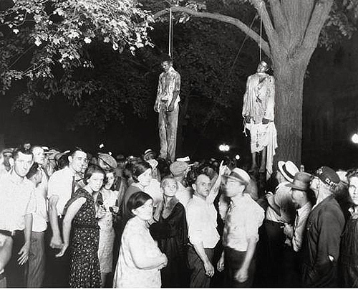
Limits on Progressivism
Virtually no progress was made on Civil Rights during this time
Labor Unions continued to struggle with legitimacy and fear of socialism
World War I shifts focus away from domestic issues, protests are viewed as unpatriotic
During the 1920s, the prohibition experiment failed miserably

