Slide 1

Social Contract
By: Toney-Paite Phillips, Ashley Moore

Slide 2
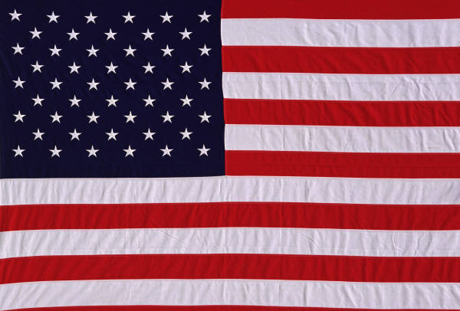

Social Contract,
An agreement between,
The people of,
A society,
People give up freedom,
To the government,
To gain protection,
And natural rights,

Slide 3
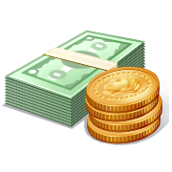
We must obey the law,
Defend the nation,
Sit on a courts jury,
Pay taxes with money,
We can stay informed,
Vote and volunteer,
Responsibilities,
We should respect our peers

Slide 4
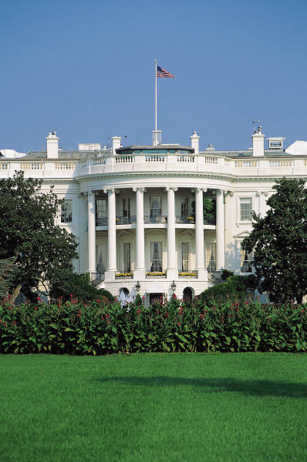

The government,
Guides the community,
Keeping order,
Provide security,
These natural rights,
By John Locke,
Enlightenment ideas,
The US now is free,

Slide 5
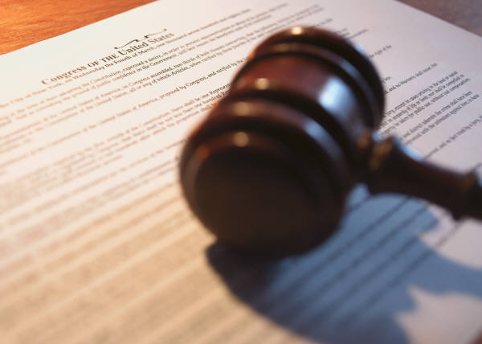
The first continental,
Congress,
Stemmed from,
The Coercive acts,
The second was made,
By Thomas Paine,
Who wrote “Common Sense”
For anti-federalists,

Slide 6

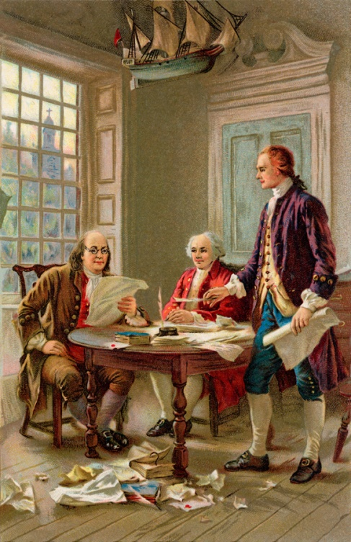
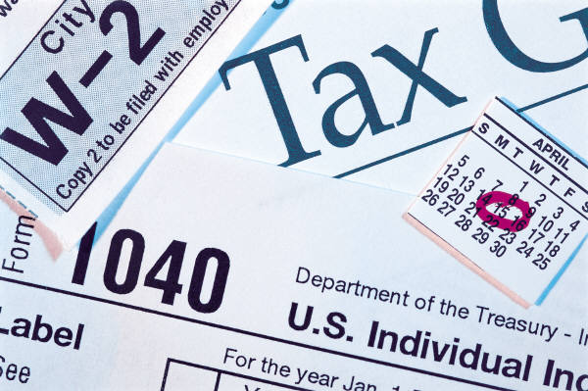
No taxation with out,
Representation,
States wanted freedom,
From Great Britain,
Declared independence,
In 1776,
Written by Jefferson,
Signed by all the men,

Slide 7
The government,
Guides the community,
Keeping order,
Provide security,
These natural rights,
By John Locke,
Enlightenment ideas,
The US now is free,

Slide 8

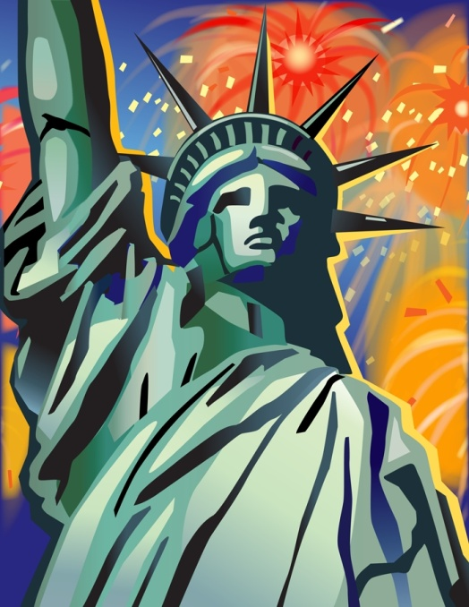
The Social Contract,
Leads to natural rights,
Our life and liberty,
And our property,
No matter what,
These rights are here to stay,
Unless you break the law,
Then they will go away,

Slide 9
The government,
Guides the community,
Keeping order,
Provide security,
These natural rights,
By John Locke,
Enlightenment ideas,
The US now is free,

