Slide 1
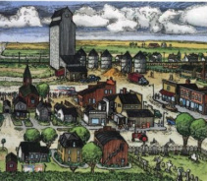
Social Institutions
Objective 1 Identify common features of all social institutions and explain how they function to meet needs of society. Objective 2 Trace changes in social institutions like family, government, and religion over time.

Slide 2
Overview
A social institution is a system of statuses, roles, values, and norms that is organized to satisfy one or more of the basic needs of society. The most basic needs of society include providing physical and emotional support of its members, transmitting knowledge, producing goods and services, and maintaining social control.

Slide 3
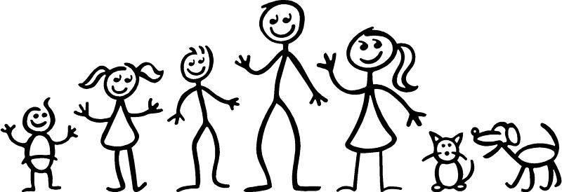
Family
Functions
Regulation of sexual activity, Reproduction, emotional support, Economic stability, socialization
Types
Nuclear, extended, monogamous, polygamous, patriarchical, egalitarian
Other Unit Connections
Values, norms, status, role, social exchange, cooperation, primary informal group, socialization, self-concept, gender roles and identity, second shift
Trends
gender inequality vs. egalitarianism
heterogamy vs. homogamy

Slide 4
Religion
Functions
Cohesion, social control, emotional support
Types
Animism, polytheism, monotheism, ethicalism, cults
Other Unit Connections
Beliefs, Values, sanctions, culture lag, conformity, primary formal group
Trends
secularism vs. fundamentalism
relationship with science

Slide 5
Education
Functions
Internalization, skills and knowledge, common identity, social integration, occupational placement
Types
Public, private, primary, secondary, homeschool, charter schools, magnet schools, community college, universities
Other Unit Connections
Norms, sanctions, culture lag, secondary formal group, socialization, peer groups, adolescence
Trends
minority achievement gap
STEM
school alternatives

Slide 6
Government
Functions
Order, protection, resolving conflict, national pride and unity
Types
Authoritarian, constitutional Democracy, monarchy, dictatorship, democratic socialism, two-party, multi-party
Other Unit Connections
Ideology, social movement, accommodation, conflict, coercion, secondary formal group, discrimination, social movements
Trends
role of new media
social movements
political parties

Slide 7
ECONOMY
Functions
Distribution of scarce resources, production of goods and services
Types
Preindustrial, industrial, postindustrial, capitalist, socialist, communist, mixed, developed, developing
Other Unit Connections
Technology, competition, accommodation, secondary formal group, stratification, wealth, SES, mobility, life chances, glass ceiling, welfare
Trends
Industrial to post-industrial
class conflict
convergence of capitalism/socialism
globalization

