Slide 1
Stratification and Inequality
Part 1

Slide 2
societies evolve…

Slide 3
Stratificaton
The hierarchical division of society based on caste, rank, or class
How has social stratification changed over time? Why?

Slide 4
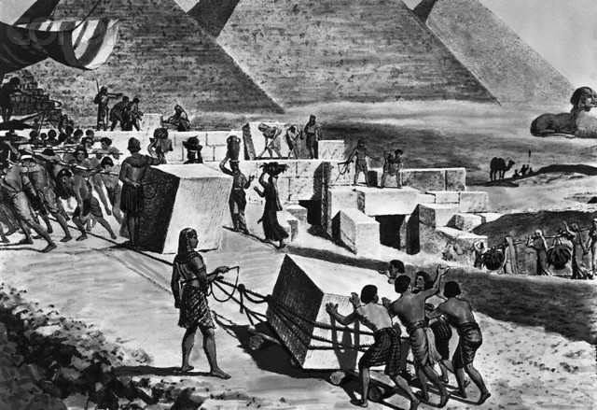
Pre-Industrial Societies

Slide 5
The primary sector is dominant, focus is on meeting communal needs.
Stratification emerges as social structure gets more complex
Hunter and gatherer: nomadic, cooperative
Horticultural and pastoral: some food surplus lead to some trade, division of labor, status
Agricultural: new social institutions emerge, distinct social classes appear

Slide 6
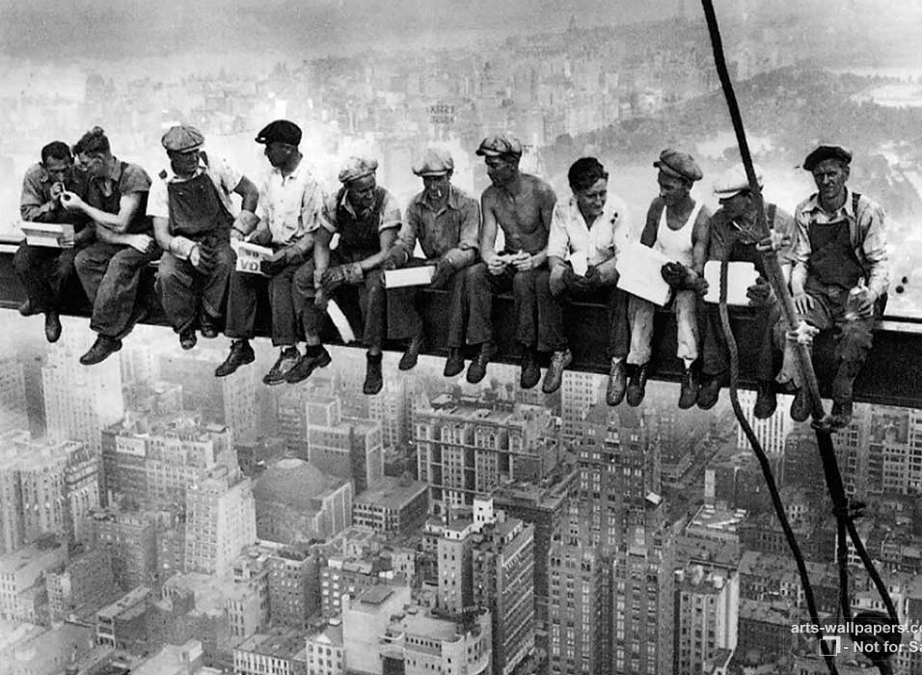
Modern Societies

Slide 7
Moves beyond primary sector, focus is on specialization and interdependence
Stratification is more fluid, social mobility increases
Industrial: More blue-collar work, results in urbanization, requires more education, weaker ties to land and extended family
Post-industrial: More white-collar work, services and technology, physical strength less important

Slide 8
How has stratification changed in the United States since the economy has transitioned from Industrial to Post-Industrial?

Slide 9
status is defined…

Slide 10
What is the difference between wealth, power, and prestige?
How much can they change over time?

Slide 11
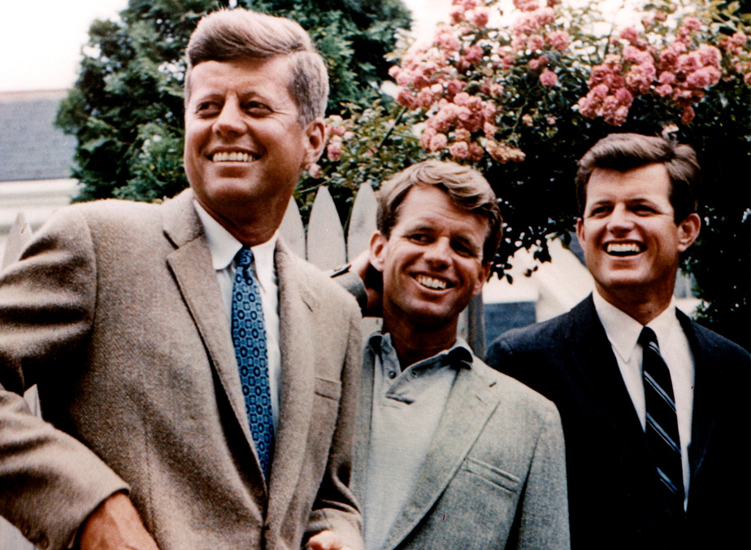
Dimensions

Slide 12
Definitions
Wealth: sum total of a person’s economic resources, including but not limited to income
Power: ability to control the behavior of others, even against their will
Prestige: recognition, respect, and admiration attached to social positions

Slide 13
Distinctions
Wealth: Is it easier to increase income than wealth due to generational/long-term affects of having or lacking capital to invest
Examples?
Power: may or may not be based on legitimate authority (heredity, military, election, merit) and involves some kind of coercion (force, sanction)
Examples?
Prestige: given voluntarily, defined by society and culture, often but not necessarily based on occupation
Examples?

Slide 14
Socioeconomic Status (SES)
A rank that combines wealth, power, and prestige
Factors: educational level, occupational prestige, place of residence, and income
People in each status tend to share outlooks, behaviors, and lifestyles
Often used in social science research

Slide 15
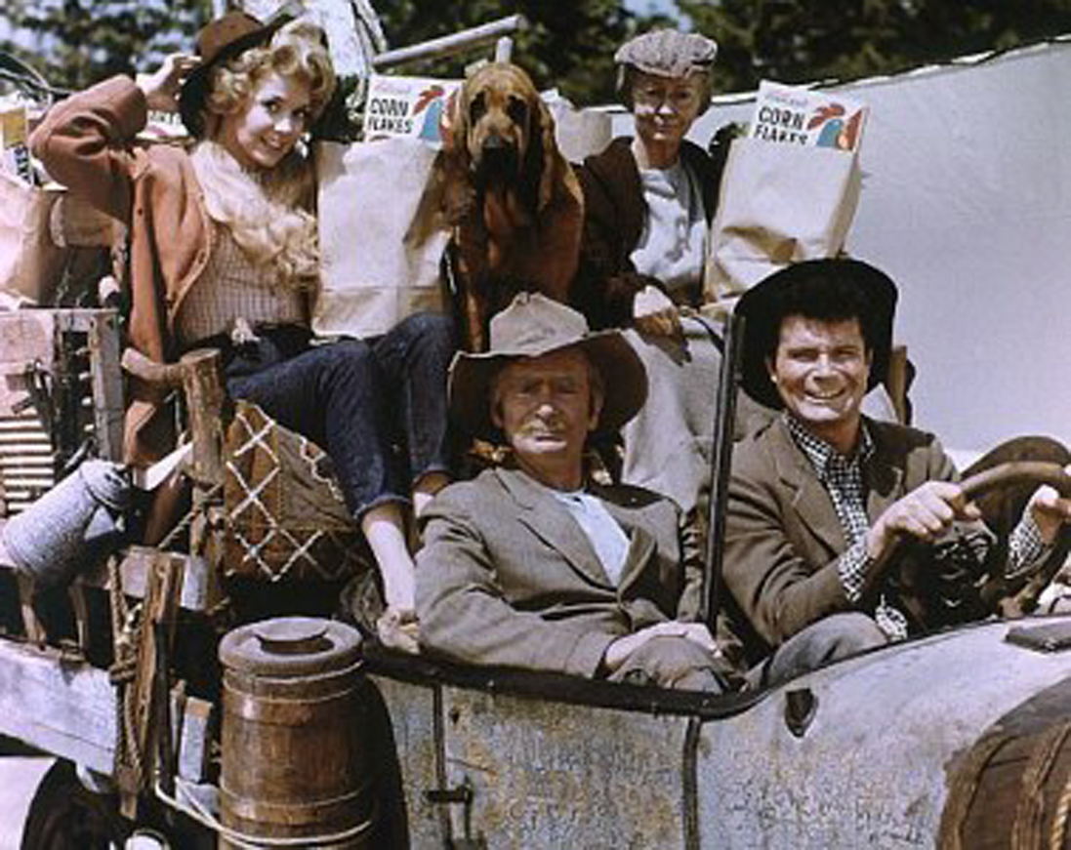
Mobility

Slide 16
Types
Horizontal mobility = moving from one occupation to another at the same social class level
Vertical mobility = a person’s occupational status moves them up or down in social class
Intergenerational mobility = a person’s child or grandchild moves up or down in social class

Slide 17
Systems
Caste system = no social mobility is possible because social status is inherited and cannot be changed
Open-class system = social class is based on merit and individual effort
How “open” is the American class system?

Slide 18
Structural Causes
New technology: can cause upward or downward mobility (mechanization/manual labor jobs)
Changes in merchandising patterns: credit, insurance, real-estate, personal services
Education: public schools, college affordability, advanced degrees
Economic recessions: increase unemployment, decrease purchasing power; pull those who are borderline down
Changes in government policies: funding, rates, wages, assistance (ex. GI Bill)

Slide 19
How does SES and social mobility compare:
Traditional vs. modern economic systems?
Authoritarian v. democratic political systems?

