Slide 1
Stratification and Inequality
Part 2

Slide 2
the gap widens…

Slide 3
What has caused inequality globally?
In the U.S. – past and present?
How does inequality affect life chances? (education, job opportunities, health care, life expectancy, standard of living, etc.)

Slide 4
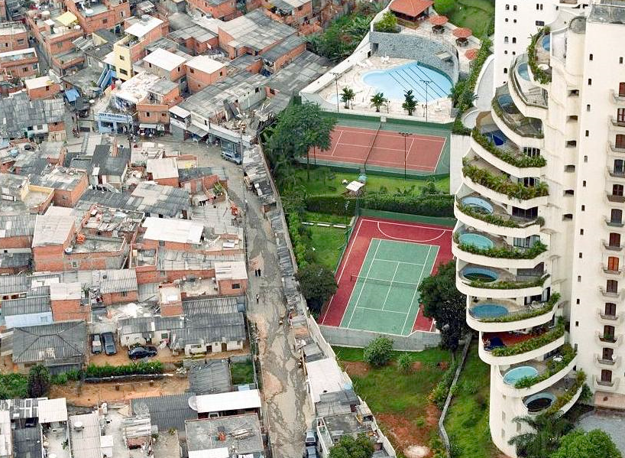
Global

Slide 5
Divisions
Northern vs. Southern hemispheres
Developed vs. Developing nations
Interdependent vs. dependent

Slide 6
Causes
Legacy of imperialism in Africa, Asia, and Latin America (75% of world’s population)
Civil wars erupted as nations gained independence - instability prevented gains in education, housing, and health care
Newly-freed developing nations took out high-interest loans from western banks

Slide 7
Outlook
Multinational corporations more powerful than many nations; “globalization” is often criticized as being “new imperialism”
Despite some advances in the developing world and some miracles like the “Asian tigers”, the gap between rich and poor nations is widening
About 1 billion people live in extreme poverty, many of them children. The UN estimates almost 35,000 children die each day from poverty.

Slide 8
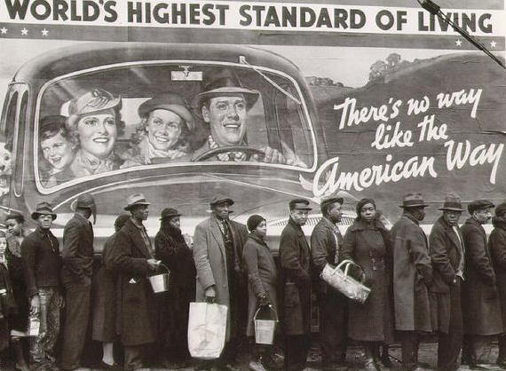
United States

Slide 9
Technically Speaking
Upper class (1%)
owners/investors, heirs, “old money” vs. “nouveau riche”
Upper middle (15%)
college educated executives, professionals
Lower middle (30%)
high school/some college, managers, skilled workers
Working class (30%)
high school, blue-collar jobs
Working poor (13%)
some high school, laborers/service workers, at-risk for poverty
Underclass (12%)
unemployment, assistance, little/no upward mobility for children

Slide 10
Generally Speaking
The Rich
The top 20% make almost half of the nation’s income and hold almost 85% of the nation’s wealth. Gap increases over time.
The Middle
Consume at high levels, overuse credit, possess little wealth. Most people say they are middle class.
The Poor
Poverty line difficult to define due to cost of living and inflation, inadequate nutrition and health care, poor working and housing conditions, family instability, at-risk for homelessness.

Slide 11
Poverty in America
Relative vs. absolute
Entangled with race/gender/age
Government response
Transfer payments and subsidies: lower tax rates, Social Security, Medicaid/Medicare, school lunches, food stamps, public housing
Changes: New Deal, GI Bill, Great Society, Workfare
Why so much debate?

Slide 12
Why is the wealth gap getting bigger over time instead of smaller?
What could/should be done about it?

Slide 13
privilege persists…

Slide 14
Minorities
Singled out and treated unequally based on physical traits or cultural practices
In what areas of society are minorities statistically overrepresented?
Underrepresented?

Slide 15
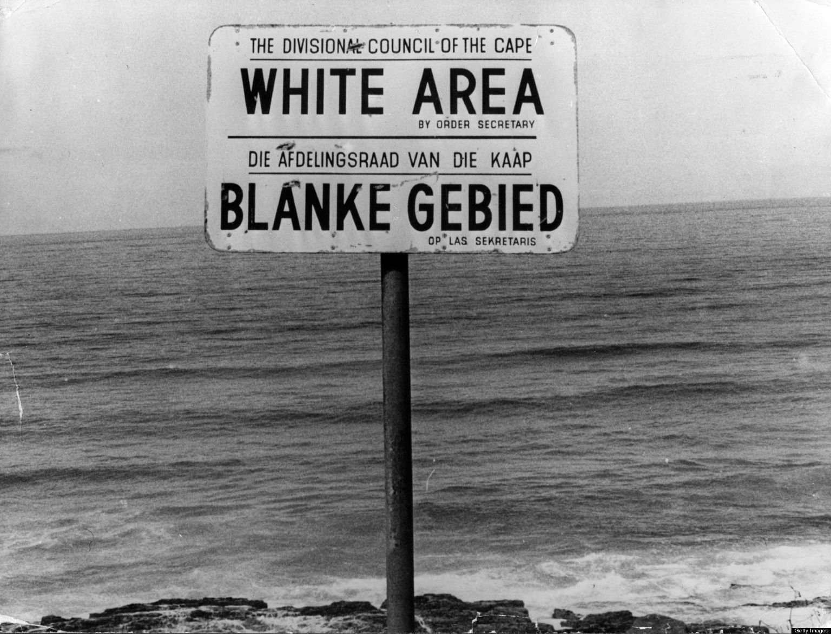
RACE/ETHNICITY

Slide 16
Minority Group Treatment
Examples from history or current events?
Cultural pluralism: diversity encouraged
Assimilation: blend into dominant culture
Legal protection: rights protected by law
Segregation: physically separated
Subjugation: controlled by force
Population transfer: removed
Extermination: destroyed

Slide 17
The “Melting Pot”
The privileged few: WASPs
White (vs. African, Asian, Hispanic)
Anglo-Saxon (NW vs. SE Europe)
Protestant (vs. Catholic, Jewish, Muslim, etc.)
Limits of integration
Most racial/ethnic groups in the United States still practice endogamy, or marriage within
De facto segregation still exists in neighborhoods, higher education, churches, etc.

Slide 18
Mobility
From Most to Least:
Asian American: from “undesirable” to “model”
Jewish and Catholic: rapid assimilation
African American: significant gains and limitations (education achievement gap, inner cities, legal system, income/wealth disparity)
Hispanic: major education-employment issues
Native American: highest rates of poverty, poor health, addiction/suicide

Slide 19
SEX/GENDER

Slide 20
Women
Patriarchy still evident in most families, religious institutions, businesses, government
Feminization of poverty: Women and children make up the largest percentage of the poor
Reproductive and childcare issues?
Second shift: working women still expected to do most household/childcare duties
Pink-collar jobs: teachers, nurses, assistants get lower pay than in male-driven professions
Glass ceiling: women do not tend to get promoted to management/leadership positions
Feminism: debate over definition, connotation

Slide 21
LGBT…
Actually 96 different permutations
Sex: spectrum of male-------female
Gender identity: transgender (he, she, xe), tomboy/metrosexual
Sexual orientation: heterosexual, homosexual, bisexual, or questioning
Gay rights debate
Biological and/or choice?
Civil rights and/or civil liberties?

Slide 22
Will white privilege ever disappear?
What are the biggest issues for minorities worldwide? Give examples from current events.

