Slide 1
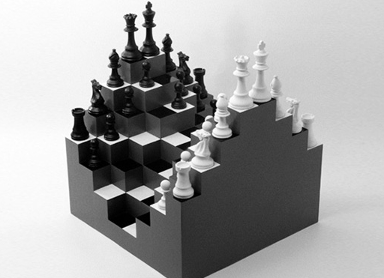
Stratification and Inequality
Part 3

Slide 2
how you see it…

Slide 3
How do different social classes and groups view stratification and inequality?

Slide 4
INTEACTIONIST

Slide 5
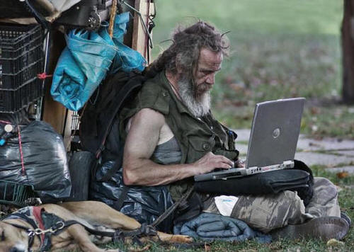
Founding Sociologist: Weber
Power and bureaucracy
Modern societies replace traditional or charismatic authority with more legitimate rational-legal authority
The resulting bureaucracy can trap individuals in a system that puts efficiency and control over all else
Protestant Ethic and the Spirit of Capitalism
Perceptions of inequality and people in other classes are tied to our values
Government decisions influenced by (sometimes competing) values of hard work, free enterprise, opportunity, prosperity, competition

Slide 6
Modern Social Psychology
Socialization and Self
Behavior is most heavily influenced by the social class into which we were born and raised
Self-esteem is influenced by how others see us, so we tend to believe that we deserve our position in society
Self-fulfilling prophecy: we tend to internalize and live up or down to others’ expectations, which can encourage or discourage social mobility
Social Structure and Interaction
Social classes, minority groups share common identity and outlook
Power imbalance between groups can lead to conformity, coercion, conflict

Slide 7
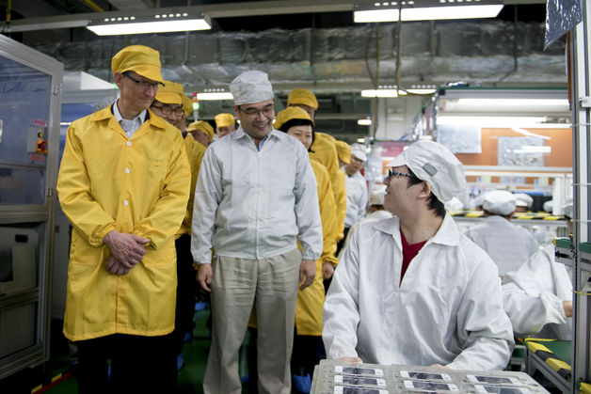
FUNCTIONALIST

Slide 8
Founding Sociologist: Durkheim
The Division of Labour in Society
Mechanical solidarity: traditional societies tied together by common goal of meeting basic needs
Organic solidarity: complex, diverse societies tied together by the interdependence of division of labor and specialization
Inequality comes from natural hierarchy, based on merit and value to society, with some regulation to prevent conflict/chaos
Individuals who lack strong ties to and internalization of the social order can suffer from anomie, leading to outcomes like suicide or deviance

Slide 9
Modern Functionalism
When inequality is dysfunctional
Reform will result from the evolution of the collective consciousness (beliefs, values, norms)
In a democracy, the best ideas for reform win out in the “marketplace of ideas” and competition between parties/interest groups
The role of social institutions
More women in the workforce > greater power/voice in society and family
Government redistribution of wealth > disruptions in the market economy
Cooperation of schools and religious organizations > provide community safety net for families

Slide 10
CONFLICT

Slide 11
Founding Sociologist: Marx
Iron law of oligarchy: power becomes more and more concentrated over time, even in democracies the elite control the resources and decision-making process
False consciousness: when workers accept ideas/values of the capitalists – schools and religions teach wealth is the result of effort and ability
Communist Manifesto
Capitalism: inequality will result in socialist revolution where government redistributes wealth
Communism: history will end the way it began, in communal societies that share all resources collectively with no need for government

Slide 12
Modern Conflict Theory
Uneven playing field
Education: achievement gap, digital divide, cost of daycare and college, public school funding
Government: interest groups, election contributions, connections, district lines
Economic: upward spiral of investments and property, downward spiral of low pay and debt
Family: instability, nutrition , preventative and mental health care
Welfare for the Poor v. Non-poor
Stigma: deserving or not
Direct relief (food stamps, welfare, etc.) vs. “trickle down” economics (tax exemptions, incentives)
“Myth” of social mobility?

Slide 13
Which perspective on stratification and inequality makes the most sense to you?
How does your position in society influence your perspective?

