Slide 1
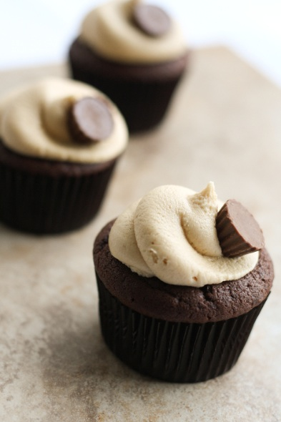
Sweet Tooth
Why you should invest in the world’s greatest cupcakes…
By: Susannah Bloom, Hannah LaCava, Asma Idries

Slide 2
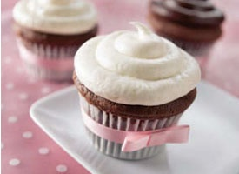
About Us
Sweet Tooth is, you guessed it, a cupcake shop.
Our main goal is to make people smile, and take away their stress for at least a moment or two.
We will have a shop as well as our catering business.
We hope you will invest in us because we plan on a successful and long lasting business.

Slide 3
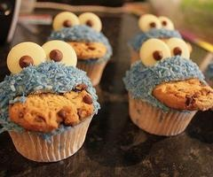
Proposal
We have a low cost budget.
We plan on buying used kitchen equipment
We will hire mainly part time employees, who will be paid a little above minimum wage and work a flexible schedule.
We will sell cupcakes for $3 each, and $30 for a dozen.
We will be located on Leesville Road next to Arby’s.

Slide 4
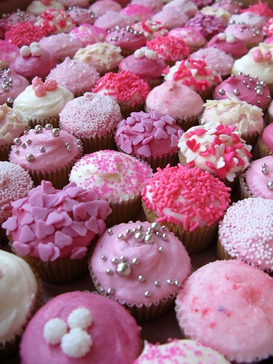
Our Expenses
We need to have a safe, clean, insured shop and catering business. This will require…
Shop owner's rent
The shop
The truck/van for catering
Car insurance
Ingredients for the cupcakes
Kitchen supplies
Ovens, refrigerators, other kitchen equipment
Cash registers, counters, tables, chairs, etc
Money for the worker’s paychecks
Money for advertising
Heating/ air conditioning
Bathroom and plumbing

Slide 5
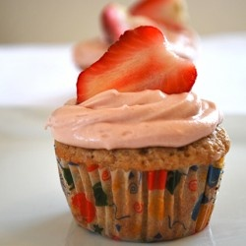
Why Invest?
Our product is extremely popular with teenagers, which is why our location near a high school is very practical.
At $3 a cupcake, they are affordable and can be enjoyed by almost anyone.
Catering services are great for reaching a wider audience, such as weddings, parties, school dances, anniversaries, and other special events.
Please click on the link to watch our video…
http://animoto.com/play/lwT17US3Loc20zozopVJ0A

Slide 6
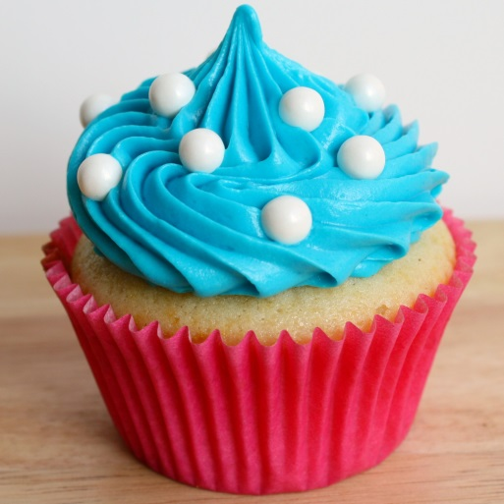
More Info…
Our product is a want. It is non-durable.
The cost to produce is lower than the selling point, therefore we will be able to make a profit.
Our resources we already have are the time we spent training and learning how to make the best cupcakes, and what kinds of cupcakes will be popular with consumers.
The risk for all investors is losing money, but the risk is worth taking because the costs are relatively low while the product is a well-liked dessert that can be consumed by anyone.
This is a wise investment because you can increase your savings and benefit yourselves while helping us with our goal!

Slide 7
Thank You!

