Slide 1

The Economy
How can we determine how the economy is doing overall?
How does government try to help when things are not going well?

Slide 2
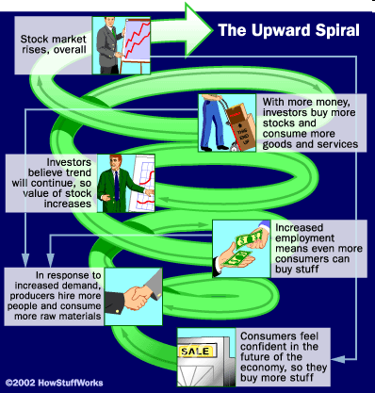
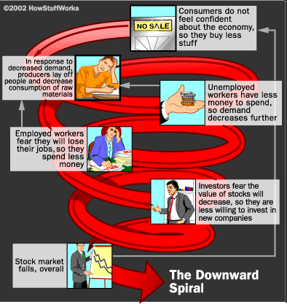
What can cause macroeconomic changes to occur?

Slide 3
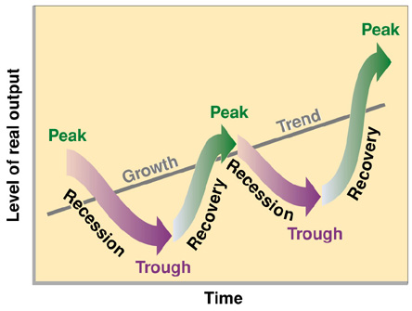
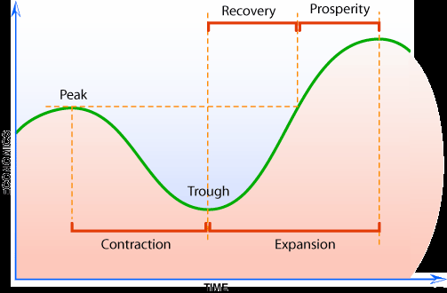
Business Cycle
Y-axis = Output, often GDP
X-axis = Time in months
Peak = Highest level of prosperity
Trough = Lowest point of contraction
Recession = 6 months or more of contraction
Depression = Prolonged period, at least several years
Where are we now?
Can we avoid recessions?

Slide 4
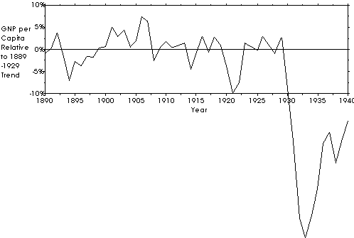
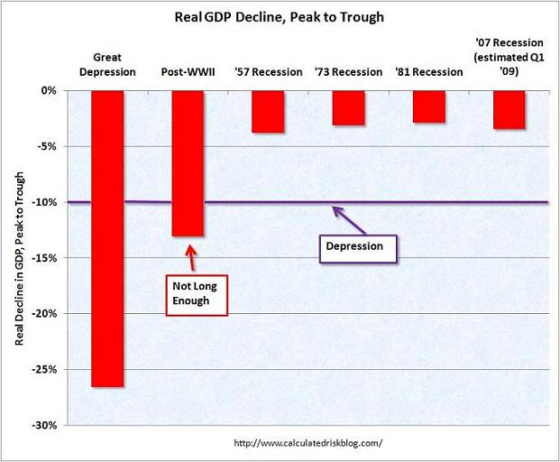

Slide 5
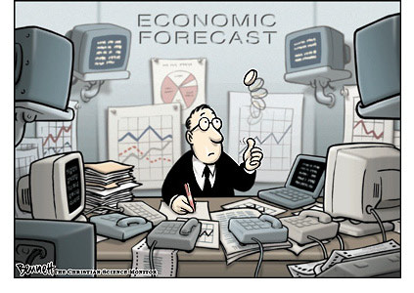
Economic Indicators
Average Prices
Unemployment Rate
Production/Output
New Businesses
Business Failures
Consumer Spending
Housing Starts
Stock Market Index

Slide 6
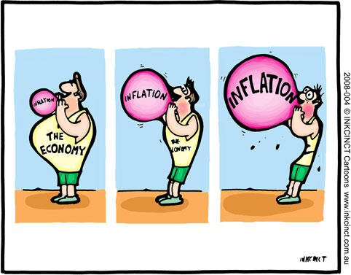
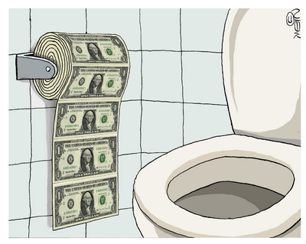
Inflation
Rise in the average price of goods and services
Measured by the Consumer Price Index (CPI)
  Monthly survey of 400 commonly used products
Causes?
Effects?

Slide 7
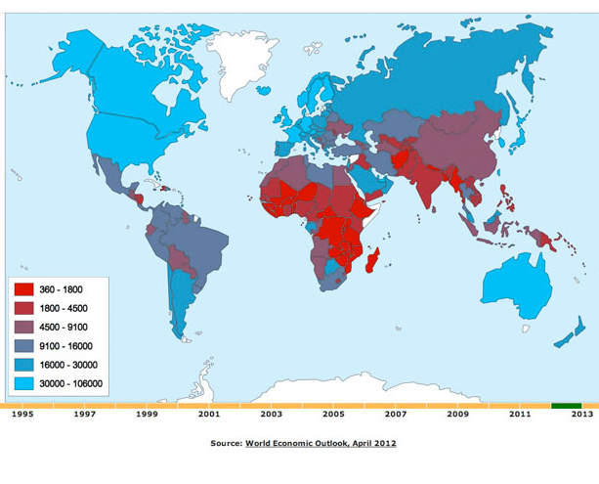
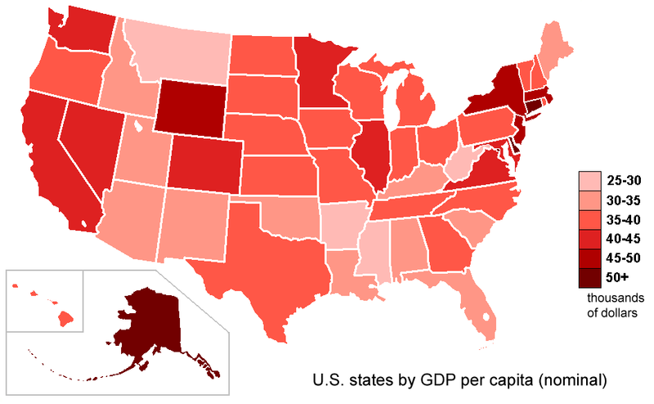
Gross Domestic Product
Total value of all goods and services sold in a year
  Based on price and quantity
  Does not show quality
  New products only
Per capita GDP = per person
  Good indicator of standard of living
Real GDP = adjusted for inflation

Slide 8
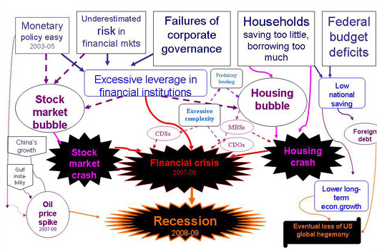
What caused the Recession of 2008?

Slide 9

Stock Market Crash
Review: Stock Market Video
Tech-boom of 90s caused global investors to flood market with available credit
Dot com bubble bursts in 2000, leading to a recession
Interest rates were lowered to encourage more borrowing and spending
The market recovered, but crashed again in 2007 when investors realized the market was inflated and began to lose confidence
What indexes are used to measure the stock market?
What do they show about the economy?

Slide 10
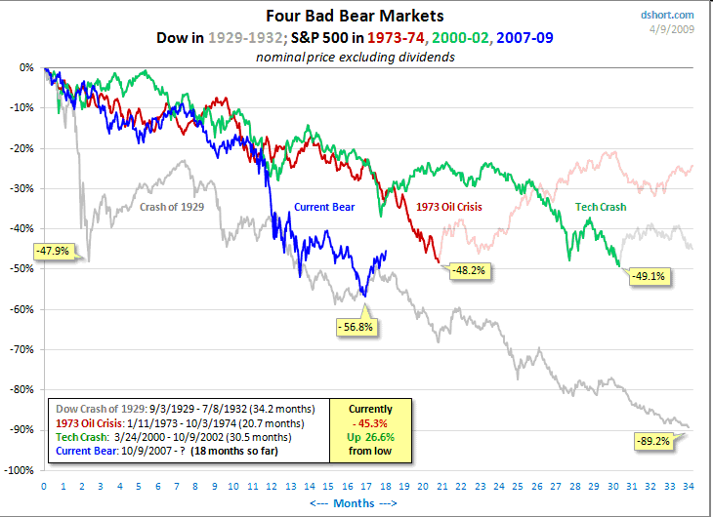

Slide 11

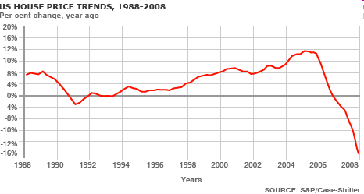
Housing Crash
Market got inflated (“Bubble”)
  Low interest rates increased
  home loans
  Banks offered risky “sub-prime” mortgages
    Sub-Prime Video
Builders took out more loans
  To increase production to meet greater demand
  To cover increasing costs due to rising oil prices
Surplus caused resale values to plunge

Slide 12

The Credit Crunch
Lenders realized assets were over-valued
Borrowers defaulted on loans and lenders demanded repayment
Financial institutions froze credit, hurting businesses that rely on loans to operate
Government “bail out” money was used to
try to prevent foreclosures and bank failures,
get credit flowing again

Slide 13
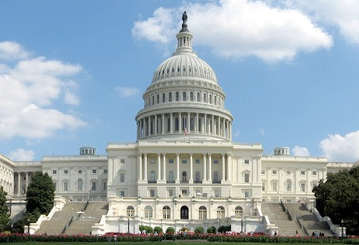
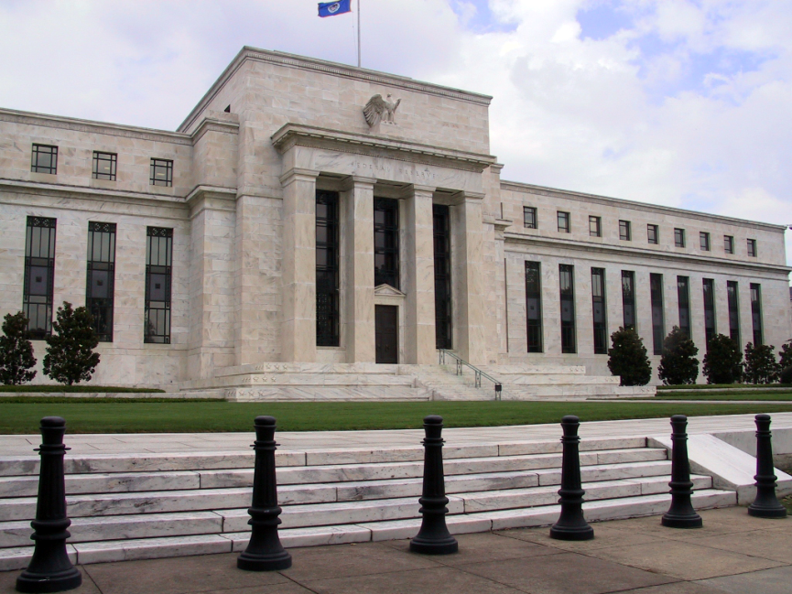
What should the government do?
Fiscal Policy
Monetary Policy
Goal: To jump start the economy during a period of contraction
  Cut taxes to “stimulate” spending and hiring
  Increase government spending on services to help those in need
  Balance the two to avoid excessive deficits and debt
Goal: To adjust money supply to meet the needs of the economy
  Expansionary: Increase money supply to encourage spending during a recession
  Contractionary: Decrease money supply to combat inflation during a peak

Slide 14
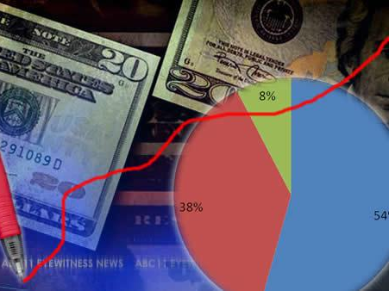
Taxes and Budget Basics
Review: Who controls taxes? The budget?
Taxes help generate revenue
  Collected at federal, state, and local levels
  Paid by individuals and businesses
  Different philosophies = Benefits received (sales) vs. Ability to pay (income)
  Based on percentage (progressive = income, flat = property, regressive = sales)
Budget = Revenue – Expenditures
  Deficit is how much expenditures exceed
  revenues in a fiscal year
    Have we ever had a surplus?
  Debt accumulates over time (like wealth)

Slide 15
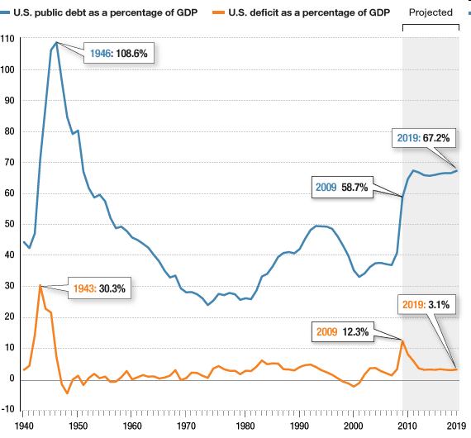
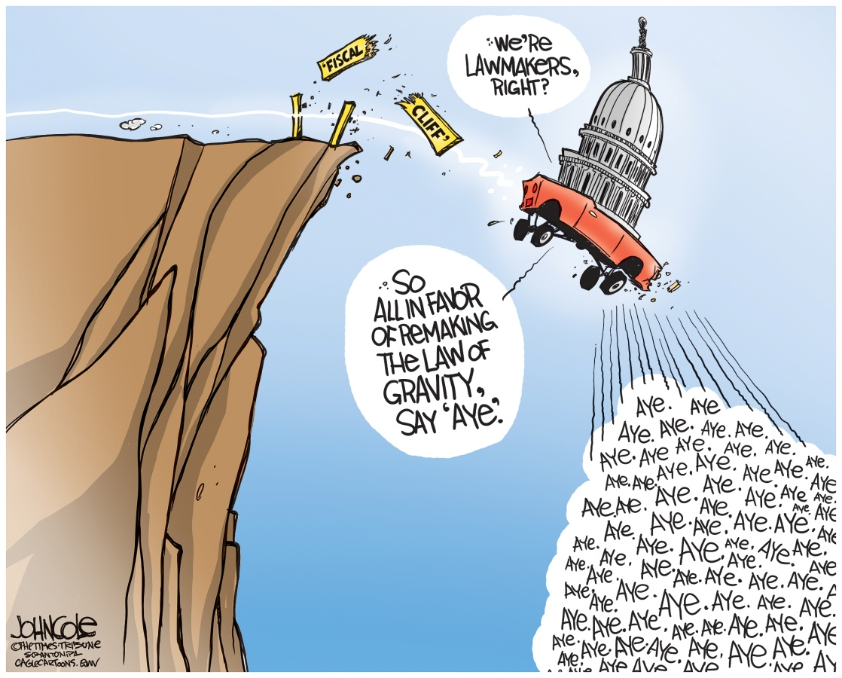
What are the pros and cons of different fiscal policies?

Slide 16
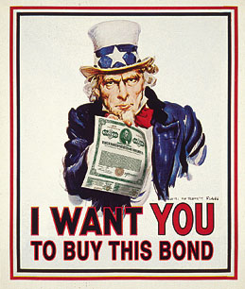

Tools of The Fed | Open-Market Operations | Reserve Requirement | Discount Rate
Illustration
Definition | Exchange of government bonds and T-bills | How much money must be kept in reserve by banks | The interest rate it offers to banks for additional money
To expand money supply | Buy bonds with new dollars to go into circulation | Lower the RR so banks lend out more money to be spent | Lower interest rates to encourage borrowing and spending
To contract money supply | Sell bonds for dollars to pull them out of circulation | Raise the RR so more money is kept in banks | Raise interest rates to discourage borrowing and encourage saving

Slide 17
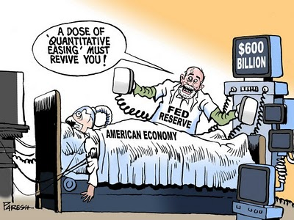
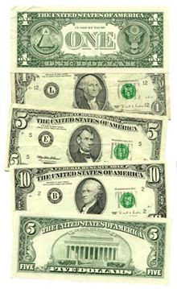
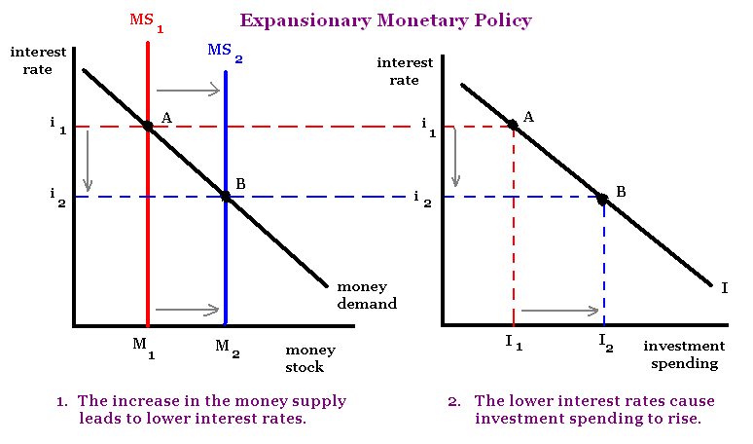
What are the pros and cons
of the Fed’s monetary policies?

Slide 18
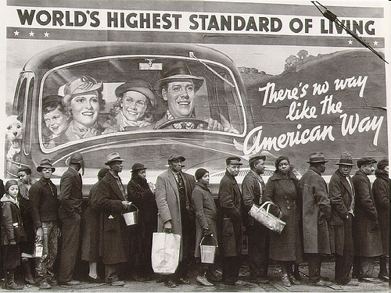
The Great Depression vs. Recession of 2009
Bank Failures | 9,000 (50%) | 57 (.6%)
Unemployment | 25% | 8.5%
Dow Jones | -89% | -54%
Prices | -25% | +.5%
Emergency spending programs | 1.5% GDP for 1 year 1934 budget deficit | 2.5% GDP for 2 years 2009 Reinvestment and Recovery Act
Increase in money supply by the Fed | +17% | +125%

Slide 19
What has changed?
What hasn’t changed?
Better understanding of supply/demand and the business cycle
Tighter regulation of banks and insurance of accounts (Fed, FDIC)
Greater oversight of stock market practices (SEC)
More govt programs to increase employment and provide assistance (SSA)
Other?
Too much credit used by producers, consumers
Overconfidence in peak times = risky investments
Interdependence causes disruptions in trade and access to resources
Parties disagree over fiscal and monetary policy
Gap between the rich and poor is growing larger
Other?

