Slide 1
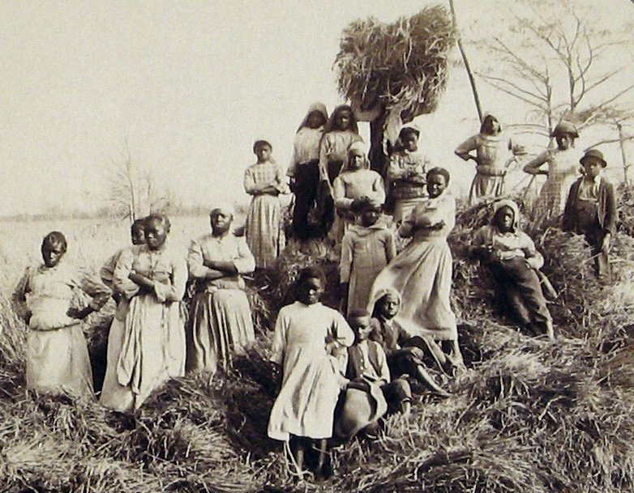
The New South
Unit 1: The Gilded Age (1870-1920)

Slide 2
“What is the chief end of man?--to get rich. In what way?--dishonestly if we can; honestly if we must.”
Mark Twain named this period in U.S. history the Gilded Age.
What did he mean?
Think of examples from the New South.

Slide 3
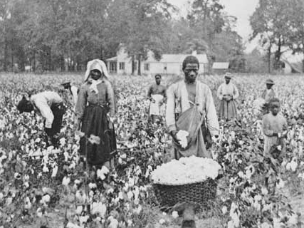
Poverty
New South economy included textiles and steel, but still had 2/5 the national average income
Problems for farmers included overproduction, deflation, and the cycle of poverty created by the sharecropping and tenant farming system
Some black farmers went West (exodusters) and worked as farmers, miners, railroad workers, and cowboys
13th Amendment violations: convict labor when due process not followed, debt peonage

Slide 4
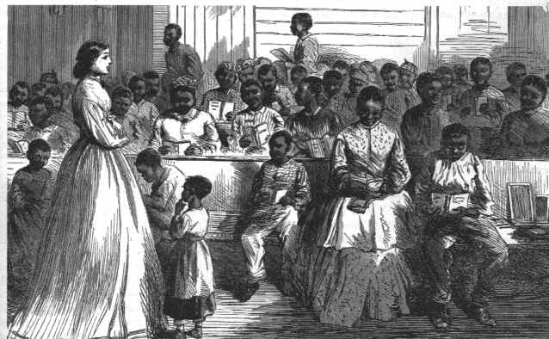
Gains in education (enrollment, curriculum, colleges, etc.) affected mostly white communities
In the 1880s only 34% of black children attended elementary school, less than 1% high school
The Freedman’s Bureau helped found black colleges like Howard. But by 1900 only 4% of blacks were in colleges or professional schools.

Slide 5
Segregation
Black codes came to be called Jim Crow laws. Jim Crow was a comic jumping character in a minstrel show.
The Supreme Court undermined the 14th Amendment and upheld segregation in Plessy v. Ferguson (1896) based on the “separate but equal” doctrine.
The Court said that the 14th guaranteed political, not social, equality.

Slide 6
The North lost interest in protecting civil rights in the South. When the Plessy decision came down, it scarcely made a ripple in the Northern press.
A boycott movement of segregated streetcars lasted for 15 years in at least 25 cities.

Slide 7
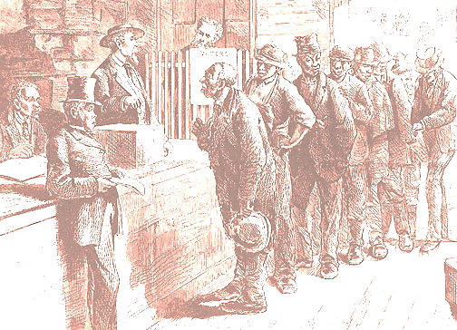
Disenfranchisement
For a time, blacks were not totally disenfranchised. They were intimidated during campaigns and experienced gerrymandered electoral districts to maintain white supremacy.
After 1877, the Republican party struggled in the South. The “redeemed” Democratic Party in the became a political machine.
When the Populist movement began to push for reforms to help farmers and laborers, the Democratic Party in the South actively worked to keep blacks from voting for the Populist Party. They pushed the race issue to overshadow the class issue.

Slide 8
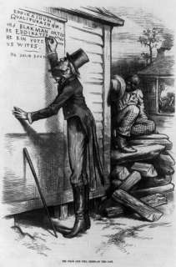
In the 1890s, states began to use poll taxes and literacy tests
The Court said that these requirements were okay because they didn’t state race as a criterion for voting.
The grandfather clause was created to enable poor illiterate whites to vote. States often gave more difficult literacy tests to blacks, and officials could fail anyone they wanted.
In 1896 in LA – 130,334 black men voted. By 1904, it was 1,342.

Slide 9
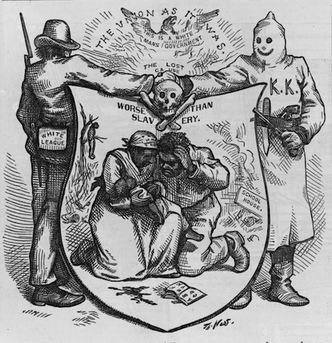
Violence
The Ku Klux Klan (KKK) started as a group of Civil War veterans, but grew to include anyone who advocated nativism and white supremacy.
Between 1890 and 1910, over a hundred blacks were lynched each year.
Congress passed a force Bill to stop the KKK, but it was ruled unconstitutional by the Court.

Slide 10
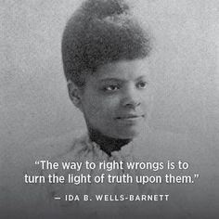
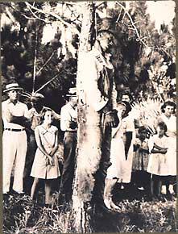
Ida B. Wells as a muckraker focusing on racial violence in the South.
She reported that most victims of lynching were successful small businessmen whose only crime was to challenge the social order. Rape was only even alleged against a third of them.
In 1892 there were 155 lynchings without a single case being punished.

Slide 11
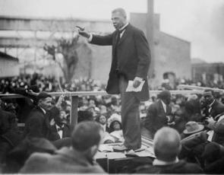
Booker T. and W.E.B.
Booker T. Washington (1856-1915) believed blacks had to accommodate themselves temporarily to white prejudices and concentrate on self-improvement.
This won him the reputation of being a “reasonable” black leader.
He wrote Up From Slavery, 1901.
In private, he lobbied against discriminatory measures and financed test cases in courts.
He pushed for vocational training for blacks and founded Tuskegee Institute in Alabama.
George Washington Carver at Tuskegee Institute in Alabama.

Slide 12
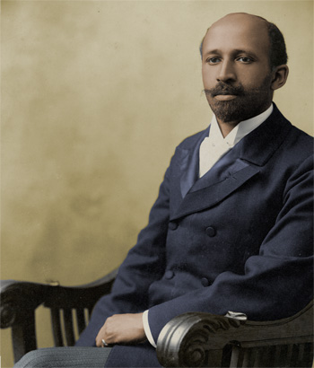
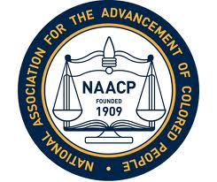
W.E.B. DuBois (1868-1963) criticized Washington, advocating full political rights and higher liberal arts education for blacks.
He believed that if blacks prepared themselves only to be farmers, mechanics, and domestics, they would remain forever in such occupations.
He was the first black person to get a doctorate from Harvard.
He wrote The Souls of Black Folk, 1903.
Du Bois helped start the Niagra Movement and founded the NAACP in 1909.
The NAACP led the legal fight to overturn segregation, organized boycotts, and provided legal counsel for lawsuits.

