Slide 1
The United Nations
“The UN was not created to take humanity to heaven but to save it from hell.”
– Dag Hammarskjold, Secretary-General 1953-1961

Slide 2
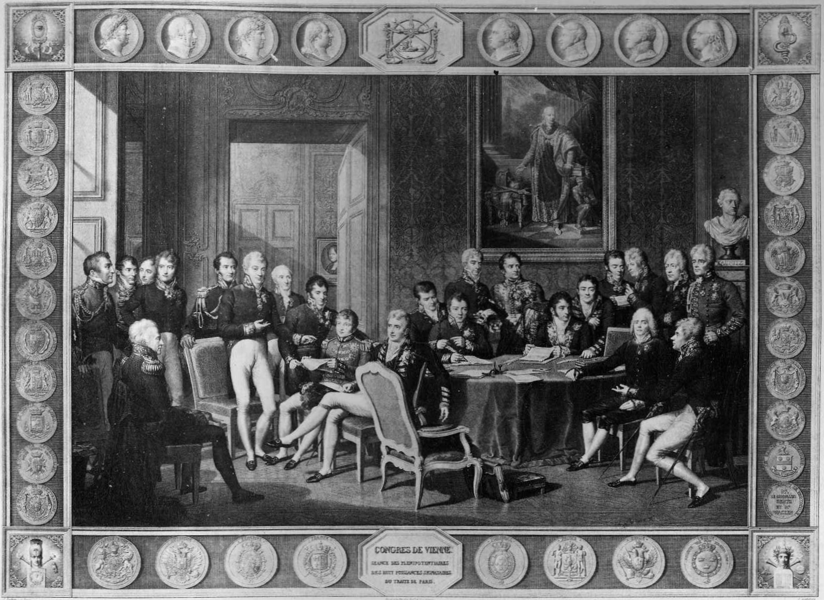
International Organizations
Peace of Westphalia (1648)
establishing national sovereignty
Congress of Vienna (1815)
maintaining a balance of power
The Hague (1899)
rules of warfare
League of Nations (1919) > Kellogg-Briand (1928)
stopping aggression, renunciation of war
Atlantic Charter (1941) > Yalta (1945)
self-determination, economic cooperation

Slide 3
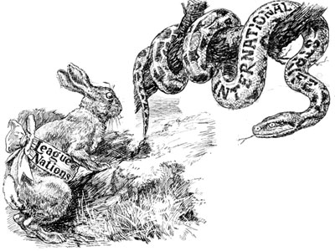
The World Wars
Failure of the League of Nations
Absence of the United States
Required unanimous vote
Weakness of sanctions
Appeasement against acts of aggression
The Big Four
China, Soviet Union, United Kingdom, United States
Framework protects their national sovereignty
Charter of the UN worked out by the original 50 states

Slide 4
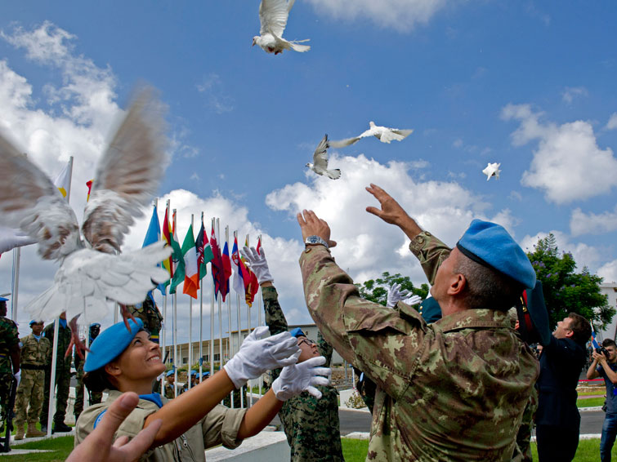
Purposes of the UN
Maintaining international peace and security
Developing friendly relations between states
Building respect for equal rights and self-determination
Promoting human rights and freedoms
Serving as a forum of cooperation in solving economic, social and humanitarian problems

Slide 5
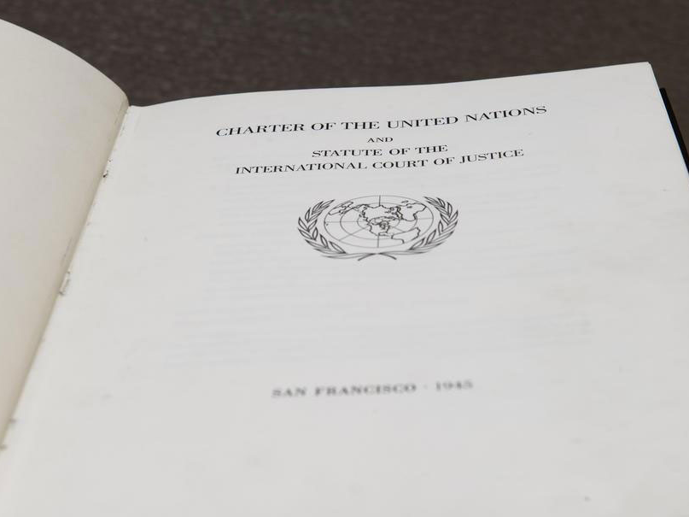
Principles of the UN
Sovereign equality of all states, regardless of wealth or power
Obligation of members to refuse aid to any state that violates Charter
Duty to settle differences by peaceful means
Renunciation of use of force or threats to limit another’s territorial or political independence
Need to maintain international peace and security
Noninterference in domestic affairs

Slide 6
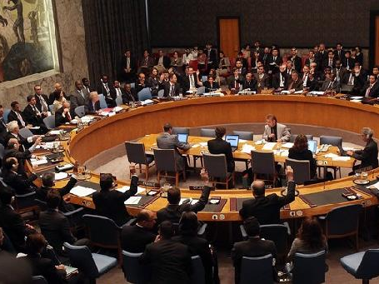
Organization
Security Council
Peacekeeping and Peacemaking
Permanent members, “P-5” (France, China, Russia, UK, US) have veto power
Other 10 members elected, rotate 2-yr terms
Decisions bind the entire United Nations
General Assembly (GA)
Made up of committees that focus on different issues
Important questions require 2/3 majority
Each member state has an equal vote
Decisions are not binding on any member state

Slide 7
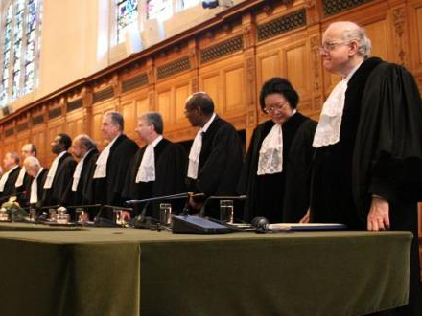
Organization
International Court of Justice (ICJ)
No compulsory jurisdiction, states must cooperate
15 justices elected by Security Council and GA
States have max 1 justice on court, if a state is involved it gets a one appointed for that case
Economic and Social Council (ECOSOC)
Coordinate and develop economic, social, educational, cultural, and health programs
Work with private non-governmental organizations (NGOs)
54 states are elected by the GA to serve 3-yr terms

Slide 8
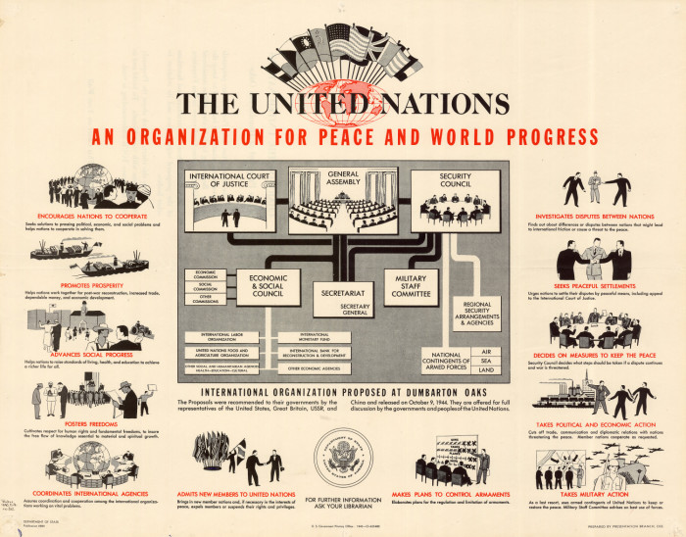
Organization
Secretariat
Administers the bureaucracy of the UN, mediates disputes between members, promotes the organization globally
Secretary-General elected by GA for 5-yr term
Staff chosen by civil service exam
Examples of…
Subsidiary Organs: Tribunals, Peacekeepers, UNICEF
Intergovernmental Agencies: WHO, IMF, WTO, World Bank
Consulting NGOs: Amnesty International, Oxfam, Red Cross, Ford Foundation

Slide 9
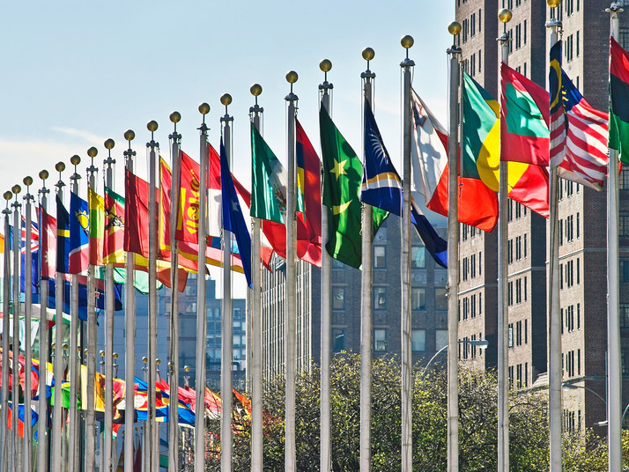
Membership
Member states
Grown from 50 to 193 since 1945
Permanent observers that became members: Ex. Switzerland, Japan
Current non-member states
Holy See, State of Palestine
Intergovernmental organizations
EU, African Union, Arab League, INTERPOL

Slide 10
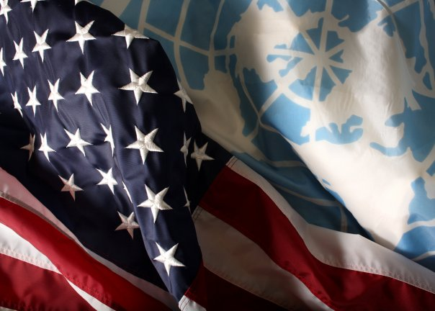
The United States
Permanent Security Council member
Largest share of UN budget and military force
US-UN Coordination
Executive Branch: President, Department of State, foreign diplomats, UN ambassadors
Congress approves funds, appointments, treaties

Slide 11
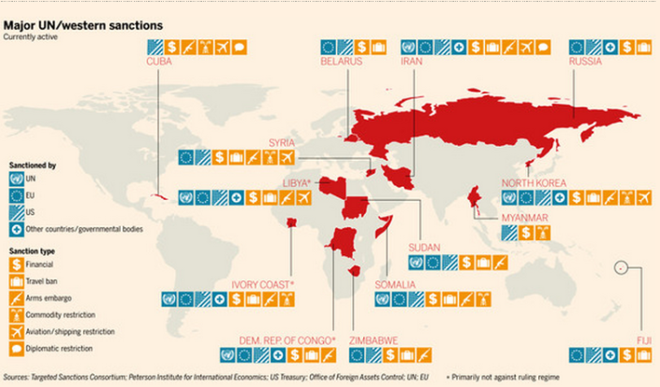
Tools of the UN
Non-coercive Consensus-building
Forums and conferences
International agreements and treaties
Mediation/negotiation
Coercive Enforcement
Diplomatic pressure: threat to expel, support for adversary
Economic sanctions
Military force with consensus and approval by Security Council (last resort)

Slide 12
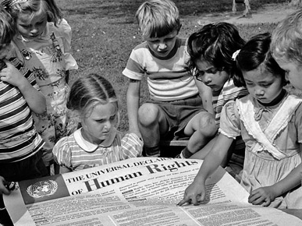
Universal Declaration of Human Rights
Create standards and norms
Equality, freedom, safety, rule of law, due process, family, property, expression, representation, labor, health, education
Address violations
Investigate, publicize, help victims and refugees, aid government in finding resources to provide more to citizens, impose sanctions, authorize force
Challenges
National sovereignty, jurisdiction

Slide 13
Millennium Goals
Poverty and hunger
Universal primary education
Gender equality and women’s issues
Child mortality
Maternal health
HIV/AIDS and malaria
Environmental sustainability
Global development

Slide 14
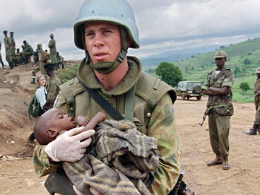
Strengths and Weaknesses
Multilateral diplomacy is legally and morally binding
Sovereignty protected, decisions reached through compromise and concession
Non-partisan states can offer creative solutions, forge alliances
Peacekeeping in nations in transition, building rule of law
Security Council outdated? P-5 too powerful?
Process is difficult, results are slow
Miscommunication due to language and cultural differences
Budget deficits
Limited jurisdiction
Peacemaking in sovereign nations

Slide 15
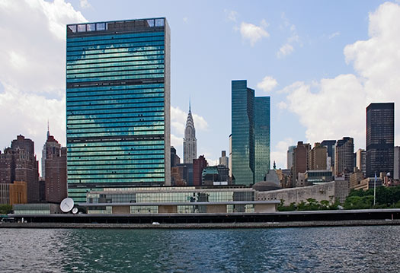
Trivia Questions
Q: Where is the UN Headquarters located?
A: New York City
The UN also has major offices in Geneva, Vienna, and Nairobi.

Slide 16
Trivia Questions
Q: What are the UN’s two working languages?
A: English and French
The official languages are Arabic, Chinese, English, French, Russian, and Spanish.

Slide 17
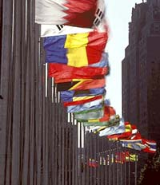
Trivia Questions
Q: The flags around the UN building are in order. What are the first and last flags?
A: Afghanistan is first Zimbabwe is last
They are in English alphabetical order.

Slide 18
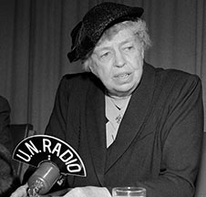
Trivia Questions
Q: Who was the first U.S. delegate to the UN?
A: Eleanor Roosevelt
She served as the Chairperson of the UN Human Rights Commission that created the Universal Declaration of Human Rights.

Slide 19
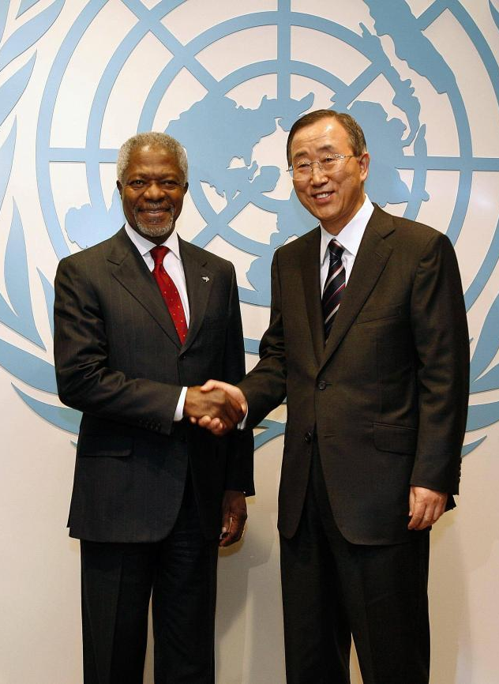
Trivia Questions
Q: Who is the Secretary-General of the UN?
A: Ban Ki-Moon (South Korea)
Kofi Annan (Ghana) served from 1997-2006. The UN and Annan were awarded the Nobel Peace Prize in 2001.

Slide 20
Trivia Questions
Q: How many times has a member of the UN family won the Nobel Peace Prize?
A: 11
For work related to Children, Refugees, Atomic Energy, Peacekeeping, Climate Change, Labor, and Chemical Weapons

Slide 21
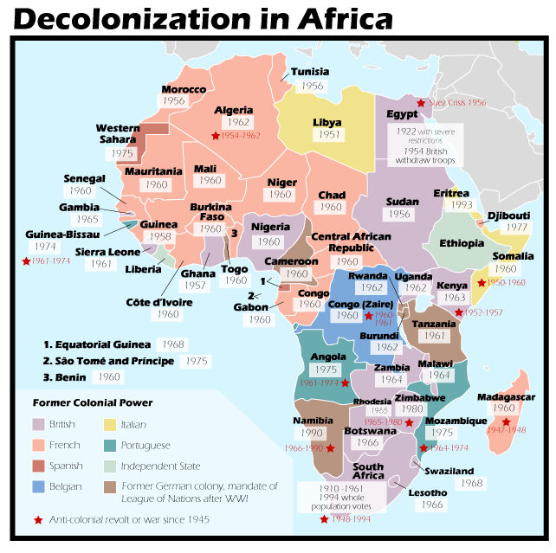
Trivia Questions
Q: What historical trend added the most new countries to the UN?
A: Decolonization
The largest number of UN missions are in those countries still struggling to establish stable governments and economies.

Slide 22
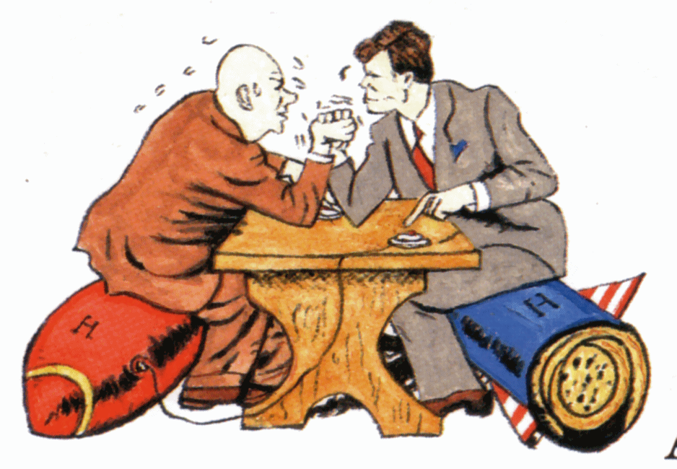
Trivia Questions
Q: Which era was the least productive in the history of the UN?
A: The Cold War
US-Soviet rivalry limited cooperation. Since then, UN activities have grown significantly.

Slide 23
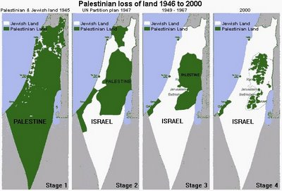
Trivia Questions
Q: Where is the UN’s first and longest- running mission?
A: Palestine
The UN Partition plan resulted in wars that caused a refugee crisis in the region.

Slide 24
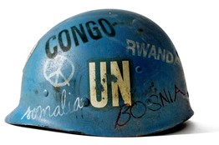
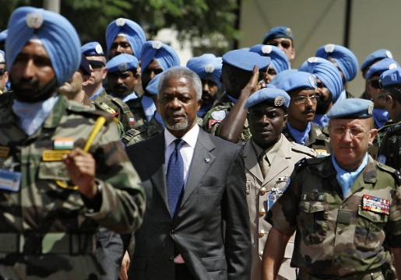
Trivia Questions
Q: What is the nickname for the UN Peacekeepers?
A: Blue Helmets
They wear any blue head covering along with their own military uniform.

Slide 25
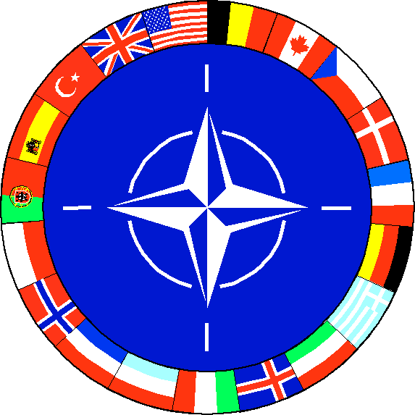
Trivia Questions
Q: What other international alliance has worked to intervene with military force when the UN could/did not?
A: NATO
NATO took military action in Bosnia, Kosovo, and Afghanistan

Slide 26
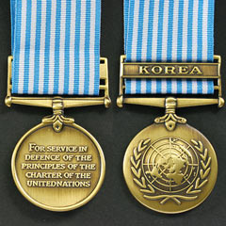
Trivia Questions
Q: What were the only two full-scale wars sponsored by the UN?
A: Korea and the Gulf War
In Korea, USSR was boycotting the Security Council because it would not recognize the new Communist government of China.

Slide 27
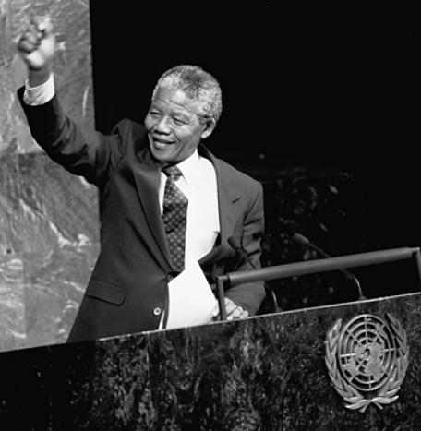
Trivia Questions
Q: What African nation did the UN use political and economic sanctions against from 1963-1993?
A: South Africa
The UN called for an embargo and threatened to expel the country because of apartheid.

Slide 28
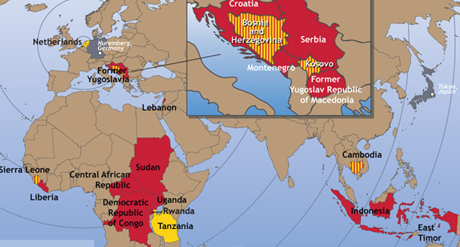
Trivia Questions
Q: Which two conflicts resulted in long-term international tribunals?
A: Rwanda and former Yugoslavia
Other areas: Cambodia, Sierra Leone, East Timor, Libya, Darfur

Slide 29
Trivia Questions
Q: When and where did Model UN begin?
A: 1951 at Harvard University
Harvard students began participating in Model League of Nations in 1927.

Slide 30
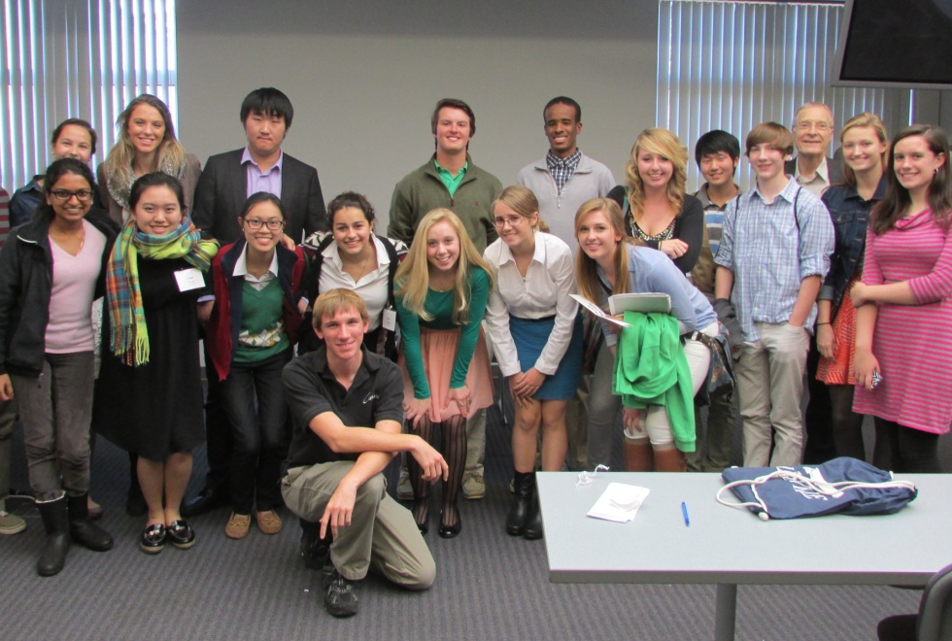
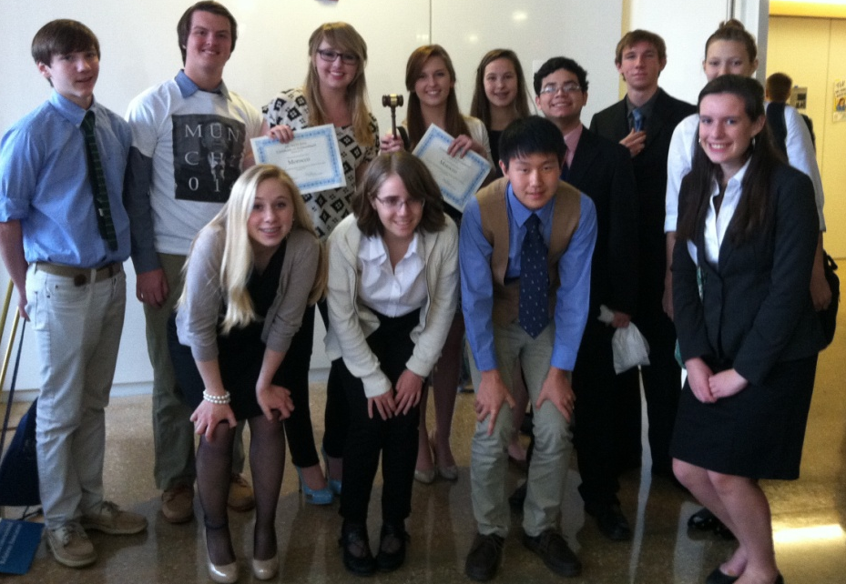
Leesville MUN Team 2013-14
The team learned about Model UN procedure and practiced debate at a training conference in November. Unfortunately, our first big conference at Duke was cancelled due to snow.
In March, the team competed in the Model UN Conference at UNC-CH. Sarah and Lauren Hudak won Best Delegate in the General Assembly Disarmament and Security Committee.

