Slide 1
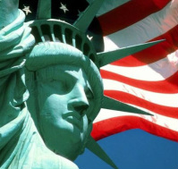
Unit 1 - American Government
Objective 1 Describe the foundation of law, government, and citizenship in American society. Objective 2 Examine founding documents and identify major influences on views about how government should work.

Slide 2
Functions of Government
Why is government necessary?
Keeping order
Makes and enforces laws to protect property, safety
Providing security
Military defense from foreign threats
Providing public services
Schools, roads, utilities, mail, parks
Guiding the community
Public policy: economic, foreign

Slide 3
Levels of Government
National = makes, enforces, and interprets federal constitution and laws that affect the whole country
State = same for state constitution and laws that affect the a whole state (but cannot go against federal law)
Local = counties, cities, and towns are defined by the state
Which level affects your life most?

Slide 4
Types of Government
Authoritarian = power held by a small group of leaders
Totalitarian/Dictatorship: single ruler controls everything by military and police force
Oligarchy: small group of wealthy elite
Absolute monarchy: king or queen inherits ultimate power
Theocracy: control by religious leaders
Examples?
Constitutional = power shared by leaders and citizens held accountable to written law
Constitutional monarchy: monarchy is limited, shares power with a legislature
Democracy…definition?

Slide 5
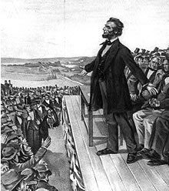
Principles of Democracy
Government of the people…
Popular sovereignty = consent of the people
Free, fair, and competitive elections
Majority rules, minority respected
by the people…
Holding office: elected or appointment
Merit-based civil service
Voting, petition/assembly, contributing $
for the people…
Different levels to represent varied interests
Branches to prevent abuse of power
Individual freedoms protected

Slide 6
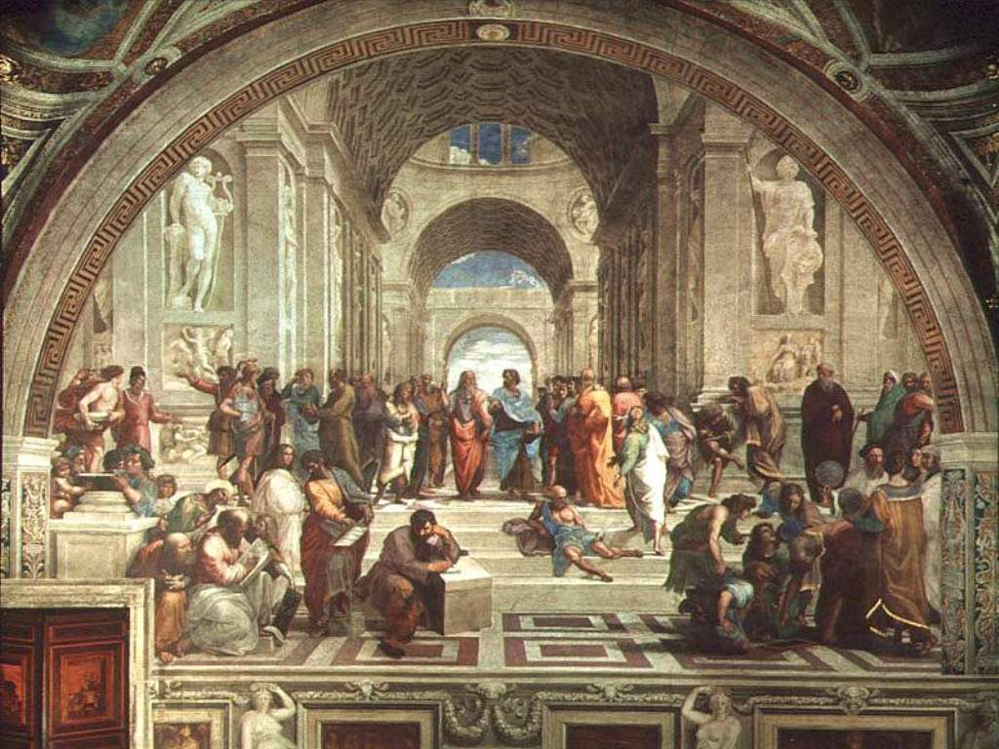
Types of Democracies
Direct democracy
Citizens vote on the issues
Ex. Athens, Plymouth
Representative democracy
Citizens vote for representatives to decide on the issues on their behalf
Ex. Rome, U.S.
Why is this so much more common than direct?

Slide 7
English Traditions
Magna Carta: First time monarch limited by Parliament
Citizens guaranteed justice: ex. trial by jury, same laws for all social classes
Parliament: Legislature slowly took over all powers from the monarchy
Glorious Revolution, English Bill of Rights (ex. no cruel and unusual punishment)
Common Law: system of law based on custom and precedents
Precedent: a ruling in a case that is used as a basis for similar cases

Slide 8
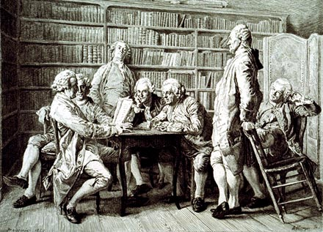
Enlightenment Influences
European philosophers of the 1700s were questioning traditional ideas about government and defining concepts that would be used and tested in the new American government, such as:
All men created equal - Rousseau
Separation of power - Montesquieu
Three branches: Legislative (makes law), Executive (enforces law), and Judicial (interprets law)

Slide 9
John Locke had the most influence:
Natural rights: All citizens are born with the rights to life, liberty, and property
Why did it get changed to “pursuit of happiness” later?
Social contract: The people agree to give up some of their freedom in exchange for government protection of their natural rights
What can happen if a citizen doesn’t live up to their end of the contract?
If the government doesn’t live up to its end?

Slide 10
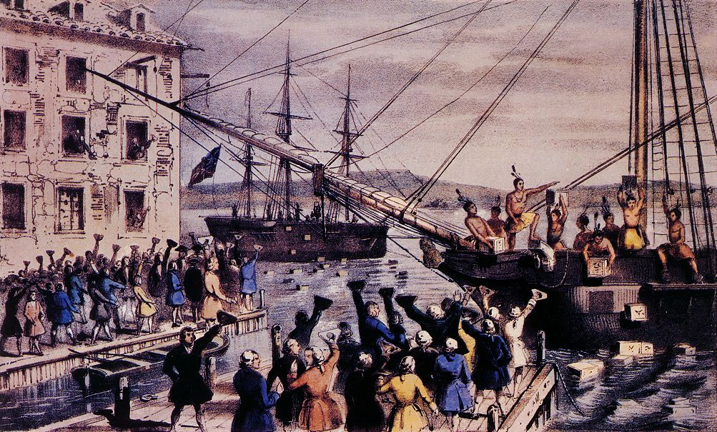
Colonial Resistance
French and Indian War > New Taxes
Cost of war caused Britain to raise taxes on colonies, which had gotten used to a policy of self-government
New Taxes > Colonial Protest
Sugar Act, Stamp Act, etc.
Boycott of British goods, Boston Tea Party
Colonial Protest > Increased Restrictions
Boston Massacre, Intolerable Acts (no trial by jury, Quartering Act, blockade)

Slide 11
Declaring Independence
First Continental Congress
Petitioned King to repeal Intolerable Acts
Lexington and Concord: British troops defeat colonial militia > Olive Branch Petition
What if the British had offered the colonies representation in Parliament at this point?
Second Continental Congress
Thomas Paine’s Common Sense helped persuade the rest of the group to declare independence
Thomas Jefferson enlisted to write

Slide 12
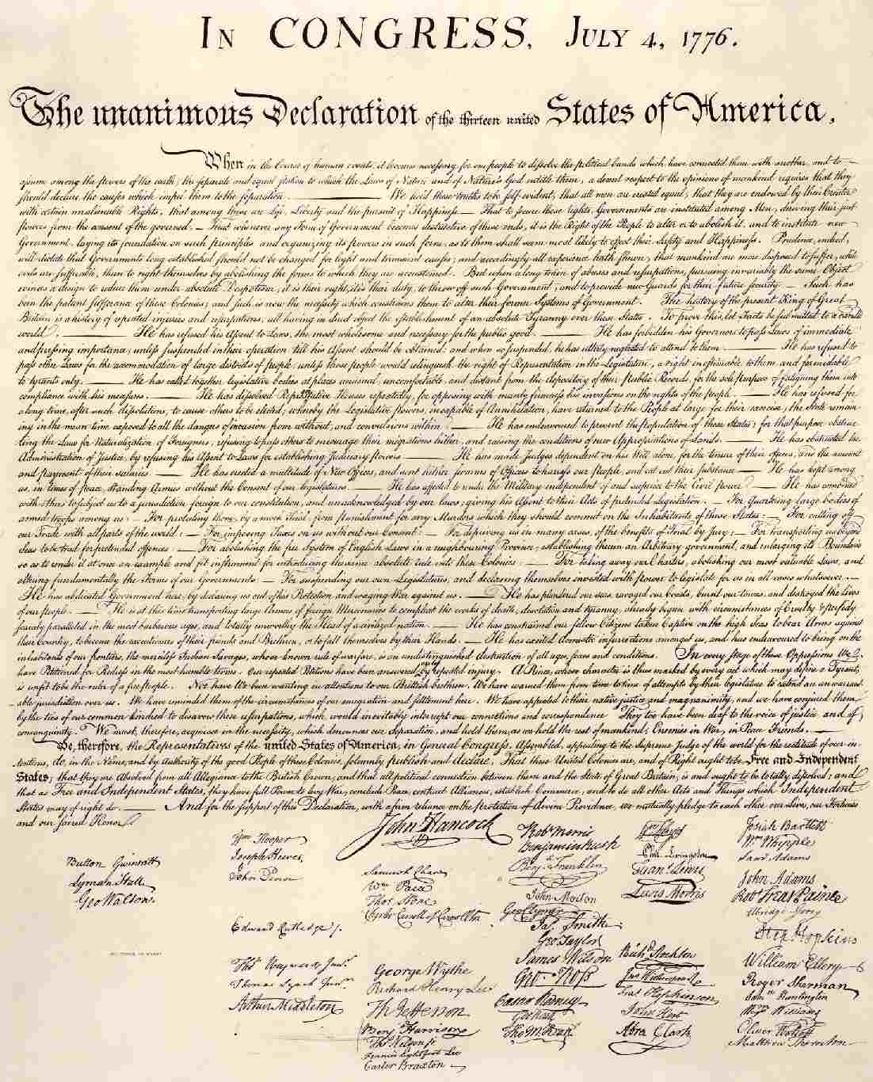
Declaration of Independence
Signed July 4, 1776
Which Enlightenment ideas are at the center of Jefferson’s argument?
What main grievances do the colonies have against the King and Parliament?
What would the result of this have been if the colonies had lost the war?

Slide 13
Articles of Confederation
As soon as the Declaration was signed, states wrote their own constitutions
After the war, it was decided they needed a limited national gov’t to create a military alliance against potential foreign threat
Opposition to strong federal gov’t was so strong:
Only one branch existed, Congress
No power to tax or enforce laws: So states had to raise taxes to pay off war debt, causing rebellions that the federal gov’t could not protect against
Shay’s Rebellion > Constitutional Convention

Slide 14
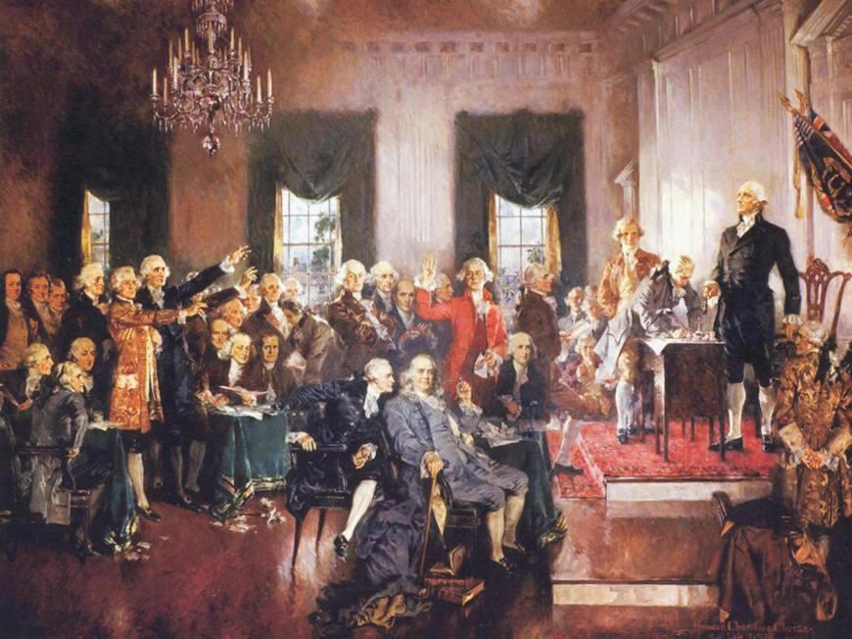
Constitutional Convention
Another problem with the Articles was that it was almost impossible to amend them, so they decide to throw them out and start over
George Washington was asked to preside over the secret proceedings
James Madison is considered the “Father of the Constitution” because he proposed the basic structure of the gov’t
It almost fell apart because of major disagreements over representation and size of government…

Slide 15
Compromises
ISSUE | Who would have supported each side? | COMPROMISE
How will states be represented in Congress? | VA Plan = by population NJ Plan = equal | Great Compromise: bicameral legislature with equal rep in the Senate and rep by population in the House
Should slaves count toward a state’s representation in the House? | They are property, don’t need representation Owners should be entitled to representation on their behalf | Three-Fifths Compromise: 3 out of every 5 slaves will count towards a state’s population
Should Congress have the power to regulate trade? | International and interstate trade should be regulated Feared taxes on exports and restrictions on slave trade | Commerce/Trade Compromise: Congress given power to regulate trade, but could not change slave trade laws for 20 years
Should the people be trusted to elect the President? | Citizens should be allowed to vote for president Citizens can’t be trusted to do this – should be chosen by educated leaders | Electoral College Compromise: Indirect system where the state legislatures (chosen by the people) decide which candidate gets the state’s electoral votes

Slide 16
Ratification Debate
9 out of 13 states had to ratify (approve) the new constitution before it could take effect
Federalists: Supported the new constitution
Believed it was important to strengthen the federal government
Wrote Federalist Papers in support of the principles and structure of the constitution
Anti-Federalists: Opposed the constitution
Believed the new constitution gave the federal gov’t too much power
Main argument was that it did not include any protections for individual freedoms - Why not?

Slide 17
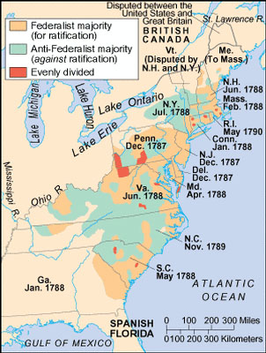
After a year of debate, the Federalists agree to add a Bill of Rights as soon as the Constitution is ratified
Ratified July 1788
North Carolina, not until Nov. 1789
Why so late?

