Slide 1
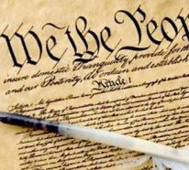
Unit 2 – U.S. Constitution
Objective 1 Analyze the structure and flexibility of the Constitution. Objective 2 Evaluate the principles of democracy and protection of liberties found in the Constitution, Bill of Rights, and landmark Supreme Court decisions.

Slide 2
Review…
Why weren’t the individual state constitutions sufficient for the new nation?
Why did the first national constitution, the Articles of Confederation, have to be replaced?
What were the main compromises that had to be made at the Constitutional Convention?
What did the Federalists have to promise the Anti-Federalists in order to get ratification?
Which major Enlightenment ideas will be reflected in the Constitution?

Slide 3
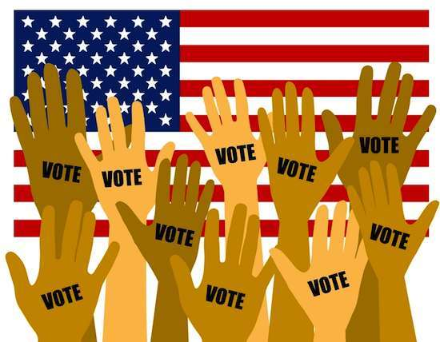
Principles
Rule of Law
No one is above the law
Federalism
Power shared between levels, with Federal gov’t supreme
Separation of Powers
Power shared between branches
Checks and Balances
Power between branches is equal
Popular Sovereignty
Consent of the governed
Republican Gov’t
Representative democracy

Slide 4
Structure
Preamble: Purpose
Articles 1-3: Separation of Powers into Legislative, Executive, and Judicial Branches
Article 4 & 6: Federalism, the division of powers between federal and state gov’t
Article 5: Amendment process
Article 7: Ratification
Amendments 1-10: Bill of Rights

Slide 5
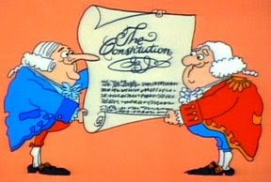
Purpose
“We the people of the United States…do ordain and establish this Constitution for the United States of America.”
In order to:
Form a more perfect union
Establish justice
Insure domestic tranquility
Provide for the common defense
Promote the general welfare
Secure the blessings of liberty to ourselves and our posterity
Examples?

Slide 6
Separation of Powers
EXECUTIVE
LEGISLATIVE
JUDICIAL
President
Congress
Supreme Court
Senate
House
Cabinet
Circuit Courts of Appeals
VP
Departments Agencies
District Courts

Slide 7
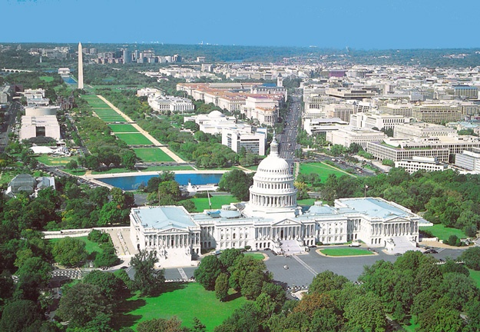
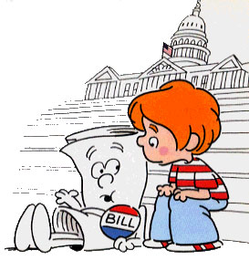
Legislative
Most important:
MAKE LAWS
Levy taxes
Coin money
Regulate trade
Provide military
Declare war
Implied Powers
Elastic Clause gives Congress the ability to make laws “necessary and proper” to carrying out these functions
Ex. National Bank

Slide 8
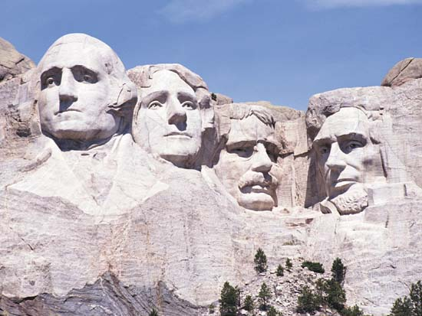
Executive
Make treaties
Appoint judges, heads of agencies
Executive Orders
Have the force of law
Limited, usually deal with matters of national security
Most Important:
CARRY OUT LAWS
Command the military
Veto/sign bills into law

Slide 9
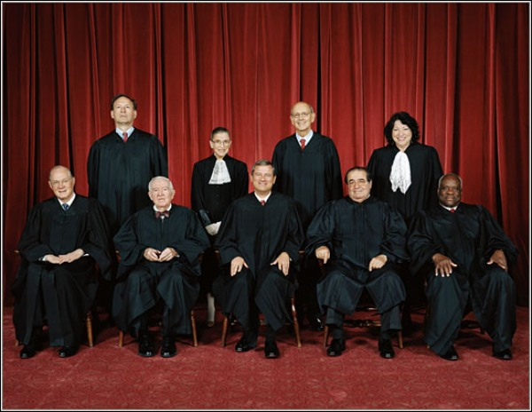
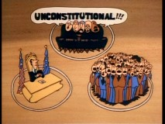
Judicial
Most important:
INTERPRET LAWS
Judicial review to determine if an act is constitutional or not, applies to:
Congress
President
States
Other cases involving
Federal laws
Disputes between states

Slide 10
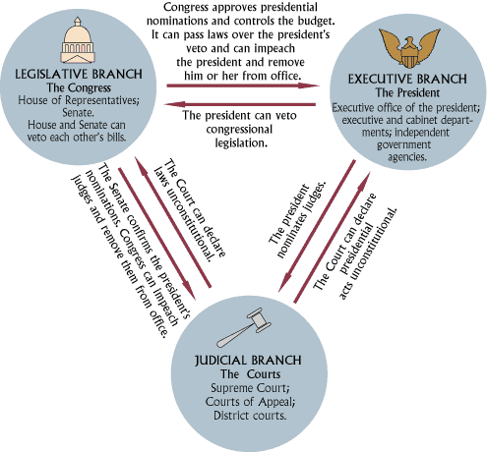
Checks and Balances

Slide 11
Federalism
Federal
Expressed (a.k.a. Delegated or Enumerated)
State
Reserved
Shared
Concurrent
Supremacy Clause = Federal Gov’t is supreme!

Slide 12
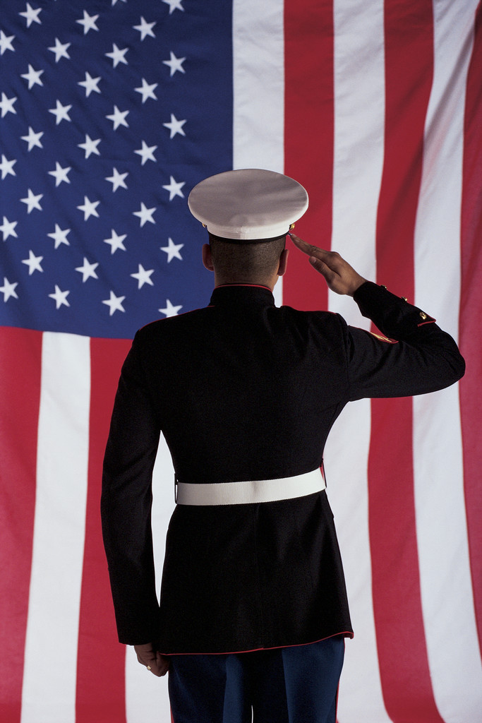
Expressed
Only the Federal government can:
Coin money
Maintain the military
Declare war
Regulate interstate or foreign trade
Make laws necessary for carrying out expressed powers of the federal gov’t
Why shouldn’t states have these powers?

Slide 13
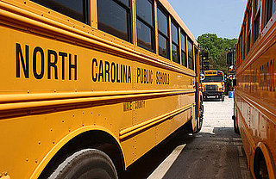
Reserved
Only state governments can:
Regulate trade within the state (intrastate)
Provide education
Regulate marriage
Conduct elections
Even national elections are run by the state
Establish local governments
Why should states have these powers?

Slide 14
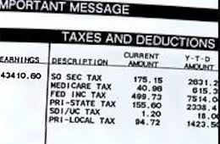
Concurrent
Both federal and state governments can:
Make and enforce laws
Levy taxes
Establish courts
Borrow $
Provide for general welfare

Slide 15
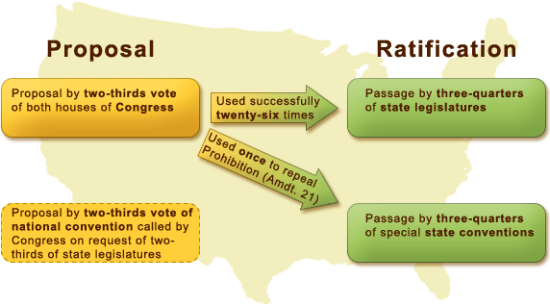
Amendments

Slide 16
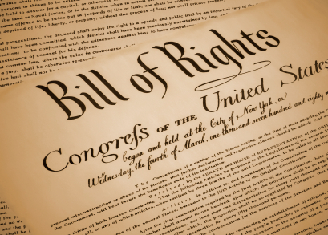
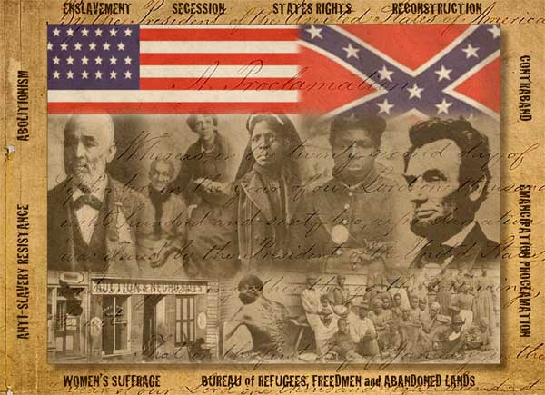
Bill of Rights: Amendments 1-10 include civil liberties, legal protections, and clarification of limits on federal gov’t
Civil War: Amendments 13-15 include abolition of slavery, civil rights, and right to vote regardless of skin color
What are the other major amendments?

Slide 17
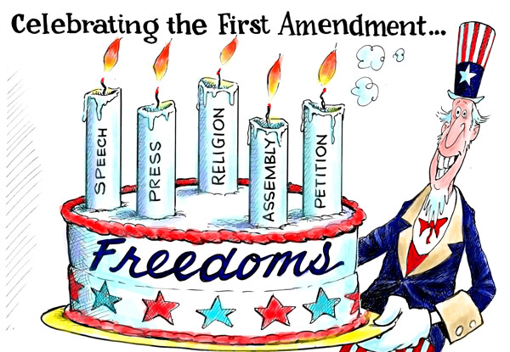
Civil Liberties
Freedoms of religious and political expression in the 1st Amendment
Religion
Establishment clause
Free exercise clause
Speech
Includes “symbolic ”
Press
No prior restraint
Assembly
Petition
What are the limits on these freedoms?

Slide 18
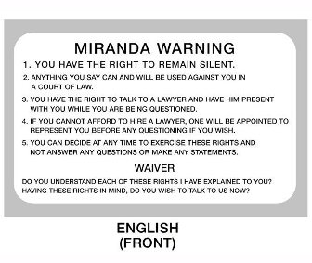
Legal Protections
Rights of the accused and due process of law to protect “life, liberty, and property”
4th: Search warrants and probable cause
5th: Double jeopardy, grand jury indictments, self-incrimination, eminent domain
6th: Speedy, public trial w/ jury and lawyer
8th: Reasonable bail, fines, punishments

Slide 19
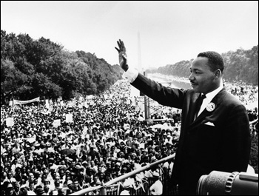
Civil Rights
Citizens given equal protection under the law in the 14th Amendment
What does this mean?
Besides African Americans, what other groups have struggled with how this Amendment has been interpreted over time?

Slide 20
Interpretation
Judicial Review
Supreme Court can rule Acts of Congress, President, and States unconstitutional
Congressional
Implied powers of Congress from the “Necessary and Proper” or Elastic Clause
Ex. 14th Amendment granted civil rights in 1868 and Brown v. Board of Education outlawed segregation in 1954, but the Civil Rights Acts of the 1960s worked out the details and closed loopholes

Slide 21
Case | Question | Constitutional Issue
Tinker v. Des Moines | Do students have the right to protest at school? | Civil liberties, 1st Amend. freedom of speech
Hazelwood v. Kuhlmeier | Can schools censor student publications? | Civil liberties, 1st Amend. freedom of press
Engel v. Vitale | Can schools sponsor a moment of prayer? | Civil liberties, 1st Amend. freedom of religion, establishment and free exercise clauses
New Jersey v. TLO | Do schools have the right to search students without a warrant? | Legal Protection/Due Process 4th Amend. search and seizure, probable cause
Brown v. Board of Ed | Is school segregation constitutional? | Civil Rights, 14th Amend. Equal protection
Swann v. Charlotte-Meck | What are schools required to do to integrate by race? | Civil Rights, 14th Amend. Equal protection
Univ of CA v. Bakke | Can universities use affirmative action in admissions? | Civil Rights, 14th Amend. Equal protection

