Slide 1
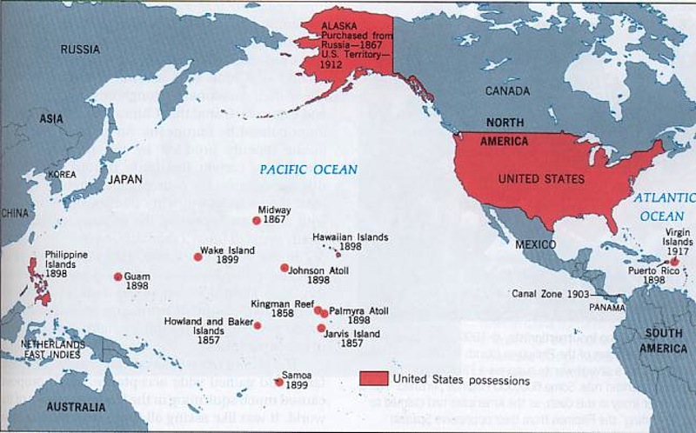
Unit 2: Imperialism and Isolationism (1890-1930)

Slide 2
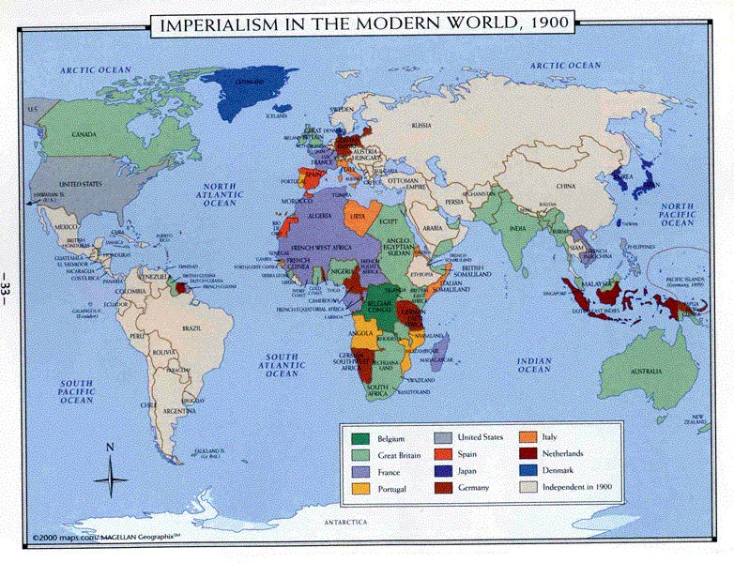
Imperialism
What is an empire?
Is imperialism the same as colonization?
Why would the U.S. get involved in this practice?
What is the difference between acquiring and taking something?

Slide 3
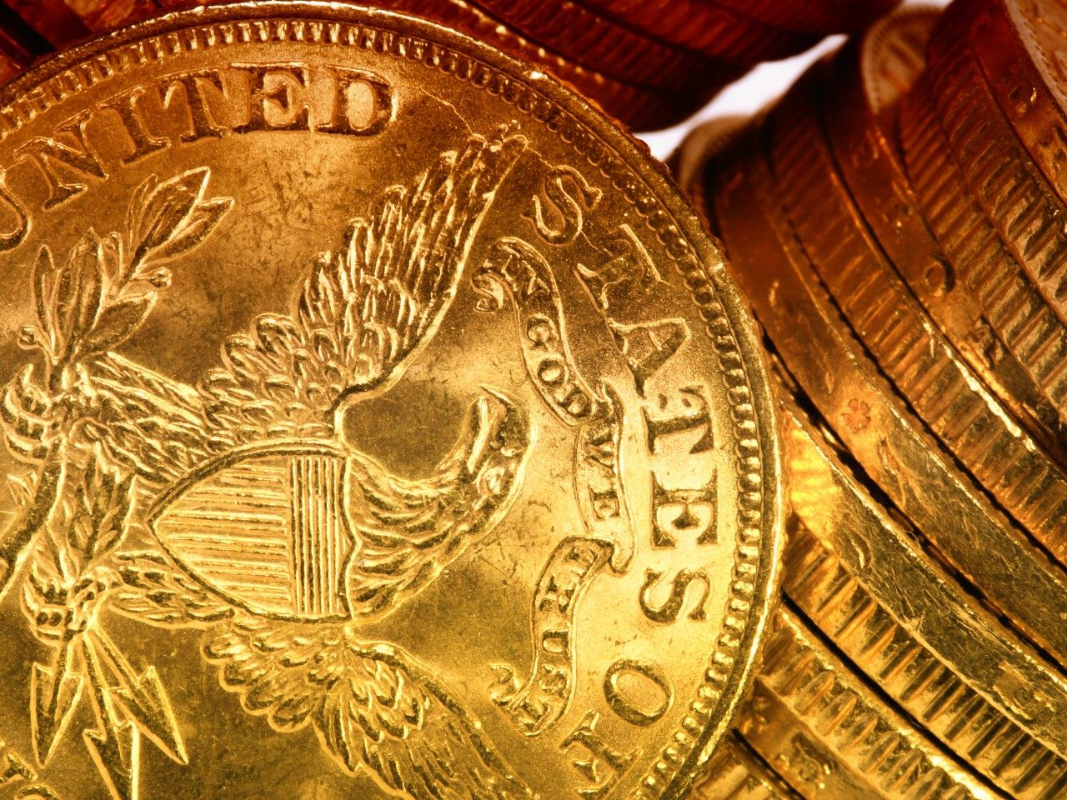
Pro-Imperialism
Money, Money, Money!
New markets fuel capitalism, help create a more favorable balance of trade (export > import)
Raw materials were needed to feed American factories
Better trade routes and outposts would help merchants
Cheap labor in foreign countries would increase profits
Reinforced by competition with European countries, need to defend trade routes and increase military presence worldwide
Justified by belief in Manifest Destiny, Social Darwinism, and the “White Man’s Burden” to spread civilization and Christianity

Slide 4
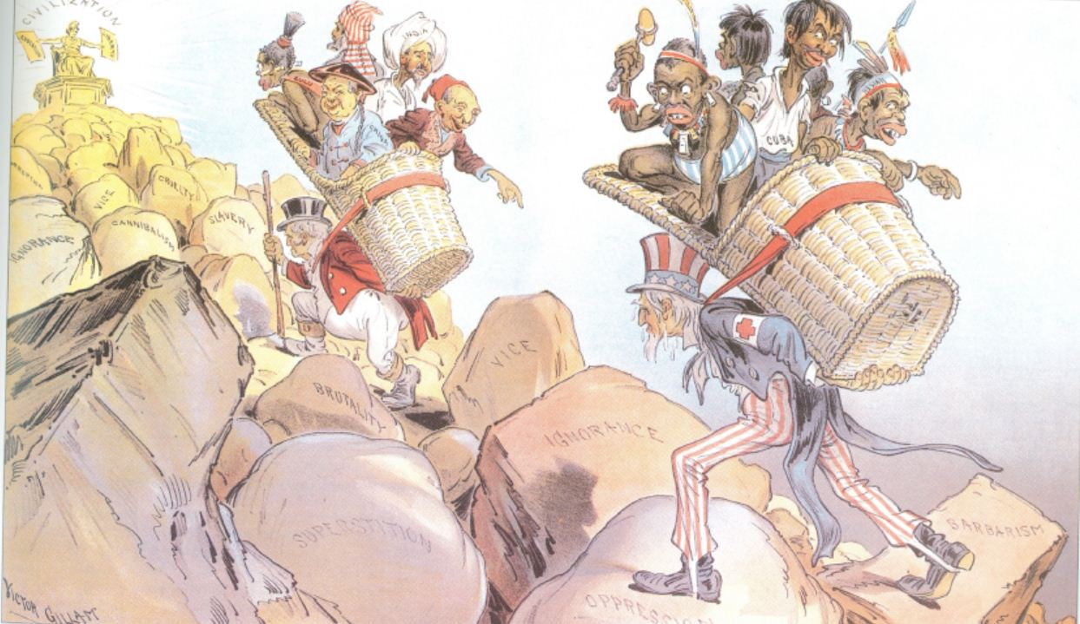

Slide 5
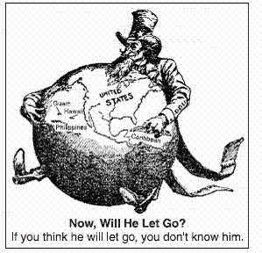
Anti-Imperialism
Goes against democratic principles
High cost to maintain military overseas
Potential for war or rebellions
Distracts from dealing with domestic issues like civil rights
Using foreign labor causes greater competition for jobs, lower wages
Nativism, xenophobia

Slide 6
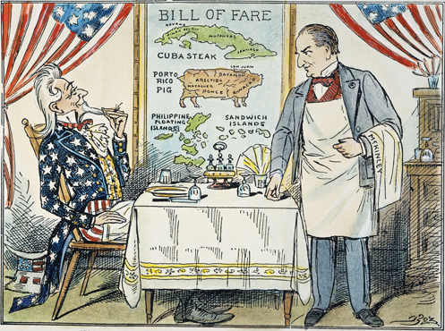
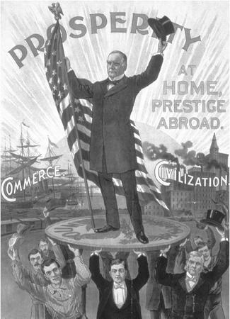
William McKinley
Republican William McKinley defeated William J. Bryan in the Election of 1896. As president, he embarked on a pro-business and pro-imperialism agenda.

Slide 7
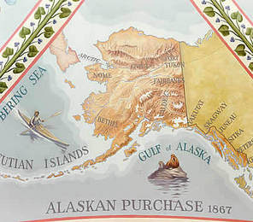
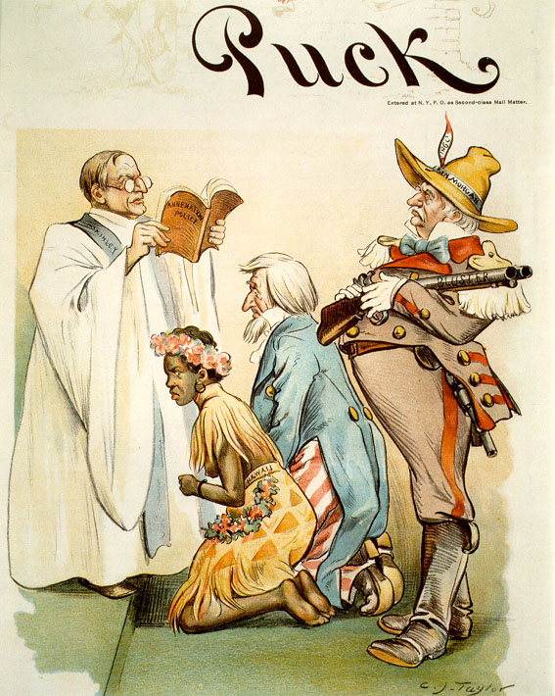
Two new states
The U.S. purchased Alaska from Russia for $7.2 million.
It was called “Seward’s Folly” because people believed the Sec. of State had wasted money on worthless land.
Led by American sugar plantation owners who wanted duty-free status and more control over Pacific trade, U.S. military forces overthrew the Hawaiian monarchy
There was debate over annexation because of the methods used to take control, but when McKinley became president it was annexed as a territory

Slide 8
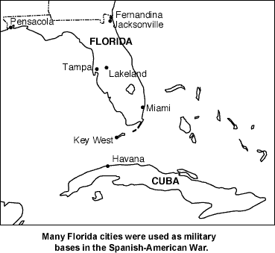
Spanish-American War
Long-term causes
Monroe Doctrine: getting European countries out of the Western Hemisphere
American sugar plantations had interests in securing a more stable government and increasing U.S. influence in Latin America
Revolutionaries in Cuba asked the U.S. for support in overthrowing Spain and becoming independent

Slide 9
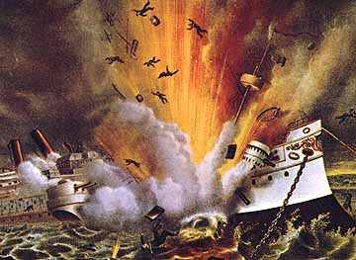
Spanish-American War
Immediate Causes
Yellow journalism: Exaggerated stories with unsupported claims, sensationalized to sell papers, got Americans in heated debate over Cuba
De Lôme Letter: Hearst published an intercepted letter written by a Spanish ambassador criticizing President McKinley with the title “Worst Insult to the United States in its History”
When the U.S.S. Maine exploded in Cuba, the papers blamed it on Spain without any proof
McKinley asked Congress for declaration of war, with promise not to annex Cuba after

Slide 10
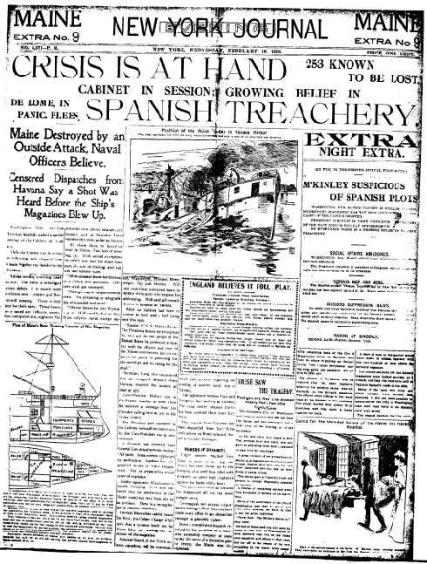
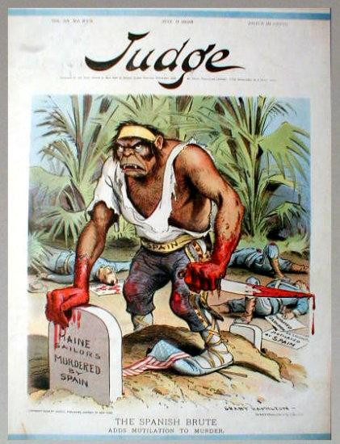

Slide 11
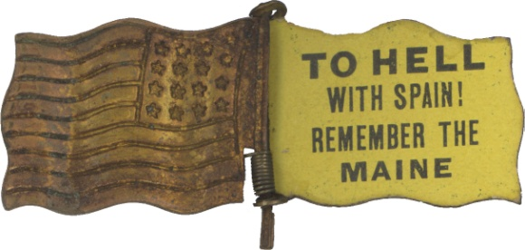
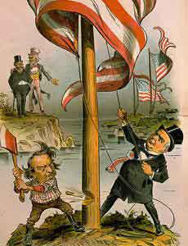
Spanish-American War
Treaty of Paris
Cuba gained independence
Platt Amendment established it as U.S. protectorate, Guantanamo naval base
Puerto Rico was added as a U.S. territory
The Foraker Act set up a government that shared power with Puerto Ricans
U.S. purchased Philippines for $20 mill
McKinley debated what to do, and then decided they were “unfit for self-government,” and that the U.S. needed to “uplift and civilize and Christianize them”

Slide 12
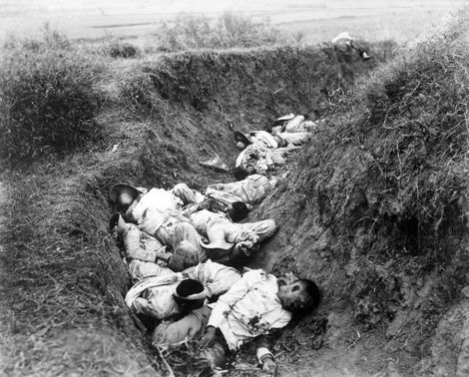
Philippine-American War
Filipinos fought for independence against the U.S. for almost three years
The U.S. put rebels in “zones of protection” or internment camps, where thousands died from disease and starvation
After the war, the U.S. set up a government that shared power with Filipinos
Independence was granted after WWII

Slide 13
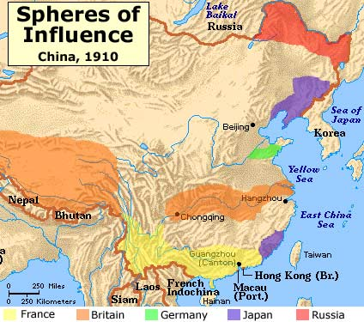
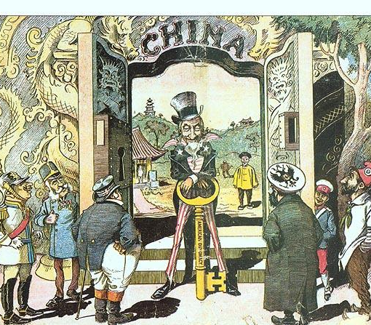
Open Door Policy in China
Taking Hawaii and the Philippines gave the U.S. a major base of trade in Asia, but China was the big market to break into
To resist colonization, China had created “spheres of influence” to limit trade with different countries to specific ports
Secretary of State John Hay issued a series of diplomatic letters to the China and the European countries asking for an end to this practice

Slide 14
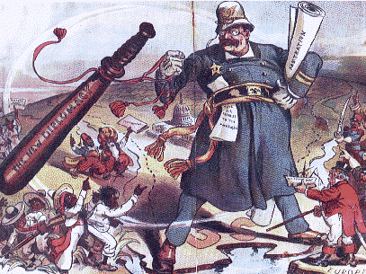
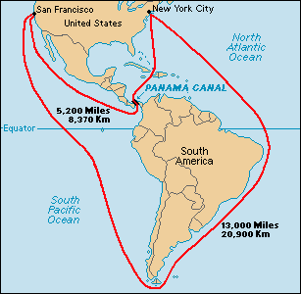
Roosevelt’s Big Stick Diplomacy
“Talk softly and carry a big stick” – strong military presence to add weight to diplomatic negotiations
Sent the Great White Fleet to pressure Russia and Japan into a negotiation
Roosevelt Corollary to the Monroe Doctrine added threat of force to protect U.S. interests in Latin America
Helped Panama win independence from Colombia in exchange for rights to build and control the Panama Canal

Slide 15
Taft’s Dollar Diplomacy
A continuation of TR’s policies in Latin America and Asia, Taft attempted to reduce European influence by offering to buy up debt to those countries in exchange for economic privilege
In Nicaragua, U.S. bankers loaned money to a pro-U.S. regime in exchange for control of their customs, railroads, and bank system

Slide 16
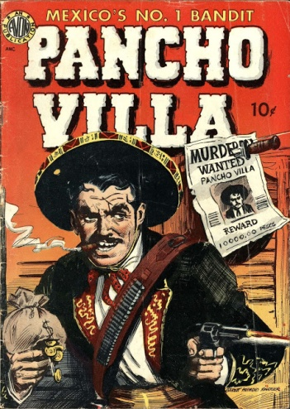
Wilson’s Missionary Diplomacy
Favored intervention when there was a moral responsibility to oppose oppressive, undemocratic, or hostile governments
Wilson intervened in the Mexican Revolution by supporting the leader that was least objectionable and helping stop a rebellion by Socialist leaders Pancho Villa and Emiliano Zapata
And then…

