Slide 1

Unit 3 – Branches & Levels of Gov’t
Objective 1
Analyze the structure and powers of the federal executive, legislative, and judicial branches.
Objective 2
Compare and contrast branches of government at the local, state, national, and international levels.

Slide 2
 | LEGISLATIVE | EXECUTIVE | JUDICIAL
FEDERAL | U.S. Congress: - Senate - House of Rep | President, VP Cabinet Exec Dept/Agencies Exec. Office of Pres. (EOP) Fed. Bureaucracy | U.S. Supreme Ct Circuit Cts of Appeals District Courts
STATE | N.C. General Assembly: Senate House of Rep | Governor N.C. Councils of State Lt. Gov Cabinet | N.C. Supreme Ct Court of Appeals Superior Courts District Courts
LOCAL | Municipal: Council, Mayor County: Board of Commissioners | Municipal: Manager, Police Chief County: Manager, Sheriff | Run at local level on behalf of the state: District Attorney Lower court judges

Slide 3
Organization of Congress
HOUSE
Lower house
By population – census,
districts within state
2 yr terms, all reps
run every time
25 yr old, 7 yr citizen
Speaker of the House
SENATE
Upper house
Equal – 2 per state
6 yr terms, elections
staggered 1/3 at a time
30 yr old, 9 yr citizen
Vice President &
President pro temp
?

Slide 4

Leadership
Speaker of House is the most powerful member of Congress – why?
  Elected by majority party
  Next in line after VP in line of succession
  Can steer legislation, decide on priorities
VP and President pro tempore preside
over the Senate only
  VP can only vote if there is a tie – why?
  President pro temp (when VP is absent)
    Senior member of the majority party
    No special powers, mostly honorary position

Slide 5
Majority leader of the Senate and Minority leader of the House are also very influential in organizing votes, etc.
  Elected by majority/minority party
Committee chairs have a lot of power to decide on the fate of bills
  Chosen by seniority
    What are the pros/cons of this system?
  Committees are where bills start: they can be killed in committee before they ever go to the floor for a vote

Slide 6
Committees
Standing = permanent
  Examples: Budget, Foreign Relations, Armed Services, Agriculture, etc.
Select = temporary, deal with a special issue
  Examples: Homeland Security, Indian Affairs
Joint = include members of both houses
  Examples: Taxation, Economics, Library

Slide 7
Congressional Powers
Review: what type of powers are given to the federal government?
Money
  Taxes, borrowing, coining
Commerce
  Regulate interstate and foreign trade
Military and Foreign Policy
  Declare war, provide and regulate armed forces
Other
  Naturalization laws, post office

Slide 8

Implied Powers
Review: where does the Constitution give Congress its implied powers?
Examples:
  Power to tax implies power to support schools, welfare programs, etc.
  Power to borrow implies power to maintain the Federal Reserve Board
  Power to regulate commerce implies power to prohibit discrimination in restaurants, etc.
  Power to provide armed forces implies right to draft
  Power to establish naturalization laws implies right to limit immigration

Slide 9
Impeachment
Congress has the power to impeach federal government officials
  Only 2 presidents have been impeached – who?
  What other officials are sometimes impeached?
Impeach = accuse of misconduct
Process
  Begins when the House votes to impeach
  Trial takes place in the Senate
  Ends when the Senate votes on guilt or innocence
  2/3rds vote necessary to remove from office

Slide 10
Limits
Bill of Rights outlines laws that Congress cannot pass – example?
Checks and Balances: President can veto a bill, the Supreme Court can rule an act unconstitutional
Other limits:
  Cannot favor one state over another or interfere with reserved powers of the states
  Cannot tax intrastate commerce or exports
  Cannot suspend the right of habeas corpus
    Court order requiring police to bring prisoners to court to explain why they are being held
  Cannot pass a bill of attainder
    Punish a person without a jury trial
  Cannot pass ex post facto laws
    Punish an action that was not illegal when committed

Slide 11
Representing the People
Making laws
  Write and introduce bills, participate in committees, debate and vote on bills on the floor
Casework
  Help constituents who request help or information
Pork-barrel projects
  Create public works projects that help home state/district
  Help businesses at home get federal grants and contracts
  Why is there so much debate about “pork”?

Slide 12
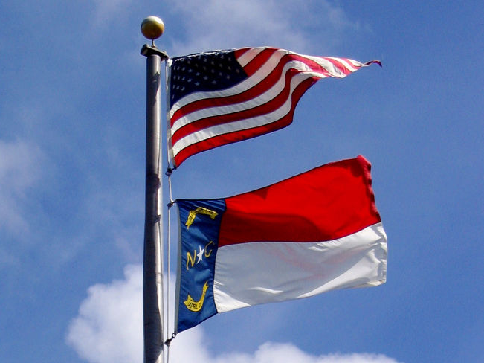
N.C. General Assembly
Review: what kind of powers are granted to the states?
  Regulate intrastate commerce, establish local gov’ts , run elections, provide education, protect public health and welfare
Organization, leadership, lawmaking process, checks/balances very similar to U.S. Congress
  One major difference: Amendments to the
  NC Constitution are decided through an election - current example?
Statutes = laws that apply statewide
  Examples: Smoking in restaurants, lottery

Slide 13
Local Legislatures
Created by General Assembly through incorporation (charter) or annexation (addition)
Make ordinances (local laws): taxes, budget, policies
 | Municipal (city/town) | County
Legislative Body | City/town Council | Board of Commissioners
Leader | Mayor | Chairperson
Services (major examples) | Taxes, Law enforcement, Waste, Water, Libraries, Parks Streets and sidewalks Traffic control Gas Electricity | Taxes, Law enforcement, Waste, Water, Libraries, Parks Elections Jails Public schools Social services

Slide 14
Federal Executive Branch
President
Presidential Advisers
Appointed,
some must be approved by Senate
Cabinet
Secretaries of Depts
EOP (Exec Office of Pres)
White House Office, Office of Management and Budget (OMB), National Security Council (NSC)
Vice
President
First Spouse
Independent Agencies
NASA, FCC, USPS, etc.
The Federal Bureaucracy
Civil service workers make up about 90% of the executive branch
Executive Departments
State, Defense, Treasury, Justice, Labor, Education, Agriculture, Energy, Homeland Security, etc.

Slide 15

The President
Chief Executive
  Carry out laws, head bureaucracy, issue executive orders
Chief Diplomat
  Direct foreign policy, make treaties, appoint ambassadors, issue executive agreements and trade sanctions
Commander in Chief
  Head military, order troops into battle or to do other peacetime jobs
Chief of State
  Greet and visit other leaders, carry out ceremonial functions
Legislative Leader
  Propose and influence legislation process, veto/sign laws, give State
  of Union
Judicial Leader
  Appoint federal/Supreme Ct
  judges, grant pardons or amnesty, issue reprieves
Economic Leader
  Create policies to help economy
  grow/solve problems, plan budget
Party Leader
  Lead party, fundraise, campaign
  for or appoint other party members

Slide 16
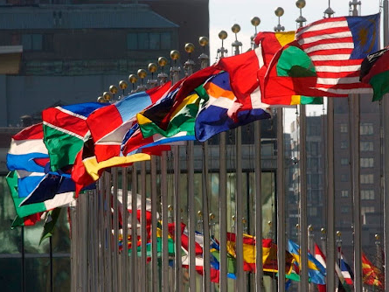
Foreign Policy
Four main goals:
National Security
  State Dept, Dept of Defense, Dept of Homeland Security, National Security Council (Top military commanders, CIA)
International trade
  If a main goal is to encourage international trade, why would the President ever issue an embargo?
Promoting world peace
  Ex. Leader in the United Nations, Middle East peace process, etc.
Promote democracy around the world
  How successful have we been?

Slide 17
Limits
Can be impeached by Congress
Executive orders subject to judicial review by Supreme Ct
  Korematsu v. U.S. (1944): Do you think the Court upheld the internment of Japanese Americans during WW2? Do you agree with the court’s decision?
Senate must approve all appointments
  Judges, Cabinet/Agency heads, Ambassadors
Congress must declare war, approve long-term troop deployment
  War Powers Act of 1973: Why would Congress limit the power
  of the President to wage war after Vietnam?
Must get sponsors for bills, Congress can override veto with 2/3 vote in both houses

Slide 18
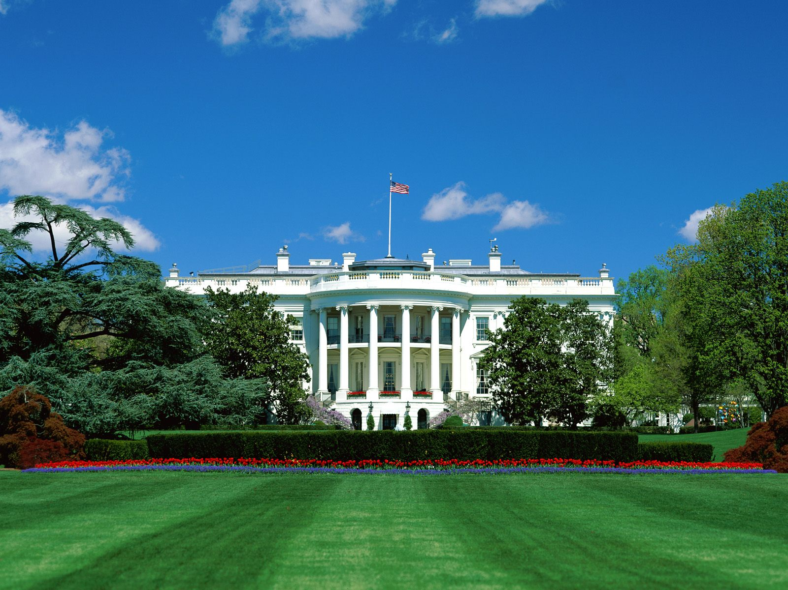
Advisers
What is the role of the Vice President?
Cabinet
  Heads of Executive Departments
    Must be approved by Senate
    Sec. of State, Defense, and Treasury most powerful
Executive Office of the President (EOP)
  White House Office
    Political appointees, closest advisers
    Chief of Staff most powerful, Press Secretary most visible
  Office of Management and Budget (OMB)
    Prepares the budget, matches proposals with goals of the administration
  National Security Council directs military and foreign policy
    Joint Chiefs of Staff, Sec of State and Defense, Director of CIA, etc.

Slide 19

Bureaucracy
Functions
  Develop specific rules and procedures based on new legislation
  Administer day-to-day operations such as delivering mail, sending out Social Security checks, and collecting taxes
  Regulate activities of companies, labor unions, airlines, nuclear power plants, etc.
Parts
  Executive Departments (under the Cabinet)
  Independent Agencies
    Executive Agencies (NASA), Gov’t Corporations (Post Service), and Regulatory Boards/Commissions (FCC)
  Civil Service Workers
    Federal government employees hired to work for a department or agency on a long-term basis
    Chosen based on the merit system, not political – why?

Slide 20
N.C. Executive Branch
Governor
Elected independently from Governor
Cabinet
(Secretaries)
Chairperson of Council
Council of State
Appointed by Gov.
Lt. Governor
Sec. of State
Attorney General
Superintendent of Schools
State Auditor
State Treasurer
Commissioner of Labor
Commissioner of Agriculture
Departments
(Commerce, Health and Human Resources, Transportation, Public Safety, Board of Education, etc.)
Departments and Agencies
What are the pros and cons of our state’s divided executive branch?

Slide 21
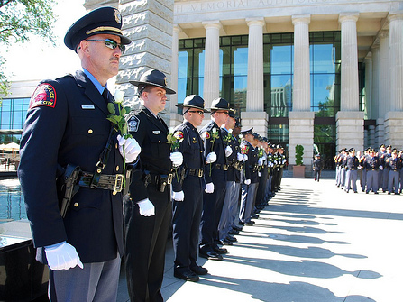
Local Executives
In NC, mayors have almost no executive power and serve mainly as the chairperson of the city/town council (“weak mayor” system)
  Why might this form of government developed over time to replace the strong executive mayor system?
So in NC municipalities and counties, the executive is a Manager is hired by the council/board to carry out local laws and head executive departments
  What are the pros/cons of this system?
The head of law enforcement for a municipality is the Chief of Police (hired by council) and for a county is the Sheriff (elected by voters)
  Why elect the sheriff?

Slide 22
Shared Legislative & Executive Powers
Congress creates and funds
the military, approves long-term troop use, declares war, and
approves treaties
Congress, General Assembly,
and local Councils/Boards
approve budgets, make
laws that determine how to
spend tax money
President commands
the military, deploys troops,
negotiates treaties, can ask
for a war declaration
President, Governor, and
local Managers propose
budgets, make decisions
about money allocated to
programs and agencies
WAR
(expressed)
BUDGET
(concurrent)

Slide 23
Federal Court System
Jurisdiction = authority to hear and decide a case
  Exclusive: Only federal courts can hear these cases
    Example?
  Concurrent: Federal and state courts can hear
    Example?
  Original: Hear case for first time
  Appellate: Hear cases when lower court decision is challenged (can uphold/reverse the decision, or remand back to lower court to be tried again)
Judges are appointed by President
  Who approves the appointment?
  Lifetime appointment (can retire or be impeached)
Review: what is a precedent?

Slide 24
Hierarchy | Jurisdiction | Major Examples of Cases
U.S. Supreme Court (1) | Appellate Limited original (disputes between states, diplomats) | Cases involving final interpretation of the U.S. Constitution (examples?) Disputes between states (examples?) Cases involving foreign diplomats Appeals of decisions made by Circuit Courts
Circuit Cts of Appeals (13) | Appellate | Appeals of decisions made by District Courts
Federal District Courts (94) | Original (Only level in the federal court system to hear testimony and include juries) | Criminal violations of federal laws (examples?) Civil lawsuits between parties from different states or against the federal gov’t (examples?) Cases involving foreign gov’ts or international waters

Slide 25
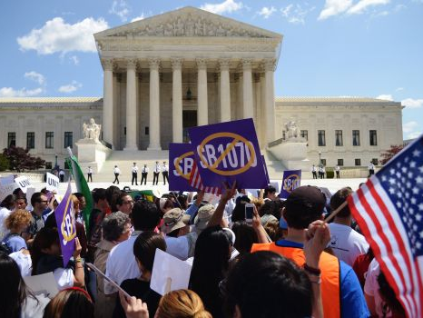
U.S. Supreme Court
Judicial review was first established in the Supreme Court case Marbury v. Madison
  Review: What is the power of judicial review?
  What branches/levels of government are subject to judicial review – examples?
Limits on the Court’s power:
  Depends on executive officials at all levels to enforce its decisions (Ex. Brown v. Board of Ed)
  Congress can get around a ruling by passing a new law or adopting a new amendment to the Constitution
  Can only rule on cases that involve federal questions and come to it through the appeals process
  Justices are appointed by President, approved by Senate, can be impeached

Slide 26
Landmark Decisions
Lawyers only present written and oral arguments, answer questions from justices
Justices meet in conferences to discuss
  Consider precedents, changing social conditions, and differing legal views – current examples?
Justices write their Opinions
  Majority: Official explanation of final decision
  Dissenting: A justice may choose to explain why he/she disagrees with the decision – why?
After the announcement, all lower courts must use the decision as the new precedent in similar cases (stare decisis – let the decision stand)

Slide 27
N.C. Courts
When could a case go higher than the N.C. Supreme Ct?
N.C. Supreme Court
Highest appeals, death penalty cases
state constitution/law interpretation
Every state level judge in NC is elected, not appointed – why?
N.C. Court of Appeals
Trial court appeals for new verdict
Superior Courts
MAJOR civil suits and
felony trial courts
District Courts
MINOR civil and criminal cases, juvenile cases, search/arrest warrants
Other judicial officers: District Attorneys, Magistrates, Public Defenders

Slide 28

N.C. Landmark Cases
State v. Mann (1830)
  Mann was a slaveholder arrested for beating an enslaved woman
  The NC Supreme Court overturned his arrest based on interpretation of the NC Constitution
  When would this case have been “overturned”?
Leandro v. State (1997)
  Citizens from 5 low-wealth counties sued the state for money to supplement their school budgets
  The NC Supreme Court ruled the state is not required to ensure equal funding for all school systems
    A follow-up case did ensure extra funding for at-risk students
    Do you agree with the Leandro decision?

