Slide 1
Wherever they's a fight so hungry people can eat, I'll be there. Wherever they's a cop beatin' up a guy, I'll be there... I'll be in the way guys yell when they're mad an'—I'll be in the way kids laugh when they're hungry and they know supper's ready. An' when our folk eat the stuff they raise an' live in the houses they build—why, I'll be there.
Speakeasies & Hoovervilles

Slide 2
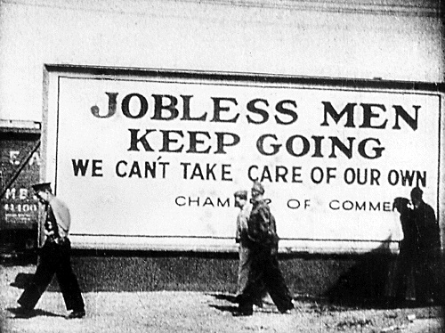
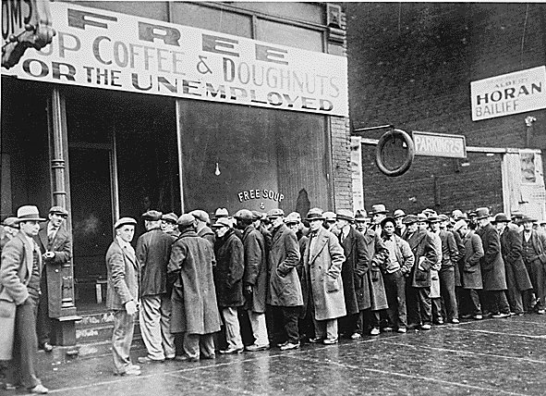
Surviving the Depression
Many people lost jobs, homes, life savings
The shame of poverty caused some to commit suicide, others to avoid seeking help
In cities people built shantytowns, charities ran soup kitchens and bread lines
Hundreds of thousands became migrants
Families sacrificed health care and education, adopted new habits of thriftiness and sharing – examples?

Slide 3
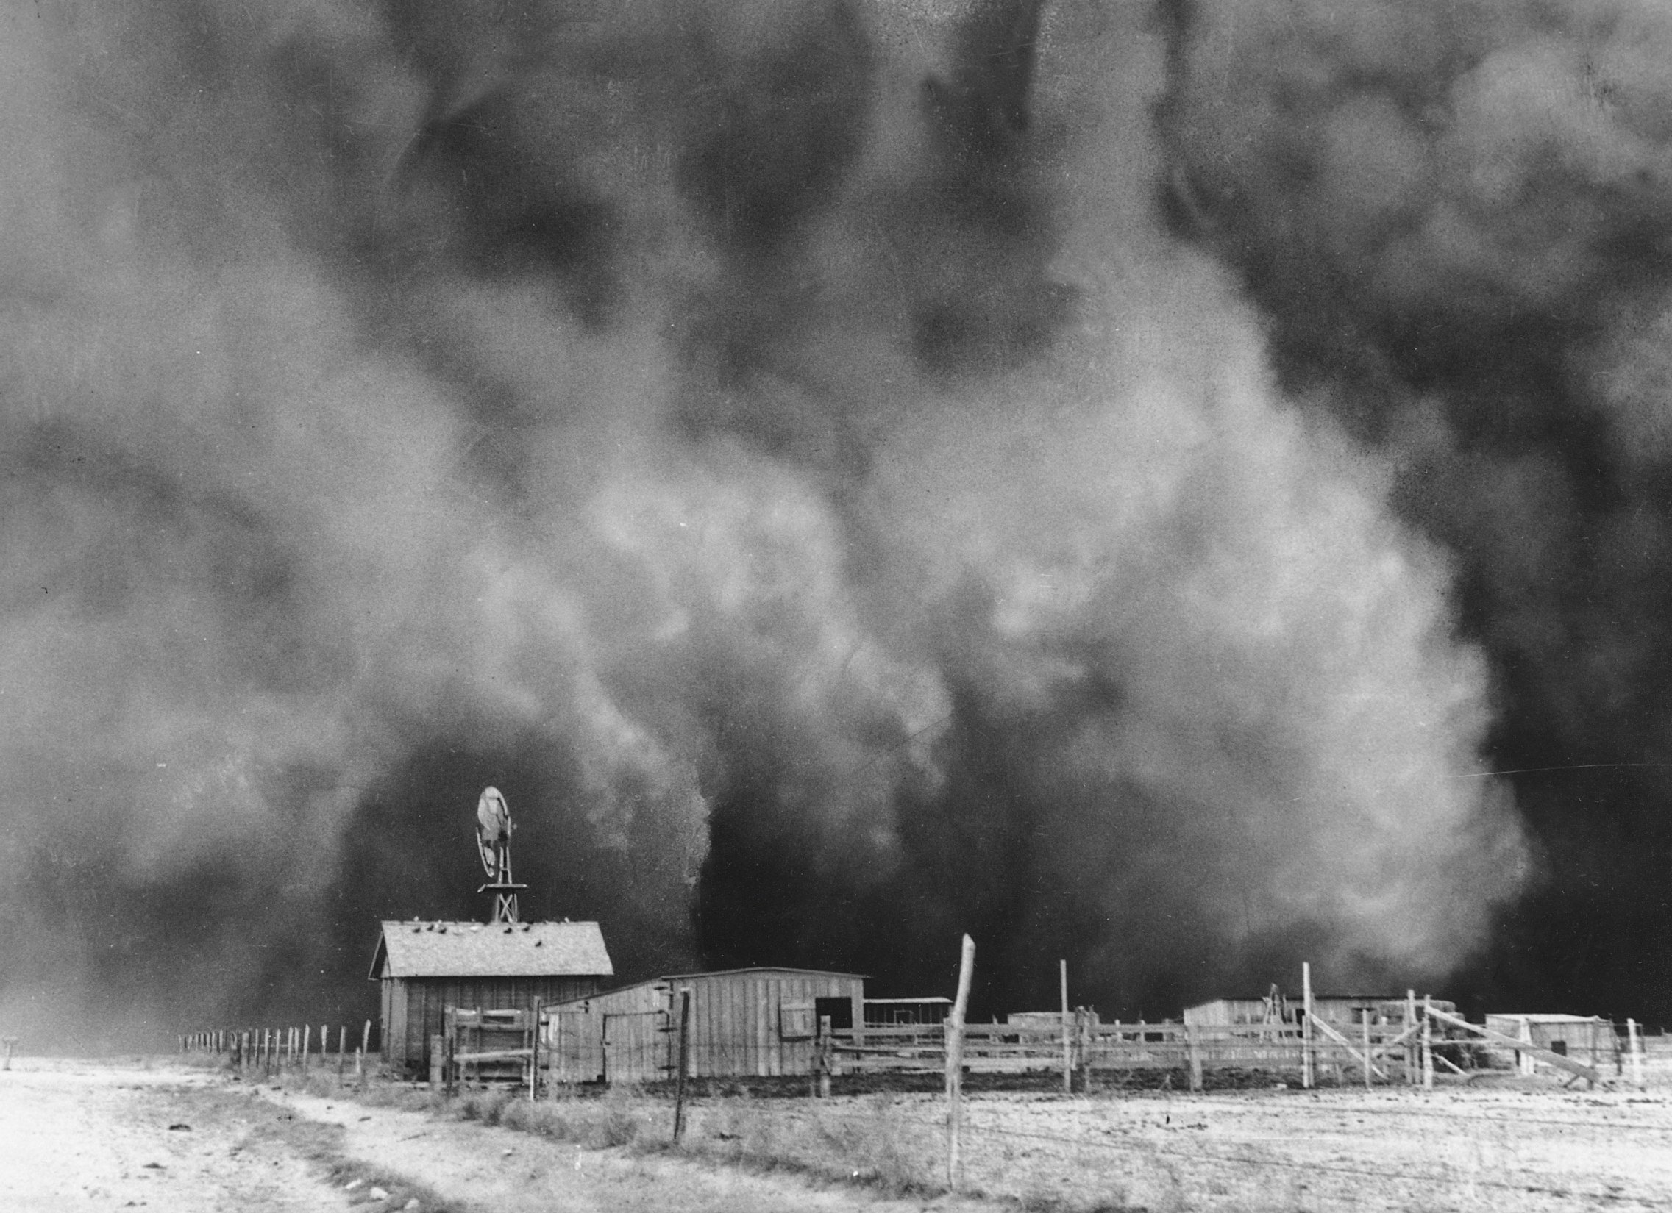
The Dust Bowl
In the 1920s
Overproduction had drained the soil of nutrients
Plowing had removed grass and trees that help protect the soil
In the 1930s
Drought and wind caused massive dust storms throughout the Great Plains
Farmers and sharecroppers affected by the Dust Bowl abandoned their farms and moved west

Slide 4
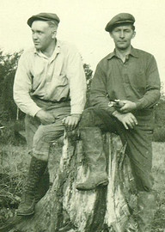
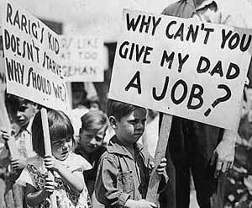
Government Response
The American belief in laissez-faire economics and “rugged individualism” guided government response – what does that mean?
Some cities offered a small amount of direct relief to families (about $2/wk)
President Herbert Hoover believed that the economy would fix itself, that aid to the needy should come from cooperative efforts from the private sector not the government

Slide 5
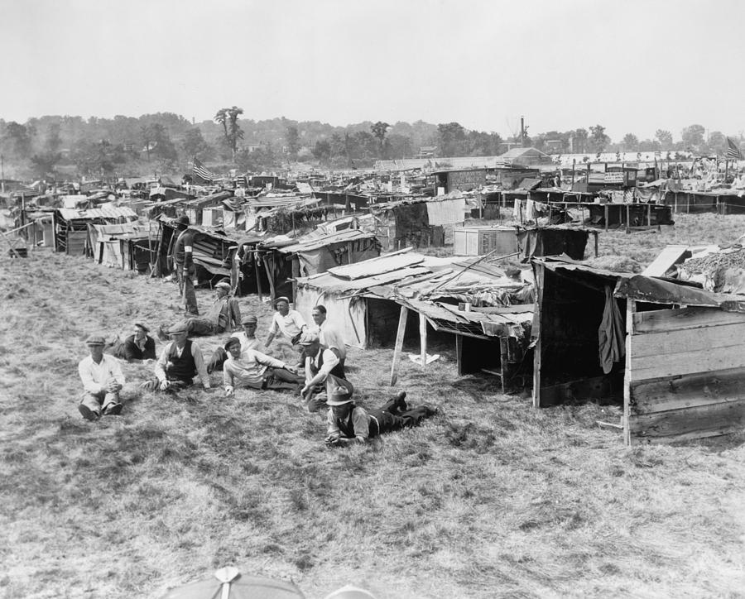
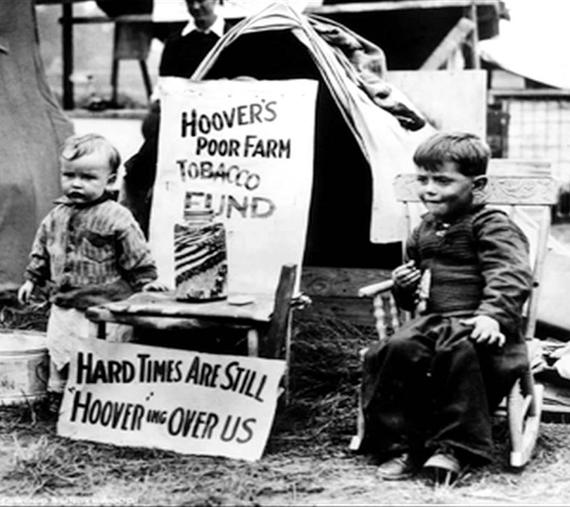
Hoovervilles
Despite some efforts to help, Hoover was blamed for failing to respond effectively
Asked employers not to cut wages, unions not to strike
Created an organization to coordinate charities
Authorized construction of the Boulder Dam (aka Hoover Dam) to provide jobs, electricity, flood control, and water
Americans got increasingly angry at the President
Some farmers destroyed or refused to sell crops at a loss
Shantytowns became “Hoovervilles” and empty pockets turned inside out were called “Hoover flags”

Slide 6
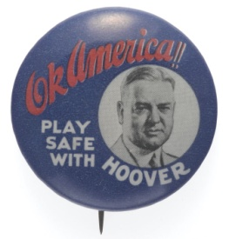
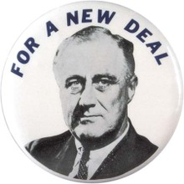
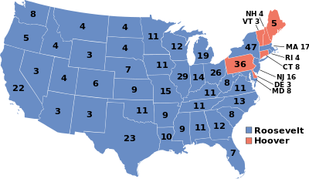
Election of 1932
Hoover tried intervention, seen as “too little, too late”
Farm Board, National Credit Corporation, Federal Home Loan Bank Act, Reconstruction Finance Corporation gave money to corporations that Hoover believed would trickle down to citizens through job growth and higher wages
How do you feel about Hoover’s beliefs/response?
His fate was sealed by his response to the Bonus Army
Army sent to use gas to disband a protest of WWI veterans
A baby died, a young boy blinded, two people shot
Franklin D. Roosevelt elected by a landslide, Democrats won large majority in the Senate and the House

Slide 7
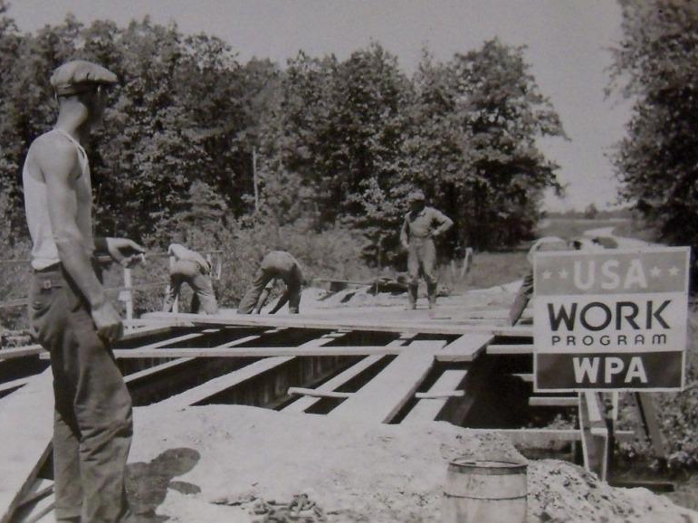
The country needs and…demands bold, persistent experimentation. It is common sense to take a method and try it: If it fails, admit it frankly and try another…
But above all, try something.

Slide 8
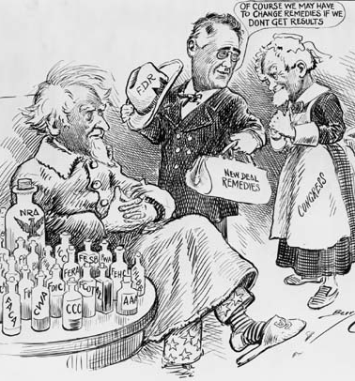
FDR’s New Deal
Assembled a “Brain Trust” to put together a massive set of policies to address problems of the Depression
Focused on the Three R’s
Relief for the needy
Recovery for the economy
Reform of finance
“The only thing we have to fear is fear itself.”
What did he mean? Do you agree?

Slide 9
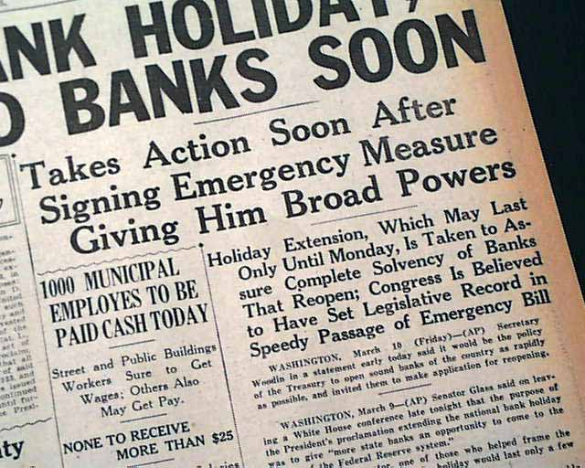
The First Hundred Days
His first act was to declare a bank holiday so the Treasury Dept could send inspectors out to banks
Those that were sound could reopen, and receive loans if they needed help
If problems were found, they would stay closed
Glass-Steagall Act established the FDIC to insure bank accounts
Federal Securities Act created the SEC to regulate stock market

Slide 10
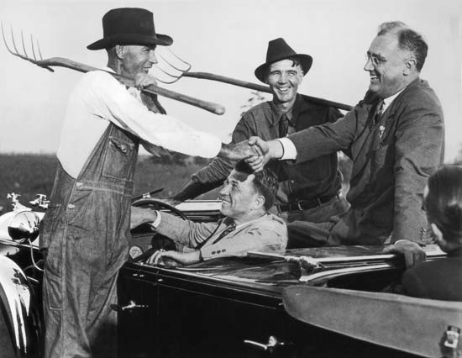
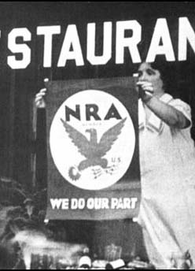
The Agricultural Adjustment Act (AAA) gave farmers money to reduce production – how? why?
Money for food, clothing, and shelter was offered through FERA and the HOLC
Jobs were created through groups like the CCC, CWA, PWA, and TVA
The National Industrial Recovery Act (NIRA) provided money to states to create jobs and also created the NRA to help establish fair practice codes for industries – examples?

Slide 11
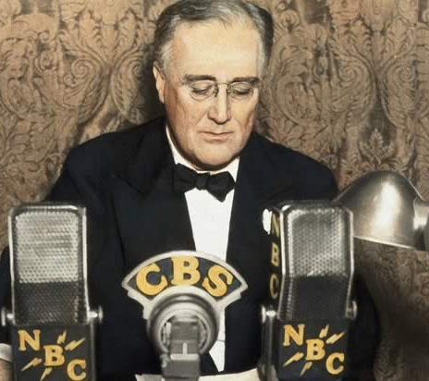
Reaction
Public morale and confidence went up
Fireside Chats explained plan, connected with citizens on a personal level
Regulation of Banks was successful
Encouraged repeal of Prohibition – why?
FDR still faced criticism
Direct relief and government works programs were not long-term solutions to job loss and were financed by deficit spending
Businesses argued that regulation stifled recovery and growth
Socialist ideas became more popular amongst those hardest hit – what groups would that be?

Slide 12
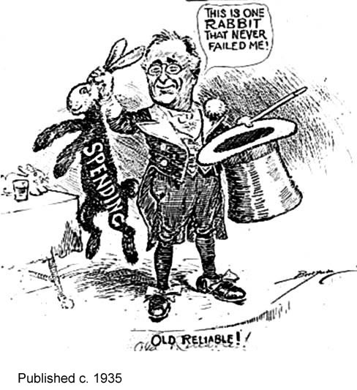
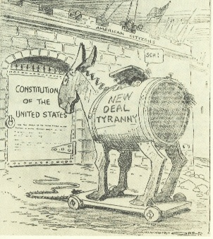
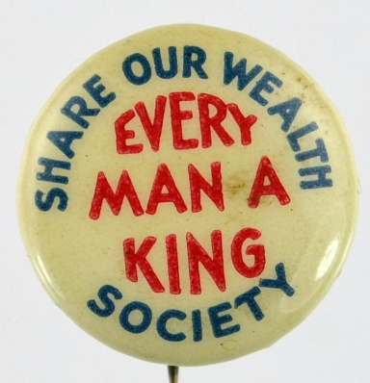
“The trouble is, Roosevelt hasn't taken all of my ideas; just part of them. I'm about one hundred yards ahead of him. We're on the same road, but I'm here and he's there.“ – Huey Long
“It's all very well for us to laugh over Huey. But actually we have to remember all the time that he really is one the of two most dangerous men in the Country.“ – Franklin D. Roosevelt

Slide 13
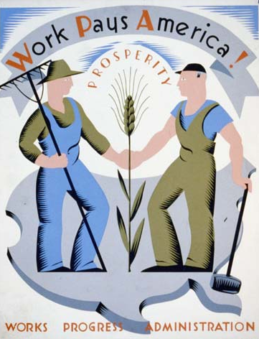
The Second Hundred Days
Why did FDR need to implement a second wave of reform?
Farmers
incentives for practicing good soil conservation
helped migrants and sharecroppers buy land
Workers
WPA created 8 million jobs for both unskilled workers and professionals
Wagner Act created the NLRB to protect unions
Fair Labor Standards Act established federal guidelines for child labor, minimum wage, and maximum hours

Slide 14
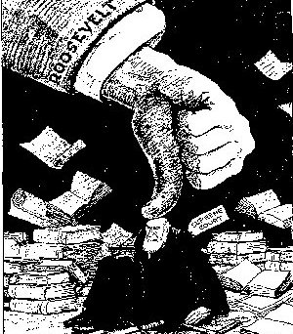
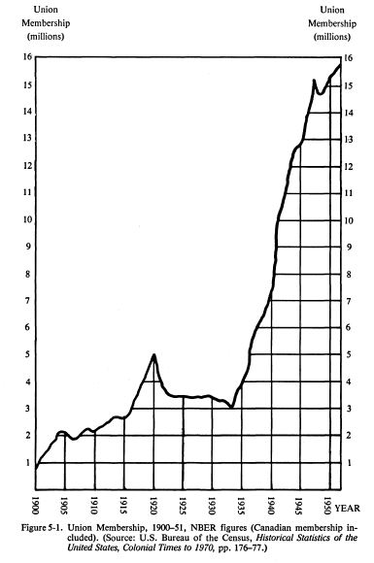
Court Packing Plan
After the Supreme Court ruled the NIRA and AAA unconstitutional, Roosevelt came up with a plan to add 6 new justices to the Supreme Court
The plan failed due to heated opposition and debate – why?
Over the next few years, 7 justices retired so FDR was able to appoint supporters to the Court anyway
NLRB v. Jones and Laughlin Steel decision signaled a change in direction, giving workers the right to unionize and the federal gov’t power to protect this right under the interstate commerce clause.
Union membership grew from 3 to 10 million

Slide 15
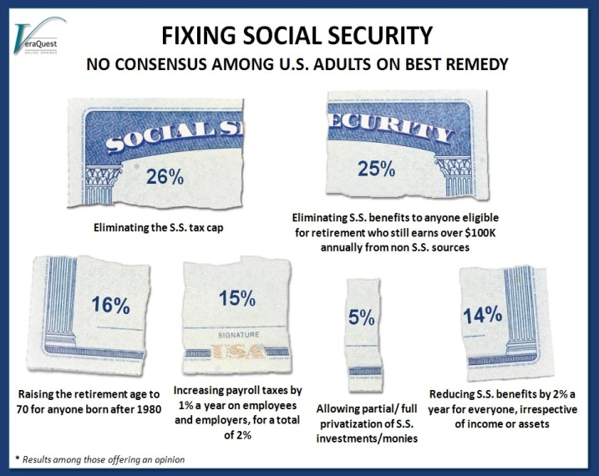
Social Security Act
Benefits
Retirement: half of funds come from the worker, half from employer
Death: benefit paid to dependent children
Unemployment: benefits paid through federal tax on employers
Disability: states receive federal aid to pay benefits
Problems
What about the self-employed?
Why is there so much debate about what to do with it now?

Slide 16
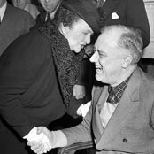
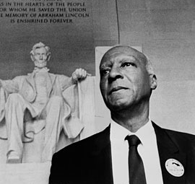
Minority Groups
Frances Perkins (Sec. of Labor) and Eleanor Roosevelt played large roles in New Deal
Why are women considered a minority group?
Civil Rights leaders like A. Philip Randolph and Mary McLeod Bethune helped advise the president on racial issues (“Black Cabinet”)
Still no federal support to stop lynching and poll taxes, works programs favored whites
John Collier helped create the Indian Reorganization Act to give Native Americans more autonomy
Continued to face severe economic problems
Mexican Americans benefitted least from New Deal programs because they tended to be migrant farmers

Slide 17
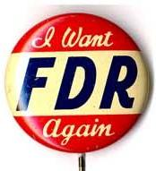
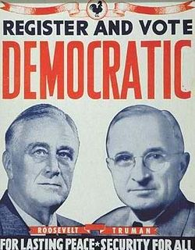
FDR wins again, and again…
Though women and minorities did not benefit equally, they still made gains from New Deal programs and lent support to FDR
The Democratic Party created the New Deal Coalition, including:
Southern whites
African Americans
Labor unions
Northern city governments
Urban immigrants
Religious groups
Did the New Deal end the Great Depression?

Slide 18
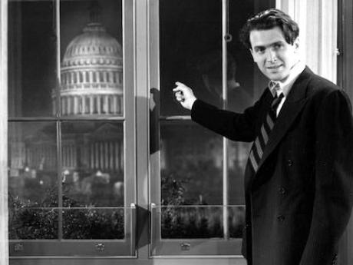
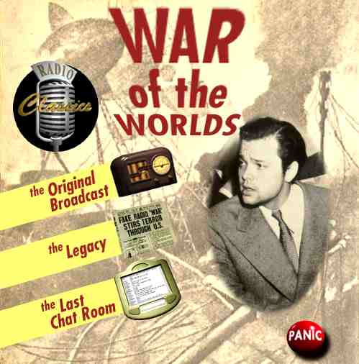
Cultural Effects
Despite economic hardships, the entertainment industry grew – why?
Movies were filled with romance, political optimism, average people succeeding
Gone with the Wind, Mr. Smith Goes to Washington
Radio was the center of information and entertainment for families
FDR’s fireside chats, soap operas, children’s programs

Slide 19
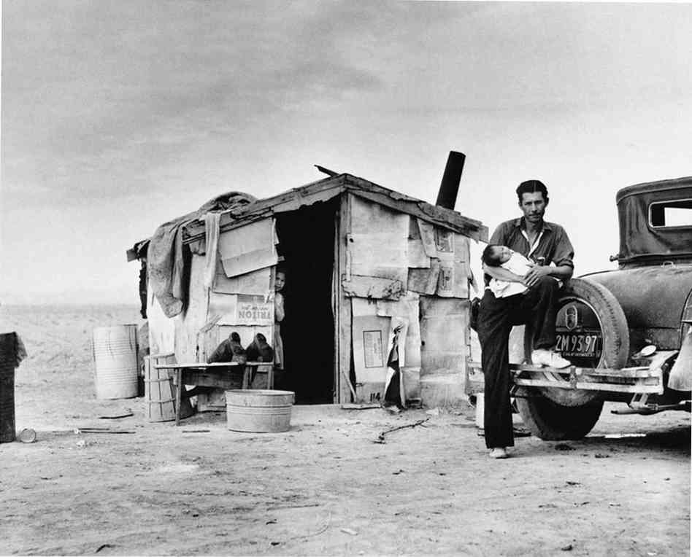
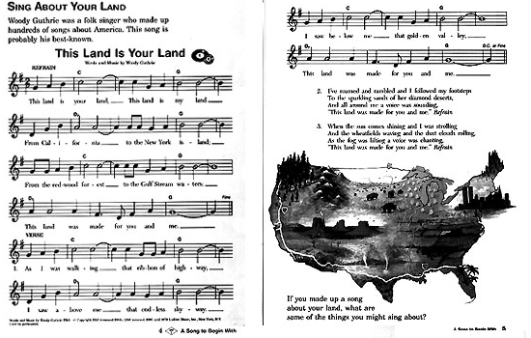
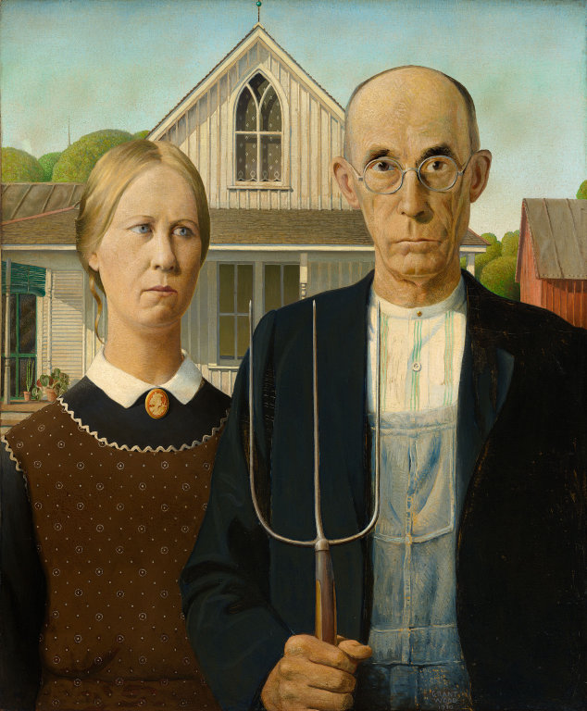
Art, music and literature was “sober and serious” reflecting democratic values, dignity and strength of character, experiences of Dust Bowl and migrants
Woody Guthrie, Grapes of Wrath
Many artists and photographers received support from New Deal programs
American Gothic, Dorothea Lange

Slide 20
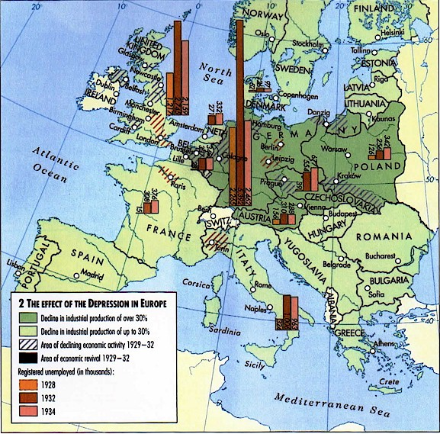
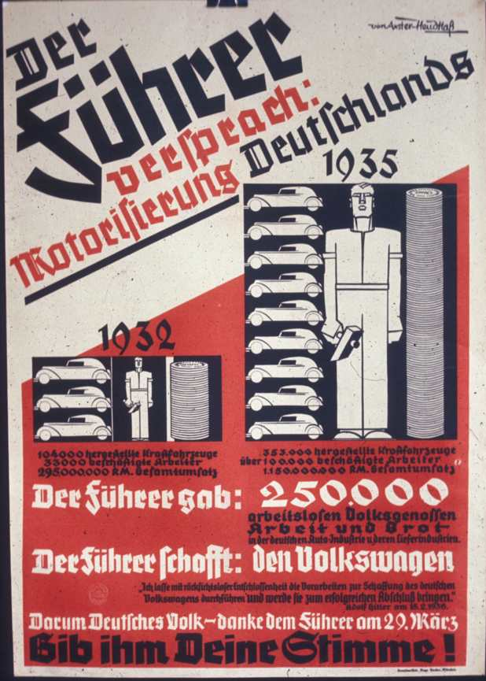
Why was this part of Europe hardest hit by the Depression?
Why was it the first to recover?

Slide 21
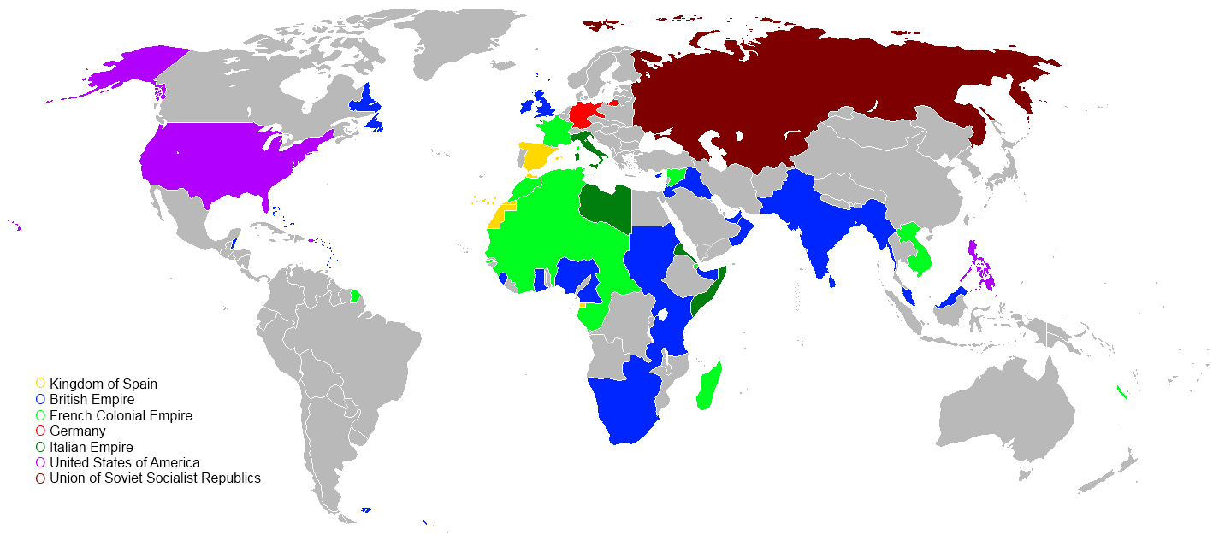
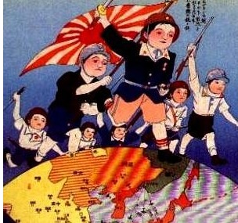
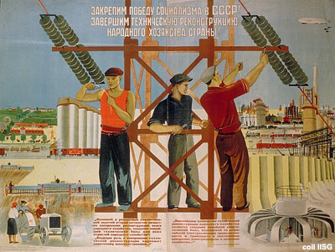
What effects did the Depression have on other parts of the world?

