Slide 1
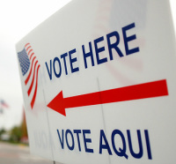
Unit 4 – Active Citizenship
Objective 1 Explain the process of naturalization, as well as the rights and responsibilities of American citizens. Objective 2 Analyze the role of political parties, the media, and interest groups in elections and public policy.

Slide 2
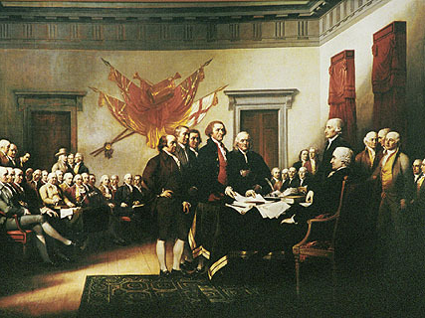
Social Contract
Citizens: members of a community who owe their loyalty to the government of the community and are entitled to government services.
Why do citizens need their government?
Government: the ruling authority for a community that oversees distribution of resources and provides order in a society.
Why does government need its citizens?

Slide 3
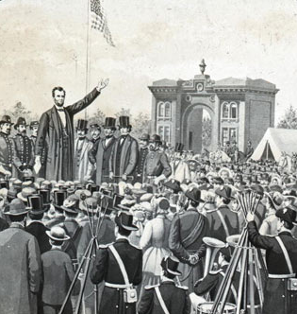
“Of the people” the government rules by consent of the governed; it gets its power from the citizens.
Specific examples?
“By the people” regular citizens are the people who participate in government.
Specific examples?
“For the people” the actions of the government should benefit the citizens.
Specific examples?

Slide 4
Fourteenth Amendment
In addition to Equal Protection…
“All persons born or naturalized in the United States, and subject to the jurisdiction thereof, are citizens of the United States and of the State wherein they reside.”
Former slaves
Native Americans?

Slide 5
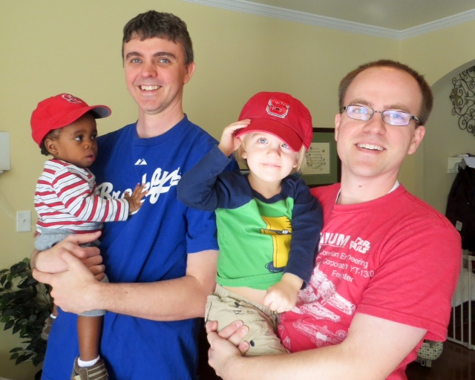
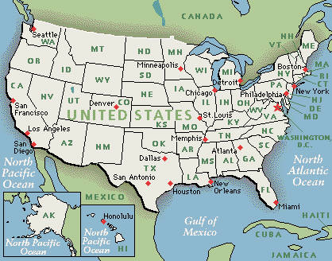
Citizenship by Birth
Jus sanguinis
“By blood”
Parents are U.S. citizens
What if you are adopted from a foreign country?
Jus soli
“By soil”
Born in U.S. territory
Where does the U.S. have territory?

Slide 6
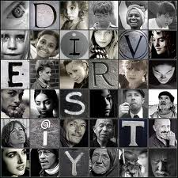
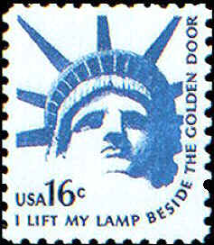
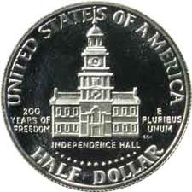
Nation of Immigrants
Almost everyone in the US is an immigrant or the descendant of an immigrant.
“E Pluribus Unum”: Out of many, one
How do we often describe this aspect of American society?
What is the difference between an immigrant and an alien?

Slide 7
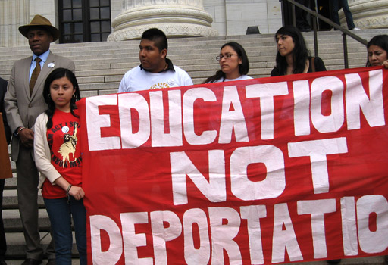
Aliens in America
Only about 675,000 aliens are allowed into the U.S. each year.
People with family members already in the country or with a special skill get preference. Why?
Legal Aliens
CAN: work, own property, attend school, receive government services
CAN’T: run for office, vote, serve on a jury
MUST: follow laws, pay taxes, carry ID.
Undocumented Residents: at least 5-6 million, get deported if caught.
Why are there so many?
What reforms are being debated?
www.uscis.gov

Slide 8
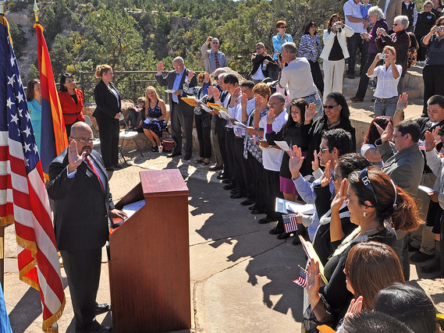
Naturalization
Be a Lawful Permanent Resident of the United States
First apply for a Visa to be allowed temporary visitation
Later apply for a Green Card for permanent residence
While here: follow laws, work, and pay taxes
Live in U.S. for 5 years (only 3 if married to a citizen)
Learn English and Civics to prepare for naturalization test
Go through Naturalization process
Apply for Citizenship
Interview with USCIS
Pass the Naturalization Test
Attend ceremony and take oath of allegiance
Do you think it should be easier or more difficult to become a citizen?

Slide 9
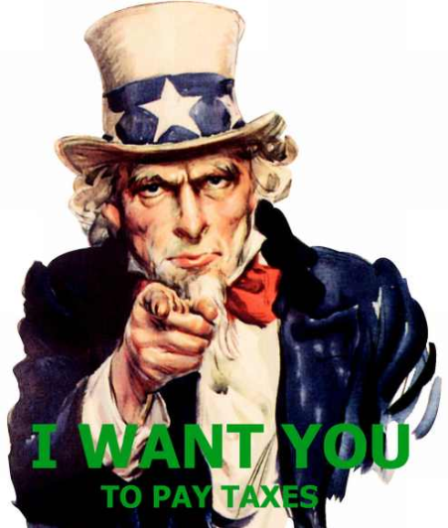
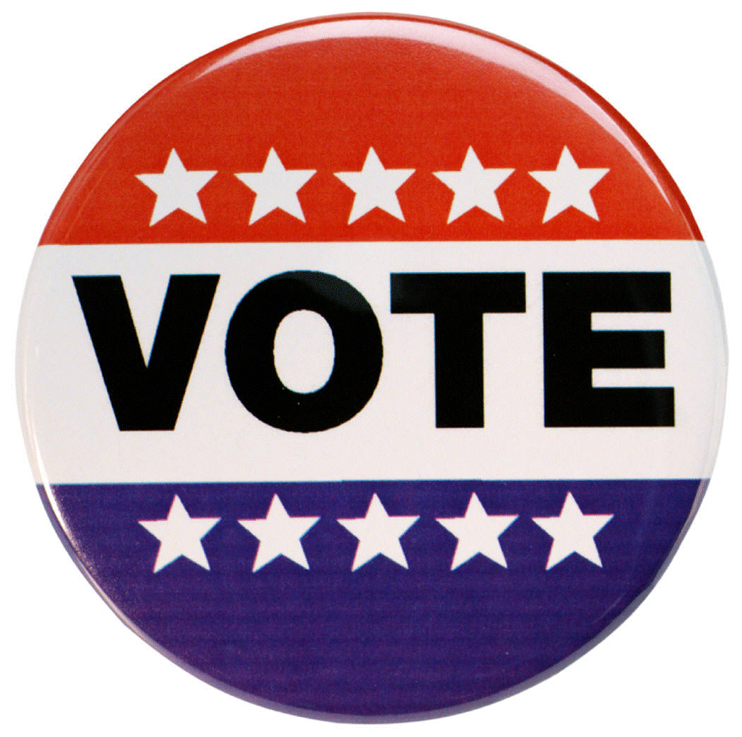
Duties and Responsibilities
Duties = Things you must do or face punishment
Responsibilities = Things you should do for greater good
Be informed and vote
Respect rights and property of others
Respect different opinions and ways of life
Volunteer time, resources
Obey the law
Pay taxes
Defend the nation (Selective Service)
Serve in court (Jury duty, witness)
Attend school (Until age 16)
What do you do now?
What will you do later?
To what extent should we make sacrifices for others?

Slide 10
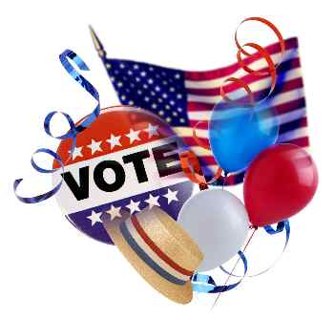
Political Parties
Definition
Association of voters with broad common interests who want to influence or control decision making in government by electing the party’s candidates to public office
Main roles
Nominate candidates for office through primary election process
Raise funds and campaign to get them elected
Do you think political parties help or hinder the democratic process?

Slide 11
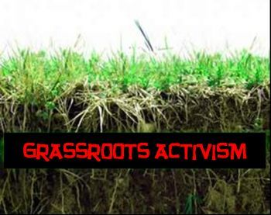
Inform citizens
Parties call, send mail, and advertize to notify voters of important issues
Personal examples?
Watchdog
Losing party will watch what the winning candidate does in office in order to recognize and point out any mistakes.
Examples?
Link levels of government
Members of the same party at different levels of government often work together to get things done.

Slide 12
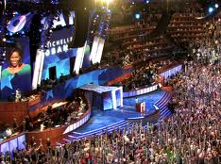
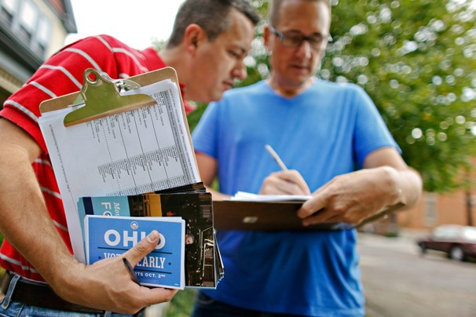
Organization of Political Parties
National Level
Main focus is fundraising
Every four years the national party provides a National Convention to nominate and announce the party’s candidate for the President
State and Local Level
Run primary elections to decide nominee
Register new voters
Grassroots: political ideas and movements that start at the local level
Examples?

Slide 13
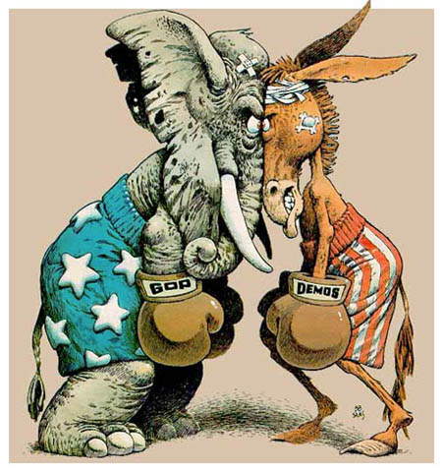
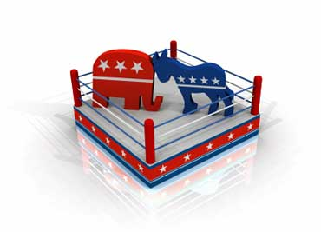
The American Two-Party System
Since 1854, either a Republican or Democrat has been elected to the Presidency.
Why?
Pros/Cons?
What does bipartisan mean?
Democratic = Donkey
(Jackson the “Jackass”)
Republican = Elephant
(GOP = Grand Old Party)

Slide 14
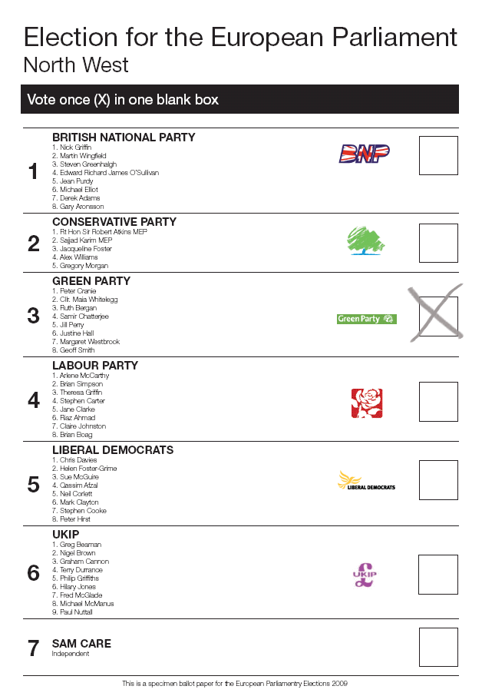
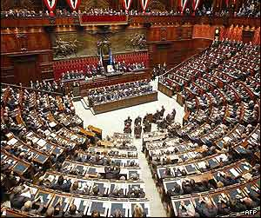
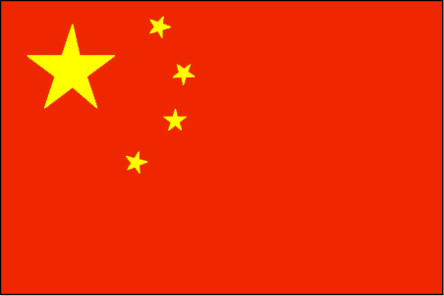
Other Party Systems
Multi-party system: many more than one party. Often, no single party wins a majority of seats so several parties join together to form a coalition government.
Pros?
Cons?
Examples?
One-party system: only one political party is legally allowed to exist. Citizens vote, but only have one candidate to choose.
Pros?
Cons?
Examples?

Slide 15
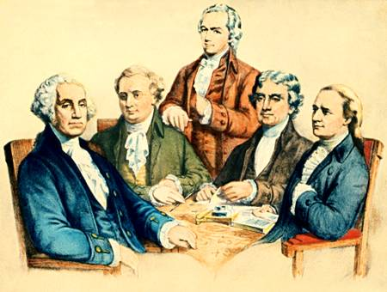
Historical Development
Washington wanted to avoid parties, but…
His Secretary of State Thomas Jefferson and his Secretary of Treasury Alexander Hamilton disagreed about everything
Hamilton = Federalist > strong central gov’t
Jefferson = Democratic-Republican (similar to Anti-Federalists) > strong individual and state powers

Slide 16
FEDERALIST
DEM-REPUBLICAN
Era of Good Feelings
Monroe, 1820s
REPUBLICAN
Election of 1824
JQA vs. Jackson
REPUBLICAN
DEMOCRATIC-REP
Anti-Jackson
Clay & Webster, 1834
WHIG
DEMOCRATIC
Compromise of 1850
Pro-Slavery
Anti-Slavery
Free-Soil Party
Know-Nothing Party
DEMOCRATIC
REPUBLICAN
Platform changed during the Great Depression
Platform changed after the Civil War and Reconstruction

Slide 17
Platforms and Planks
A platform is the party’s statement of principles, beliefs, and positions. A plank is an single issue in the platform like Taxes.
Democratic Party
Republican Party
Moderately liberal (“left”): progressive reform, social change
Highly educated, young, minority groups
Regulation (environment, workplace, gun control)
Social Programs (welfare, arts funding, foreign aid)
Tolerance (pro-choice, gay rights, church/state)
Famous Democrats?
www.democrats.org
Moderately conservative (“right”): small, traditional government
Business and Banking leaders, Conservative Christians
Economic (less regulation, tax breaks, corporate incentives)
Security (military, guns, death penalty, immigration)
Morals (religion, marriage, pro-life, self-reliance)
Famous Republicans?
www.gop.com

Slide 18
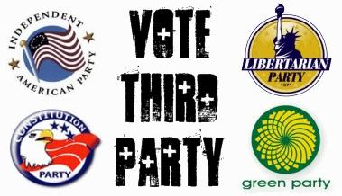
Third Parties
A third party is any political party other than Dem and Rep.
How many are there? What are the most popular ones?
Why do they so rarely win an election?
So why bother?
Ideas/views of third parties are often adopted by one of the main parties
Populist Party – died out but most of the issues were adopted by Democrats (farmers, laborers)
Third parties can affect the outcome of an election
Teddy Roosevelt broke off of Republican Party to form his own, splitting the vote and giving the election to Democrat Woodrow Wilson
In 2000, Nader (Green) took votes away from Gore (D), which helped Bush (R) win the election.
It isn’t set in stone
Republican Party started off as a third party – took less than 10 years to win the Presidency b/c slavery issue heated up
votesmart.org/political-parties

Slide 19
Suffrage
Who had the right to vote when our Constitution was written?
Qualifications:
Citizen
Registered
Do you have to register with a political party?
Resident of the state
18 or older
15th Amendment (1870) Prohibits denying a person’s right to vote on the basis of race
19th Amendment (1920) Guarantees women the right to vote
23rd Amendment (1961) Residents of D.C. can vote
24th Amendment (1964) Outlaws poll tax in national elections
26th Amendment (1971) Minimum voting age reduced to 18 for all elections

Slide 20
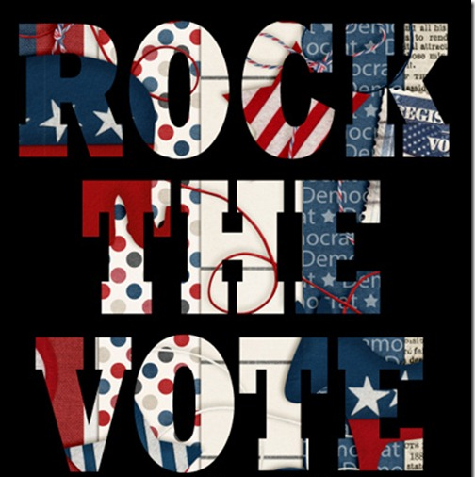
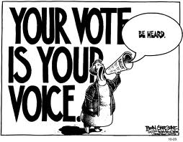
Voting
Why is voting important?
Why is voter turnout so low in the U.S.?
What groups are most likely to vote?
What has been done recently to address this issue?
How do most people prepare to vote?
How should you prepare?

Slide 21
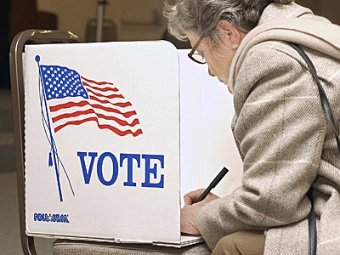
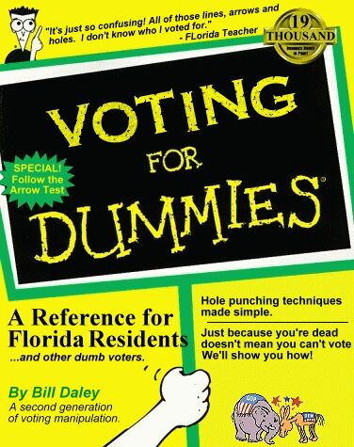
Register
Library, School, County Election Office, DMV
Register with a Party or as Unaffiliated?
Find your precinct and polling place, dates/times, request Absentee ballot or do Early registration if necessary
Stay informed with TV, magazines, newspapers, and the Internet.
Does the candidate share your same views?
Is the candidate reliable?
Is the candidate experienced?
Will the candidate be effective?
Does the candidate have a chance to win?
Show identification, complete the ballot in secret
Straight/split ticket?

Slide 22
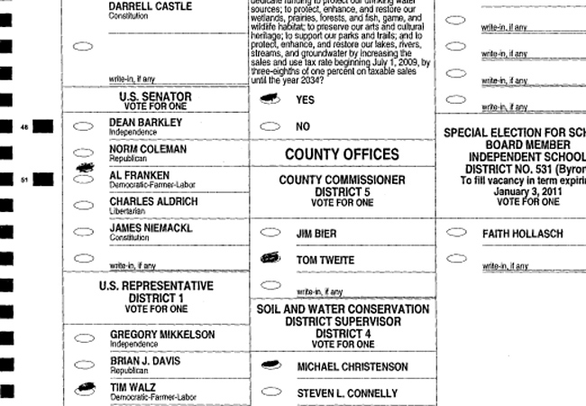
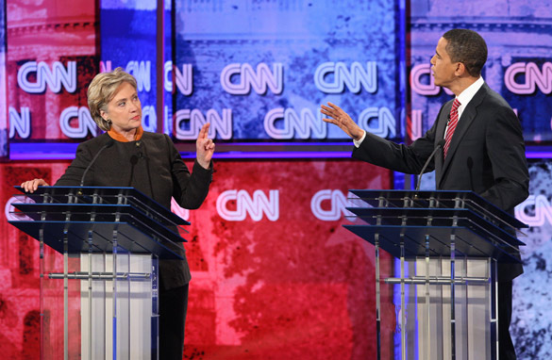
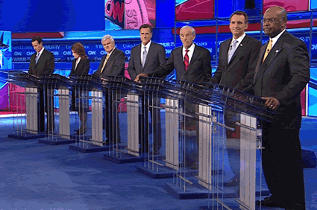
Elections
Review: Who runs elections?
Primary elections: Parties choose one nominee to run in the general election
Closed/open: If you have to be a registered member of the party or not
Why would this matter?
General elections
Vote for candidates at national, state, and local levels
Vote on state or local laws:
When citizens propose a new state law, it is an initiative. If enough people sign the initiative petition, it becomes a proposition that will be put on the ballot. The referendum is when the citizens vote to approve or reject a state law.
Special elections
Runoff: When there is no clear winner
Recall: Vote to remove a state official from office, force an early election

Slide 23
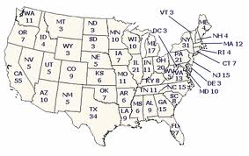
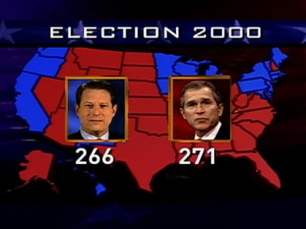
Presidential
Primary Elections to narrow down field
National Convention to announce candidate, platform
Debate Season
Media blitz, Public opinion polls
General Election held in every state on first Tues in Nov.
Electoral College
Winner-take-all-system:
Whoever wins the General election in the state gets all of the state’s electoral votes
Why do we use this system?
Pros/cons?
www.270towin.com
fivethirtyeight.blogs.nytimes.com

Slide 24
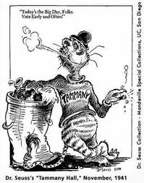
Reform
In the early 1900s, reforms were passed to deal with election fraud
Political machines: In some state and local governments, one party had so much power they controlled everything, even elections
Now, the biggest debate is over campaign finance reform
Why?
elections.nytimes.com/2012/campaign-finance

Slide 25
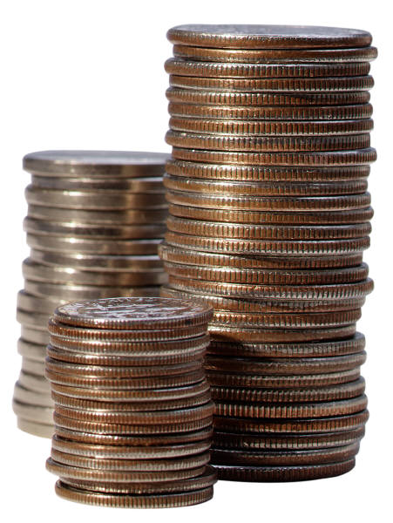
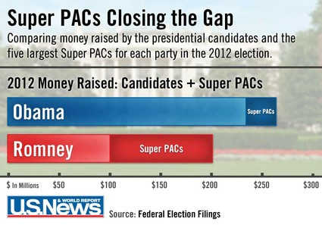
Money, Money, Money
Federal Election Commission
Sets limits on direct contributions to candidates
Public v. Private funding
Public: Presidential Election Campaign Fund, check box to donate on tax return
Private: Individuals, corporations, labor unions, interests groups
PACs are used by interest groups to raise $
Hard v. Soft money
Hard: Direct contributions to candidates are limited
Soft: Contributions to parties for general use or independent activities are unlimited
Citizens United (2010) led to rise of Super PACs
Do you agree with donation limits?

Slide 26
Interest Groups
How are interest groups different from political parties?
Types
Economic
Special Interest
Public
Activities
Form PACs to help candidates who support their issue get elected
Hire lobbyists to influence lawmakers
Use media to sway public opinion
votesmart.org/interest-groups
Major U.S. Interest Groups
National Association for the Advancement of Colored People | NAACP
American Federation of Labor and Congress of Industrial Organizations | AFL-CIO
American Medical Association | AMA
National Organization of Women | NOW
American Association of Retired Persons | AARP
National Rifle Association | NRA
American Civil Liberties Union | ACLU

Slide 27
The Media
Public Opinion
Public officials pay attention to public opinion when they set their agenda of important issues to address
Mass media reflects public opinion and attitudes about the issues, but it can also influence them
Example?
How is has the internet and social media affected politics?
How can you be on your guard for media bias?
Polls
Public opinion polls are taken regularly to monitor and track changes
Exit polls are taken as people leave the voting precincts to help them report early results
How does this work?
Propaganda
Promotion of a particular viewpoint or idea using persuasive techniques

Slide 28
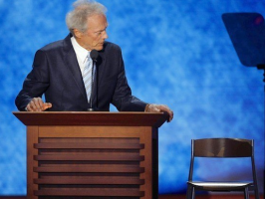
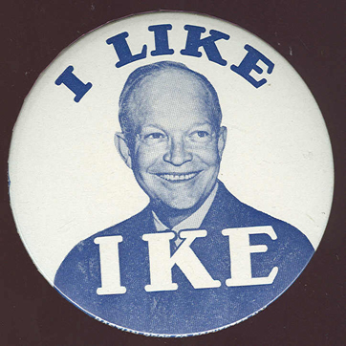
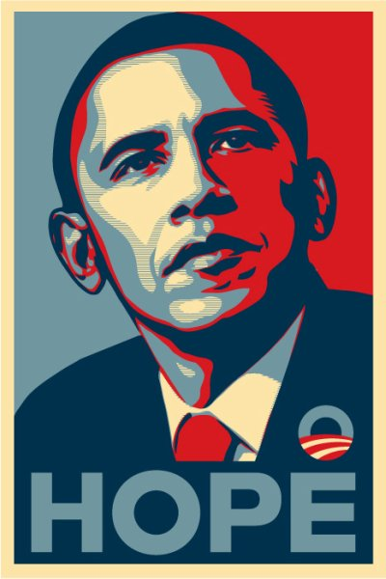
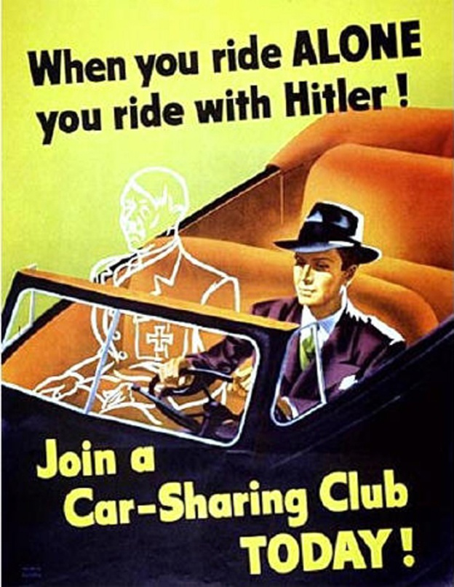
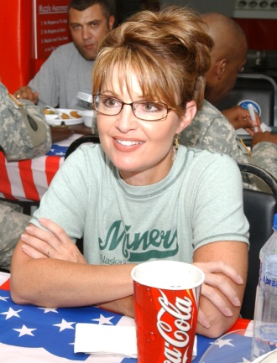
Propaganda
Glittering Generality
Sounds good, so vague it is essentially meaningless
Endorsement
Support from an influential celebrity or group
Name Calling
Unpleasant association or label
Bandwagon
Everyone else agrees, be on the winning team
Just Plain Folks
I’m just like you, so you can trust me
Why do propaganda techniques work?
Does propaganda help or hinder democracy?
Examples?
www.livingroomcandidate.org

