Slide 1

Unit 5 – Social Structure
Objective 1
Explain how statuses and roles impact the behavior of individuals and groups.
Objective 2
Compare different types of groups in society at the macro and micro levels.

Slide 2
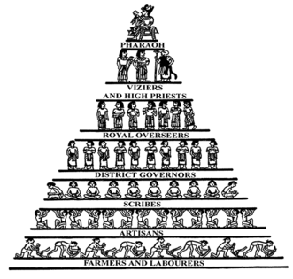
Social Structure
Network of interrelated statuses and roles that guide and make human interaction predictable
Macro
  Structure of society overall:
  preindustrial, industrial, postindustrial
  Large groups: structure of industries,
  governments, bureaucracies, etc.
Micro
  Small groups: approximately 2-15 members

Slide 3
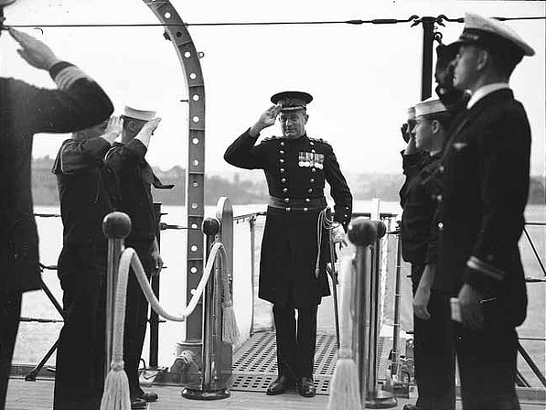
Status
A socially defined position in a group or in a society, a way of defining where individuals fit in society and how they relate to others
  Ascribed: Assigned though inherited traits or given automatically when a certain age is reached
  Achieved: Achieved through direct efforts like special skills, knowledge, or abilities
Master status: Is the one status of the many that you hold that plays the greatest role in shaping your life and identity
  Can your Master status change? Why/why not?

Slide 4
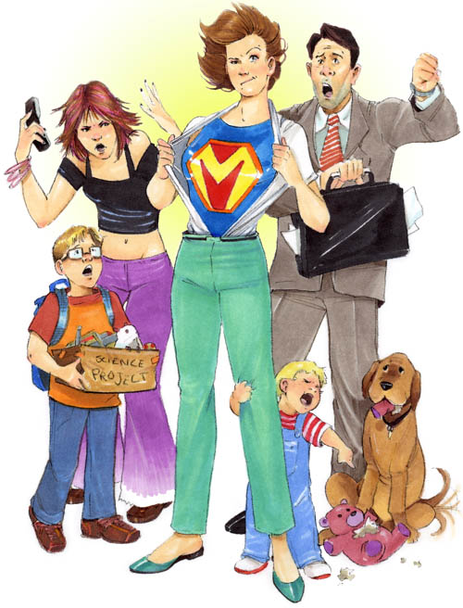
Roles
Behavior expected of someone occupying a status
  Includes both rights and obligations, since most roles are reciprocal (father-son, wife-husband, employer-employee)
Role performance: behavior doesn’t always meet expectations
  Role strain: Difficulty meeting the role set (multiple expectations) of a single status
  Role conflict: Fulfilling role of one status makes it difficult to fulfill the role of another status

Slide 5
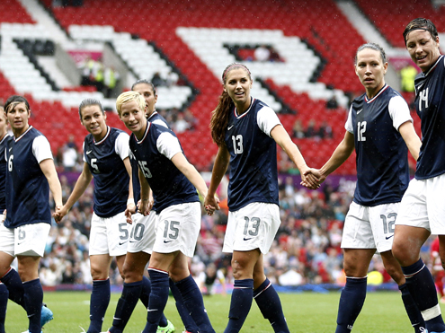
Groups
Criteria:
  Consists of 2 or more people
  There is interaction among members
  Members have shared expectations
  Have some sense of common identity
Examples that DON’T meet the criteria:
  Aggregate: people gathered in the same place at the same time
  Social category: have shared traits or common status
  Social network: sum total of a person’s direct and indirect relationships/interactions with other people

Slide 6
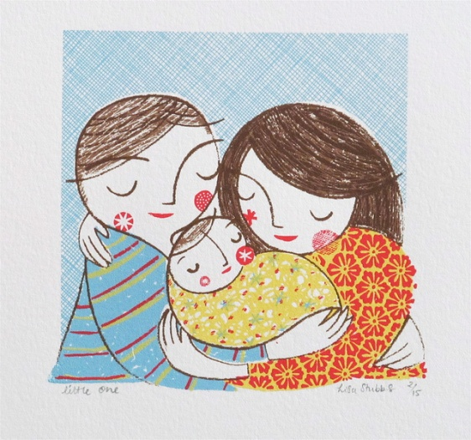
Examples that DO meet the criteria:
  Dyads/Triads: 2-3 people
  Small groups: Few enough members
  that everyone is able to interact on
  a face-to-face basis (less than about 15)
  Formal v. Informal: Degree of clear definition to the structure, goals, and activities of the group
  Primary v. Secondary: Degree of closeness, time, intimacy, emotional support
  In-group v. Out-group: Self-identification (symbols, clothing, names, slogans) and competition

Slide 7

E-communities?
  Definition: groups that interact online rather than face-to-face
  What examples DO meet the criteria to be a group?
  What are some online examples that do NOT meet the criteria?

Slide 8
Leaders
Groups need leaders to carry out functions
  Define boundaries: who does/doesn’t belong
  Set goals, assigning tasks, making decisions
  Employ sanctions to ensure conformity to norms
Types of leadership
  Instrumental: task-oriented, planning
  Expressive: emotion-oriented, morale
  Can one leader be both? Examples?

Slide 9

Social Institutions
A way society organizes statuses and roles to satisfy one or more basic needs of society
Examples: what needs does it satisfy?
  Family
  Education
  Economy
  Government
  Religion

Slide 10
Perspectives
What aspects of social structure would be of most interest to a(n):
Interactionist?
Functionalist?
Conflict theorist?

