Slide 1
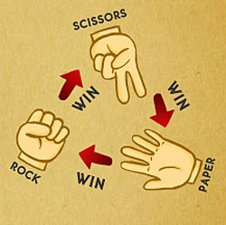
Unit 6 – Interaction
Objective 1
Compare different types of interaction and explain how one type of interaction can evolve into another.
Objective 2
Evaluate the dramaturgical approach to the study of interaction.

Slide 2
Interaction
Interaction takes place when the action of one person causes another person or people to act
Different types of interaction have different causes and effects:
  Which types promote
  social stability?
  Which promote change?

Slide 3
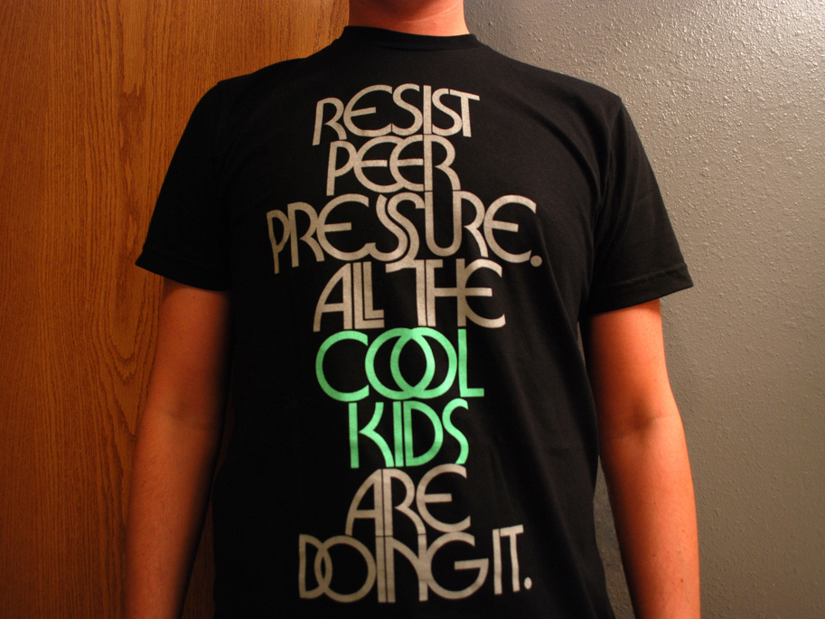
Conformity
Adapting behavior to fit the behavior and expectations of others
Examples:
  Saying the pledge of allegiance when you don’t really care about it but don’t want others to think you are unpatriotic
  Drinking because your friends pressure you to or you want to fit in with a certain crowd
What are the pros and cons of conformity?

Slide 4
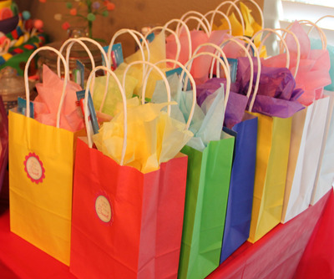
Exchange
Interaction based on give and take, shared values and trust, with informal rules
  Ex. Greetings, taking turns in conversation, making and keeping dates
One person voluntarily does something for
another, expecting a reward in return out of
obligation based on the norm of reciprocity
  Ex. Gift-giving, doing a favor, compliments
Exchange theory: Everything we do, even what
may appear to be selfless, is for some return
  Ex. Charity = respect, reward in afterlife, etc.
  Do you agree?

Slide 5
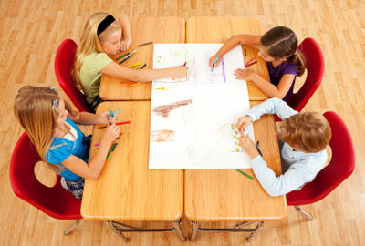
Cooperation
Individuals or groups combine their efforts and resources to reach a shared goal
  Ex. Raising money for charity, agreeing on rules to a game, organizing a food rationing system
Cooperation may include friendly competition to motivate members to work harder for the group
  Ex. Co-workers competing for employee of the month in order to improve customer service, which will increase sales profits and salaries for all
How does cooperation differ from exchange?
  Exchange: you offer to do your sister’s chores for her so she will let you borrow her favorite jeans
  Cooperation: you help your sister rake the yard because you can’t leave together to go to the movies until it is done

Slide 6
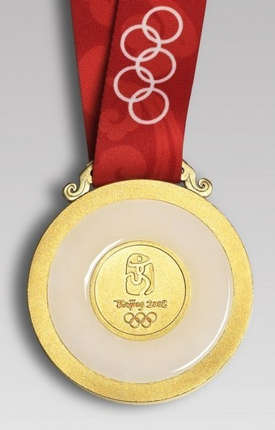
Competition
Individuals or groups oppose each other
to reach a goal that only one can achieve,
with rules agreed to in advance
  Ex. Sporting events, college admissions, elections
Review: How do the Functionalist and Conflict perspectives differ in their views on competition?
When it follows accepted rules of conduct, it can be positive to motivate people to perform
  Ex. A scientist discovers a cure in order to win a Nobel prize
It can lead to cheating, strained relationships, psychological stress, inequality, and conflict >>

Slide 7
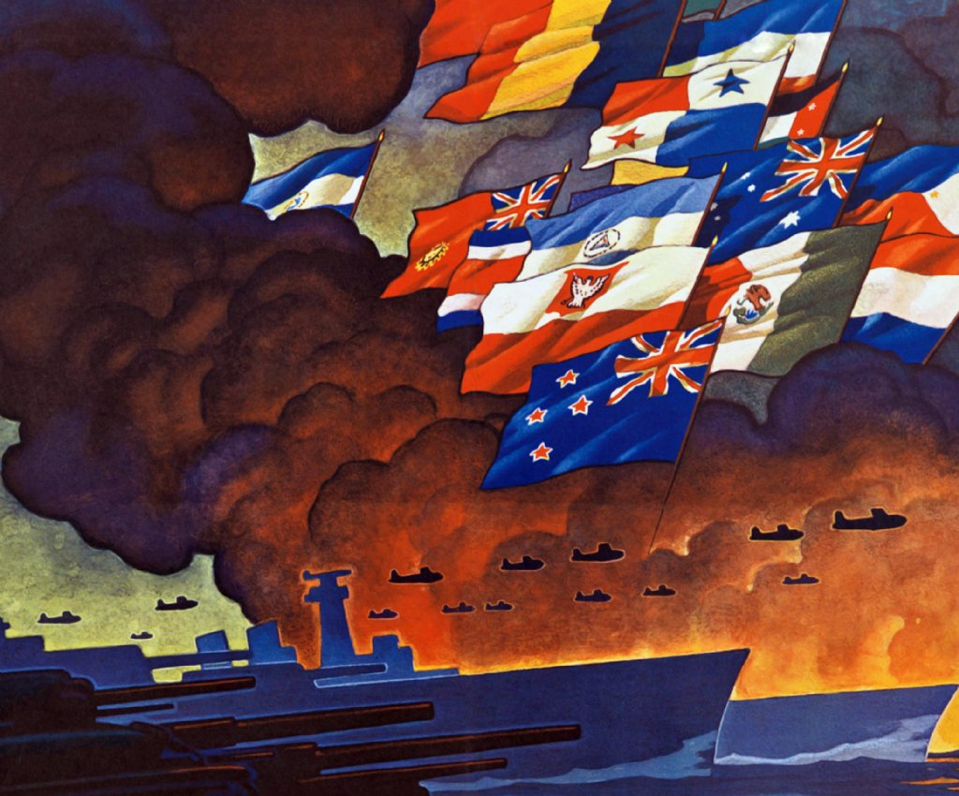
Conflict
Individuals or groups work against and harm each other to win a reward
  Ex. Wars, fights, sabotage
How is conflict different from competition?
  Rules don’t exist or are broken
    Ex. Steroid use, lying on application
  Defeating or harming the opponent can become just as or more important than winning the reward
    Ex. Smear campaigns, retaliation

Slide 8
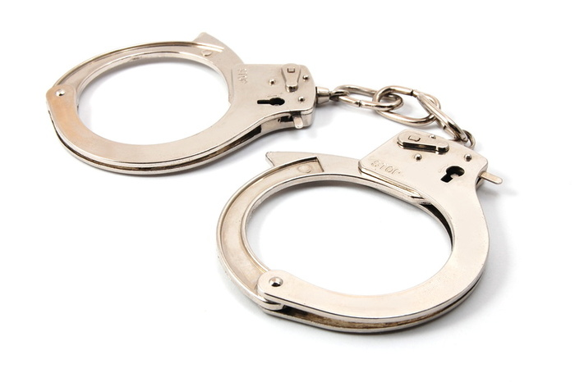
Coercion
Being forced to give into the will of another
  Ex. Prisoners of war being forced to give up information through torture
Can also be through social pressure, not physical force
  Ex. Negative sanctions like ridicule, bullying, punishment, withholding
How is coercion different than conflict?
  Coercion is achieved by a significant imbalance in power of one over the other
    Ex. Government – citizen, Boss – worker, Stronger – weaker
  Will often go hand-in-hand, one can lead to the other
    Ex. An oppressive regime causes a civil war, sabotage includes blackmail, the loser is forced to pay reparations

Slide 9
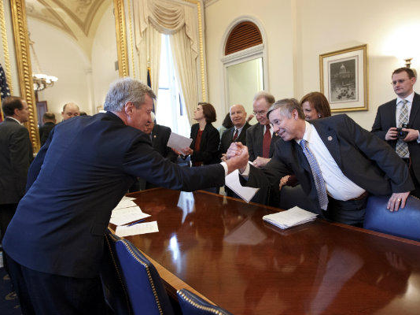
Accommodation
Parties compromise in order to share resources, settle a dispute, or resolve conflict
  Ex. Cease-fire to end a stalemate, labor-management negotiations, mediation to finalize a divorce settlement
On a continuum, it is in between:
  Conformity, exchange, or cooperation
  Competition, conflict, or coercion
  What would the continuum represent?

Slide 10
Comparison
Joe has an extra sandwich for lunch, and
Steve wants Joe to give it to him. Identify
each type of interaction that could occur:
Steve threatens to hit Joe if he doesn’t hand over the sandwich
Joe gives it to him in hopes that Steve will help him out during football try-outs, Steve says thank you
Joe agrees to give it to Steve for a dollar
After Steve’s agreed to pay, Joe throws it away in spite, so they end up in a fight
Steve’s teammate Fred wants the sandwich too, so they arm-wrestle for it
Joe gives him the sandwich and gets his friend Lisa to chip in dessert so Steve’s fueled up for the big game tonight
Lisa gives Steve her dessert, even though she doesn’t want to, because she doesn’t want Joe to think she’s selfish

Slide 11
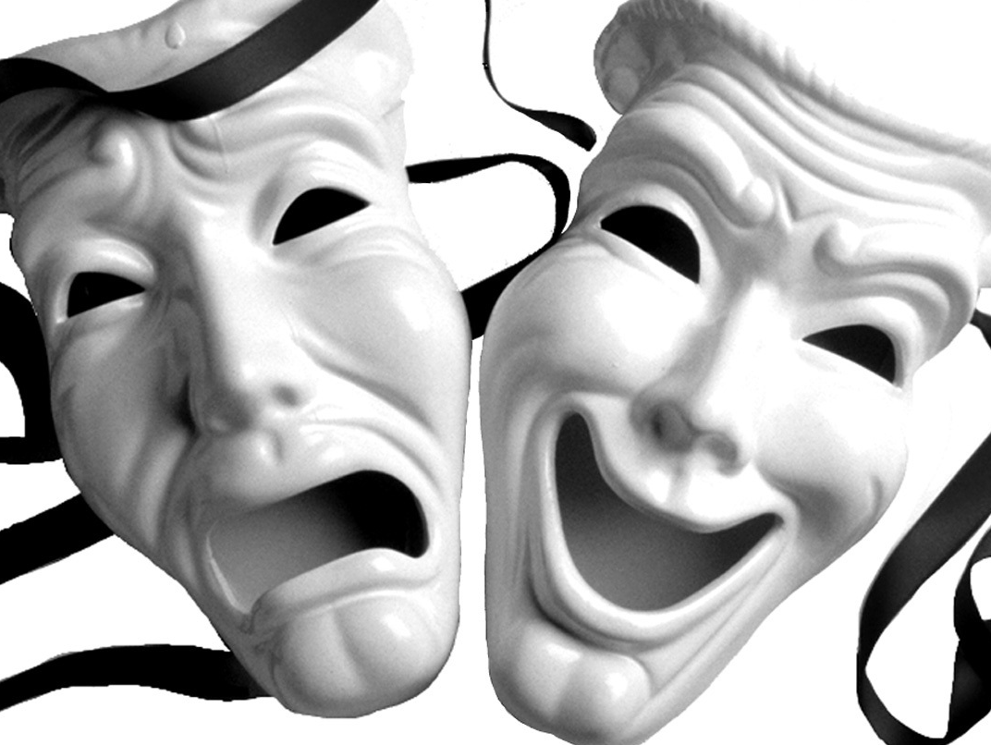
Dramaturgy
Social Psychology theory, from the Interactionist perspective, that started with Erving Goffman’s The Presentation of Self in Everyday Life.
Premise: Our “self” is not fixed, but is relative to the different roles we play in our interactions with others.
Based on the metaphor of life as theater
  “All the world’s a stage, And all the men and women merely players. They have their exits and their entrances; And one man in his time plays many parts…”
  (Shakespeare, As You Like It)

Slide 12
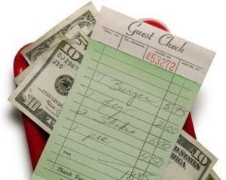
Actor/Character: A person in a given role, performing the duties consistent with that role.
  A 25-year-old woman working as a waitress at a restaurant takes orders, refills drinks, and brings food to her customers.
Audience: The people for whom we perform our roles. They are also actors performing for their own audiences.
  The waitress’ audience includes the people at the tables she is serving. At each table, there are people playing roles such as parent, friend, coworker, or date for their own audiences.
Setting: Physical place where interaction occurs and the props, costumes, lighting, sound, etc. used to communicate expectations and meaning to the audience symbolically.
  The restaurant’s tables, menus, light fixtures, background music, and staff uniforms set the stage for interaction there – family time, social hour, business lunch, romantic dinner, etc. The waitress may wear an engagement ring, signifying her commitment to marry or possibly to deter customers from making unwanted advances.

Slide 13
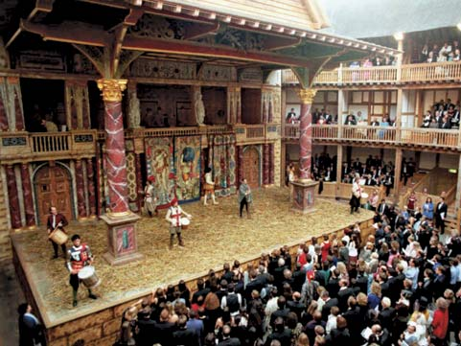
Performance: The overall impression made to the audience by the actor through dialogue and non-verbal gestures, body language, and facial expressions. Can consist of both intentional and unintentional expressions, as well as impression management techniques like self-enhancement, exaggeration, concealment, flattery, excuses, and lying.
  The waitress wants to receive a good tip, so she intentionally tries to express herself as competent, respectful, and friendly to her customers. She may laugh at a joke she does not find funny, smile and nod at an unreasonable request, or blame the cook for a mistake she made in taking the order. Unintentionally, she may give away her boredom by looking too often at her watch or give the impression of annoyance by sighing or gritting her teeth.
Script: Dialogue or actions that are not improvised, but expected or rehearsed.
  The waitress’ script would include the greetings and responses she has been trained to use with her customers such as “may I help you,” “my pleasure,” and “come back to see us again”. She may hear scripted dialogue being used by her customers when she hears a mother remind her son to “say please”, or a young man tell his date “I love you” and she replies tentatively with “I love you, too.”

Slide 14
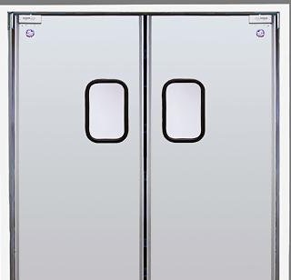
Front stage: A situation in which we interact with others in public or professional setting. On the front stage, the actor occupies a well-defined status with specific role expectations in relation to the audience.
  The waitress is acting on the front stage when she is on the dining room floor in front of her customers and boss. Her customers are acting on their respective front stages also, for example, parents are focused on managing their children so they don’t make a scene in public.
Back stage: Relative to the front stage, it is the place where the front stage audience is not present and the actor can break character. Even back stage, we are still acting but playing a different character for a different audience.
  When the waitress goes back to the kitchen, she is back stage so she can complain about her customers or express her desire to get a new job. Yet she is still acting the role of coworker, and will act differently there than she would at home with her friends and family.

Slide 15
Evaluation
Do you agree that the “self” is relative
to the different statuses and roles we
play in our interactions with others?
How does this relate to other
theories of the self we’ve learned about?
To what extent do you think we “perform” for an audience in our daily life?
Can you think of another metaphor to describe human interaction?

