Slide 1
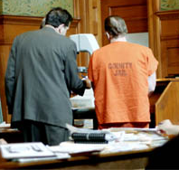
Unit 6 – Legal Process
Objective 1
Compare different law enforcement agencies, courts, and trials at the federal and state levels.
Objective 2
Evaluate the degree to which due process has been protected by Supreme Court decisions.

Slide 2
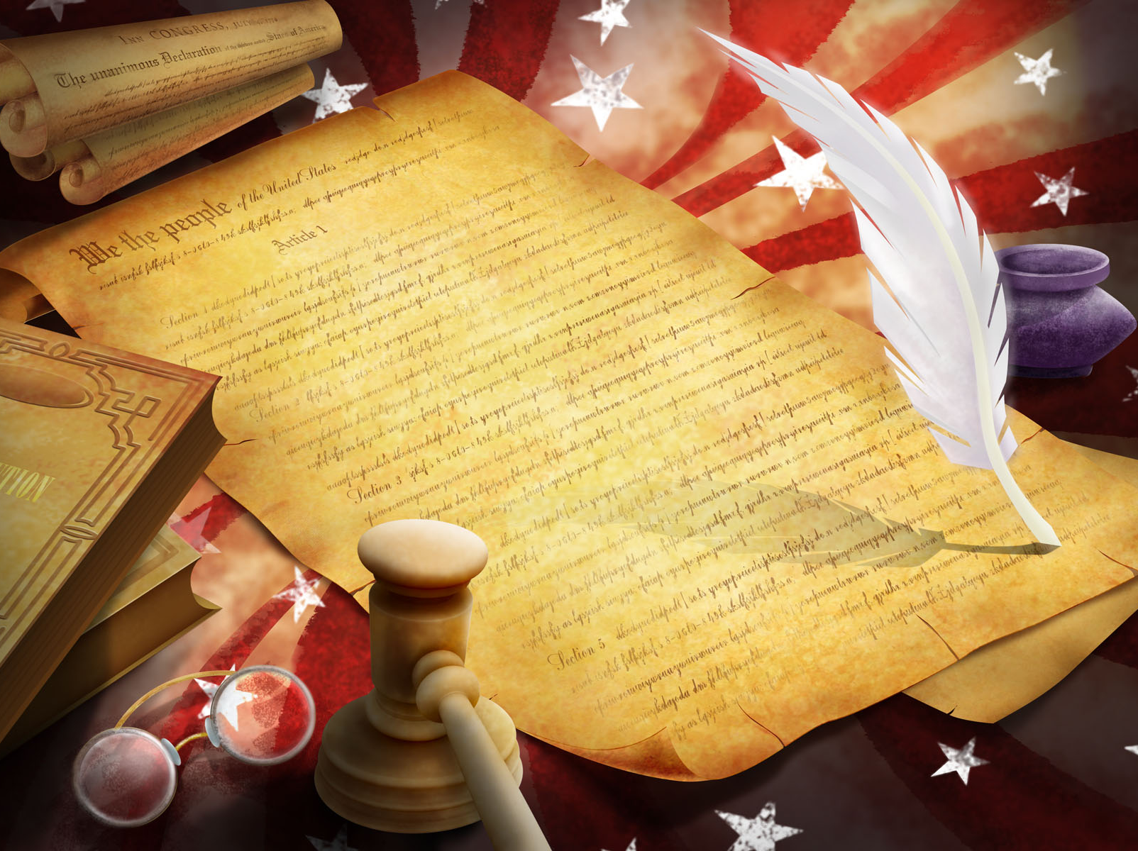
Review…
Writ of Habeas corpus
Ex post facto laws
Bills of attainder
Rule of Law
Due process
Equal protection
Double jeopardy
Eminent domain
Self-incrimination
Probable cause
Grand jury indictment
Appeal

Slide 3


 | FEDERAL | STATE | LOCAL
Courts/ Judicial Officers | U.S. Supreme Court Circuit Cts of Appeals Federal District Cts U.S. Attorney General | N.C. Supreme Court Courts of Appeals Superior Court District Courts N.C. Attorney General | District Attorneys Public Defenders
Law Enforcement Agencies | Dept of Justice FBI Marshals Service DEA ATF Homeland Security Secret Service | Dept of Public Safety N.C. Highway Patrol N.C. National Guard Dept of Justice State Bureau of Investigation (SBI) Dept of Correction | Wake County Sheriff Department Raleigh Police Department

Slide 4
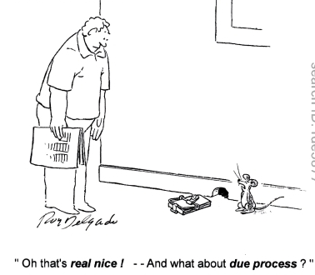
Due Process
Procedures that must be followed to protect life, liberty, and property
5th Amendment: Federal
14th Amendment: States
Can you resist arrest if due process is being violated?

Slide 5
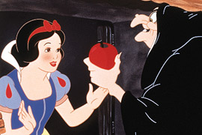
Exclusionary Rule
4th Amendment – must have probable cause or search warrant to search or seize property
Mapp v. Ohio
  Search must be strictly limited
  to the terms of the warrant
  Any evidence gained from an
  illegal search must be excluded
  from the trial
  Do you think this is fair?

Slide 6
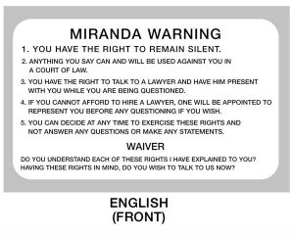
Miranda Rights
Miranda v. Arizona: suspects must be informed of rights at time of arrest, before any questioning takes place
Rights included in the warning
  5th Amendment: Right to remain silent
  6th Amendment: Right to lawyer

Slide 7
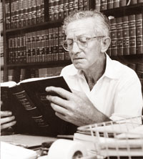

Public Defense
When must the government provide a
lawyer for someone accused of a crime?
Gideon v. Wainright
  Having a lawyer is essential
  to due process
  Public defense must be offered if necessary for any charge that could result in prison time, at the federal or state level

Slide 8
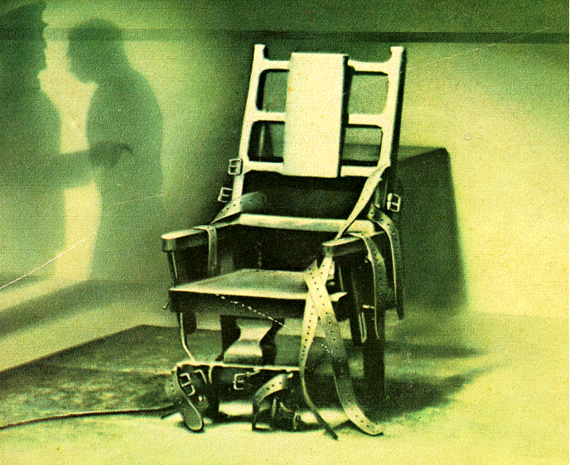
Capital Punishment
Do you believe that the death penalty violates the 8th Amendment as “cruel and unusual punishment”?
Furman v. GA and Gregg v. GA
  Limitations: Cannot be biased or arbitrary, cannot be used for the mentally ill or juveniles
  Used by federal government and many states
  States had to come up with a system to meet constitutional standards
    In North Carolina?

Slide 9
Types of Crimes
Crimes against People vs. Property
  Murder, manslaughter, assault, battery
  Theft, Arson, Vandalism, Trespassing
Felonies vs. Misdemeanors
  More or less than 1 year in prison
  Can vary depending on state and previous record
Federal vs. State
  Federal priorities: Threats to national security like Terrorism or Espionage, Human or Drug Trafficking, Organized crime, Bank robbery, “White-collar” crimes like fraud, Kidnapping, etc.
Victimless?

Slide 10
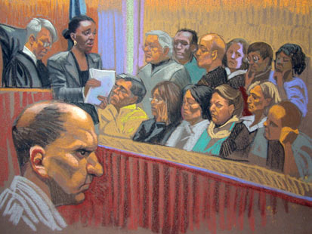
Criminal Cases
Arrest
  Proper warrants
  Miranda warning
  Access to lawyer
Pre-trial
  Preliminary hearing
    Charges, bail set
    Grand jury indictment in felony cases
  Arraignment, plea:
    Guilty, No Contest, or Plea Bargain: no trial
      What are the pros/cons of plea bargaining?
Trial
  Jury selection (voir dire)
  Evidence and testimony, cross-examination
  Jury deliberation and verdict
    Acquit: cannot be retried (double jeopardy)
    Hung jury: Retrial or prosecution drops charges
    Guilt: beyond all reasonable doubt
      Sentencing by judge
      Can appeal
      Possibility of parole?

Slide 11

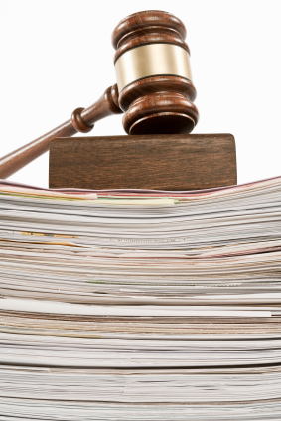
Civil Cases
Complaint
  Plaintiff files lawsuit
  Defendant summoned
    Pleadings, counter-suit?
Pre-trial
  Discovery
    All evidence and witnesses shared on both sides
  Conference
    Most end before trial
      Lawsuit dropped
      Settle out of court
      Mediation
      Arbitration
Trial
  Jury may be requested
  Evidence and testimony, cross-examination
  Decision
    Plaintiff wins: produced a “preponderance of evidence” that defendant caused harm
      Remedy set: Monetary compensation, injunction issued, rights restored
    Defendant wins: court costs paid by plaintiff
  Appeal
    Either side can appeal for reversal or different remedy

Slide 12
Punishment
Why do criminals receive different punishments?
What purposes do they serve – punishment, safety, retaliation, deterrence, rehabilitation, etc.?
  Warning, Fine, Community Service, or Probation?
  Incarceration or Institutionalization?
  Minimum or Maximum security prison?
  Prison with or without possibility of parole?
  Life Sentence or Death Penalty?
Civil remedies?
  Compensatory damages
  Punitive damages
  Injunctions

Slide 13
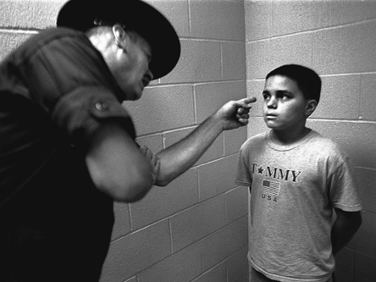
Juvenile Cases
Civil cases: custody, rights, injury
Criminal cases: Neglect, Delinquency
How do they differ from adult cases?
  Special courts, officers, and lawyers
  Closed to public, records sealed, no jury
  Can start with a petition by school or parent
  Punishment focused on rehabilitation
    Stern lecture, special school, correctional facility
  If neglect is found, court becomes guardian

