Slide 1
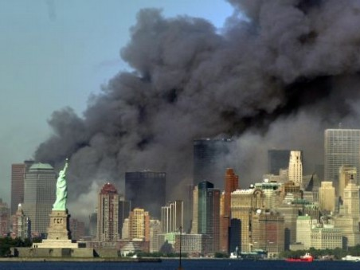
New Hopes, New Fears
Unit 9: Carter to Obama

Slide 2
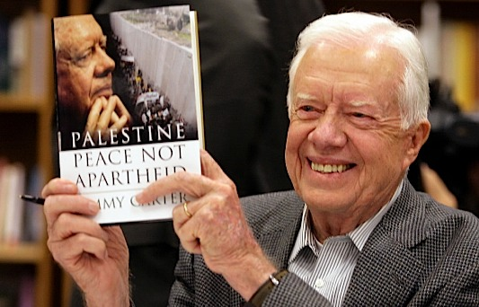
Jimmy Carter (1977-1981)
Democrat, 1 term
Washington “outsider”
helped him win election after Johnson and Nixon, but he had trouble with the politics of the job
Model Ex-President
Habitat for Humanity
Middle East diplomacy

Slide 3
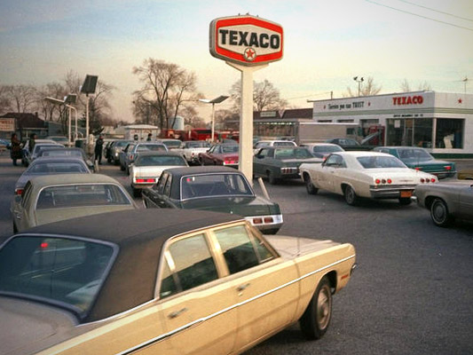
Domestic Events and Policies
Energy Crisis
proposals resisted by fuel-producing states and automakers, “Malaise” speech
National Energy Act: tax on gas-guzzlers, no price controls on domestic fuel, tax credits for alt. energy
Three Mile Island nuclear reactor
Middle East conflict > fuel shortage + price hike = even worse inflation
Automation + high energy costs + increased foreign competition = downsizing
Affirmative Action
University of CA v. Bakke

Slide 4
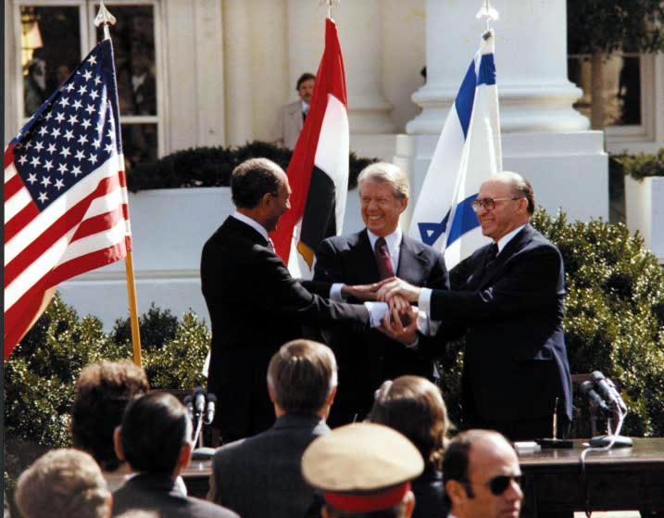
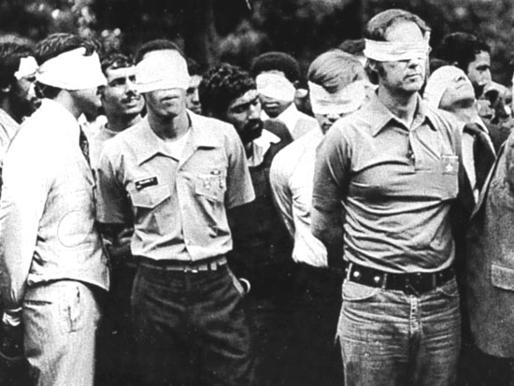
Foreign Events and Policies
Human Rights
use of sanctions
Détente suffers: Soviet invasion of Afghanistan – SALT II treaty fails
Panama Canal treaties improve LA-relations
Camp David Accords
historic, though largely symbolic, negotiation between Israel and Egypt (see p. 1022)
Iran Hostage Crisis
resulted from support of the shah against rebels, allowing him to enter U.S. for cancer treatment
didn’t release until Reagan sworn in

Slide 5
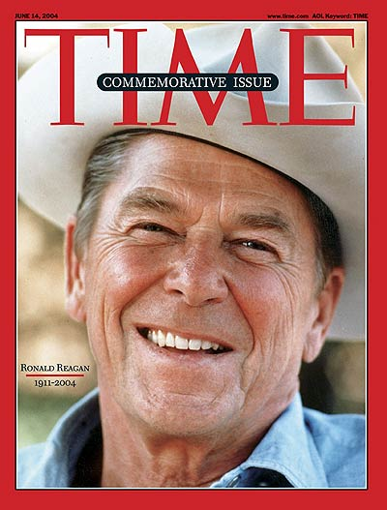
Ronald Reagan (1981-1989)
Republican, 2 terms
The Great Communicator
Conservative
Included: religious people, anti-abortion forces, anti-affirmative action, anti-welfare, anti- “big government”
Cut gov’t. programs such as: food stamps, welfare, job training, Medicaid, school lunches, student loans
Result: smaller gov’t., inner cities suffer
Appointed several conservative Supreme Court justices, including Sandra Day O’Connor

Slide 6
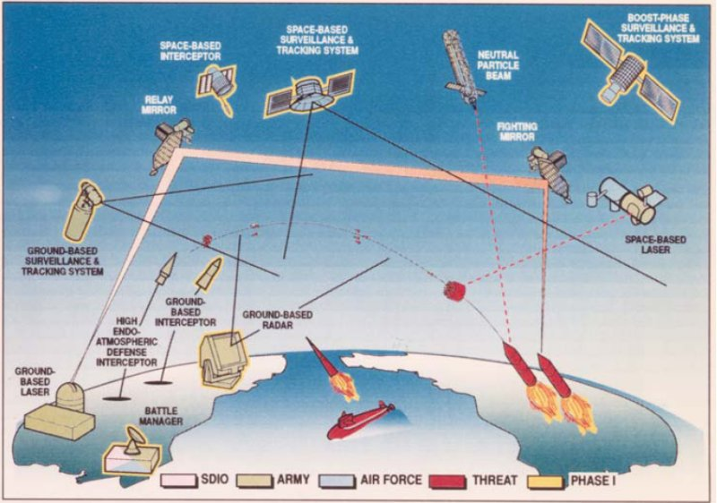
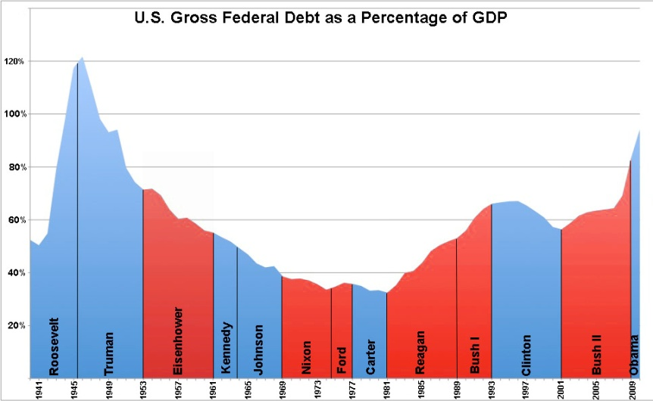
Domestic Events and Policies
Reaganomics
Cut taxes 25 percent + Increase military spending
Ex: Star Wars – SDI
Result: HUGE DEBT
Deregulation
Less regulation + inspections of business
“Supply-side” or “Trickle-down” economics
Ex: banks, nursing homes, airlines, the environment
Result: lower prices, savings and loan crisis
Social Issues
AIDS
War on Drugs

Slide 7
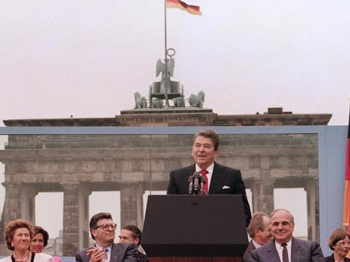
Foreign Events and Policies
Soviet Union
Called “evil empire”, “peace through strength”
New leader of USSR Gorbachev and Reagan have good relations
Policies: perestroika = economic reform and Glastnost = openness, reform led to breakup of USSR
“Mr. Gorbachev, tear down this wall!”
Chernobyl nuclear disaster
Panama
20, 000 US troops overthrow drug-trafficking Pres. Manuel Noriega

Slide 8
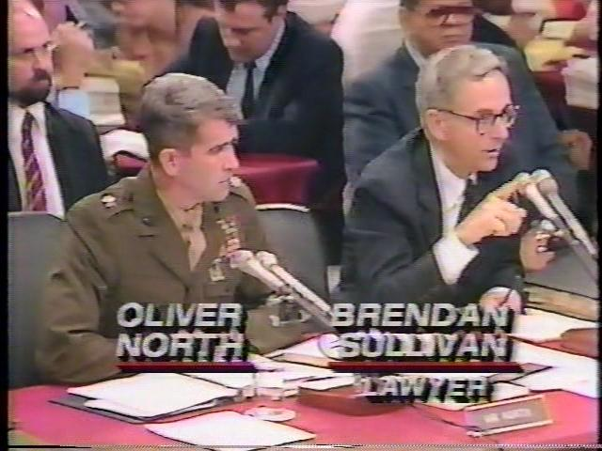
Foreign Events and Policies
Nicaragua
Supported anti-communist group called contras.
Congress bans funding of Contras in Boland Amendment. Reagan admin. secretly sells weapons to Iran to raise $ to give them.
Result: Iran–Contra Scandal, but the “Teflon President” deflects the scandal, Vice Pres. Bush pardons all when he is President.
Grenada
(Island nation near Cuba) – 2,000 US troops to overthrow pro-Castro gov’t.

Slide 9
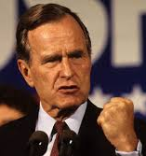
George Bush (1989-1992)
Republican, 1 term
Reagan “lite”
Had been his Vice President, continued his policies
“Read my lips . . . no new taxes”
but ended up raising taxes, which hurt his re-election bid

Slide 10
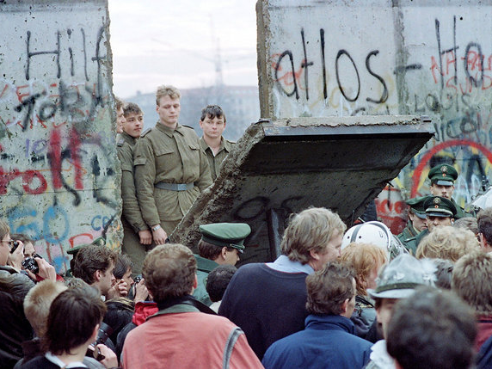
Foreign Events and Policies
Cold War
1989: Fall of Berlin Wall, Tiananmen Square
1991: Soviet Union dissolves, Commonwealth of Independent States formed. Other counties in the former Soviet bloc make transitions also
1992-1993: Bush and Russian president Boris Yeltsin declare end to Cold War, sign START II to cut nuclear arsenals by 2/3

Slide 11
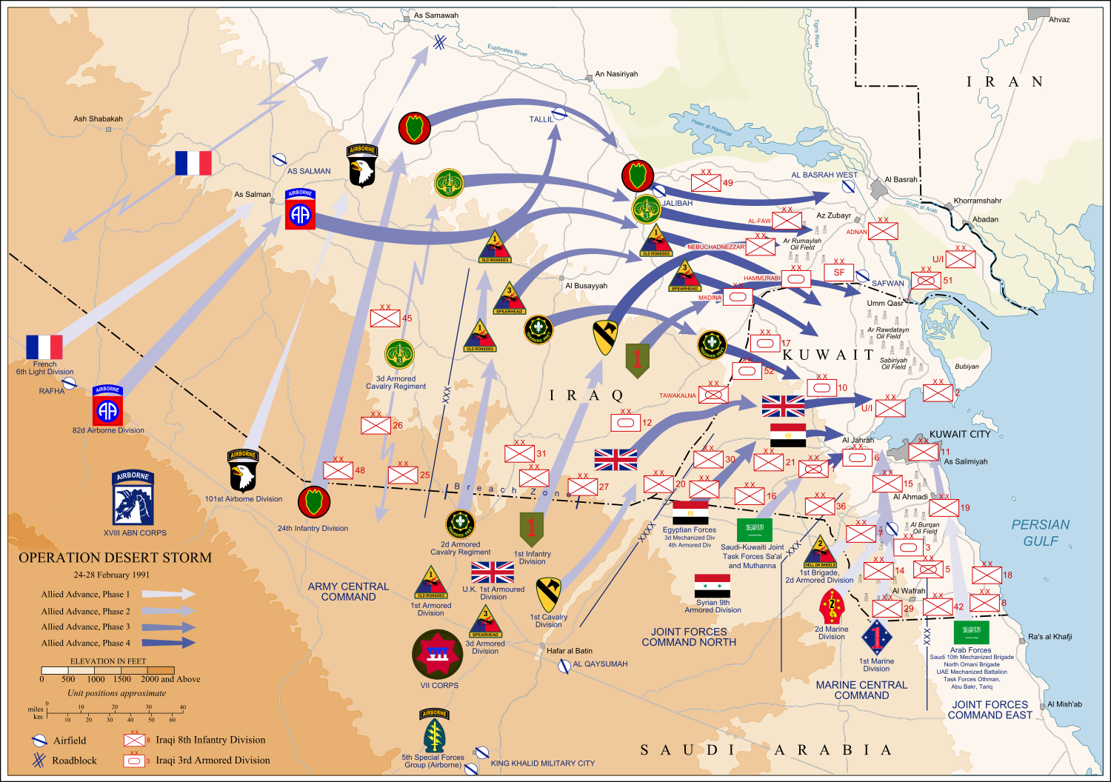
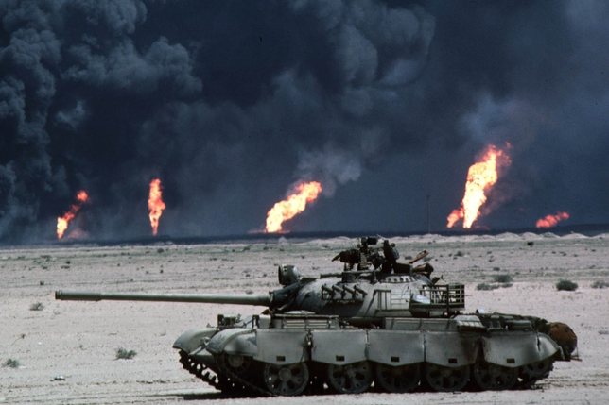
Foreign Events and Policies
Operation Desert Storm – “1st Iraq War”
Goal: to protect our access to oil in the Persian Gulf
Saddam Hussein attacks Kuwait.
UN-coalition: forces led by US defeat Iraq in less than 5 days with < 400 casualties.
But…Saddam Hussein remains in power. In treaty, promises weapons inspections

Slide 12
Domestic Events and Policies
Financial Issues
Savings and Loan Crisis
Issues with deregulation
Debt
From increased military spending, cutting taxes
Had to break campaign promise
Recession 1990-92
Americans with Disabilities Act

Slide 13
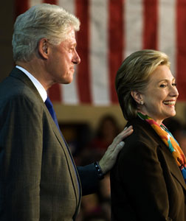
Bill Clinton (1993-2001)
Democrat, 2 terms
New Democrat
“New”: balance budget, reform welfare, streamline gov’t, supported death penalty
“Old”: Universal health care coverage, more student aid, gays in the military

Slide 14
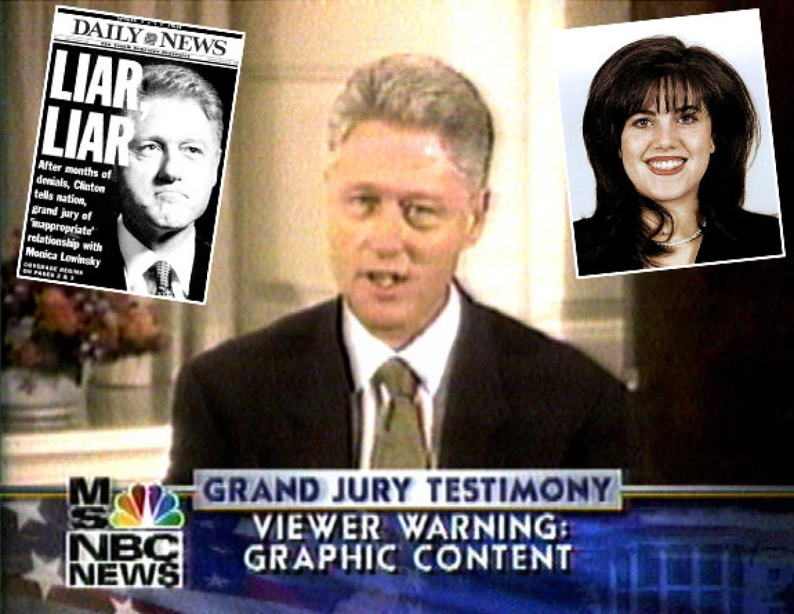
Domestic Events and Policies
Military and security
Don’t ask, don’t tell
Oklahoma City bombings, Unabomber
Battle with Republican Congress
Newt Gingrich – Contract with America
Budget showdown > gov’t shutdown – Reps. get blame, Clinton re-elected but…
Impeachment: Perjury and obstruction of justice during investigations of Monica Lewinksy scandal and Paula Jones lawsuit
Found not guilty, but Americans were mad
Also implicated in Whitewater scandal in AK

Slide 15
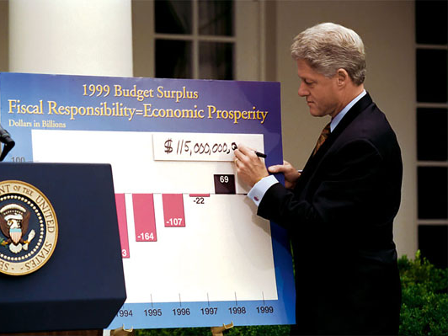
Domestic Events and Policies
Balancing the Budget
Sacrificed programs he wanted to cut spending and balance the budget.
Robust economy: (fueled by the “new” internet economy”) kept tax revenues high
By 1998 the government had a surplus
Worked with Congress to cut welfare rolls by 50% - work requirements, time limits
Health Care
Problems: Insurance companies, drs, health management orgs. couldn’t agree
Hillary Clinton: put in charge of proposals; not well received by Reps – failed

Slide 16
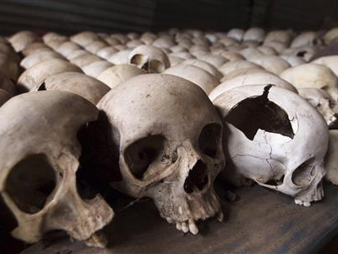
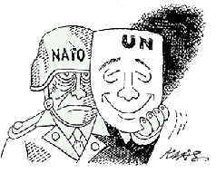
Foreign Events and Policies
Trade
NAFTA (North American Free Trade Agreement) – eliminate trade barriers like tariffs between U.S., Mexico, and Canada
Normal trading status extended to China
Peacekeeping
Africa: Rwandan genocide, Black Hawks shot down in Somalia, al-Qaeda bombs U.S. Embassy
Former Yugoslavia: U.S. aids NATO mission to protect “safe zones” in Bosnia, UN investigates Milosevic, “ethnic cleansing” in Kosovo
Oslo Accords: historic, though largely symbolic, first negotiation between Israel and the Palestinian Liberation Organization

Slide 17
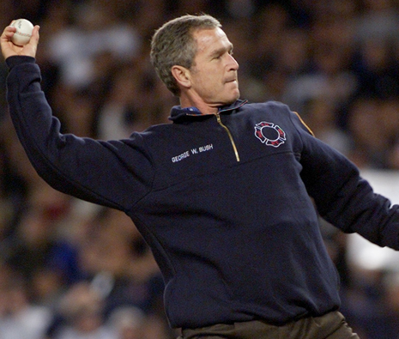
George W. Bush (2001-2009)
Republican, 2 terms
Election of 2000
Florida – hanging chads, confusing ballots, Governor Jeb Bush
Bush v. Gore: Five weeks later the Supreme Court stopped the manual recounts

Slide 18
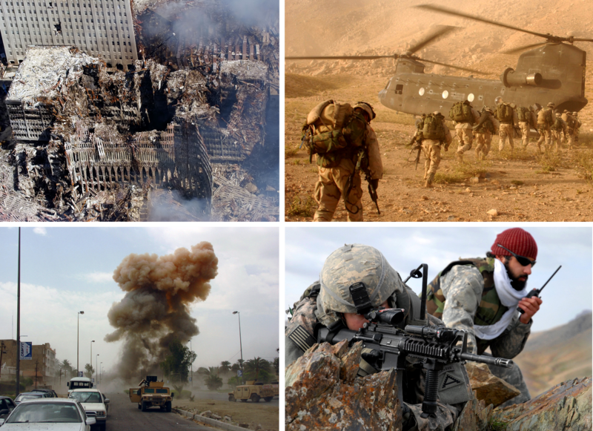
Foreign Events and Policies
September 11
Patriot Act: Gitmo, enhanced interrogation, racial profiling, wiretapping
War on Terror
Afghanistan: Osama bin Laden, al-Qaeda and Taliban strongholds
Iraq
Saddam Hussein and WMDs, fails to get UN coalition, Sunni vs. Shia civil conflict, Abu Graib

Slide 19
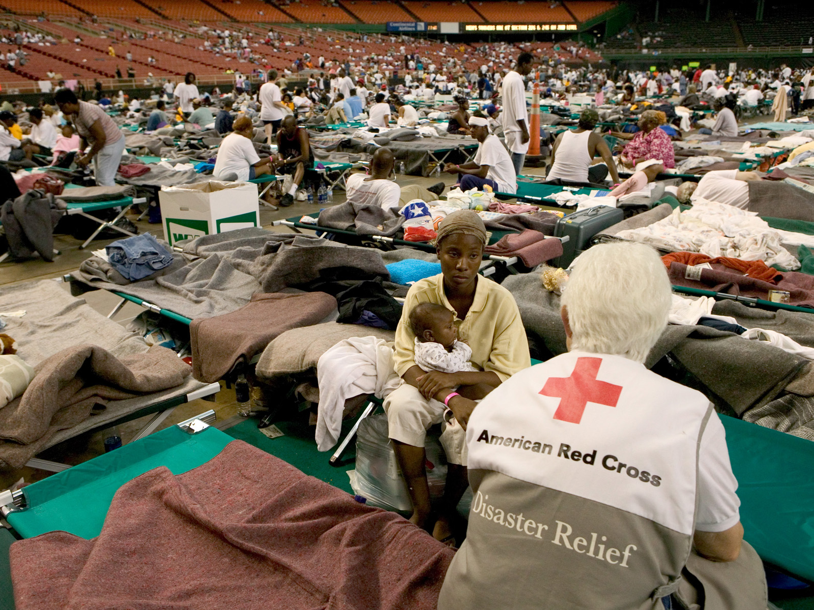
Domestic Events and Policies
The Great Recession
Dotcom and housing bubbles burst
Bailouts for banks, industries “too big to fail”
Budget
Tax cuts + 2 wars = huge deficit
High spending and regulation efforts alienates more conservative Republicans
Other Issues
Katrina disaster and FEMA
Environmentalism – Inconvenient Truth, Kyoto Protocol, “Drill baby drill”
No Child Left Behind Act

Slide 20
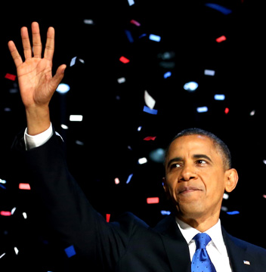
Barack Obama (2009-2017)
Democrat, 2 terms
Election of 2008 – Democratic landslide
Since then, Republicans have gradually taken back Congress and many states
International support
Nobel Peace Prize for nonproliferation, Arab relations
Even now, very popular in many parts of the world (our “slow recovery” has been better than many countries after the recession)

Slide 21
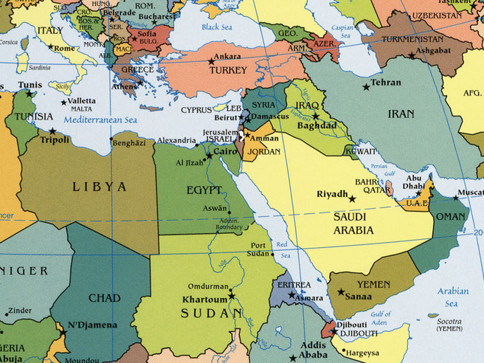
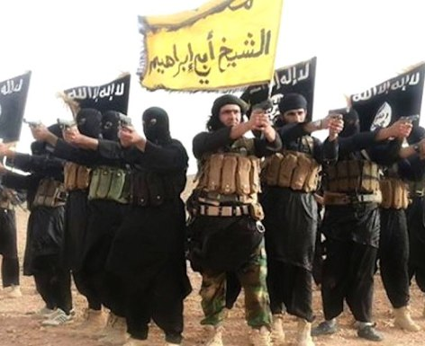
Foreign Events and Policies
Pulling out of Iraq
troops withdrawn, civil conflict
ISIS/ISIL dilemma
More focus on Afghanistan
Bin Laden
Continuing issue with terrorists
Diplomacy Issues
After “Arab Spring”: unrest, turmoil
Israel: strained relationship with Netanyahu
Benghazi fallout
Post-Cold War relationships: Cuba, Russia, China

Slide 22
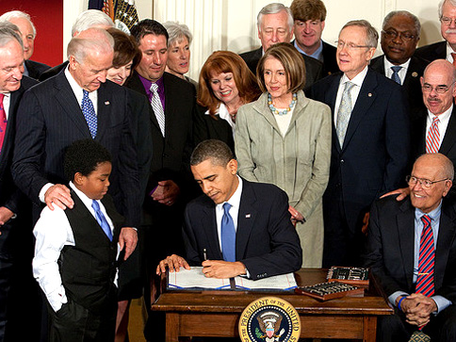
Domestic Events and Policies
From Recession to Slow Recovery
Affordable Health Care Act: “Obamacare”
Major platform issues, stay tuned…
Gay rights: “Don’t Ask, Don’t Tell” repealed, Obergefell
GITMO: prisoner transfer, torture report
Gun control: NRA, Sandy Hook, San Bernadino, etc.
Environment: Clean energy, fracking, Paris talks
Crisis in Ferguson, Baltimore, etc.
Militarization of police (War on drugs, 9/11)
Racial issues

