Slide 1
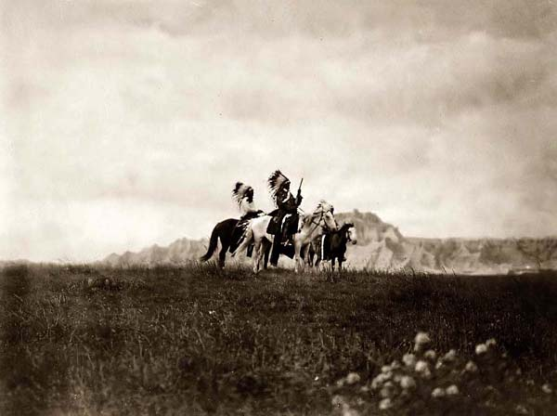
The West: Native Americans
Unit 1: The Gilded Age (1870-1920)
“They made us many promises, more than I can remember, but they never kept but one: they promised to take our land and they took it.” – Red Cloud

Slide 2
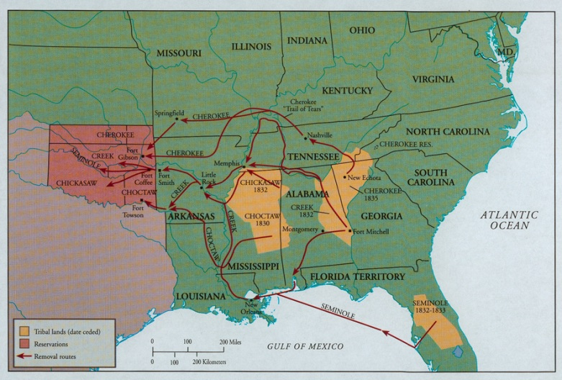
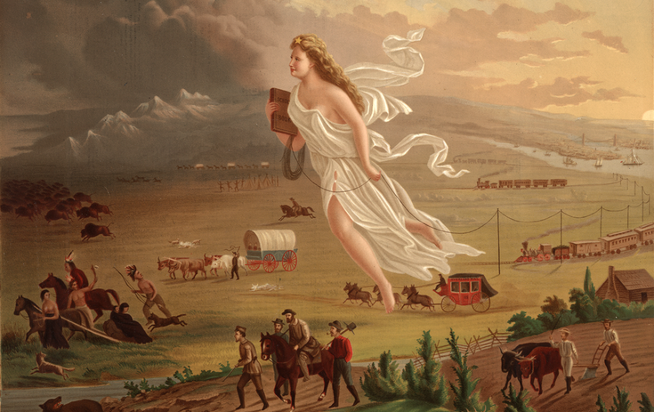
Review
What were the causes and effects of the Indian Removal Act?
Explain how the belief in Manifest Destiny affected the Native population.
How does this period of our history reflect the theme of the Gilded Age?

Slide 3
Contrasting Perspectives
President Jackson thought the “savage,” uncivilized red men should be grateful for the “generous” Removal policy.
The Topeka Weekly Leader described Natives as “a set of miserable, dirty, lousy, blanketed, thieving, lying, sneaking, murdering, graceless, faithless gut-eating skunks as the Lord ever permitted to infect the Earth…whose immediate and final extermination all men, except Indian agents and traders, should pray for…”
The Board of Indian Commissions reported to President Grant: “a sickening record of murder, outrage, robbery and wrongs committed by the [border white man], as the rule, and occasional savage outbreaks and unspeakably barbarous deeds of retaliation by the [Indians], as the exception.”
William T. Sherman defined a reservation as “a parcel of land inhabited by Indians and surrounded by thieves.”

Slide 4
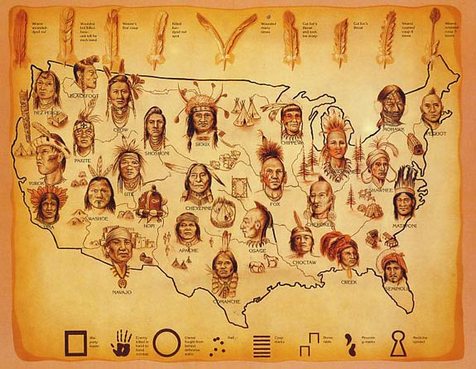
Concentration Policy
Until the 1850s, the permanent Indian Territory was used mainly by the Pony Express, railroads, and telegraph companies
The government negotiated separate agreements with different tribes to move them from the path of white settlement and trade
By scattering tribes and placing them on reservations, the gov’t could control them better
This policy evolved into a more aggressive reservation policy in the 1860-70s.

Slide 5
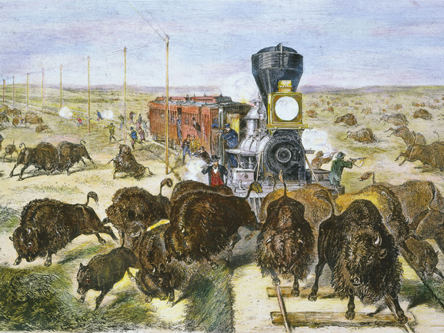
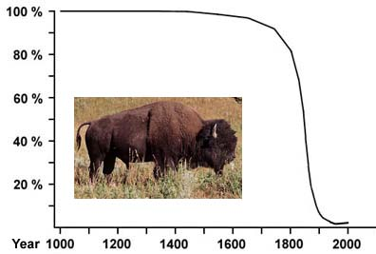
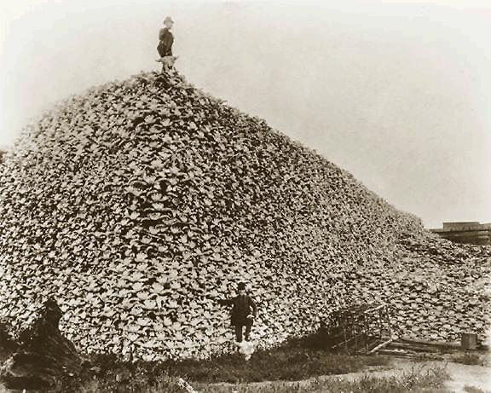
What motivated the destruction of the buffalo?

Slide 6
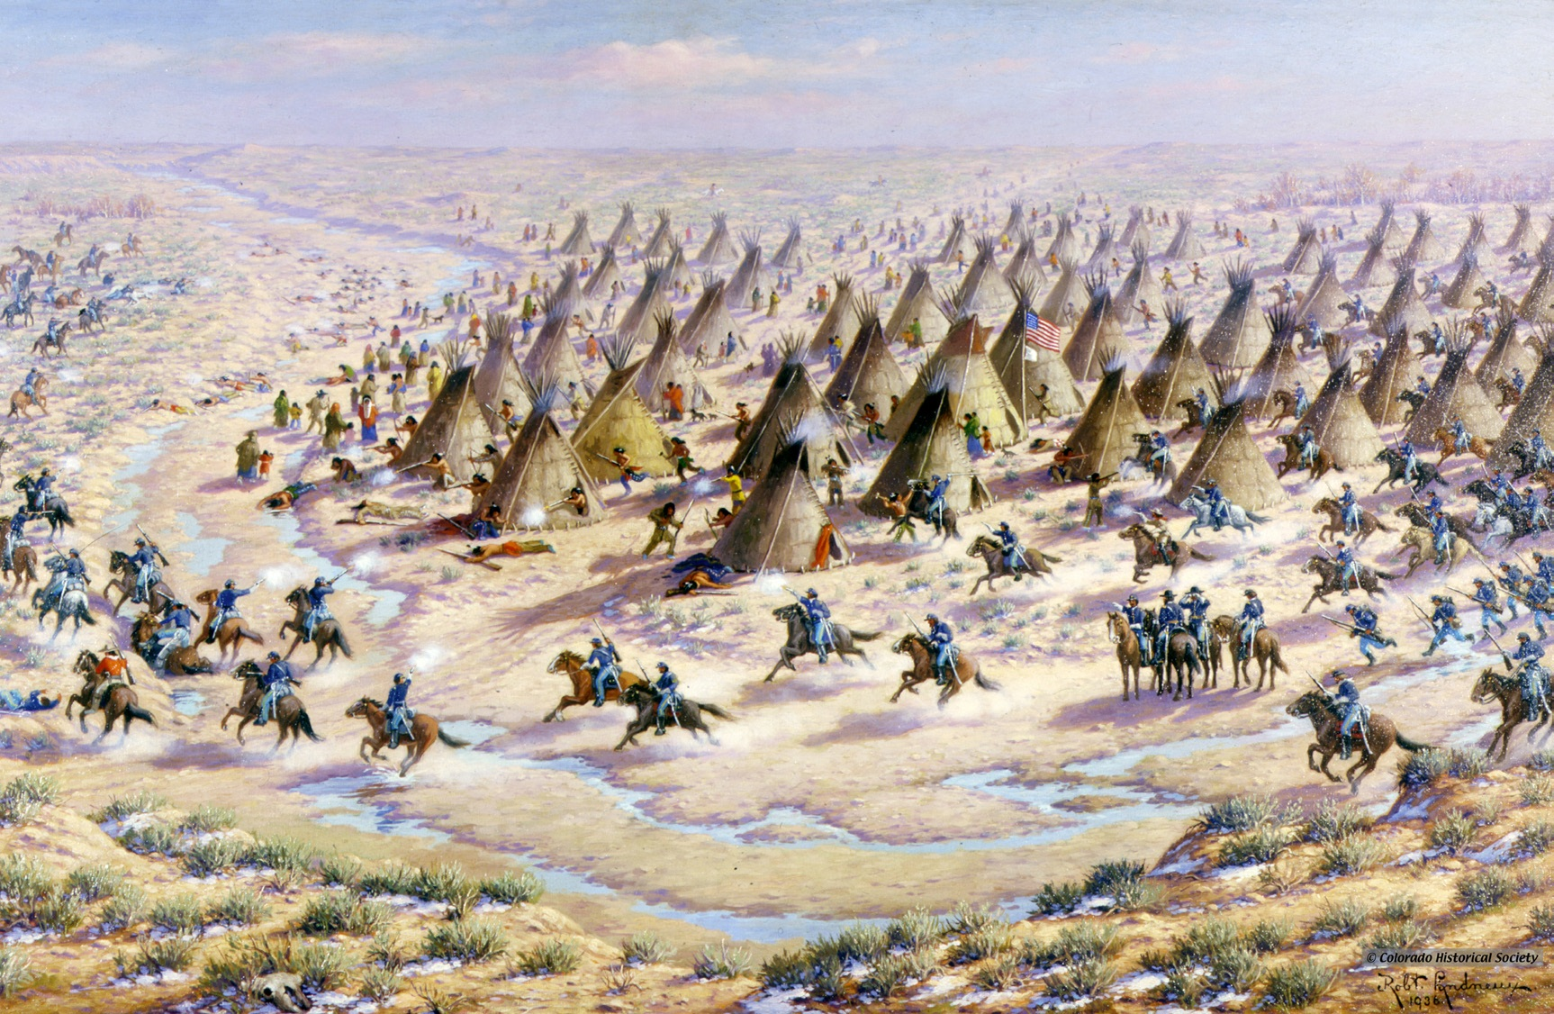
Reservation Policy
Homestead Act of 1862
Gov’t forced tribes in Oklahoma to sell 2 million acres. Boomers staked entire district in a matter of hours. More taken later.
Sand Creek Massacre 1864
Army forces killed 150 peaceful Cheyenne, mostly women and children
Fort Laramie Treaty of 1868
Closed the Bozeman Trail. Sioux Reservation would draw rations and provisions from the gov’t, and the gov’t would protect Indians against harm by Americans. Included nomadic hunting grounds.

Slide 7
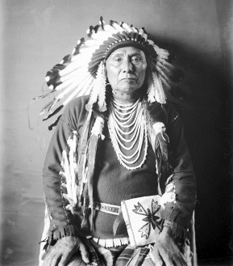
Resistance
Treaties did not provide adequate land and gov’t agents often cheated Indians
Many Indians fled reservations and were pursued by the Army until they surrendered
Nez Perce, Chief Joseph
Apache, Geronimo
A peace commission was sent to negotiate treaties, Office of Indian Affairs would be in control of the tribes
“I will fight no more forever.” – Chief Joseph

Slide 8
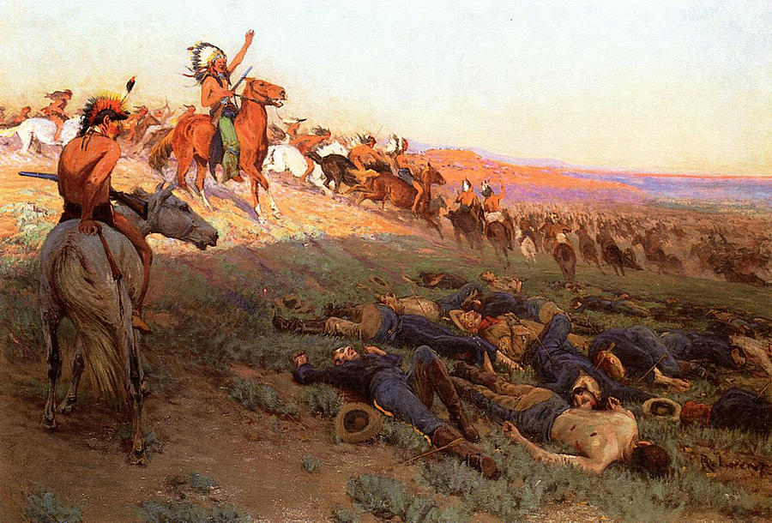
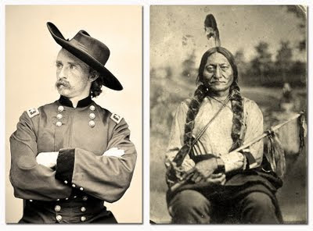
Gold rush in the Black Hills led to violations of Sioux hunting grounds
Indians raided mining settlements and fighting broke out, so the Indian Office ordered them back to reservation
They began to organize under the leadership of Sitting Bull, Crazy Horse, and Two Moons
Custer’s Army was defeated at Little Bighorn due to poor strategy and communication, but Indian victory was short-lived
Military rule was imposed, arms and horses were confiscated, a commission forced the “sale” of the Black Hills, and the Army pursued them relentlessly through the winter until they surrendered

Slide 9
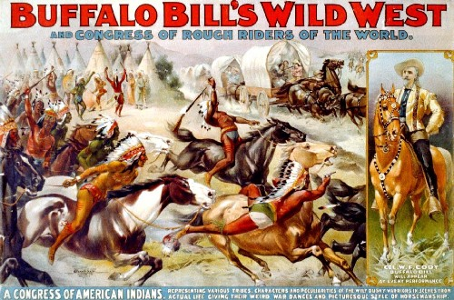
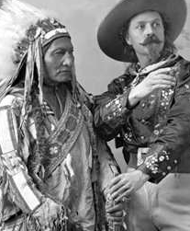
Why would Sitting Bull be willing to join the show?

Slide 10
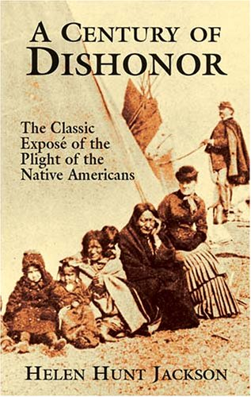
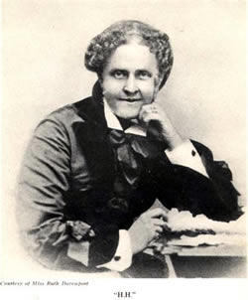
Assimilation “Peace” Policy
Even friends of Natives concluded it would be best for them to give up communal lands and assimilate
Helen Hunt Jackson’s A Century of Dishonor and the Indian Rights Association spread the idea as a humanitarian reform
Best to become small farmers and good Christians

Slide 11
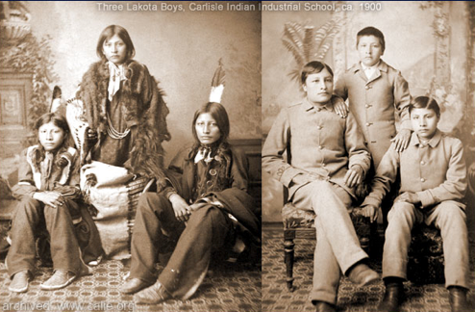
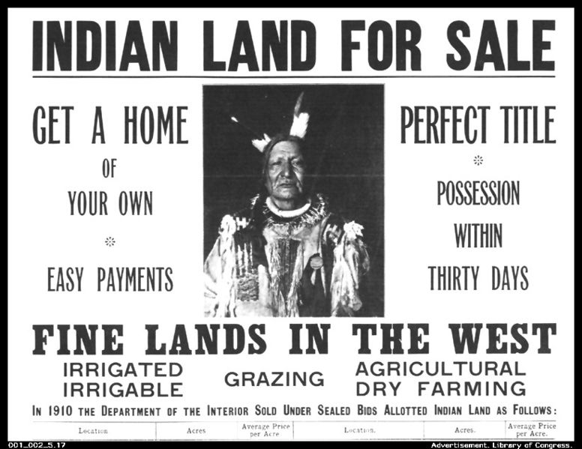
Dawes Act
Families were given land and supplies to farm, children were sent to boarding school
“Surplus” land would be sold to settlers with profits going back to tribes
Chiefs, including Sitting Bull, went to D.C. to negotiate and ended up arguing the price rather than the principle
After it was raised from .50 to 1.25/acre and rations increased, the tribes approved the deal

Slide 12
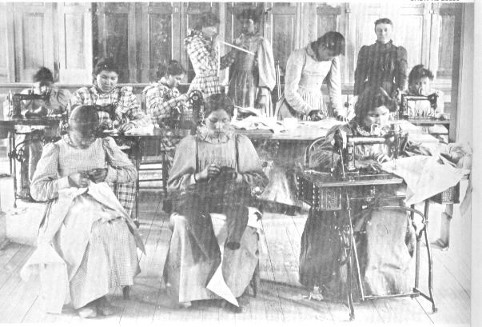
Despite intentions, the Dawes Act failed:
The Bureau of Indian Affairs was corrupt
The allotted land was unviable and the Natives were not ready to settle down as farmers
By the winter of 1890 they were starving and racked with disease
Boarding schools alienated children from their tribes and failed to prepare them for either culture
“I believe in education because I believe it will kill the Indian in me and leave the man and the citizen.”
In 1894, the gov’t ruled the 14th did not apply to Native Americans

Slide 13
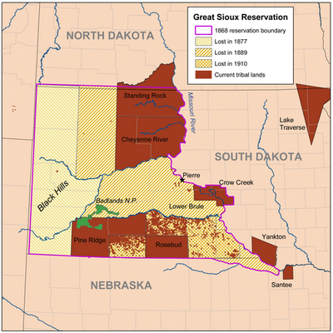
Wounded Knee
In 1890 the gov’t announced it had tribal approval to open the Sioux “surplus” land to white settlement
Holy man started the Ghost Dance ritual to prepare for decline of whites and rebirth of their way of life
After Sitting Bull was arrested and killed, Big Foot led group of Sioux across the Badlands
When they met the Army, he surrendered

Slide 14
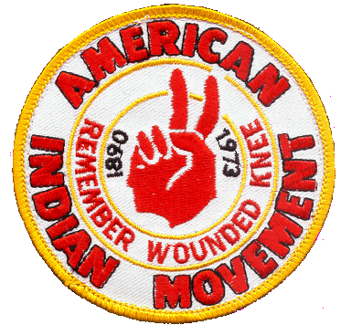
Next morning, they were surrounded by 500 troops (many from Custer’s old regiment)
When some resisted, the troops killed 200-300 mostly unarmed Sioux
Wounded Knee: The Darkest Hour
20 Congressional medals of honor were awarded to troops
This essentially ended the Indian Wars – 900 engagements over 25 years

Slide 15
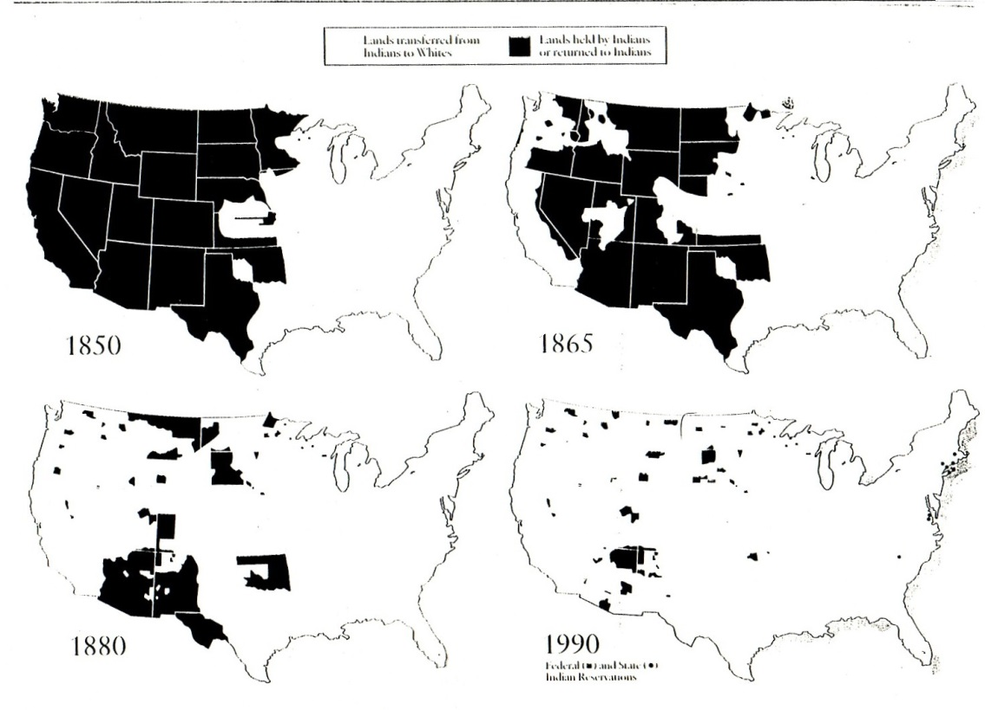
Outcome
1865-1890 White population increased 400%
Reservations struggle with poverty, health problems
Native issues will not be addressed again until 1920s
How could the U.S. government have acted in a more humanitarian, democratic, and effective way?
Is there anything the Native tribes could have done differently to help their situation?

