Slide 1
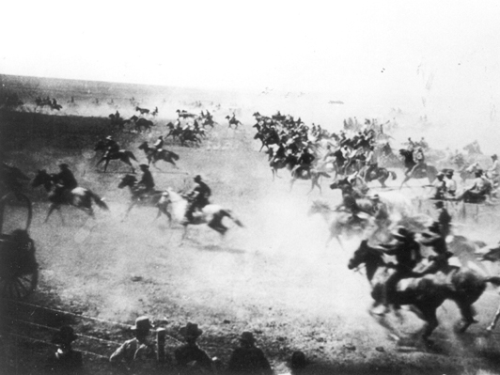
The West: Settlers
Unit 1: The Gilded Age (1870-1920)

Slide 2
Cowboys
Growing demand from cities > boom in cattle industry, ranchers used cowboys to get cattle to RRs
long drive, Chisholm Trail
refrigerator cars
Cowboy life romanticized, in reality was very tough
Buffalo Bill and Calamity Jane
Barbed wire helped farmers but led to range wars, closed frontier
conservation movement
Turner thesis: bad for Americans?

Slide 3
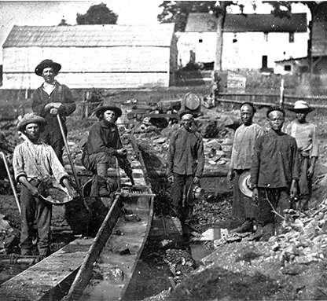
Miners
Gold rushes in CA, Colorado, Black Hills
Comstock Lode silver rush in Nevada
Prospectors: veterans, immigrants, African Ams
Boom towns were dangerous, ruled by vigilante justice
Most disappointed, few struck it rich

Slide 4
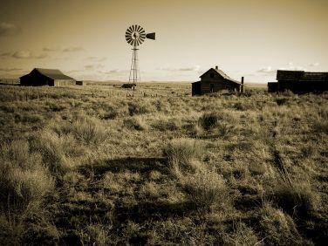
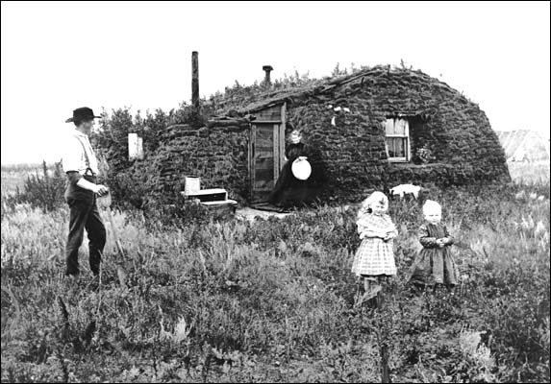
Farmers
Homestead Act: land to 600,000 families
Land rushes, Sooners
Soddys, drought, locusts
New Technology
McCormick and Deere
Morrill Act: colleges, research
Debt and Bankruptcy
Large bonanza farms failed
Small farmers ended up in debt due to overproduction, expensive equipment, RR charges

Slide 5
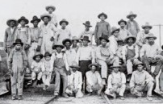
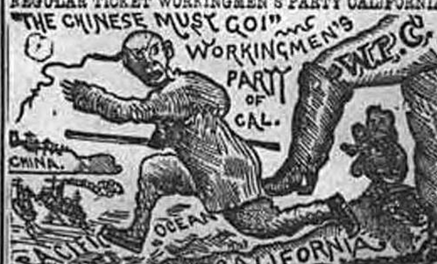
Minorities
African Americans
Exodusters
Buffalo soldiers: all-black Army regiment used during Indian Wars
Mexican immigrants
Vaqueros
Debt peonage
Chinese immigrants
Gold rush
Many used to build transcontinental RR
After it was finished, increasing nativism resulted in the Chinese Exclusion Act

Slide 6
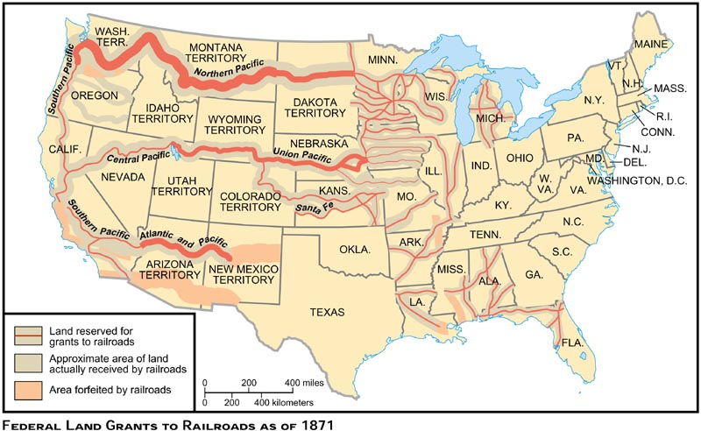
Promontory Point, Utah
170 million acres, and a significant portion of the Homestead Act land

Slide 7
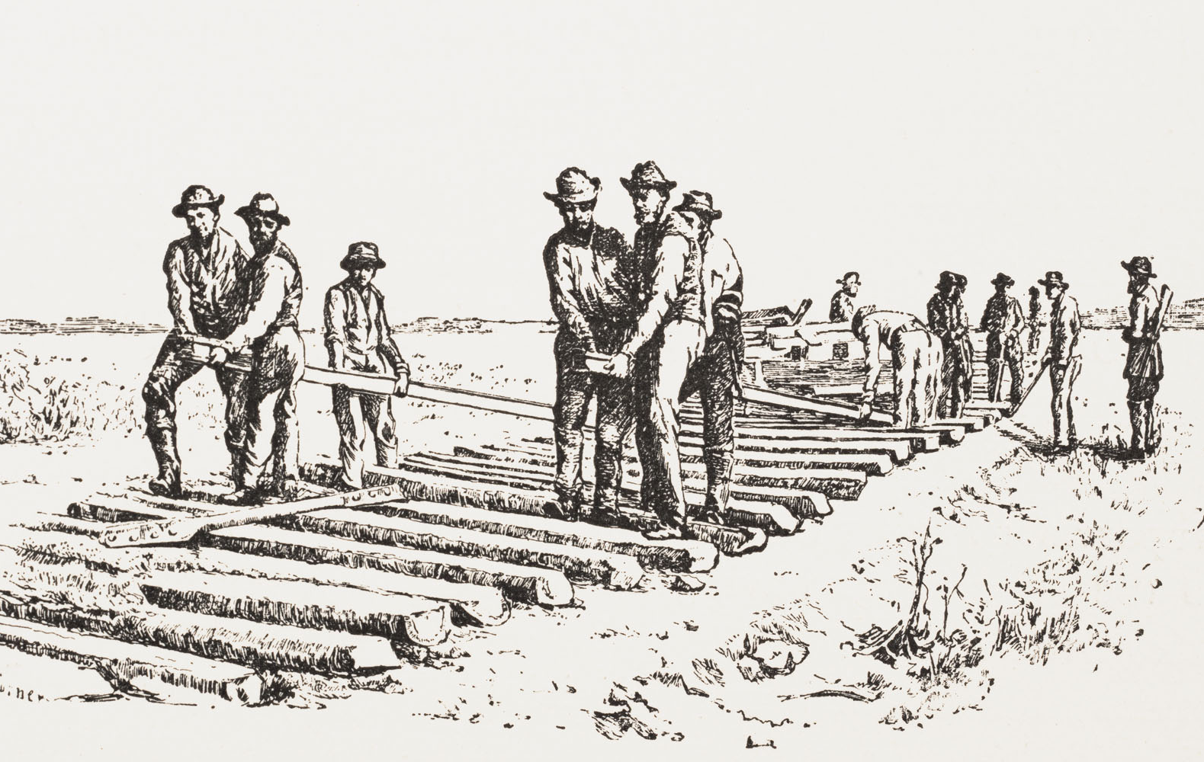
Railroads
Workers
Conditions were dangerous and poor, most were unemployed veterans and immigrants
Pullman towns house/control
Corruption
Land grant misuse: Crédit Mobilier
Price fixing and discrimination
Regulation
Granger laws at state level: Munn v. Illinois
Interstate Commerce Act create the ICC for federal regulation, but was weak

Slide 8
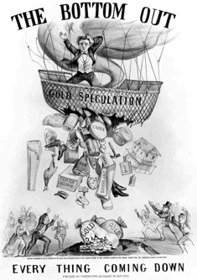
Panic of 1893
Railroad bubble bursts due to speculation and shaky financing > bank failures and a run on the gold supply
Coxley’s march on Washington
Pullman strike
Led to consolidation of railroads and the Free Silver movement
greenbacks > deflation after Civil War
new mines flooded market with silver

Slide 9
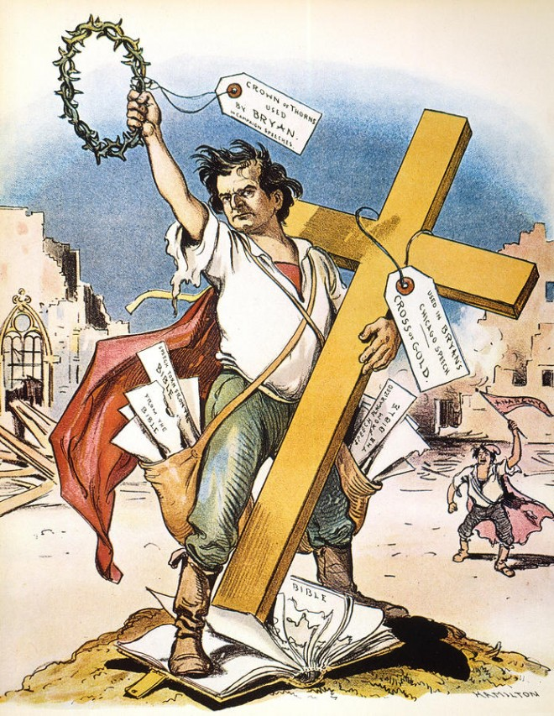
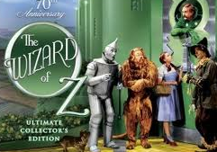
People’s Party
Omaha Platform based on issues of farmer and industrial workers (“common man”)
direct election of senators, graduated income tax, 8-hr workday, bimetallism
“Silverites” supported bimetallism, the government backing money with silver in addition to gold in order to increase the money supply and stimulate the economy
“Goldbugs” wanted to keep the current gold standard, which was more stable and benefited bankers and businesses
Fusion with the Democratic Party
William Jennings Bryan’s “Cross of Gold” speech earned him the nomination of both parties
Lost to Republican William McKinley

