Slide 1
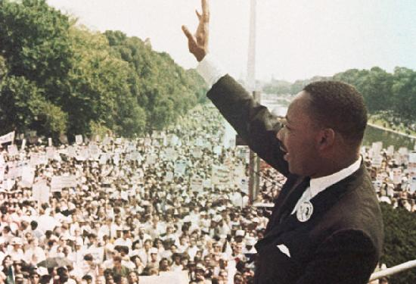
Crisis of Authority
Part B: Domestic

Slide 2
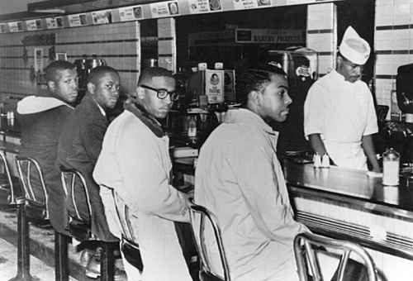
Taking on Segregation
Migrations during Reconstruction and World Wars caused more division between North and South
NAACP (review…)
Tried to get federal anti-lynching laws enacted
Brown: Thurgood Marshall, Little Rock Nine
Montgomery Bus Boycott: Rosa Parks, MLK
MLK and the SCLC
Southern Christian Leadership Conference
Soul Force: Henry David Thoreau (civil disobedience), A. Philip Randolph (collective bargaining), and Gandhi (nonviolence)
SNCC and CORE
Students began with sit-ins to desegregate lunch counters
A&T students at Greensboro Woolworths

Slide 3
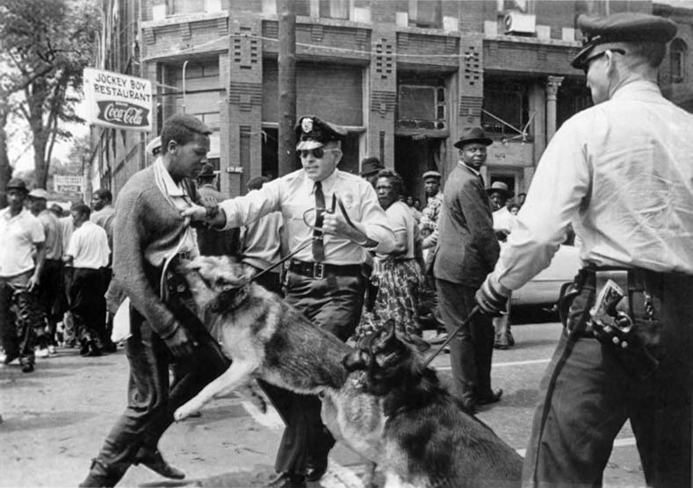
Triumphs of a Crusade
Freedom Riders
CORE/SNCC students rode buses into South
Provoked violence, JFK/RFK sent federal marshals
ICC banned segregation on all interstate facilities
Birmingham
MLK arrested (Letters from Birmingham Jail)
Children’s crusade: arrested, fire hoses, attack dogs
TV coverage outrages public, JFK sends Civil Rights bill to Congress
March on Washington
Led by A. Philip Randolph and Bayard Ruskin
MLK’s “I Have Dream Speech”
Resulted in the Civil Rights Act of 1964 – equal access in public accommodations

Slide 4
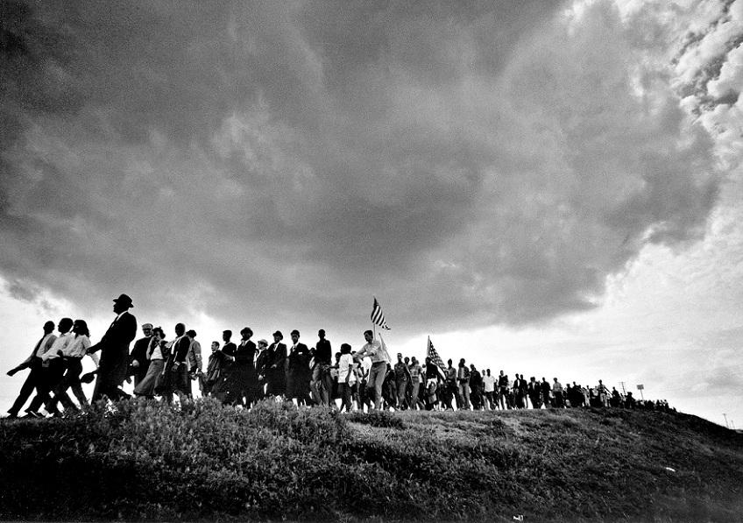
Triumphs of a Crusade
Voting Rights
24th Amendment ratified – banned poll taxes
Freedom Summer
CORE/SNCC movement to register voters in the South
Resulted in KKK violence and murders
Selma Campaign
MLK organized a 50-mile march from Selma to Montgomery to protest at the Alabama capital
Federal marshals had to be sent to protect them
Voting Rights Act of 1965
LBJ presented to Congress
Eliminated literacy tests and gave federal officials power to register voters

Slide 5
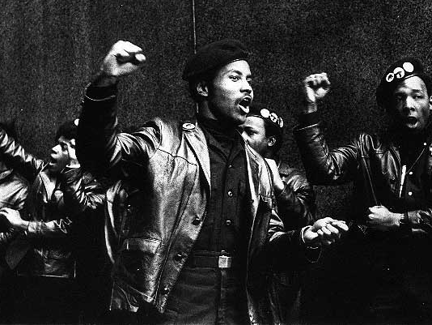
Challenges and Changes
Violence in cities increased due to de facto segregation, white flight, poverty, and job competition
Nonviolent v. Militant
Malcolm X: armed self-defense > Ballots or Bullets
Stokley Carmichael: SNCC/CORE – “Black Power”
Black Panthers: revolutionary socialism
Assassination
MLK killed by James Earl Ray
Riots broke out in over 100 cities
LBJ appointed Kerner Commission: racism > poverty
Civil Rights Act of 1968
Ended housing discrimination

Slide 6
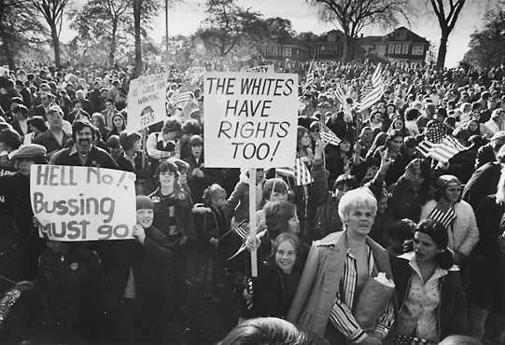
Challenges and Changes
Successes
Ended de jure segregation in public accommodations, education, housing
Voting rights led to election of African Americans: more power and better representation
Limitations
Poverty in the inner cities
De facto housing segregation and white flight reversed progress toward school integration
Swann v. Charlotte Mecklenburg - busing
Affirmative action in education and the workplace: Effective? Reverse discrimination?

Slide 7
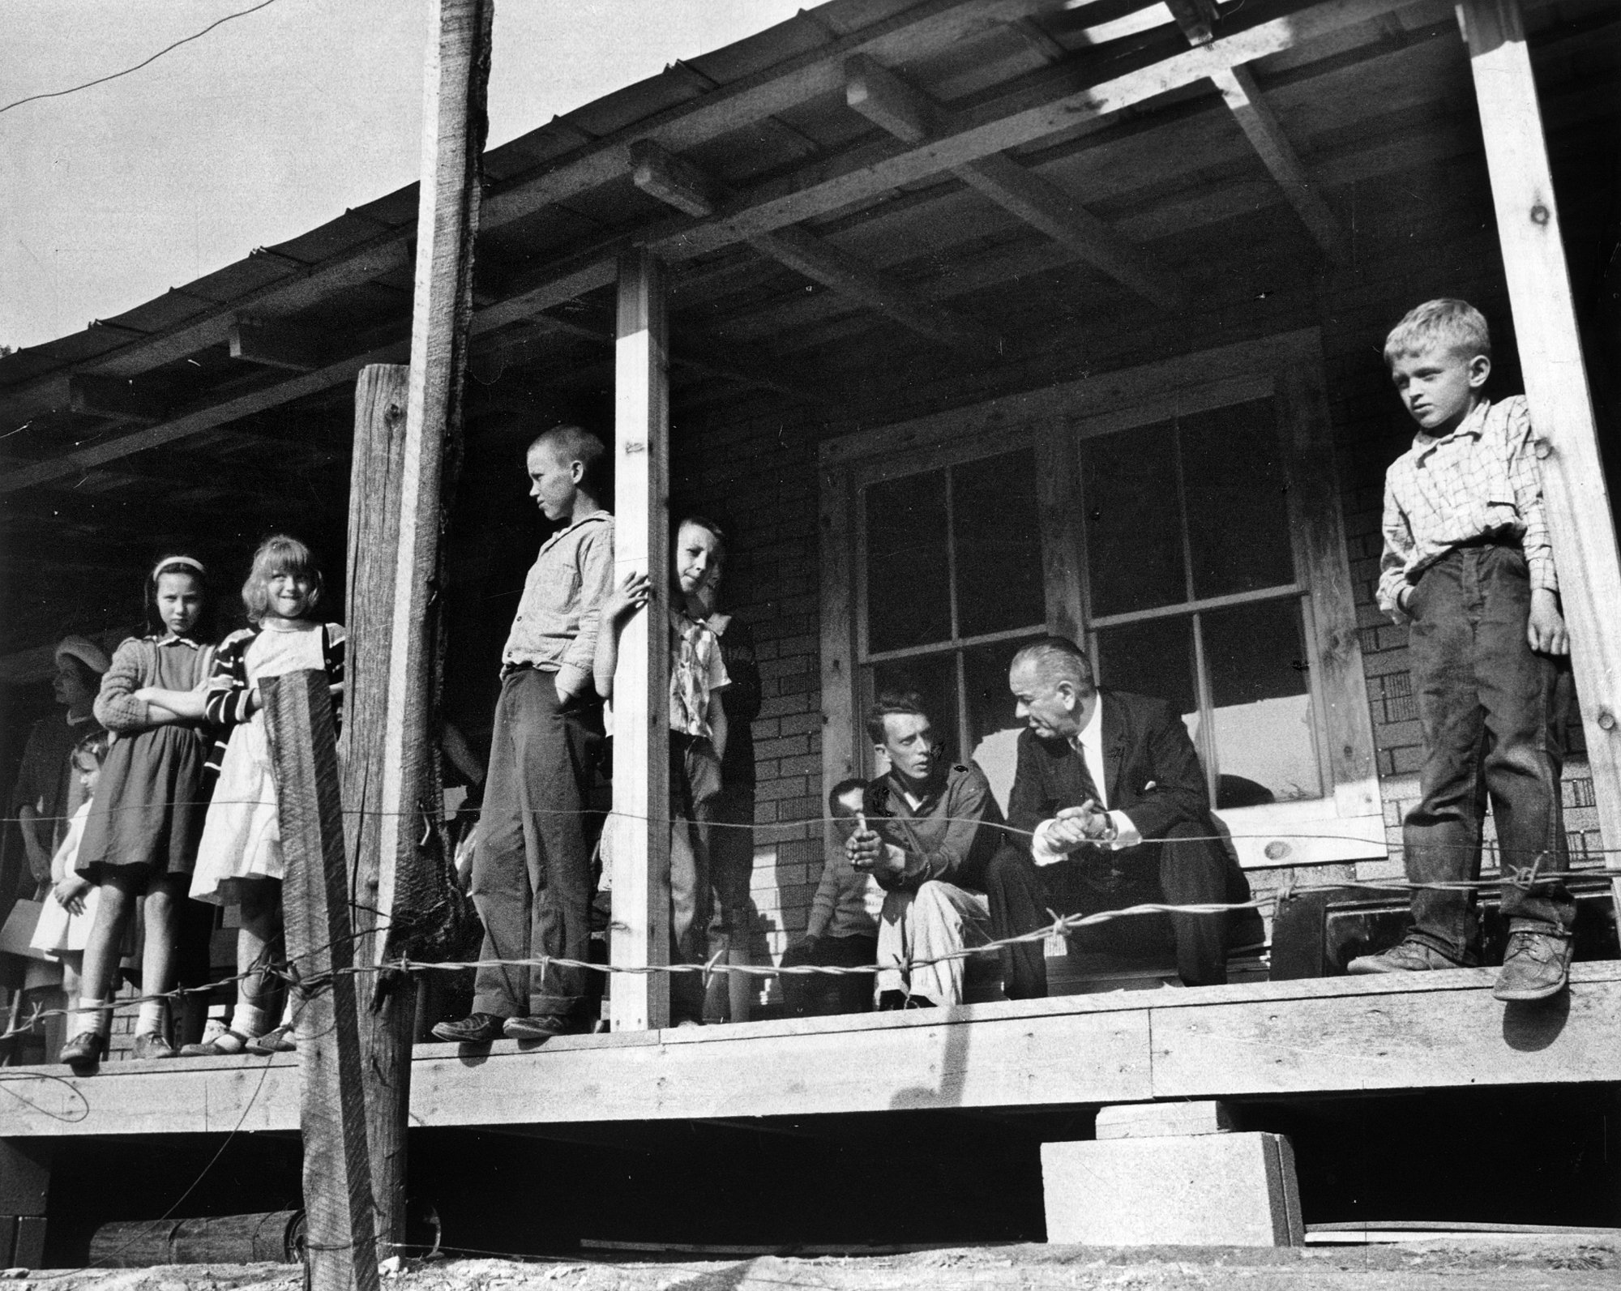
LBJ’s Great Society
War on Poverty
In Congress, strong supporter of New Deal programs
Economic Opportunity Act (1964): Job Corps, VISTA, Head Start, Community Action Program
Medicare and Medicaid
Civil Rights
As Senate majority leader: Civil Rights Act of 1957
As President: Civil Rights Act of 1964, 24th Amendment, Voting Rights Act of 1965
Other Areas of Reform
Immigration: ended quota system
Cities: Federal and low-income housing, HUD
Education: Scholarships, PBS

Slide 8
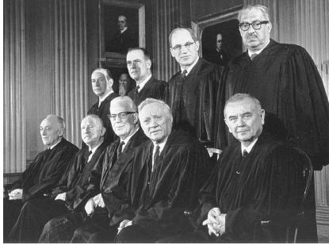
LBJ’s Great Society
Warren Court
Brown: “separate inherently unequal”
Baker and Reynolds: “one person, one vote” through reapportionment
Mapp : 4th amend, exclusionary rule
Gideon and Escobedo: legal counsel
Miranda: rights read before questioning
Limitations
Vietnam took resources and attention away
Conservative backlash over role of federal gov’t and deficit spending

Slide 9
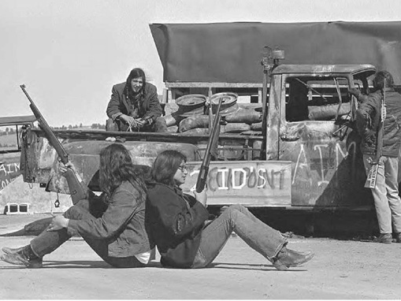
Latinos and Native Americans
Latino groups
Cesar Chavez: farm workers union, boycott
Bilingual Education Act
Native Americans
AIM: often militant activist group
Trail of Broken Treaties march, occupied the Bureau of Indian Affairs in D.C.
Seized town of Wounded Knee, took hostages
Legal remedies
Indian Self-Determination and Education Assistance Act
Court settlements, recognition of tribal lands, financial compensation

Slide 10
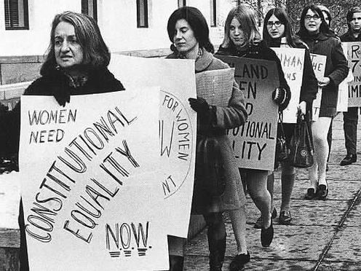
Women Fight for Equality
National Organization of Women (NOW)
Betty Friedan, Feminine Mystique
Childcare, education, workplace discrimination
Roe v. Wade
Protects right to an abortion in the 1st trimester
State can regulate more in 2nd and 3rd trimesters
Conservative reaction
Phyllis Schlafly: anti-feminist movement
Defeat of the Equal Rights Amendment

Slide 11
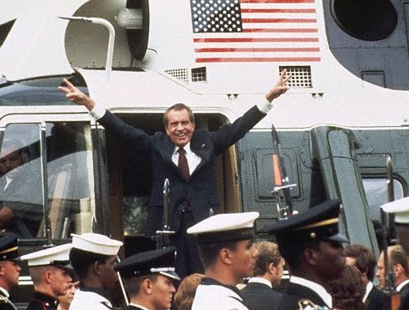
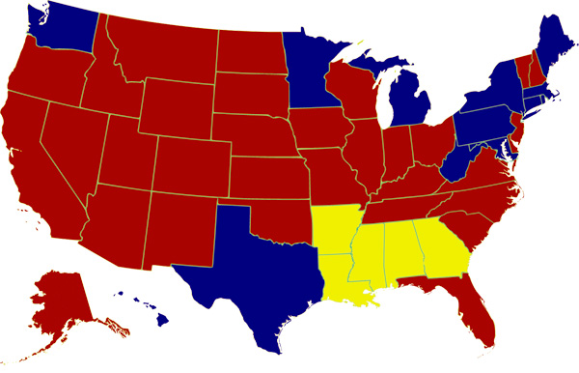
The Nixon Administration
New Federalism
Revenue sharing: more power to state/local gov’t to choose how to spend their federal money
In some cases, he worked with Democrats in Congress
Increased Social Security, Medicare/Medicaid, and food stamps
Worked against Democrats on other Great Society programs
Tried to impound funds for other programs (ex. housing, education)
Abolished the Office of Economic Opportunity
Southern Strategy
Slowed school segregation
Sued by NAACP as violation of Brown II and lost
Supreme Court ruled in favor of busing in Swann
Tried to stop Congress from extending Voting Rights Act giving federal gov’t power to help register voters in the South

Slide 12
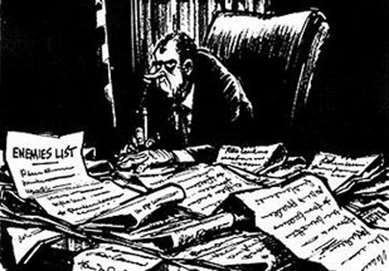
Watergate: Nixon’s Downfall
Imperial presidency
More power to executive, distance from Congress
Secrecy within a small group of advisors
Law and Order Politics
Had little tolerance for anti-war movement
Used FBI/CIA/IRS against people on his “enemies list”
Election of 1972
CRP broke into DNC headquarters at Watergate complex to steal campaign secrets, bug offices
Tried to stop FBI investigation, bought silence of the burglars
Won in a landslide

Slide 13
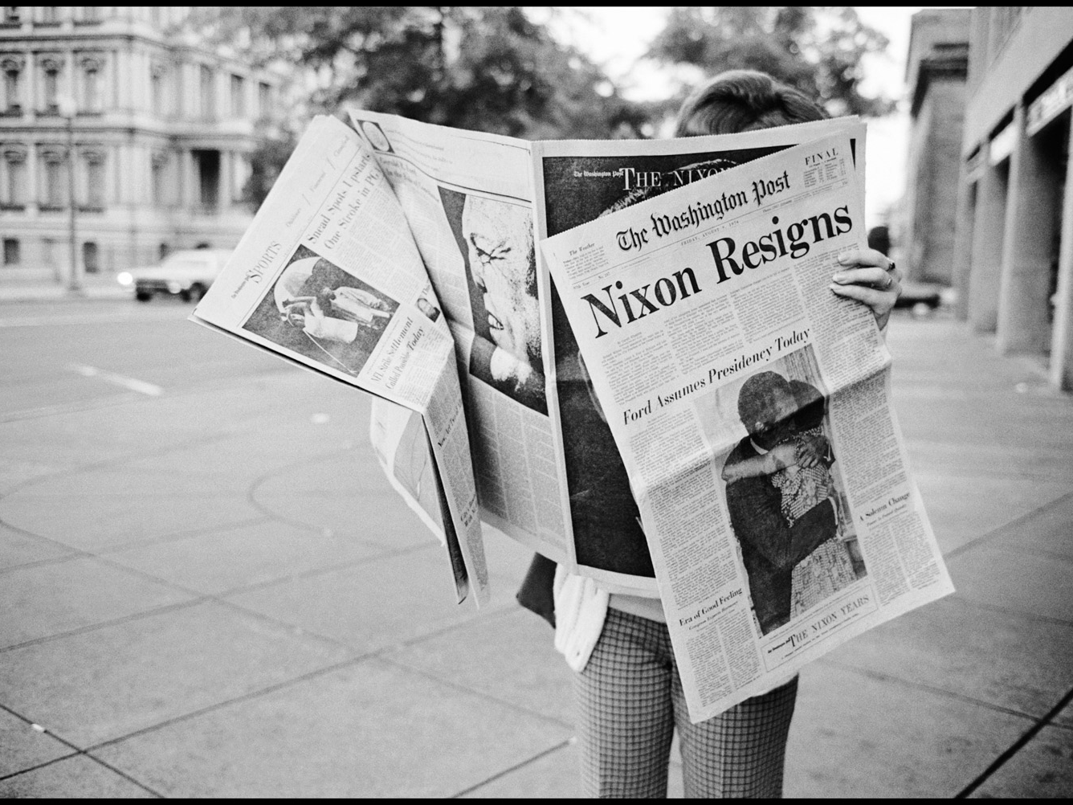
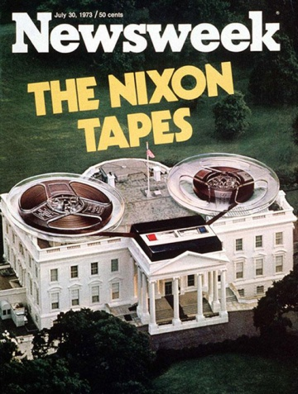
Watergate: Nixon’s Downfall
Senate investigation
Testimony implicates Nixon in the cover-up
Refuses to hand over taped conversations
Saturday Night Massacre
Spiro Agnew resigns over a bribery scandal
Nixon uses 25th Amend to appoint Gerald Ford VP
U.S. v. Nixon
Nixon claims executive privilege, but Supreme Court rules that it is a matter of criminal activity not national security
The House begins impeachment proceedings
Tapes are released, but with segments missing
Nixon resigns, Ford becomes President

Slide 14
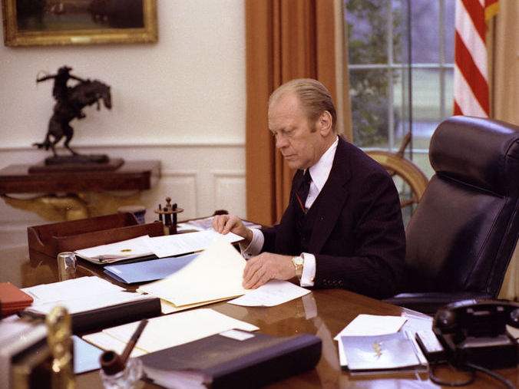
The Ford Years
Pardon: angered the public, but freed him up to handle other issues
Economic problems
WIN: “Whip Inflation Now” failed due to lack on incentives to conserve energy
Tight money policy: cut gov’t spending, Fed raised interest rates > Worst recession since 1933

