Slide 1
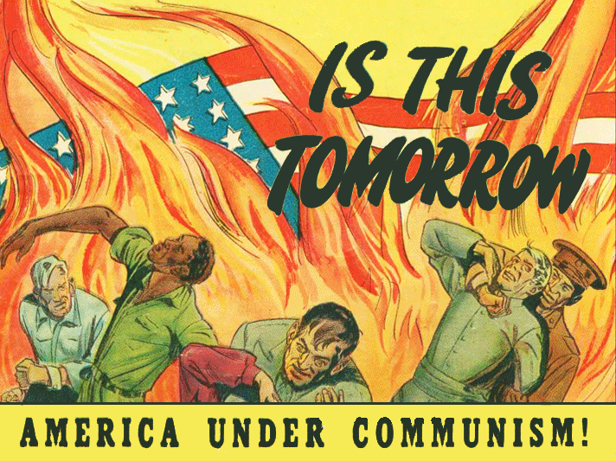
From D-Day to Doomsday
Part B - Domestic

Slide 2
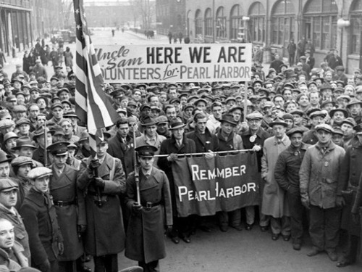
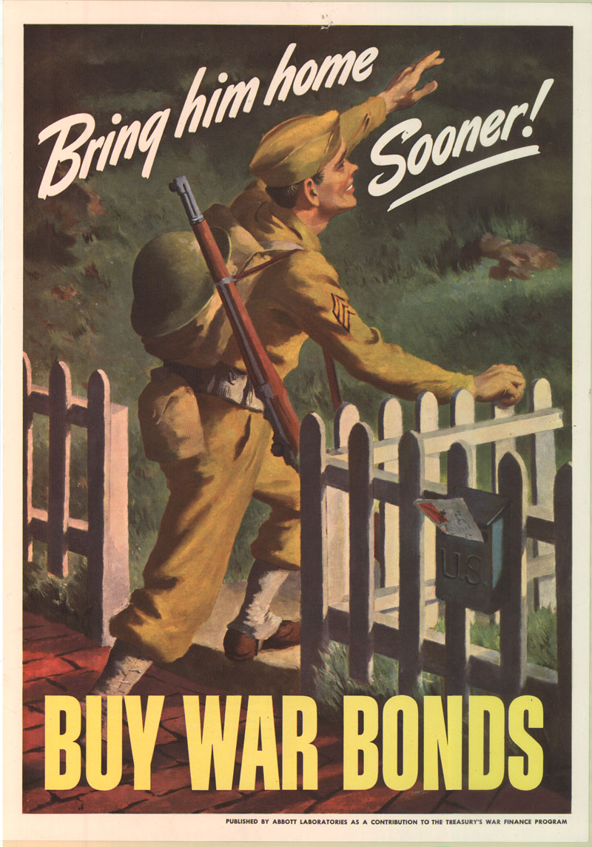
Mobilizing for WWII
Military Strength
5 million volunteered, 10 million drafted
OSRD (ex. radar, sonar, pesticides) and Manhattan Project – atomic bomb
Financing the War
Income taxes raised, expanded to include middle and lower income households
Sold war bonds

Slide 3
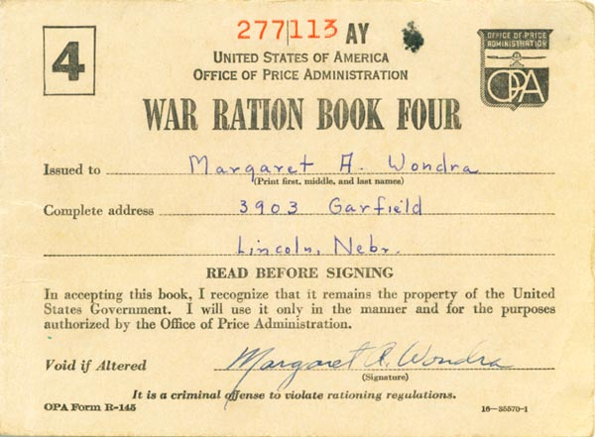
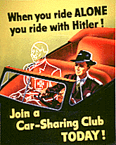
Industrial Coordination
Millions of workers recruited to war industries, causing mass migrations
Factories converted to war production
War Production Board rationed supplies like oil, gas, rubber, etc.
National War Labor Board limited union/strike activity in war industries
Office of Price Administration
Froze wages, prices, and rents to combat inflation that had been such a huge problem in WWI
Created a ration system for gas, meat, sugar, shoes, etc.

Slide 4
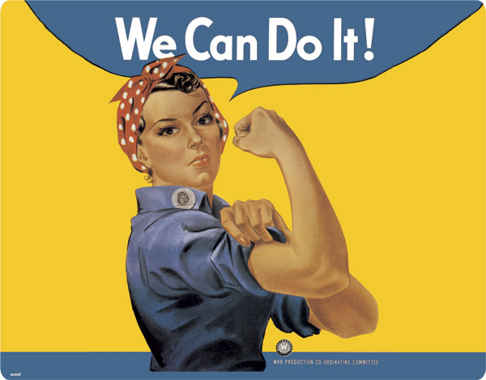
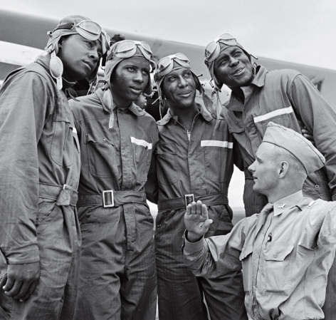
Minorities in the War
Women
WAAC formed to expand the role of women in the military, though still not able to fight
“Rosie the Riveter” symbolized women working in heavy industry for the first time
African Americans
Military still segregated
Racial tensions increased in the north as a result of the Great Migration
FDR issued executive order asking for an end to discrimination in war related industries
GI Bill benefits not equally enjoyed due to educational and housing discrimination

Slide 5
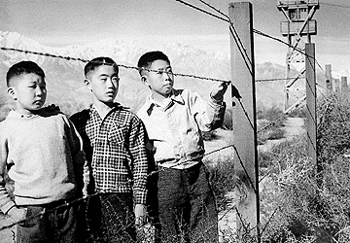
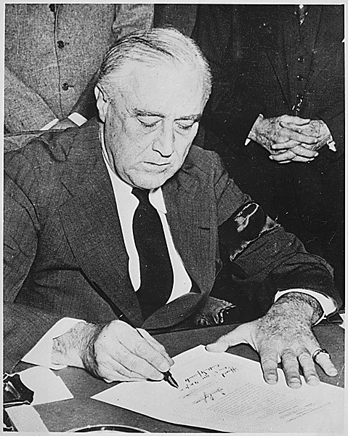
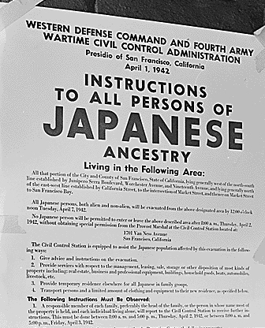
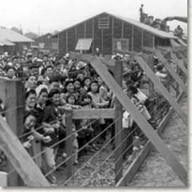
Japanese Internment
After Pearl Harbor, FDR issued Executive Order 9066 to contain Japanese Americans living on the West Coast
Businesses and homes were evacuated when they were moved into detention camps
Despite this, many Japanese Americans wanted to help the U.S. in the war effort and were eventually allowed to join

Slide 6
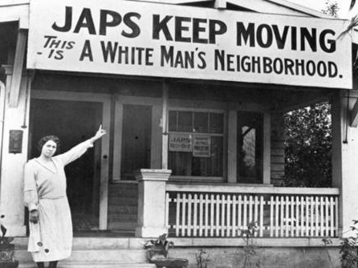
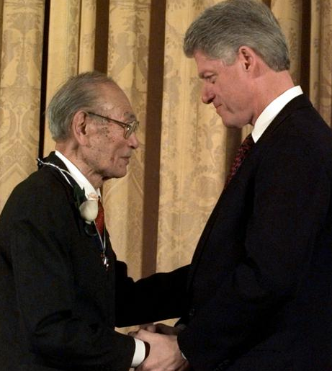
In Korematsu v. U.S. (1944), the Supreme Court upheld the order as a constitutional exercise of executive power during wartime
The government has since admitted it was racially motivated because the victims did not pose a security threat, and reparations have been paid to families
The principle that executive power increases and civil liberties may be restricted during wartime still holds

Slide 7
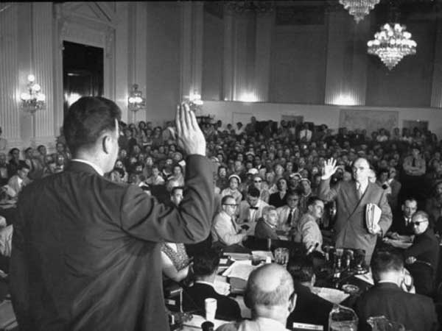
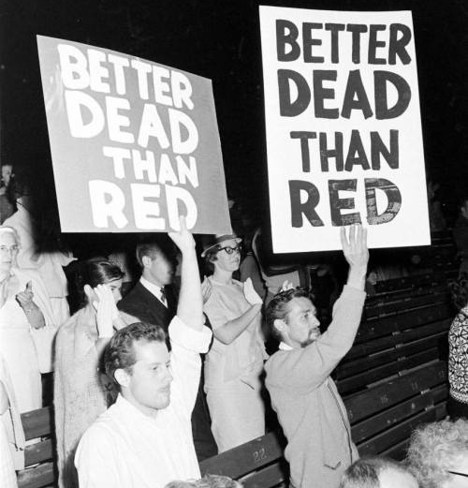
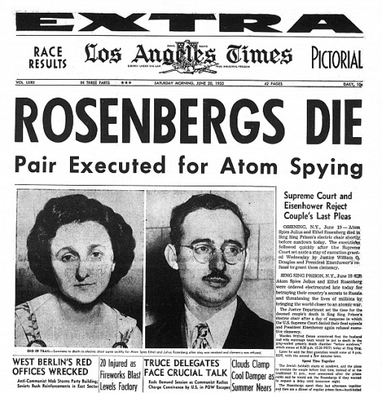
Cold War at Home
Loyalty Review Board
To investigate disloyalty in government employees
House Un-American Activities Committee
Congress began investigating private industry too, like Hollywood
McCarran Act
Unlawful to plan any action that might lead to…
Passed over Truman’s veto
The Rosenbergs
Implicated in leaking atomic secrets to USSR, executed

Slide 8
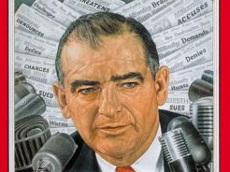
McCarthyism
Joseph McCarthy claimed Democrats had let Communists infiltrate the State Department
Led a “witch hunt” in the Senate
Unsupported accusations, bully tactics
Coerced people to “name” others that could have ties to communism in order to get themselves off the hook
When he sparked an investigation against the Army, the televised hearings outraged the public and he got shut down

Slide 9
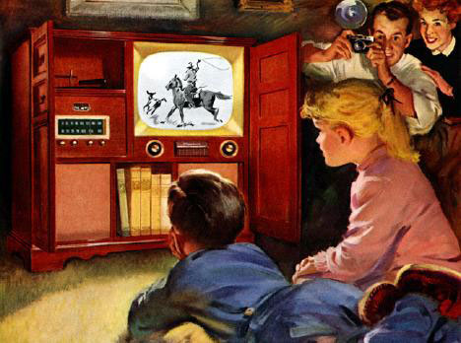
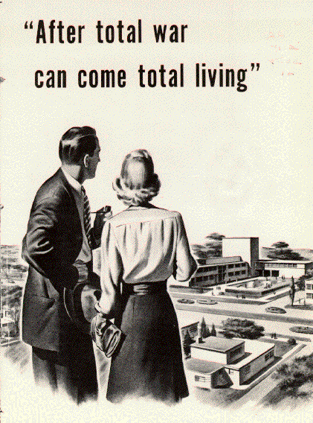
Postwar Economy
Congress established controls to keep inflation somewhat under control after the OPA ended
Cold War fears kept defense spending high
The Marshall Plan helped trade with Europe
The GI Bill helped veterans move to the suburbs
Interstate Highways fueled trade
Americans had saved and invested wisely during the 1930s-40s and were ready to spend

Slide 10
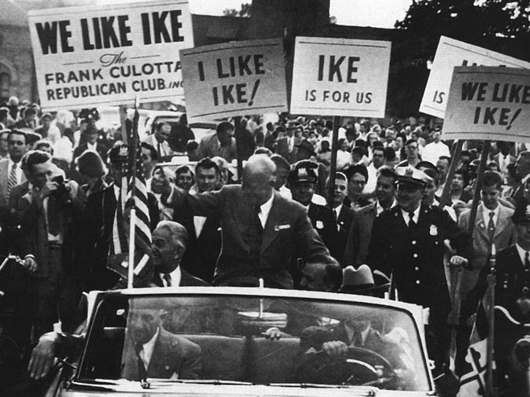
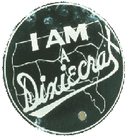
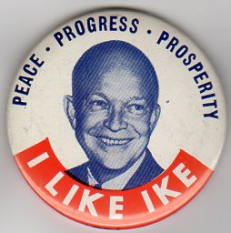
From Truman to Ike
Truman struggled with Labor Union support
He threatened to draft striking workers into the army
Congressed passed the Taft-Hartley act over his veto, overturning rights won by labor unions during the New Deal
His support for Civil Rights caused division in the Democratic Party
Desegregated the military, asked Congress for anti-lynching law and ban on poll taxes
The Fair Deal extended New Deal reforms (Social Security, minimum wage, aid for cities) but was blocked in some cases by Republicans working with Dixiecrats
Republicans nominated Dwight Eisenhower
Military expertise in stopping communism abroad
Dynamic conservatism (“Conservative when it comes to money and liberal when it comes to human beings.”)

Slide 11
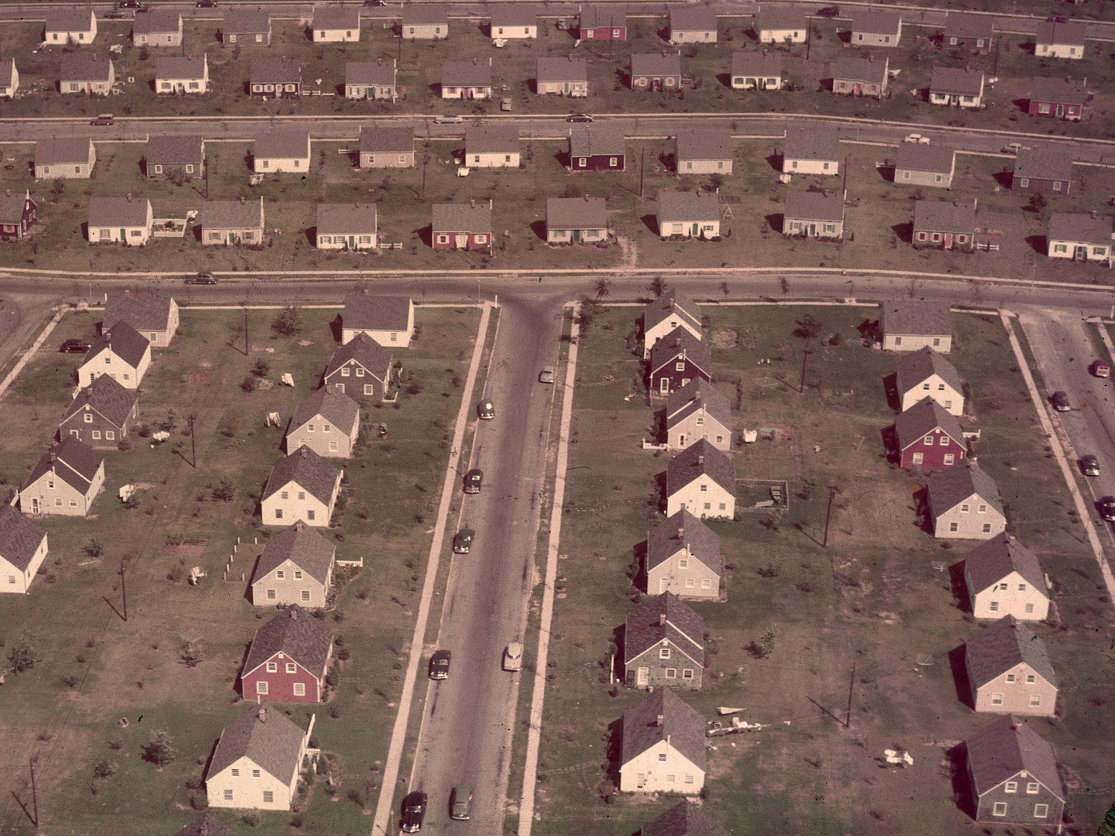
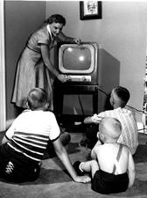
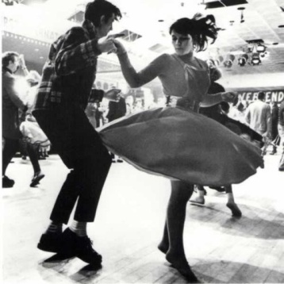
Culture of the 1950s
Baby Boom
High birth rate 1940-1960 led to the largest generation in American history
Medical care (Ex. Jonas Salk, Dr. Spock)
Glorification of homemaker v. new career opportunities
Conformity and Consumerism
Franchises, Levittowns, credit cards, automobiles
Marketing: planned obsolescence, advertizing
Beatniks rebelled against conformity
Pop Culture
Americans, esp. teens, had more leisure time
Television ushered in a new era in mass media
Rock ‘n’ Roll grew out of rhythm and blues tradition, appealed to teens and made adults nervous

Slide 12
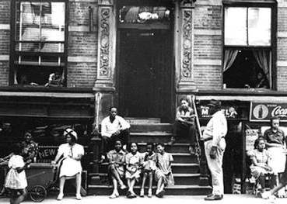
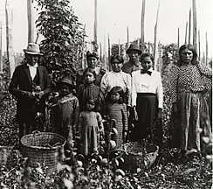
The Other America
White flight
Middle class whites left cities for suburbs (w/ help of GI Bill)
Inner cities became neglected
Urban renewal failed to support displaced families
Mexican immigrants
Braceros were allowed into the U.S. during WWII due to an agricultural shortage, were expected to return when it was over
Native Americans
Made some gains during the 1920s-30s (citizenship, reservation autonomy)
Lost support from government during the 1940s-50s (discrimination in military during WWII, termination policy ended the reservation system)

Slide 13
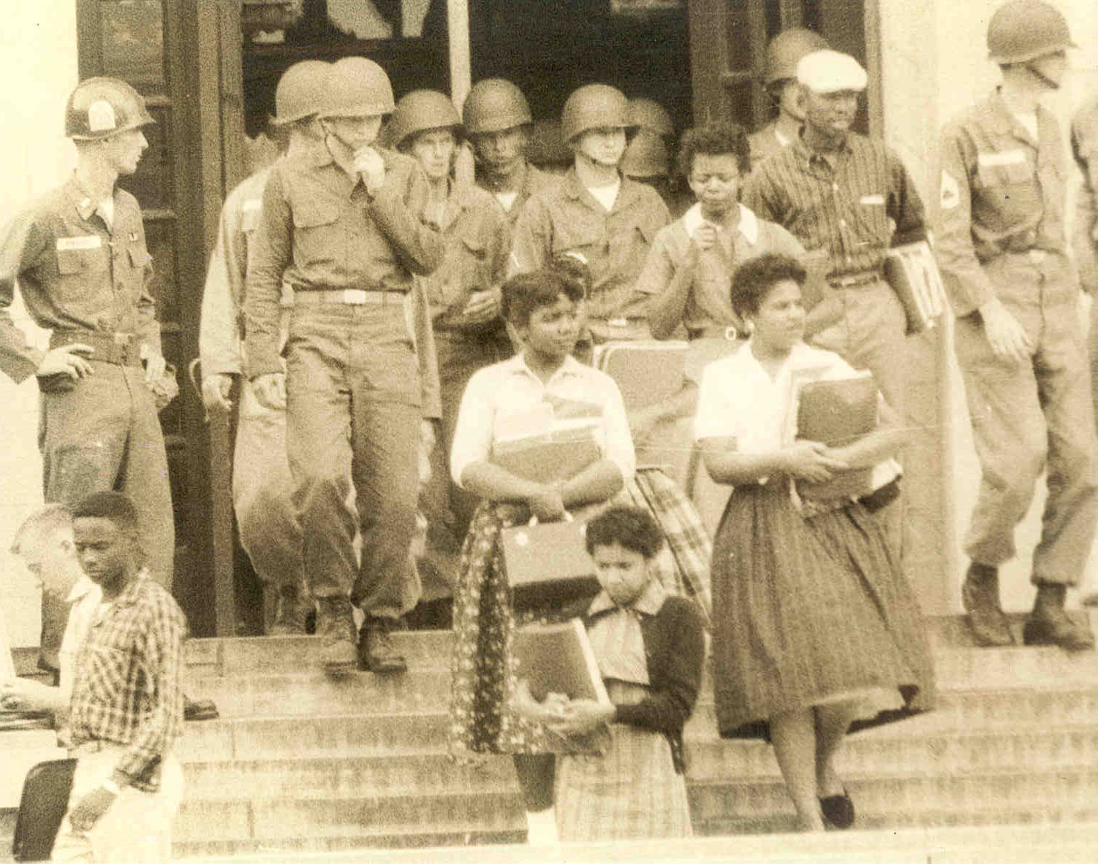
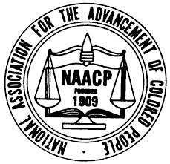
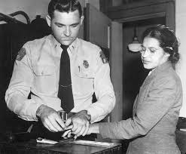
Movement on Civil Rights
Brown v. Board of Education (1954)
NAACP provided legal team under Thurgood Marshall
Overturned Plessy v. Ferguson: “Separate is inherently unequal”
Little Rock Nine: Eisenhower, National Guard
Bus Boycott (1955)
Rosa Parks was an NAACP officer
MLK, Jr. elected to organize and lead

