Slide 1
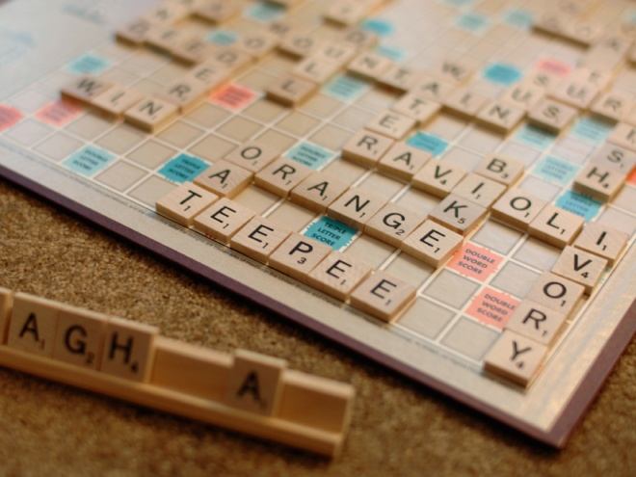
History Skill Builder
Making Relevant Connections

Slide 2
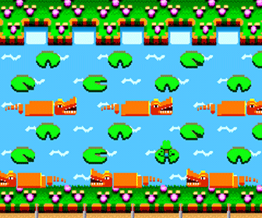
Relevant Connections
“Those who cannot remember the past are condemned to repeat it”
Looking for connections between different time periods helps you piece together the larger historical context and trace change over time
Seeing patterns that repeat over time can help you evaluate current proposals and actions to predict how they might play out

Slide 3
Identify General topic, then Specific trend/idea
Economic: debate over taxes, boom and bust
Political: change in political parties, corruption
Legal: interpretation of Constitution, regulations
Social-Cultural: new values, race or class conflict
Technological: industrialization, spread of ideas
Geographic: migration to cities, scarce resources
Foreign: reaction to war, trade policies, diplomacy
Government: federal v. state powers, checks/balances
Citizens: civil rights, immigration, opportunities
Economic: debate over taxes, boom and bust
Political: change in political parties, corruption
Legal: interpretation of Constitution, regulations
Social-Cultural: new values, race or class conflict
Technological: industrialization, spread of ideas
Geographic: migration to cities, scarce resources
Foreign: reaction to war, trade policies, diplomacy
Government: federal v. state powers, checks/balances
Citizens: civil rights, immigration, opportunities

Slide 4
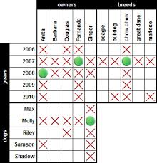
Read, Review, Research
Analyze: Who, What, When, Where, Why, and How?
What historical background do I need to review or research?
Annotate – source, purpose, bias, context, language, style, etc.
Look for similarities and differences
Make specific connections to what we have been learning in class

Slide 5
Tie it all together in a meaningful way
Why does it matter? Then? Now?
Will this trend continue to repeat itself? Why/why not?
What other historical or current examples would be relevant?
What lessons could be learned?

Slide 6
Show your work
Regardless of how you are asked to explain the connection (essay, paragraph, constructed response, presentation, share with class)…
Explain the relevant connection
Support the connection with at least one specific example from each case
Elaborate on greater historical significance and/or relevance to current events

Slide 7
We have just learned about the Japanese attack on the U.S. naval based at Pearl Harbor, which brought the U.S. into World War II. Find an example from U.S. History that can compare, and explain the connection between them.
General: Military, War
Specific: Attack on U.S. military, causes for joining a war, major conflict involving multiple enemies/countries
Possible examples:
Earlier history – Revolutionary? War of 1812? Mexican-American? Spanish-American?
Later – Cold War? Korea? Vietnam? Iraq? War on Terror,? Afghanistan?

Slide 8
“Yesterday, Dec. 7, 1941 - a date which will live in infamy - the United States of America was suddenly and deliberately attacked by naval and air forces of the Empire of Japan…Always will we remember the character of the onslaught against us. No matter how long it may take us to overcome this premeditated invasion, the American people in their righteous might will win through to absolute victory…”
– President Franklin D. Roosevelt, Address to Congress, Dec. 7, 1941
“This act will not stand; we will find those who did it; we will smoke them out of their holes; we will get them running and we'll bring them to justice. We will not only deal with those who dare attack America, we will deal with those who harbor them and feed them and house them…”
– President George W. Bush, Remarks at Camp David, Sep. 15, 2001

Slide 9
“Yesterday, Dec. 7, 1941 - a date which will live in infamy - the United States of America was suddenly and deliberately attacked by naval and air forces of the Empire of Japan…Always will we remember the character of the onslaught against us. No matter how long it may take us to overcome this premeditated invasion, the American people in their righteous might will win through to absolute victory…”
– President Franklin D. Roosevelt, Address to Congress, Dec. 7, 1941
“This act will not stand; we will find those who did it; we will smoke them out of their holes; we will get them running and we'll bring them to justice. We will not only deal with those who dare attack America, we will deal with those who harbor them and feed them and house them…”
– President George W. Bush, Remarks at Camp David, Sep. 15, 2001
Review and/or Research:
Why were we attacked? From our perspective? From theirs?
How was the U.S. involved with that country/group in the past? What previous events would be relevant?
Did most Americans agree? Was the U.S. response successful? What were the long-term effects? Today?
Afghanistan, War on Terror
World War II

Slide 10
After both Sept. 11 and Pearl Harbor, the U.S. President denounced the attack as unprovoked and promised the American people to defeat those responsible. In both cases, the U.S. was about to enter a dangerous and indefinite conflict that would take the lives of many Americans, so the President needed to calm fears and boost morale. There was also a complicated history between the U.S. and the enemy in both situations. Before WWII, the U.S. had control of the Philippines and supported French and British colonies in Asia, which affected Japan because it wanted to build its own Asian empire. After WWII, the U.S. was deeply involved in the creation and support of Israel in Palestine, which has been a continual source of anti-American feeling in Arab countries and fuel for terrorist groups. Both Presidents were confident of victory - despite the fact that in World War II it meant fighting a war in Europe and the Pacific simultaneously, and after Sept. 11 it meant fighting a war against an unconventional enemy that could have ties to many different countries throughout the Middle East. Americans can draw on experiences in WWII to help shape policy in the War on Terror. For example, how can the U.S. build a strong alliance in the War on Terror like the one that existed in WWII?

Slide 11
After both Sept. 11 and Pearl Harbor, the U.S. President denounced the attack as unprovoked and promised the American people to defeat those responsible. In both cases, the U.S. was about to enter a dangerous and indefinite conflict that would take the lives of many Americans, so the President needed to calm fears and boost morale. There was also a complicated history between the U.S. and the enemy in both situations. Before WWII, the U.S. had control of the Philippines and supported French and British colonies in Asia, which affected Japan because it wanted to build its own Asian empire. After WWII, the U.S. was deeply involved in the creation and support of Israel in Palestine, which has been a continual source of anti-American feeling in Arab countries and fuel for terrorist groups. Both Presidents were confident of victory - despite the fact that in World War II it meant fighting a war in Europe and the Pacific simultaneously, and after Sept. 11 it meant fighting a war against an unconventional enemy that could have ties to many different countries throughout the Middle East. Americans can draw on experiences in WWII to help shape policy in the War on Terror. For example, how can the U.S. build a strong alliance in the War on Terror like the one that existed in WWII?

Slide 12
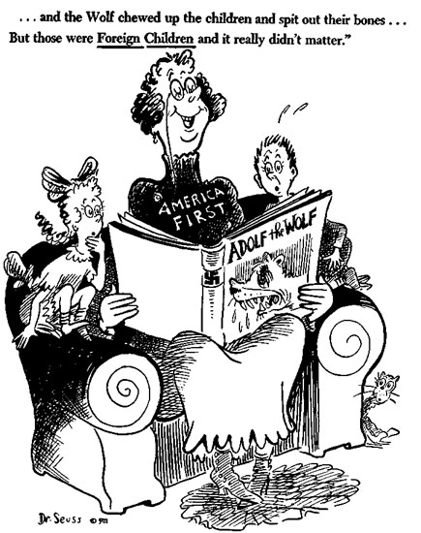
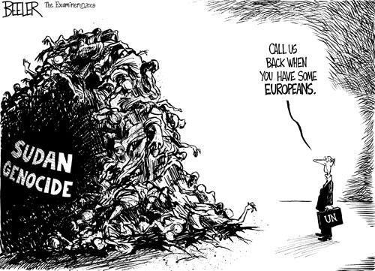
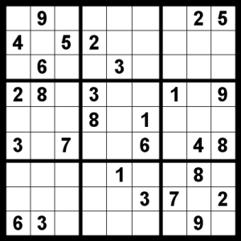

Slide 13
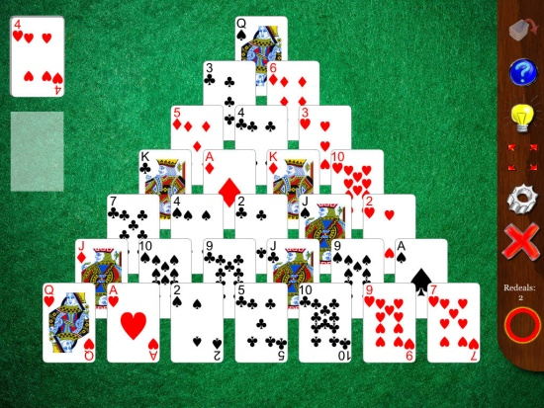
Finding your own Current Events
Search terms
Go beyond just basic term (“Imperialism”) – Be more specific to the trend/idea (“U.S. intervention Middle East”)
Ask about how far back you can go, it may depend on topic
News articles
Events that are happening now are reported first, then they go into more and more background as you read further (online sources often give links to more info on side/bottom)
Mainstream news outlets try to write at about an 8th grade reading level – if it is for a more specialized audience it may be over your head
Reliability
Wikipedia: look for Red Warnings at Top, you can use it to give you ideas for a search, you can also sometimes find good reliable sources cited at bottom
Op-Ed (Opinion-Editorial) Columns and Blogs: random v. published by a reliable news source, still opinion so look for strong supporting facts
Check multiple sources to get a balanced account, some are more liberal or conservative

Slide 14
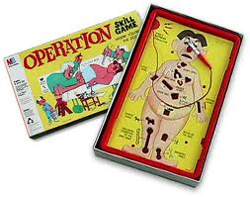
Practice, Practice, Practice
As with any skill, you may not get it the first time (or second…)
Review these directions and examples anytime I ask you to make connections between different time periods!
The written portion of the next test will be based on this skill.

