Slide 1
Sheldon’s
Where quality is the best policy.

Slide 2
About our Business
We are a retail dealer of fine clothing for both Men and Women.
High quality clothing is in demand for young people in this day and age, and our business plans to take advantage of this.

Slide 3
Why should you invest?
Our business is highly consumer-oriented.
A survey taken of our consumers shows an interest in clothing, and that means more money for our stockholders.
We are confident that the return for our stockholders will outweigh the risk, based on the information gathered in our survey, and recent trends observable in the youth today.

Slide 4
Our Plans
As a retail clothing store, our short term goals are to establish a market for our products, and to provide a place for established buyers to spend their money on our quality goods.
We will NOT make our own products. We will buy from several brands in bulk, and sell at a mark-up based on several factors like brand, quantity and demand.

Slide 5
What we need from you
We need your trust. When you buy stocks from us, it tells us that you trust us to succeed. The expenses that we need to make our dream a reality include, but may not be limited to: Lease for the store, initial deposit for clothes, advertising, utilities, furnishing/decorations. Moderate level funding will be required. In return for you trust, we hope to give compensation in the form of dividends, and to increase the value of our stocks so you can sell the shares you buy today in the future for huge amounts of profit.

Slide 6
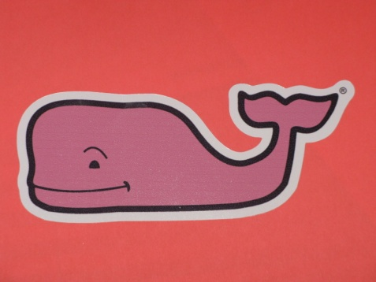
Some brands we will keep in stock:

Slide 7
In Conclusion
As a startup company, Sheldon’s hopes to provide quality clothing for our customers and to provide a good option for potential stockholders to trust us with their investments. We appreciate you taking the time to view our presentation and remember, quality is the best policy.

