Slide 1
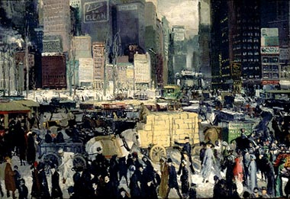
The Cities
Unit 1: The Gilded Age (1870-1920)

Slide 2
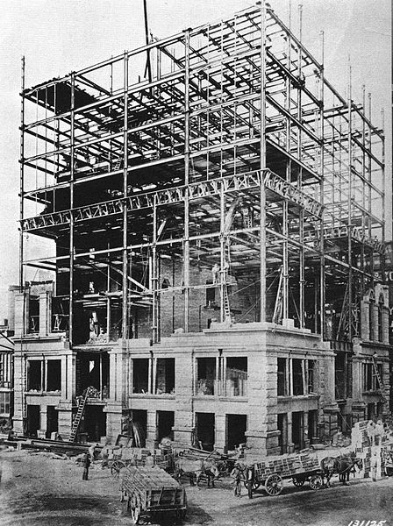
Industrialization
Large supplies of natural resources like oil, coal, and steel
An explosion of inventions like steam engines, electric power, typewriters, telephones, airplanes
Growing city populations demanding new products like skyscrapers, bridges, streetcars

Slide 3
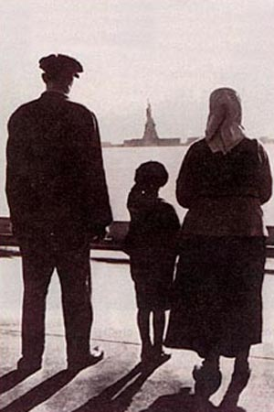
Immigration and Migration
Most settled in the cities where they faced the challenges of culture shock, nativism, and poverty
To help each other survive, most immigrant groups formed ethnic communities
Many took advantage of increasing public education to “Americanize” their children

Slide 4
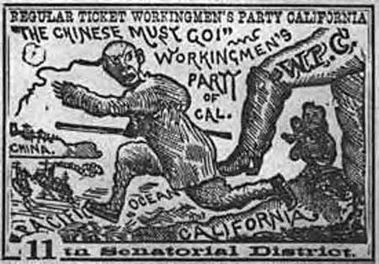
Immigrants who assimilated most successfully were White Anglo-Saxon Protestants (WASPs). Those who faced the most prejudice and poverty were Asian, Mexican, Catholic, and Jewish.
The Chinese Exclusion Act banned Chinese immigrants. In the Gentlemen’s Agreement, Japan agreed to limit Japanese emigration to America in exchange for better treatment of Japanese people living in California.
As more African Americans migrated to northern cities, de facto segregation increased (vs. de jure)

Slide 5
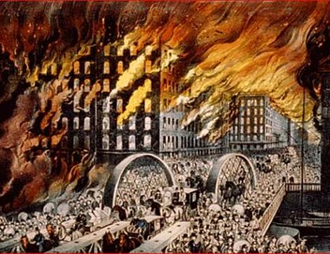
Urban Problems
Problems: overcrowding, water shortages, sewage and garbage overflow, crime, rapidly-spreading fires
Solutions: row houses and tenements, mass transit systems, water works, sanitation departments, paid police and fire departments.

Slide 6
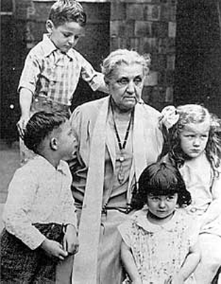
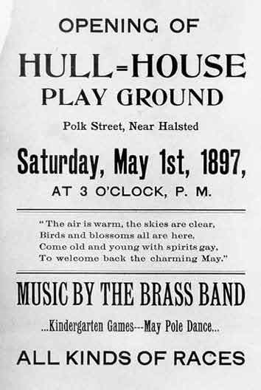
Social reformers like Jane Addams did much to help the urban poor, starting the Social Gospel Movement. Settlement houses provided food, shelter, education, and health care.
City parks, Amusement parks, bicycling, professional boxing and baseball improved quality of life

Slide 7
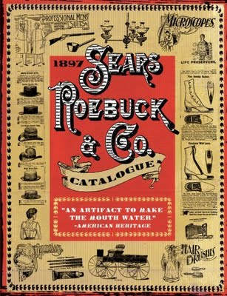
Big Business
The use of machines in the factories increased efficiency and led to the mass production of cheap products.
Advertising, mail-order catalogues, department stores and rural free delivery made it possible for people living outside of the cities able to purchase their goods.

Slide 8
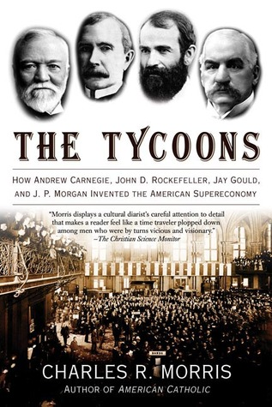
The idea of Social Darwinism became popular, based on natural selection, competition, and free enterprise
Carnegie: Through vertical integration, he bought out companies that supplied raw materials and railroads needed to store and ship steel. Through horizontal integration, he merged with his remaining competitors.
Rockefeller: He lowered oil prices below the cost of production to drive competitors out of business and then raised prices above their original levels. He also formed trusts to achieve monopolies.

Slide 9
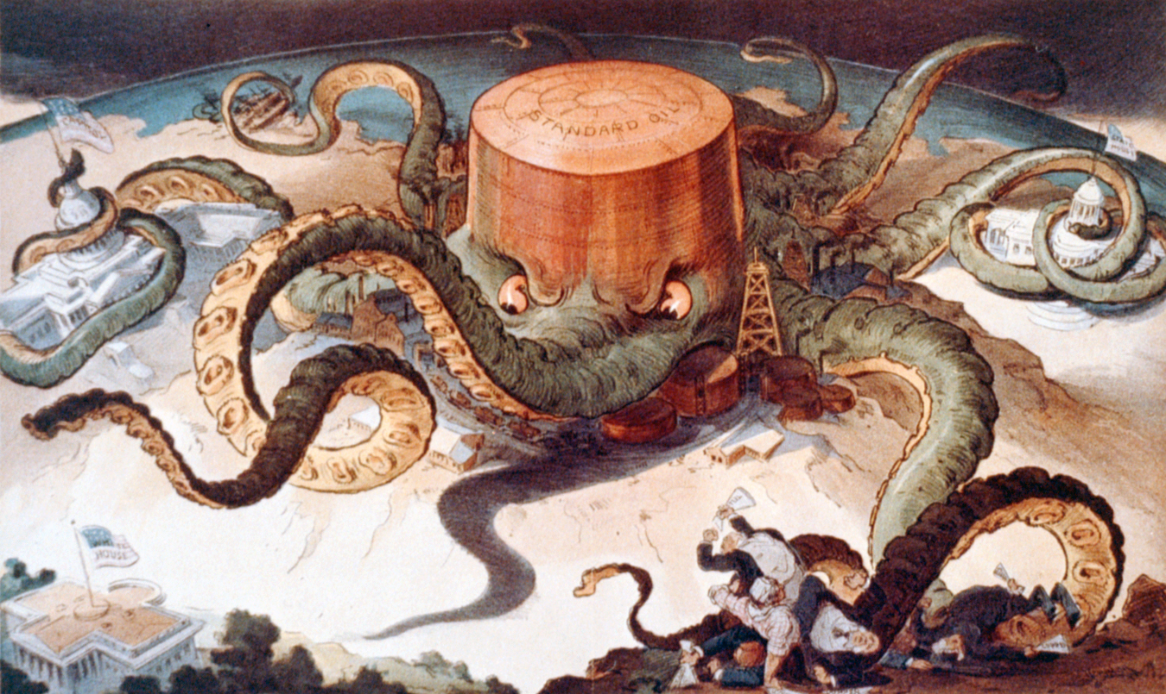

Slide 10
Many people benefited from the increase in factory jobs and lower prices, but the government got concerned about the effect of monopolies on the capitalist system
The Sherman Antitrust Act was passed to make monopolies that interfered with free trade illegal, though it had so many loopholes that it became almost impossible to enforce.

Slide 11
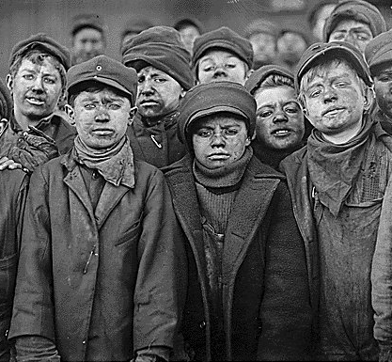
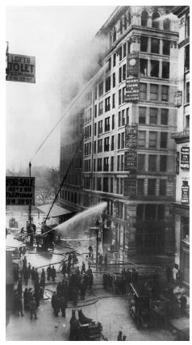
Labor Unions
Workers considered “Captains of Industry” to be “Robber Barons” instead because they got rich by exploiting their employees.
They formed labor unions to fight for higher wages, lower hours, child labor laws, and safety precautions.
Most union activity at the time was in the steel, railroad, coal, and garment industries

Slide 12
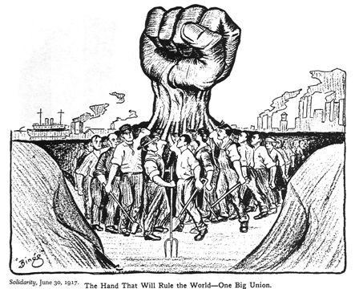
Unions emerged, but were not very successful at this time
Had to overcome divisions: skill level, race, gender, methods
Public opinion of unions would decline when strikes turned violent
Some extreme groups turned to socialism, so all union members were labeled socialist

Slide 13
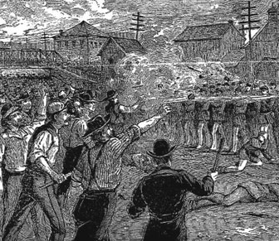
Workers were fired for joining unions, replaced with strikebreakers (scabs), sometimes blacklisted
Government backed industries: called in National Guard, issued court injunctions based on interference with interstate trade
Corporations actually used the Sherman Antitrust Act to classify unions as cartels and strip them of power

Slide 14
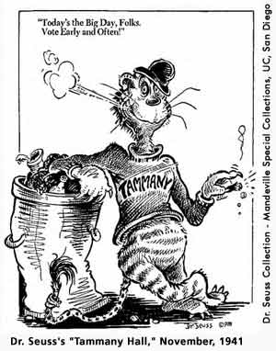
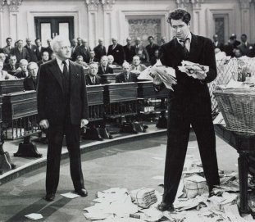
Political Power
Many cities were run by political machines that controlled the activities of a political party.
The machine “boss” controlled city government, jobs, agencies, and finances. They gained loyalty and influence by offering political or financial support to voters.
As they gained power, they became corrupt and got rich through graft like kickbacks and bribes. They kept power through election fraud.

Slide 15
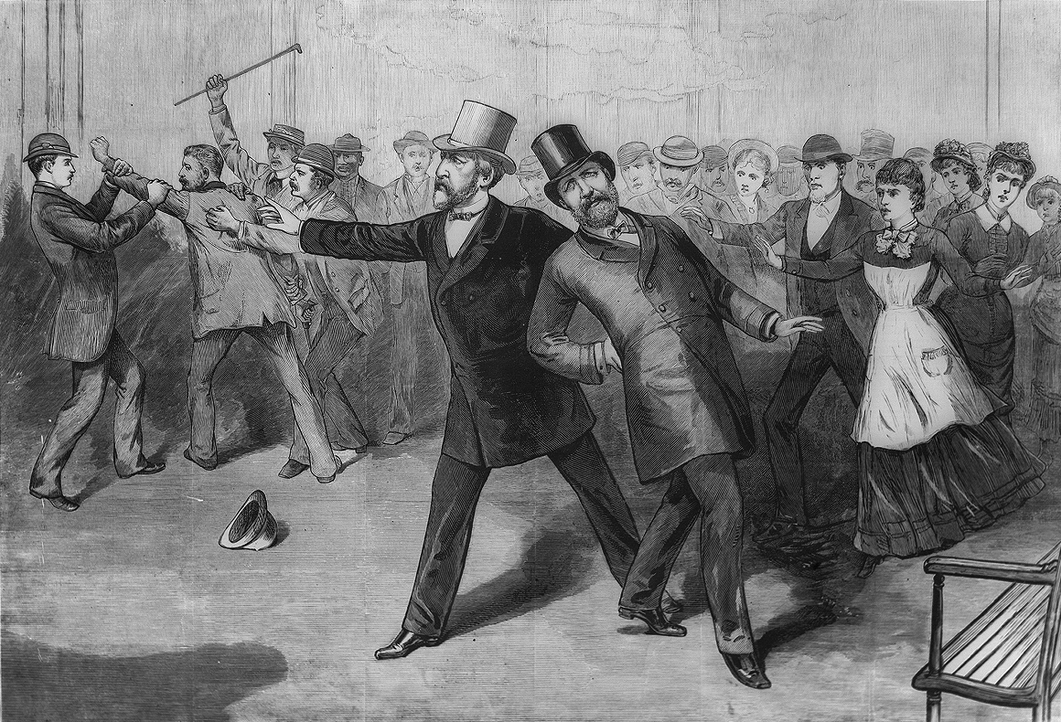
The Pendleton Act created a merit system to ensure government jobs went to the most qualified, as opposed to the old patronage system which gave jobs to political supporters.
Unfortunately, when this hurt politician’s ability to raise money from supporters they turned to big business leaders.
Businesses wanted tariffs raised, but they also caused prices to go up. Despite efforts to lower tariffs, the McKinley Tariff Act raised them to their highest level yet.

Slide 16
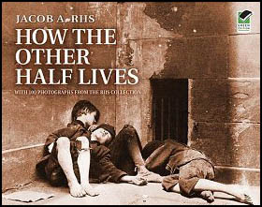
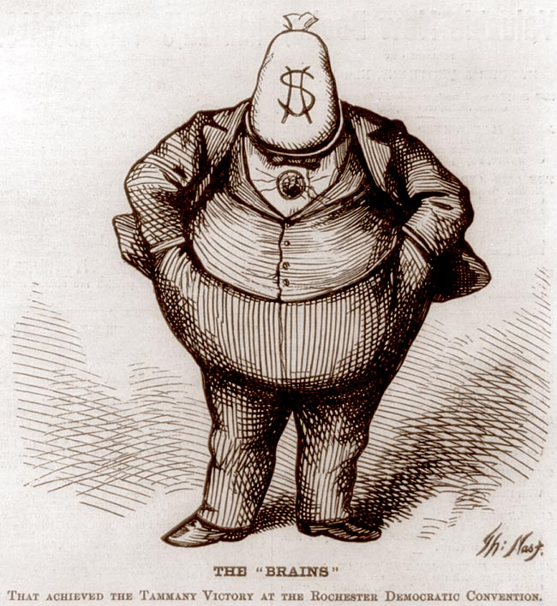
Printing presses and the Kodak camera gave rise to a new era of journalism
Political cartoonists like Thomas Nast helped raise public outrage about corruption
The effect was limited: newspapers run by tycoons like Pulitzer and Hearst were booming businesses that used sensational stories and exaggeration to increase circulation.

