Slide 1
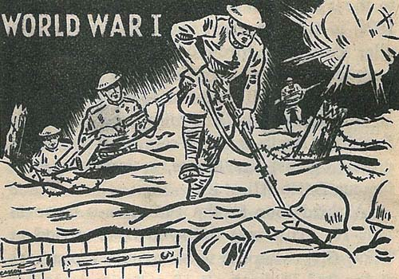
“The War to End All Wars…”
Unit 2: Imperialism and Isolationism (1890-1930)

Slide 2
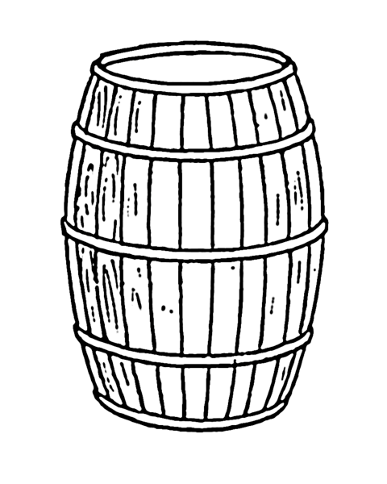
What would cause a “world” war to break out?

Slide 3
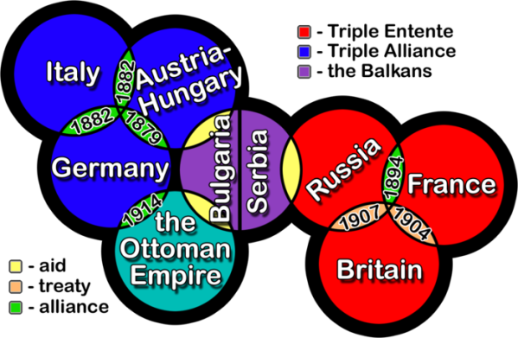
Long-term Causes
Militarism = Armed intimidation → escalation/fear
Alliances = Buddy system → Allies vs. Central Powers
Imperialism = Empire building → competition/jealousy
Nationalism = national interests first → rivalry/hostility (offensive and defensive)

Slide 4
Long-term Causes
Militarism = Armed intimidation → escalation/fear
Alliances = Buddy system → Allies vs. Central Powers
Imperialism = Empire building → competition/jealousy
Nationalism = national interests first → rivalry/hostility (offensive and defensive)

Slide 5
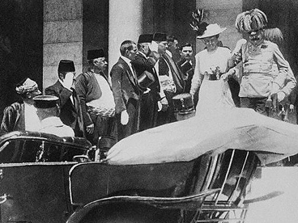
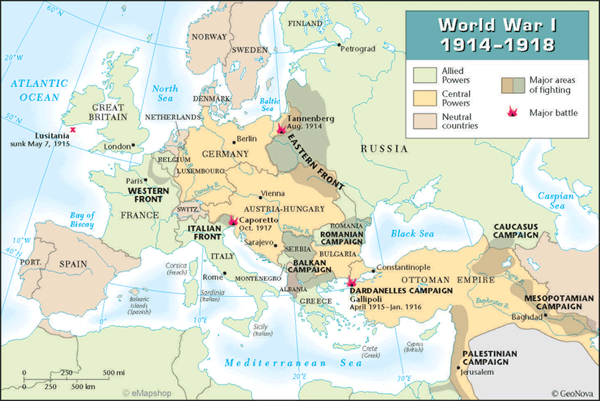
Immediate Causes
Balkan Peninsula = “Powder keg of Europe” →
Archduke Ferdinand assassinated (1914) →
Alliance System pulls nations in →
German Invasions on Eastern and Western Front

Slide 6
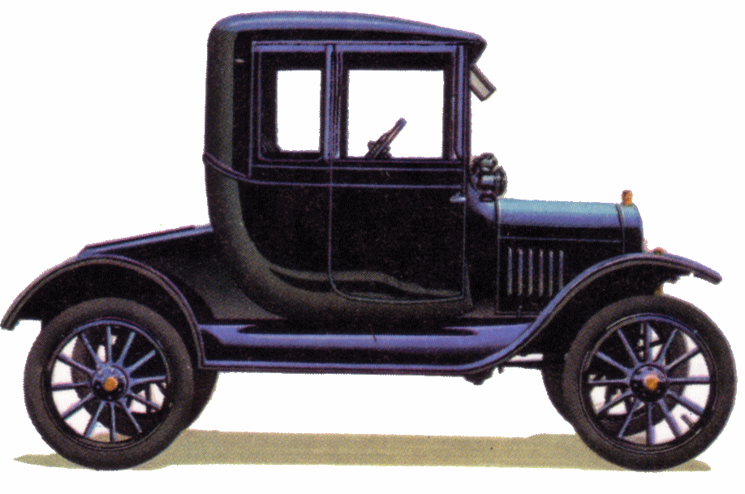
Why would the U.S. get involved in a war in Europe?

Slide 7
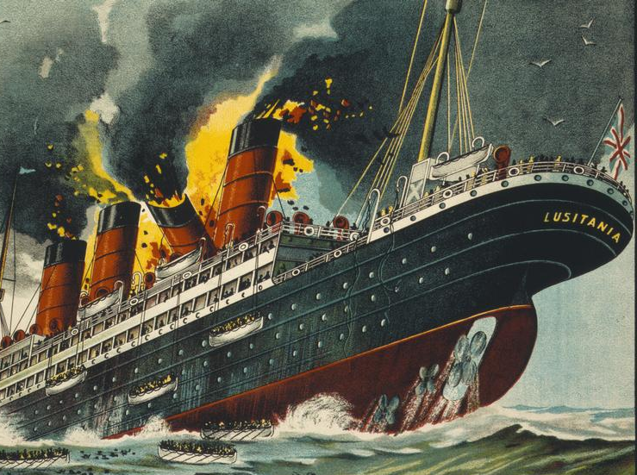
The Debate…
YES
NO
Immigrants’ concern, interests
Germany’s “bully” tactics
Economic interdependence → Sympathy for Allies
Socialists: imperialist struggle
Parents: protect sons
Pacifists: war is evil
“If civilization is to advance, the day must come when a nation will feel no more obligated to accept a challenge to war that an American citizen now feels to accept a challenge to fight a duel.” – W.J.Bryan

Slide 8
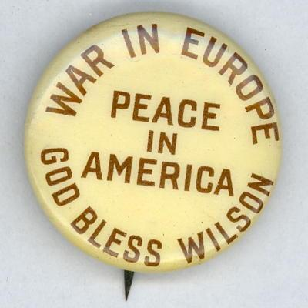
Wilson’s Position
Though he opposed Germany’s use of unrestricted submarine warfare to break through the British blockade, Wilson did not view these as “actual overt acts” of aggression against the U.S.
In 1916, the re-election campaign included the slogan, “He kept us out of war!”

Slide 9
Neutrality Breaks Down
Zimmerman Note (Germany-Mexico)
Unarmed American merchant ships sunk
Russian czar overthrown – democracies vs. monarchies
“The present German submarine warfare against commerce is a warfare against mankind… The world must be made safe for democracy.”
– Wilson’s War Resolution (1917)

Slide 10
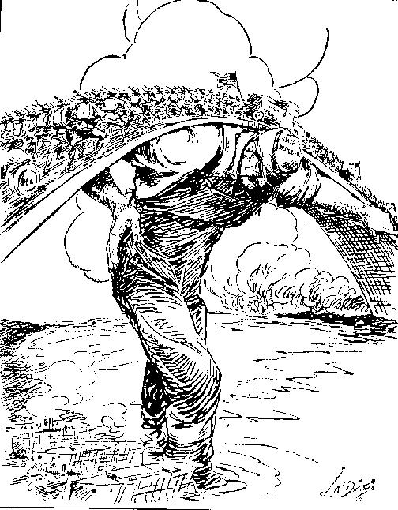
How do we get a military force overseas?

Slide 11
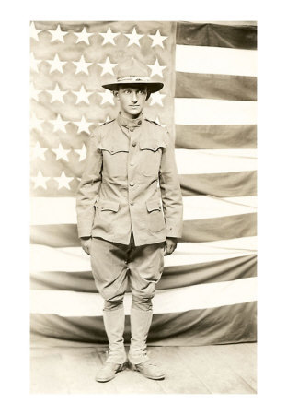
Mobilization
Selective Service Act = 18+ males must register for draft (Conscientious objectors – moral opposition)
“Bridge to France” = shipbuilding
Convoy system = military ships escort merchant ships
“Doughboy” freshness

Slide 12
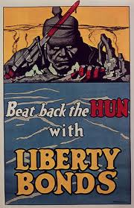
How does the war affect American society?

Slide 13
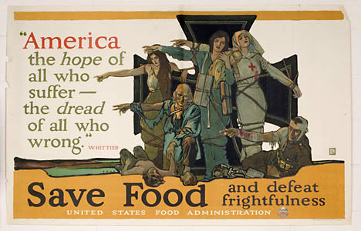
The Home Front
Public + Private industry needed: weapons, ammunition, etc. →
Congress gives Wilson direct control over “wartime economy”
War Industries Board
Fuel Administration
National War Labor Board
Food Administration (voluntary rationing, Victory gardens)
Raised taxes
Liberty Loans (War bonds = loan to the gov’t)
Committee on Public Information (propaganda, Four-Minute Men)
“It is not an army we must shape and train for war, it is a nation.” - Wilson

Slide 14
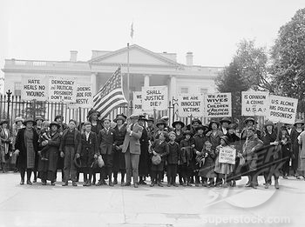
Civil Liberties
Nativism + Anti-German reaction = Anti-immigrant hysteria
Espionage and Sedition Acts fine/imprisonment for :
Draft interference
Blocking sale of war bonds
Saying anything “disloyal”
→ Violated spirit of 1st Amend (Schenck v. U.S.)
→ Targeted socialists and labor leaders (Red Scare I coming soon…)

Slide 15
Social Changes
Women increase public service → 19th Amend.
Great Migration = Southern blacks move North
Why? Discrimination (de jure), cotton failure, job availability in cities increased (Model T assembly lines opened to blacks, immigration decreased, men going off to war)
→ Crowded ghettos, outrageous rent
→ Discrimination (de facto) and hostility – competition for jobs (“scabs”) → race riots

Slide 16
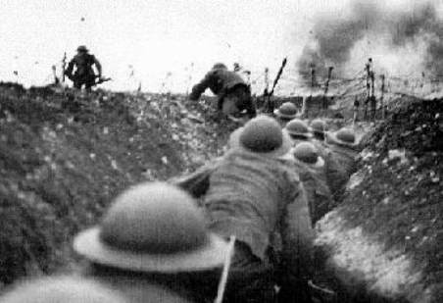
Why is WWI the first “modern” war?

Slide 17
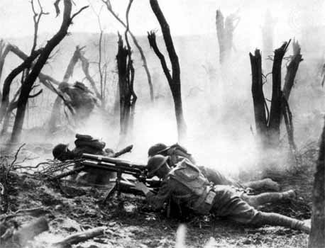
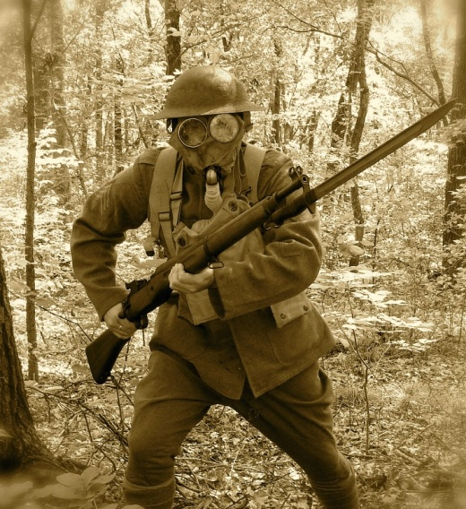
Mechanized Warfare
Relies on machines powered by gasoline and diesel engines
Machine guns – 600 rpm
Tanks – clear path for infantry
Poison gas → gas masks
→ “shell shock”

Slide 18
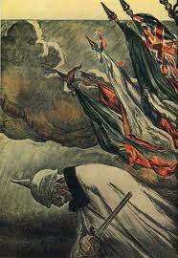
Germany Collapses
Economy and military exhausted (U.S. entrance gives Allies the push they need to hold on…)
→ Mutiny = military refused to keep fighting
Rebellion = overthrew the king (keiser) → Republic

Slide 19
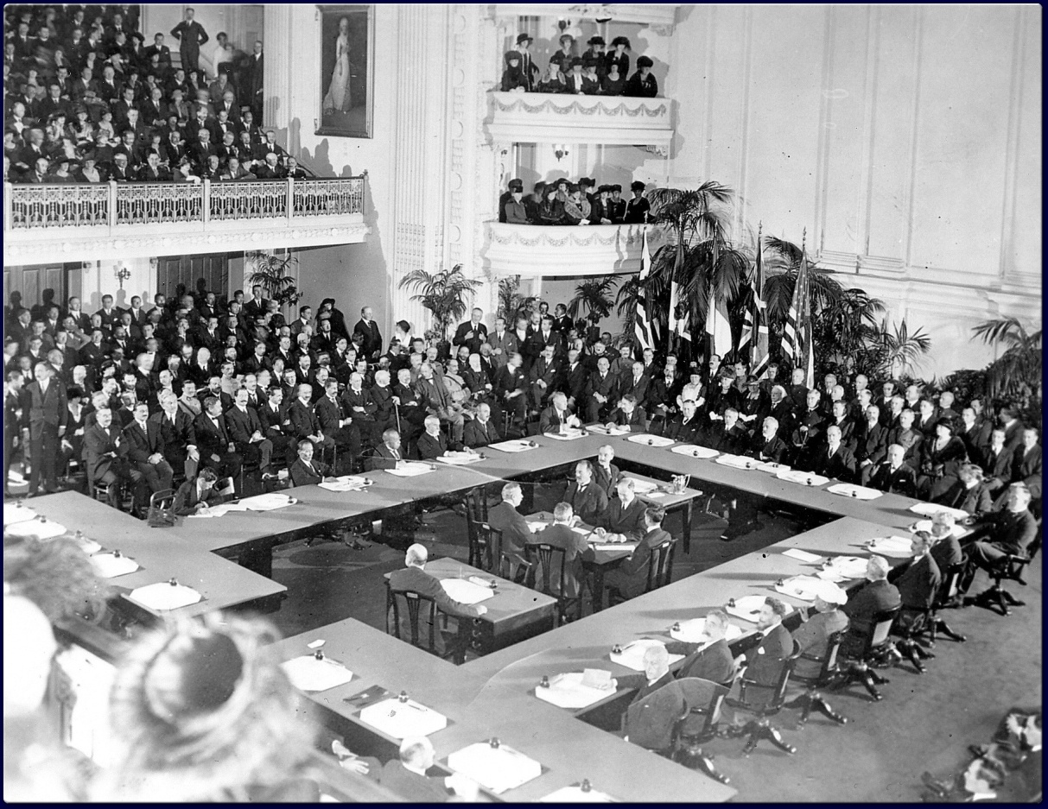
How can we avoid another world war?

Slide 20
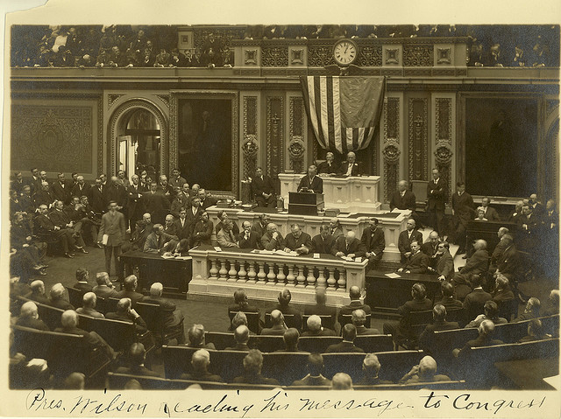
Wilson’s 14 Points
Speech to Congress
#1-5 addressed causes:
No secret treaties
Freedom of seas
Free trade (lower or no tariffs)
Arms (weapons) reduction
Consider interests of colonial people
#6-13: boundary changes favored “historically established lines of nationality.”
#14: only one included in the actual treaty! called for the League of Nations = international organization to settle crises

Slide 21
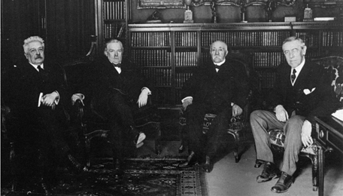
Treaty of Versailles
9 new nations (Poland, Czech, Yugoslavia, etc.)
Ottoman Empire → 4 mandates = “temporary” colonies: Iraq, Syria, Lebanon, Palestine (now Israel and Jordan)
Germany: demilitarized, forced to sign “war-guilt” clause and pay reparations (war damages) → ☹
U.S. did NOT sign it
Too harsh, sell-out to imperialism, didn’t satisfy demands for self-determination
Debate over League of Nations…

Slide 22
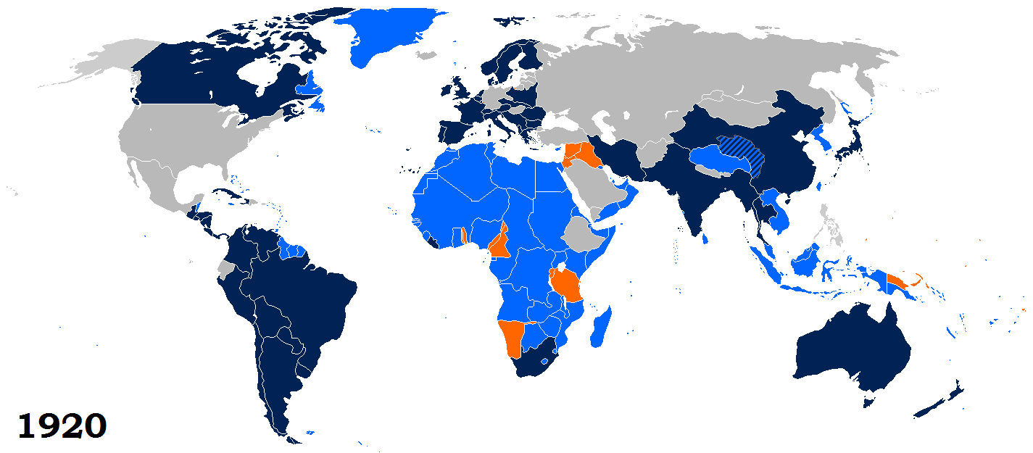
League of Nations
YES: Wilson – Protection against future “aggression”
NO: Henry Cabot Lodge, etc. – Threat to self-determination: “the right of our people to govern themselves free from all restraint, legal or moral, of foreign powers.” (Remember GW’s farewell address…)
Wilson would not compromise, then has a stroke and can’t continue to campaign for it. Congress votes it down.
→ League is formed, but U.S. does NOT join

Slide 23
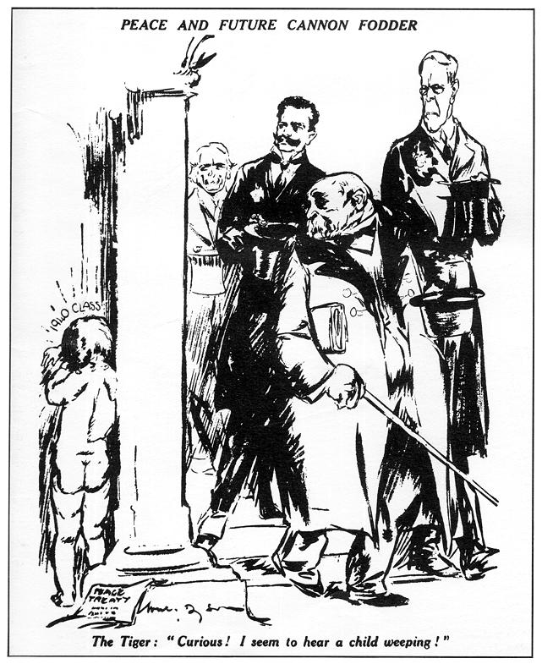
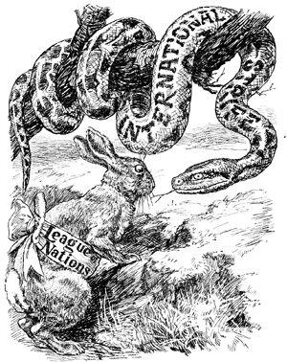
How do we know the conflict isn’t resolved?

Slide 24
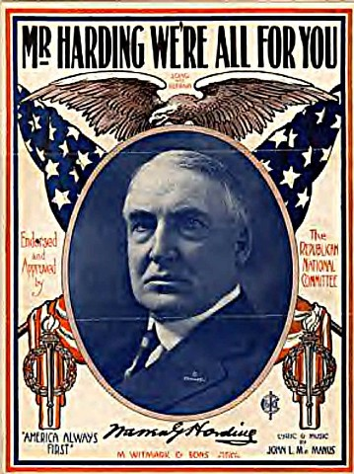
Return to Normalcy
“America's present need is not heroics, but healing; not nostrums, but normalcy; not revolution, but restoration; not agitation, but adjustment; not surgery, but serenity; not the dramatic, but the dispassionate; not experiment, but equipoise; not submergence in internationality, but sustainment in triumphant nationality.”
President Warren G. Harding called for a “return to normalcy” to a time before WWI and the Progressive Era

Slide 25
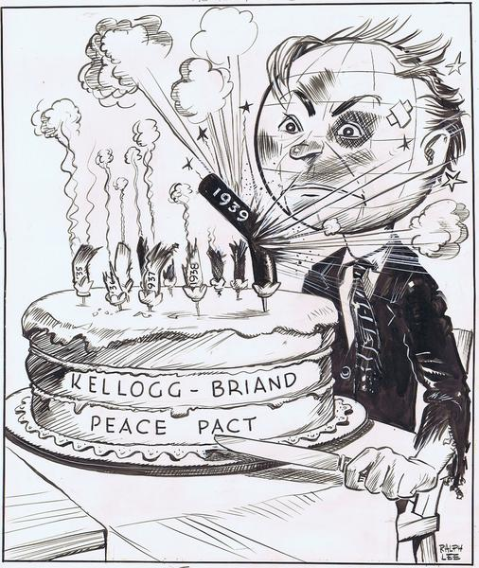
Isolationism
He invited the major powers to the Washington Naval Conference to agree to stop making and even destroy warships
In 1928, fifteen countries signed the Kellogg-Briand Pact to renounce war as a national policy
The U.S. would hold to its isolationism until several years after the start of WWII.

Slide 26
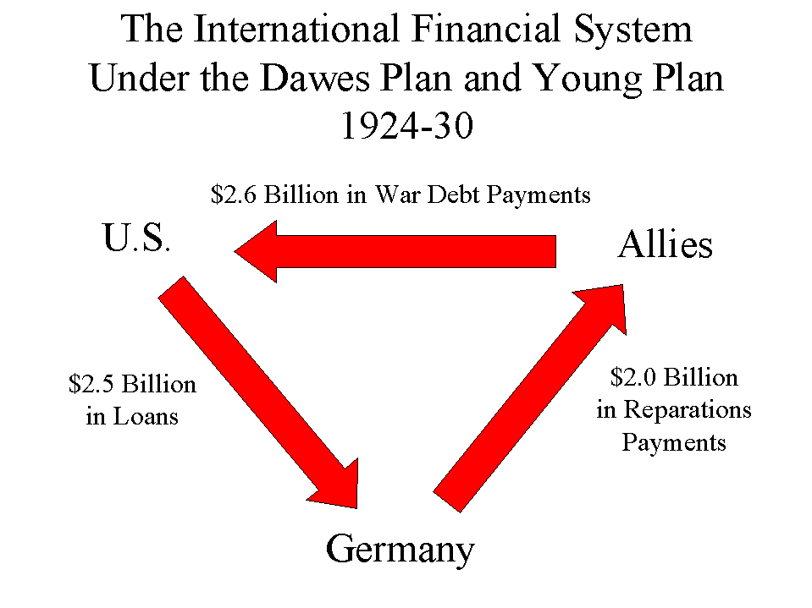
Tariffs
The Fordney-McCumber Tarriff Raised taxes on imports to 60%, the highest level ever.
Stifled international trade in general, which hurt European recovery
Helped U.S. industries but made it impossible for Britain and France to sell enough goods in the U.S. to pay war debts
The U.S. intervened to keep war from breaking out over German reparations

Slide 27
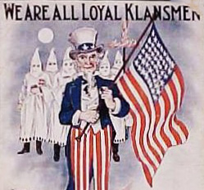
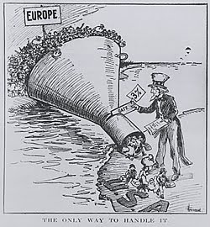
Nativism
KKK membership soars as it promises devotion to “100 percent Americanism”
Emergency Quota Act of 1921 set strict limits on immigration
Immigrants often had legal rights violated
Sacco and Vanzetti executed without due process of law

Slide 28
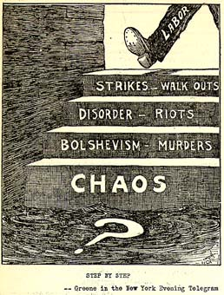
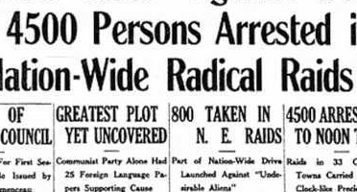
Red Scare
Russian Revolution sparked fear of communism
Suspected communists and socialists had civil liberties violated in the Palmer Raids
Management labeled labor leaders “communists” to scare workers away from joining unions
U.S. Steel Strike
Unions also had trouble organizing and stayed segregated by race

