Slide 1
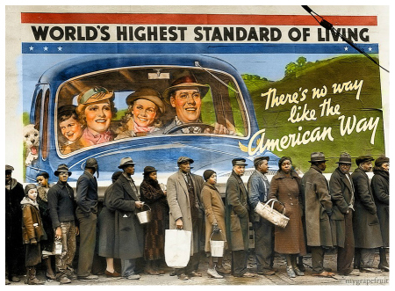
Speakeasies & Hoovervilles Pt. A – The Twenties

Slide 2
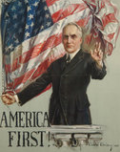
Post-War Review
What did Harding mean by a “Return to Normalcy?”
How was nativism reflected in various government policies and social trends in the 20s?
Describe the Red Scare.
How would you describe U.S. foreign policy after WWI?
What was the effect of raising tariffs?
Were labor unions growing or declining?

Slide 3
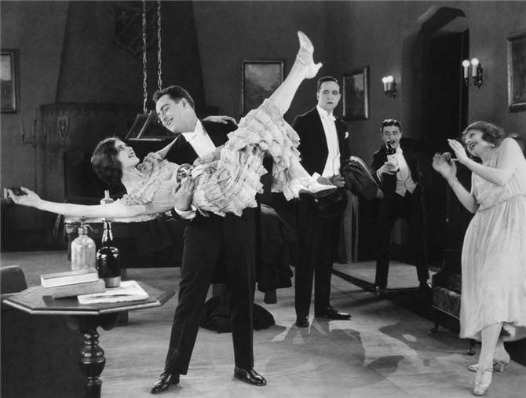
It was an age of miracles, it was an age of art, it was an age of excess, and it was an age of satire…

Slide 4
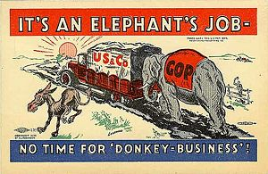
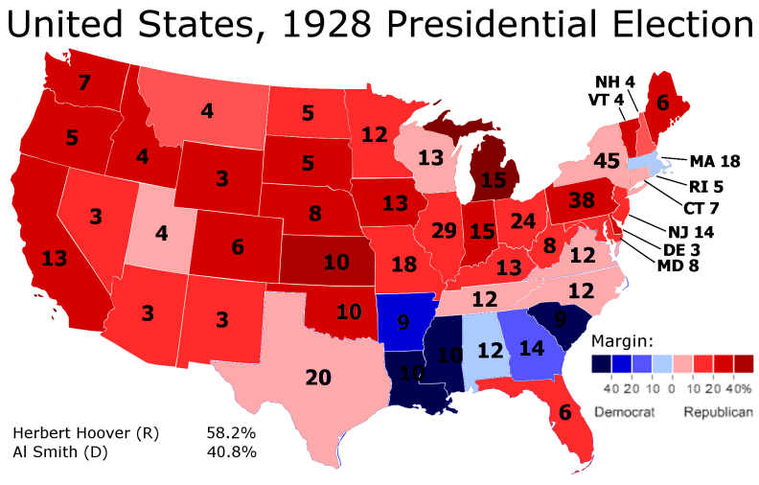
Republican Presidents
All favored conservative policies: lower taxes, higher tariffs, few regulations, stopping strikes
Has that changed over time?
The party suffered from the Harding scandals (ex. Teapot Dome) but benefitted from the prosperity of the time

Slide 5
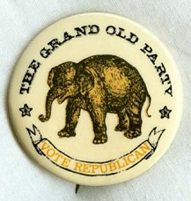
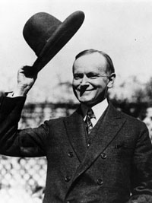
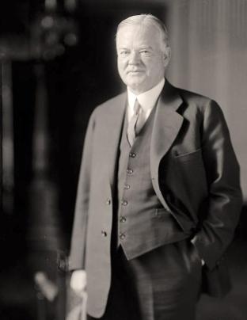
Warren G. Harding
“I know somewhere there is an economist who knows the truth, but I don’t know where to find him and haven’t the sense to know him and trust him when I find him…”
Calvin Coolidge
“The chief business of the American people is business…The man who builds a factory builds a temple…”
Herbert Hoover
“We in America are nearer to the final triumph over poverty than ever before.”

Slide 6
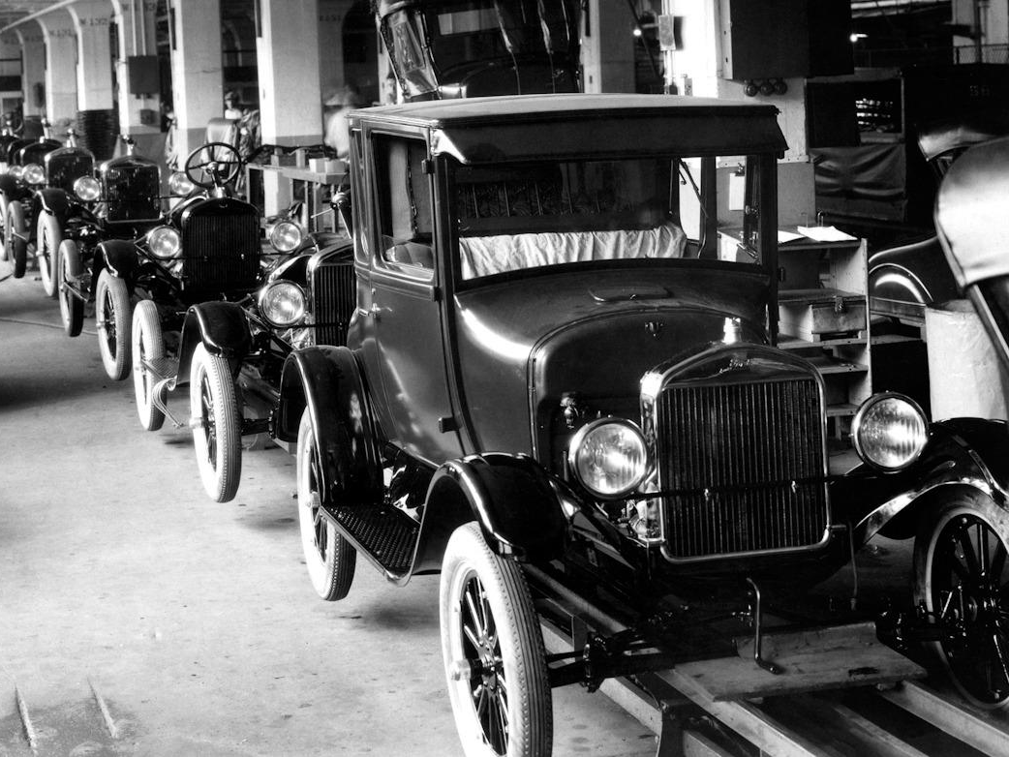
Industry Flourishes
Industries benefited from pro-business policies, decline of labor movement, new technology
The automobile caused urban sprawl, boosted social and economic activities – how?
Electrical conveniences like irons and refrigerators improved standard of living
Advertizing techniques appealed to people’s wants to make them seem like needs

Slide 7
Superficial Prosperity
Incomes increased for many, but…
Gap between managers and workers grew larger
Not all industries grew (ex. railroads, iron, textiles)
Farmers went into debt to produce more during WWI, which led to food surpluses and low prices afterwards
Industries increased production as consumers began using easy credit
Installment plan
Problem: For consumers? For producers?

Slide 8
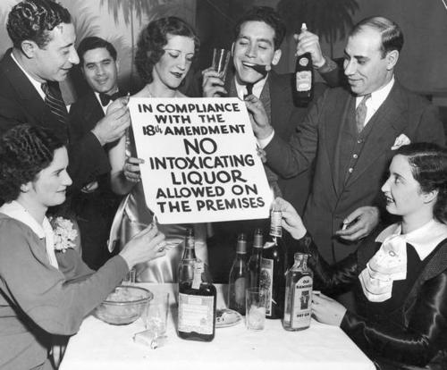
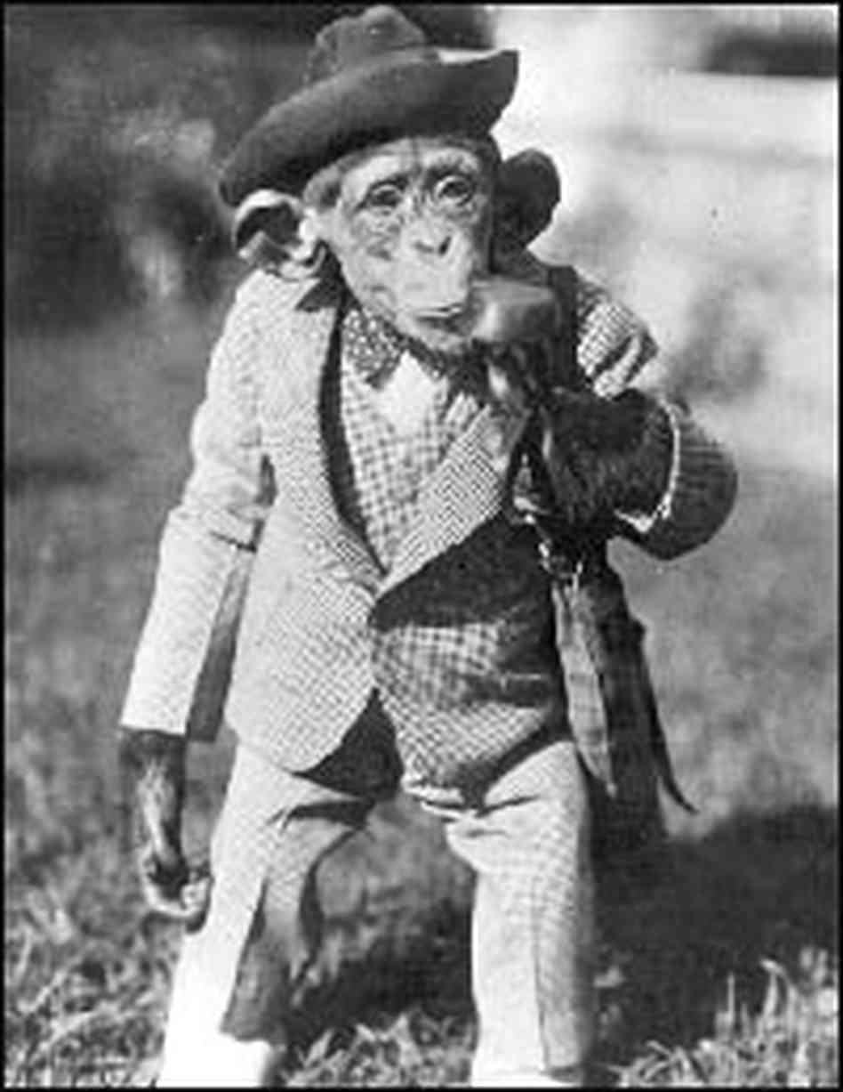
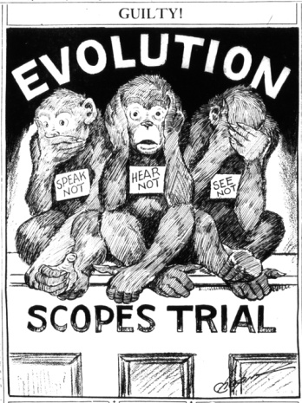
Traditional v. Modern Ideas
Migration to cities led to a more urban culture
Fast-paced, crowded, changing, worldly
Prohibition unpopular in cities
Review: Who supported prohibition/temperance?
Speakeasies, bootleggers, organized crime
Fundamentalists opposed teaching evolution
Scopes Trial and the ACLU (Darrow v. WJB)

Slide 9
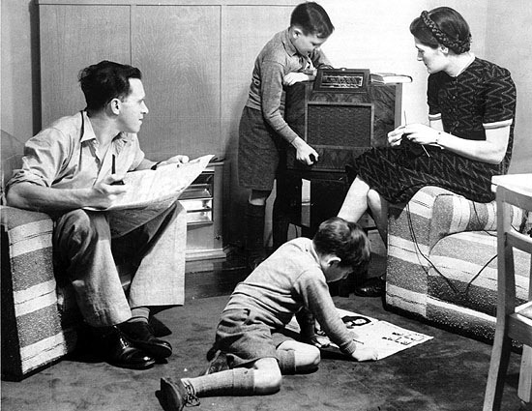
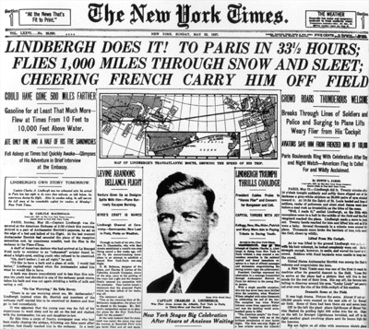
Spread of Information
School enrollments and spending skyrocketed
Curriculum included more vocational training to prepare for industrial jobs
Radio became more important than newspapers and magazines – why?
Mass media spread arts/leisure
Baseball
Jazz
Lindbergh’s flight

Slide 10
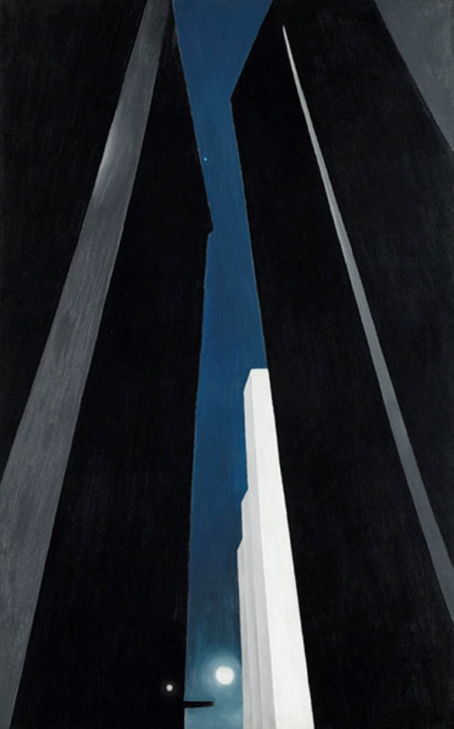
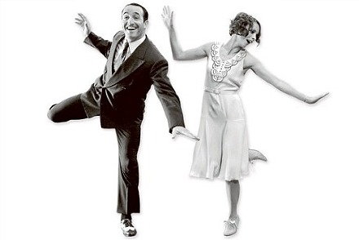
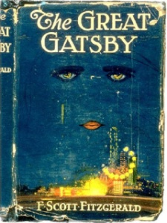
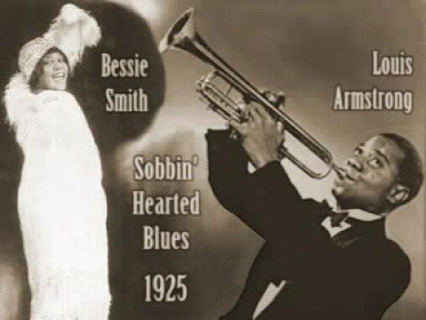
The Jazz Age
Literature
F. Scott Fitzgerald, Ernest Hemingway, Langston Hughes, Zora Neale Hurston
Art
Georgia O’Keeffe, Edward Hopper
Music
George Gershwin, Bessie Smith, Louis Armstrong, Duke Ellington
Dance
Charleston, dance marathons

Slide 11
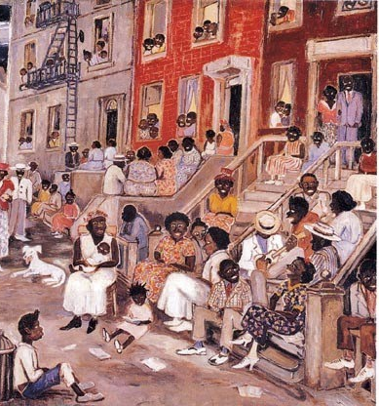
Harlem Renaissance
Harlem
Langston Hughes
What happens to a dream deferred?
Does it dry up
like a raisin in the sun?
Or fester like a sore—
And then run?
Does it stink like rotten meat?
Or crust and sugar over—
like a syrupy sweet?
Maybe it just sags
like a heavy load.
Or does it explode?
The Great Migration to northern cities led to race riots
Black urban communities like Harlem suffered from overcrowding and poverty
NAACP: anti-lynching laws
W.E.B. DuBois
Marcus Garvey founded the UNIA, proposed the Back to Africa movement

Slide 12
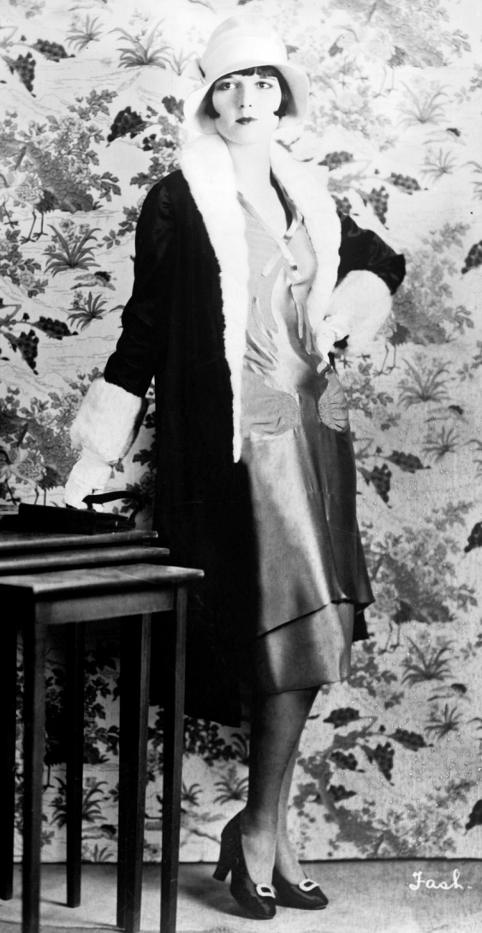
Changes for Women
Women won the right to vote after WWI, became very politically active
Flappers challenged traditional fashion and attitudes, but faced a double standard – has that changed?
Women had more time than ever before
Birth control information spread
Children spent more time in school
Store-bought goods, electrical conveniences
More women in the workforce, but were confined mostly to “pink-collar” jobs – examples?

Slide 13
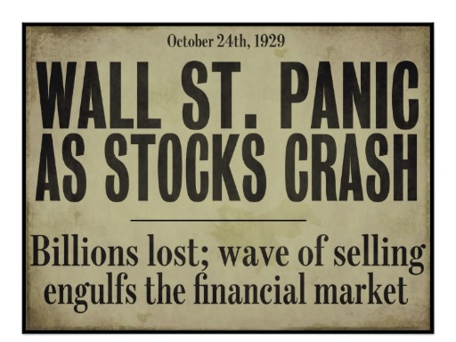

Slide 14
The Bubble Bursts
Consumers
Overused installment plans, then hit saturation point
Producers
Mechanization, overproduction caused surplus and deflation
Investors
Speculation, buying on margin caused instability/crash
Banks
Risky loans and stocks resulted in lost savings, frozen credit
Government
High tariffs stifled international trade, laissez-faire policies did not help prevent or recover
Everyone = ?

Slide 15
Snowball Effect
Farmers go into debt to increase production, surplus lowers prices, farmers can’t pay back loans, banks stop giving loans
Layoffs decrease purchasing power, lower demand affects other industries, more layoffs
Banks lose money in stock market, banks call in debts, businesses fail, can’t pay back loans, banks freeze credit
Businesses expand during bubble to attract new investors, keep production up and report high profits when bubble bursts to keep investors
Other?

