Slide 1
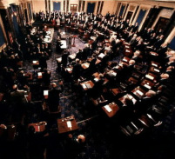
Unit 5 – Making Laws
Objective 1 Compare and contrast different types of laws, their purpose, and how they are carried out. Objective 2 Analyze the process of debating and making laws in the different branches and levels of government.

Slide 2
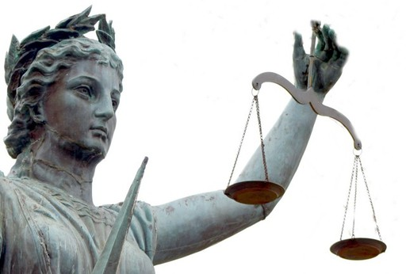
Discussion Questions
What is the purpose of law?
What are the characteristics of a good law?
How have the laws of our country evolved over time?
Which basic legal principles are most essential to democracy?

Slide 3
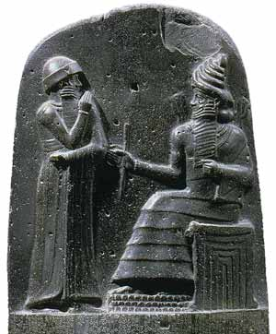
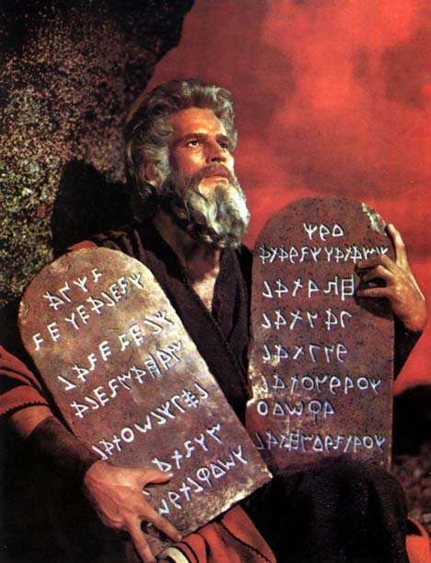
History of Law
Hammurabi’s Code
First written laws. Why is this important?
Harsh by today’s standards – ex. Eye for eye, life for life
Included both criminal and civil law
“Cause justice to prevail in the land / To destroy the wicked and evil / That the strong may not oppress the weak.”
Ten Commandments
Religious duties – ex. “keep the sabbath”
Moral and ethical conduct – ex. “thou shall not steal”

Slide 4
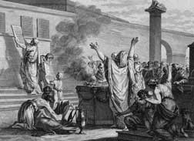
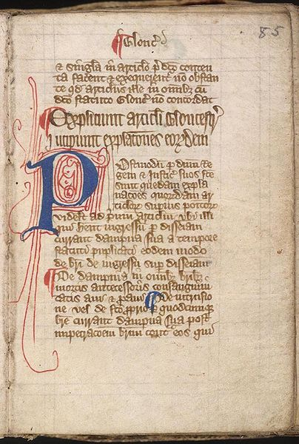
Roman Law
Jurisprudence: the study of law
Basic principles – ex. Innocent until proven guilty beyond reasonable doubt
How did it spread throughout Europe and into North America?
English Law
Common Law: based on traditions and precedent
Magna Carta – ex. due process of law, trial by jury of peers
English Bill of Rights: power to legislature

Slide 5
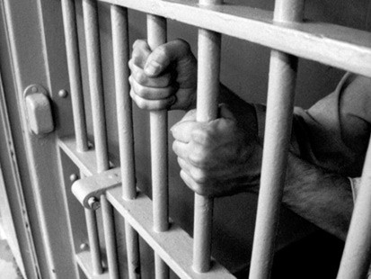
Types of Law
Criminal: Prevents people from deliberately or recklessly harming others or property
Felony: serious
Misdemeanor: minor
Civil: Settles disputes between people when no law has been broken
Tort law: injury occurs due to negligence
Family law: Examples?

Slide 6
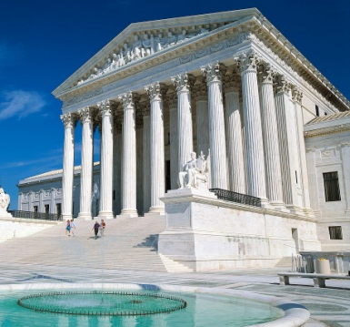
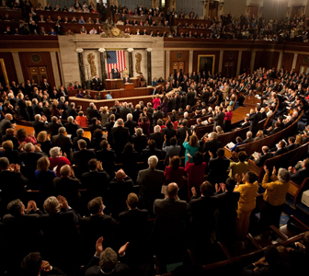
Constitutional
Deals with formation, construction, and interpretation of constitutions
Rights of citizens, limits on government
Administrative
Rules and regulations that the executive branch must make to carry out its job
Statutory
Law written by a legislature
The term statute now refers specifically to laws written by state legislatures
Local laws?

Slide 7
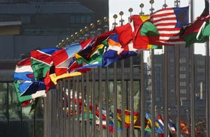
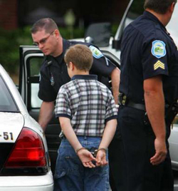
International
Geographic areas outside of a single country (ex. Oceans)
Agreements between two or more countries
Geneva (rules of war), Kyoto (environment), United Nations Tribunals (genocide)
Why is international law so complicated?
Juvenile
Two types of cases: neglect, delinquency
What are the main goals of juvenile law?

Slide 8
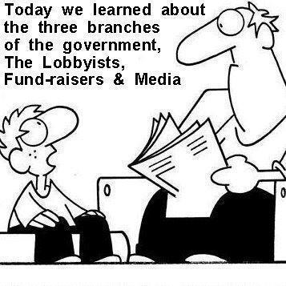
Influencing Law
How do each of these groups affect the lawmaking process in the U.S.?
Political Parties
Constituents
Interest Groups
Lobbyists
Media
Public Opinion
www.anonymousartofrevolution.com

Slide 9
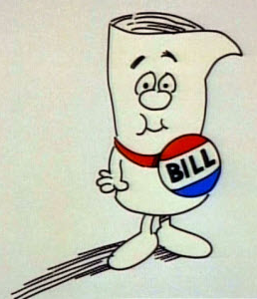
From Bill to Law
Idea is proposed by members of Congress, lobbyists, political parties, etc.
Bill is written up and sponsored by a senator or representative

Slide 10
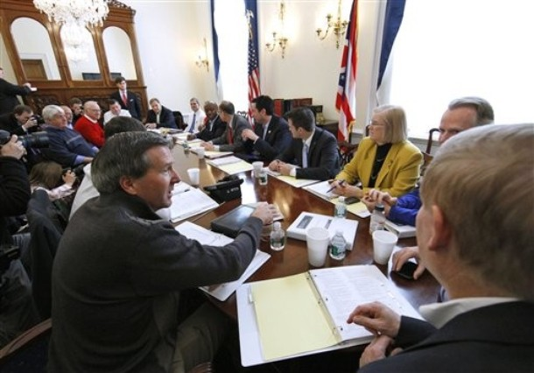
in committee…
Each bill goes to the appropriate standing committee where experts are consulted and amendments are discussed. It can be:
passed with no changes
passed with changes
replaced with an alternative
ignored or “pigeonholed”
killed

Slide 11
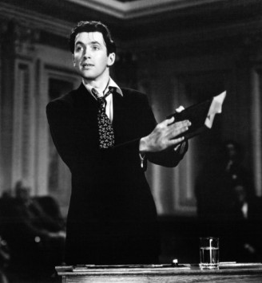
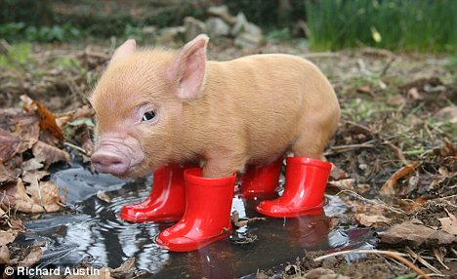
on the floor…
Floor Debate: Both houses allow all members to debate the bill and propose changes.
There are some different rules in the Senate. Why?
Senators can add amendments called “riders” that are unconnected to the bill
Senators can filibuster because there are no speaking time limits. They can only be ended by a “Cloture” vote of 3/5 of the Senate.
Vote: a simple majority of 51% is needed to pass a bill

Slide 12
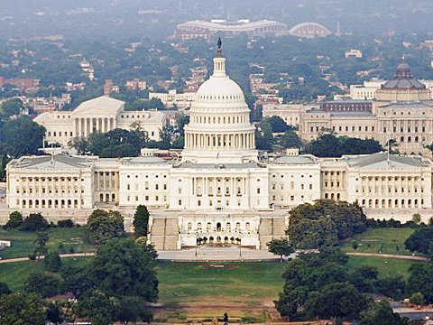
to the other house….
Passed bill goes to the other house and starts the process all over again (committee > floor)
If changes are made to the bill to pass the second house…
Goes to conference committee to reconcile it into one single version
Final compromise bill must be approved by both houses

Slide 13
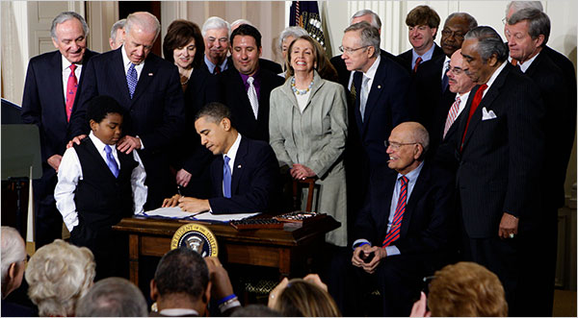
at the White House…
The President can
Sign the bill into law
Veto the bill
Can still become law if overridden by a 2/3 vote of both houses of Congress. If not, it dies.
Keep the bill for 10 days
If Congress is in session, it becomes law, but if Congress adjourns during that time, it dies (this is the pocket-veto).
Why not just sign or veto?

